Slide 1
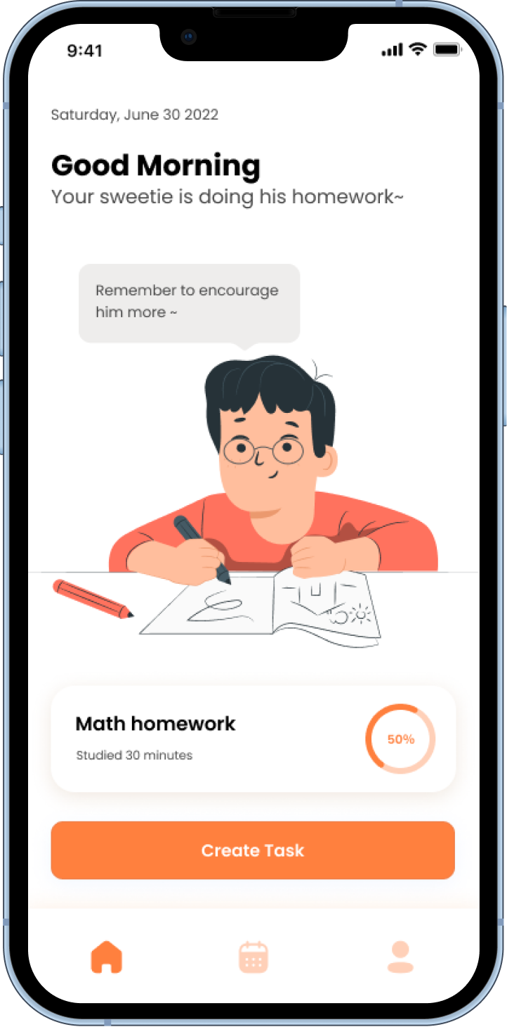
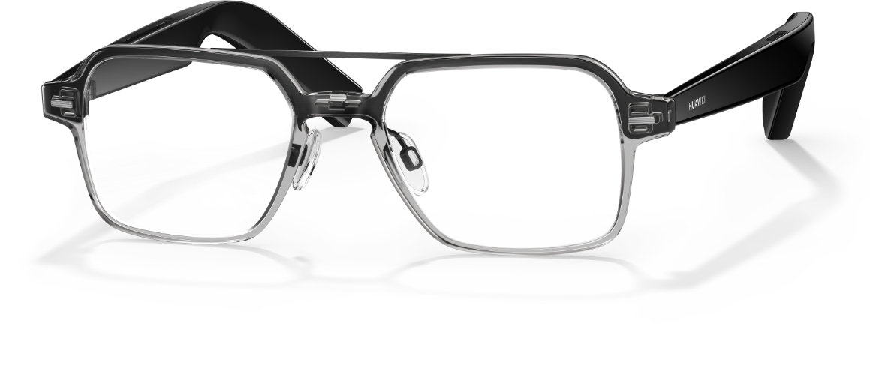

FOCAREUS
Kids’ Invisible Study Companion
Cultivating Better Study Habits
Developing Bonds via Intelligent Data

Slide 2
Video

Slide 3
Background
Children's inattentiveness and unhealthy behavior
Many parents have experienced problems with their children's inattentiveness, which can have a significant impact on normal life and learning.
Parents are busy with work
Many parents are too busy to keep an eye on their children's learning status, but they want to know and care.
Myopia prevention and control glasses market is emerging
There is a huge market for OK lenses and defocus lenses that can slow down the growth of myopia in young people.

Slide 4
Who are our target users?
Children
6-12 years old
Population greater than 100 million
Parents
Busy work schedule
Want to care about their children
Focus on the education of children

Slide 5
Preliminary Research
Record
Summary
1
Record the results of the interviews and summarize them
3
Summarize users' pain points and needs
2
4
User Interviews
Journey Map
Analyzed the whole process of children's homework
We interviewed five young parents

Slide 6
Pain points and needs
When children are studying at home
Children
Does not pay attention
Sometimes does not sit well
Not able to start writing homework on their own
Does not have a sense of time
Sometimes not very motivated to study
Needs a lot of encouragement and reminders
Wants to feel a sense of accomplishment
Parents
Sometimes work is busy
Want to understand their child's growing needs
Want their children to be able to combine work and rest
Have a plan to organize their study

Slide 7
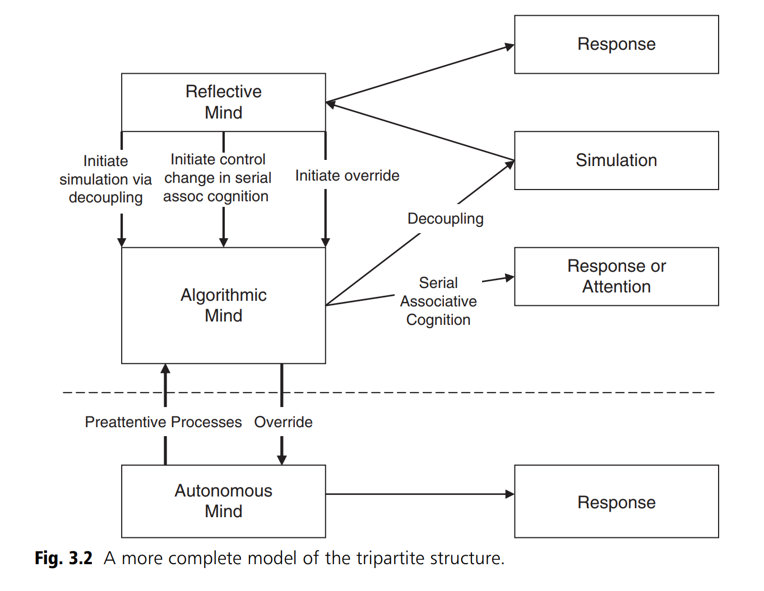
The tripartite model of thinking
Based on the tripartite model of thinking by Keith E. Stanovich, we obtain the design strategy.
Design so that complex algorithmic mind processes receive some assistance
Designed so that the behavior of the algorithmic mind triggers positive reflective mindfulness, generates positive beliefs and habits, etc.
Children's triple mind is fragile and immature and needs to be guided appropriately.

Slide 8
FOCAREUS
A good partner to help children learn
Aids and motivates children to develop good study habits
Connects children and parents

Slide 9

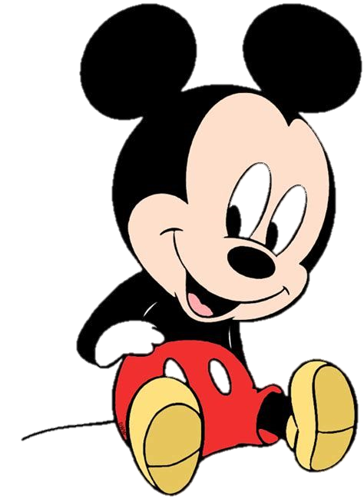
Cartoon character voice
Constantly encourage and remind children to better motivate them.

Slide 10

Learning status detection and prompting
Detects attention and sitting posture in real time and provides reminders

Slide 11

Surprise sound effects
There will be specific sound effects at the beginning/rest/completion of the task to create a sense of surprise ritual and increase the child's sense of accomplishment

Slide 12

Time Reminder
Help planning time and remind children to study with work and rest

Slide 13
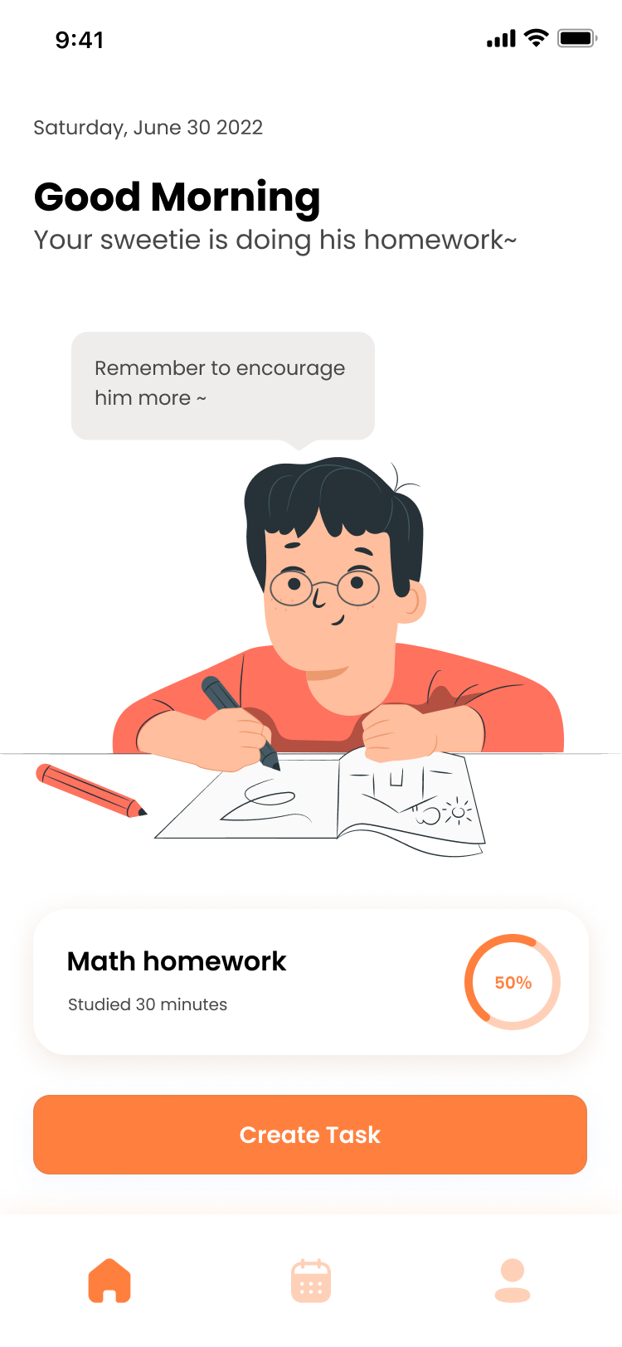
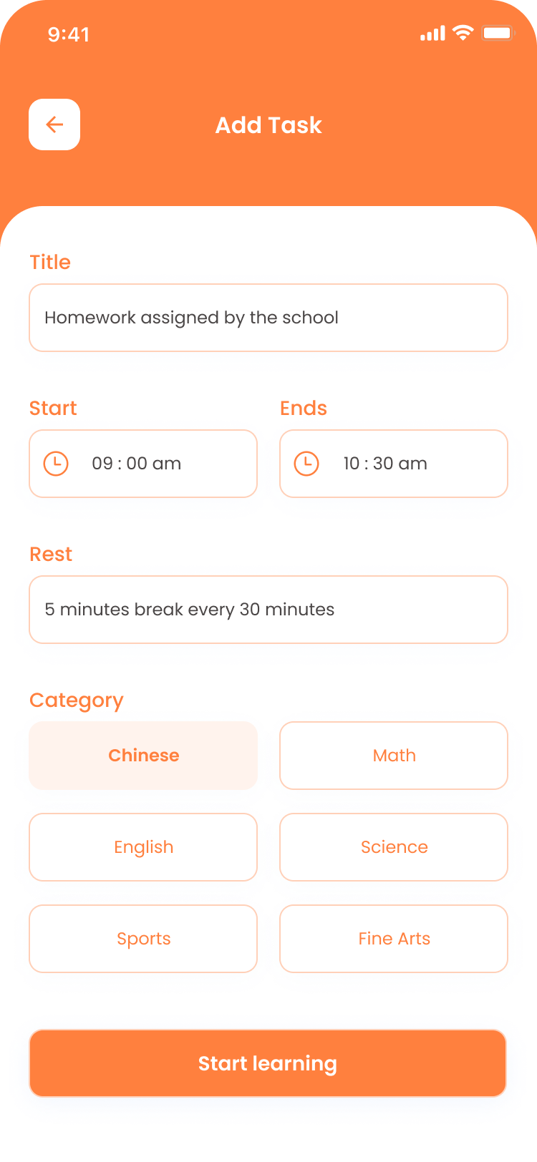
Create learning tasks together
By creating learning tasks together, parents and children can help their children plan their time wisely and promote parent-child communication.

Slide 14
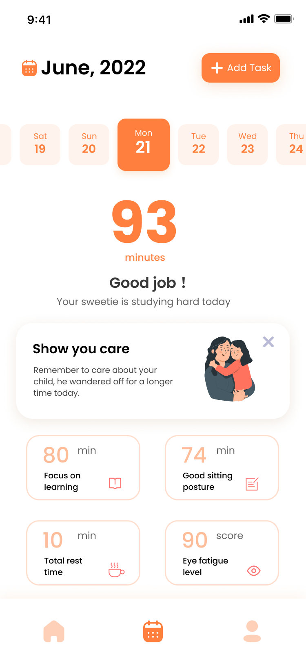
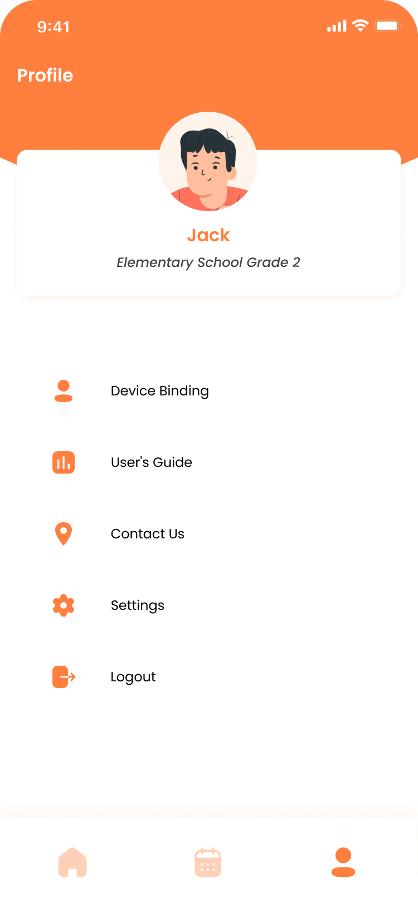
Remind Parents to encourage and care for their children
Based on the detected data, parents are prompted to care more and encourage their children, and weaken the negative effects of the data.
It becomes the child's growth record log, so that the child can better improve himself/herself with positive feedback.

Slide 15
APP frame : MVP frame
View
GetSensorData
PositionAnalysis
PosterJudge
①
②
③
Presenter
FocusJudge
④
Medol/
repository
API
SensorData

Slide 16
Human Pose Estimation:by Angle
pitch angle ------> degree of the bow
deflection angle------> degree of head skewing
z
x
x
x
degree of head skewing
degree of the bow
z
y
g
y

Slide 17
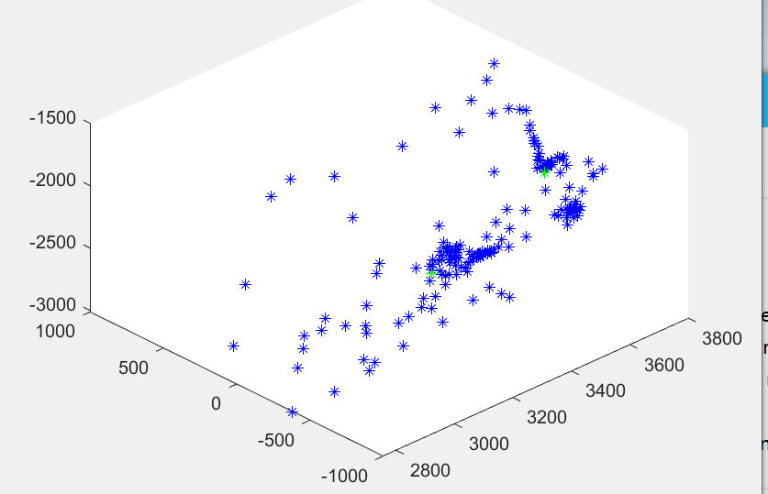
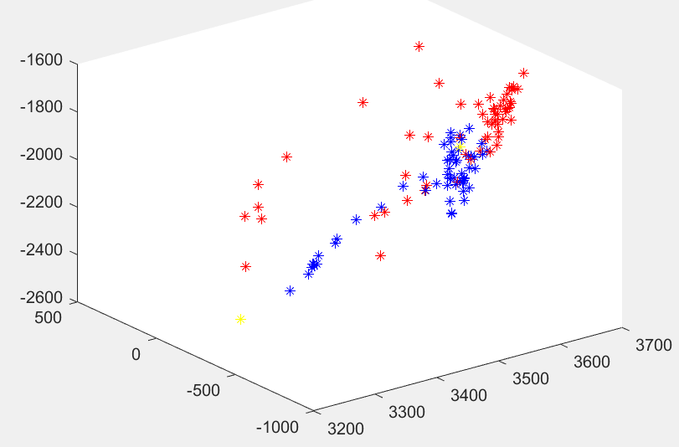
Attention detection:by K-means
Sample & get the focus
K-means method
Statistics & judge

Slide 18
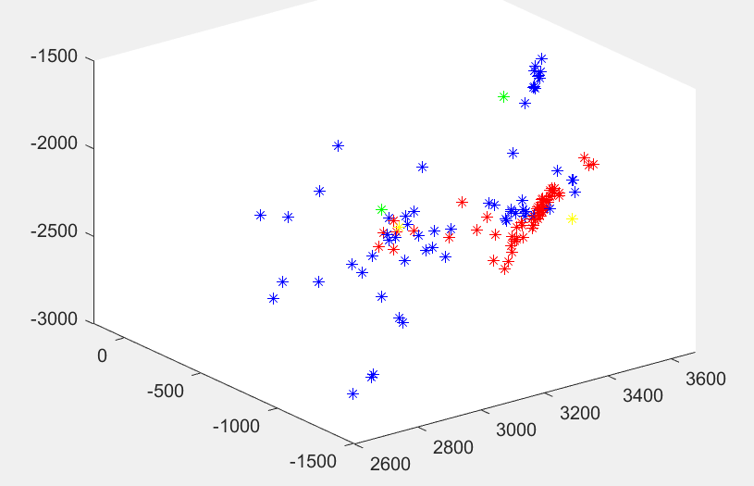
Attention detection:by K-meas
Sample & get the focus
Computing focus again
blue/red:the old/new dots
green/yellow:the old/new focus

