Slide 1
Title Defense
Project Title:
Group Members:
Shulabh Shrestha
Raja Mandal
Aishwarya Prashant
Saistha Pradhan

Slide 2
Objectives
To enable quick and easy pre-ordering of food for students
To provide real-time order tracking
To improve canteen efficiency and reduce waiting time

Slide 3
Scope
Students can view menu, order food, and track status
Admin can manage items, update status, and mark sold out
No online payment, only physical payment at canteen

Slide 4
Feasibility Study
Technical Feasibility: Easily developed using basic web technologies with no complex requirements.
Operational Feasibility: Simple for students and staff to use, improving canteen workflow.
Economic Feasibility: Low-cost system with high efficiency benefits.

Slide 5
Tools and Techniques
Git and GitHub for collaborations
Draw.io for making UML Diagrams
PHP will be our primary programming language(Front&Backend)

Slide 6
Expected Outcome
Students able to place orders instantly.
Real-time order tracking helps staff prepare only what’s needed.
Improved inventory control with “Sold out” system.

Slide 7
Literature Review
1. QR-Based Canteen System
Authors: G. K. Patil et al. Summary: Uses QR code to access menu and place orders, reducing waiting time. Knowledge Gap: Requires QR setup and lacks real-time tracking and simple usability.

Slide 8
2. Android-Based Canteen Ordering System
Authors: S. N. Patil et al. Summary: Mobile app for ordering food, helps reduce queue during peak time. Knowledge Gap: Requires app installation and not accessible for all users.

Slide 9
3. Smart Canteen Management System
Authors: R. K. Sharma et al. Summary: Provides digital ordering and management features. Knowledge Gap: Complex system, focuses on online payment rather than simple solutions.

Slide 10
Methodology
The proposed Canteen Pre-order System is developed using the Waterfall Model, where each phase is completed step-by-step in a sequential manner.
Requirement Analysis
System Design
Implementation
Testing
Deployment
Maintenance

Slide 11
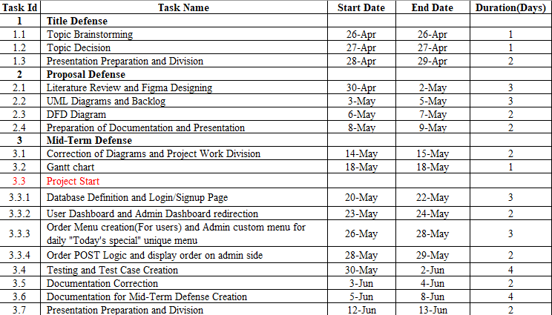
Timeline

Slide 12
Future Enhancements

