Slide 1
Unit-2
Data Models

Slide 2
Contents
Conceptual, Logical, and Physical Model
Introduction to Entity Relationship Model
Entities type
Entities set
Attributes and Keys
Relationship types and sets
E-R Diagrams
E-R to Relational Model

Slide 3
Data Model
A Data Model is the collection of conceptual tools for describing
  Data
  Data Relationship
  Data Semantics
  Data Constraints
  A Data Model ensures that the real-world meaning of data is preserved while providing a clear path toward efficient implementation in a database system.

Slide 4
Three Levels of Data Modeling
A Data Model can be represented at three different levels of abstraction, each showing data from a different point of view.
Level | Focus | Audience | Example Output
Conceptual Model | High-level view of data and relationships | Business users, analysts | ER Diagram (entities, relationships)
Logical Model | Detailed structure of data elements and relationships | Data architects, DB designers | Normalized tables with keys, attributes, and relationships
Physical Model | Actual implementation in the database | DB developers, administrators | SQL DDL, indexes, storage settings

Slide 5
Conceptual Data Model
The Conceptual Data Model provides a high-level description of the enterprise data and captures the semantics of the real-world domain being modeled.
It is independent of any database technology or implementation detail.
Purpose
  Identify main entities, their attributes, and relationships.
  Communicate with end-users and analysts for requirement understanding.
  Define what data the system should contain, not how it will be stored.

Slide 6
Logical Data Model
The Logical Data Model translates the conceptual design into a detailed structure that can be implemented in a specific type of database (usually the relational model).
It defines data in terms of tables, attributes, and relationships
Purpose
  Specify all entities and their attributes clearly.
  Define primary and foreign keys.
  Identify cardinalities and integrity constraints.
  Remove redundancy through normalization.

Slide 7
Physical Data Model
The Physical Data Model represents how the data will actually be stored and implemented in a specific database management system (DBMS).
It includes:
  SQL table definitions
  Data types for each column
  Indexes, partitions
  Constraints and storage parameters
This is specific to a particular Database Management System that we are using.

Slide 8
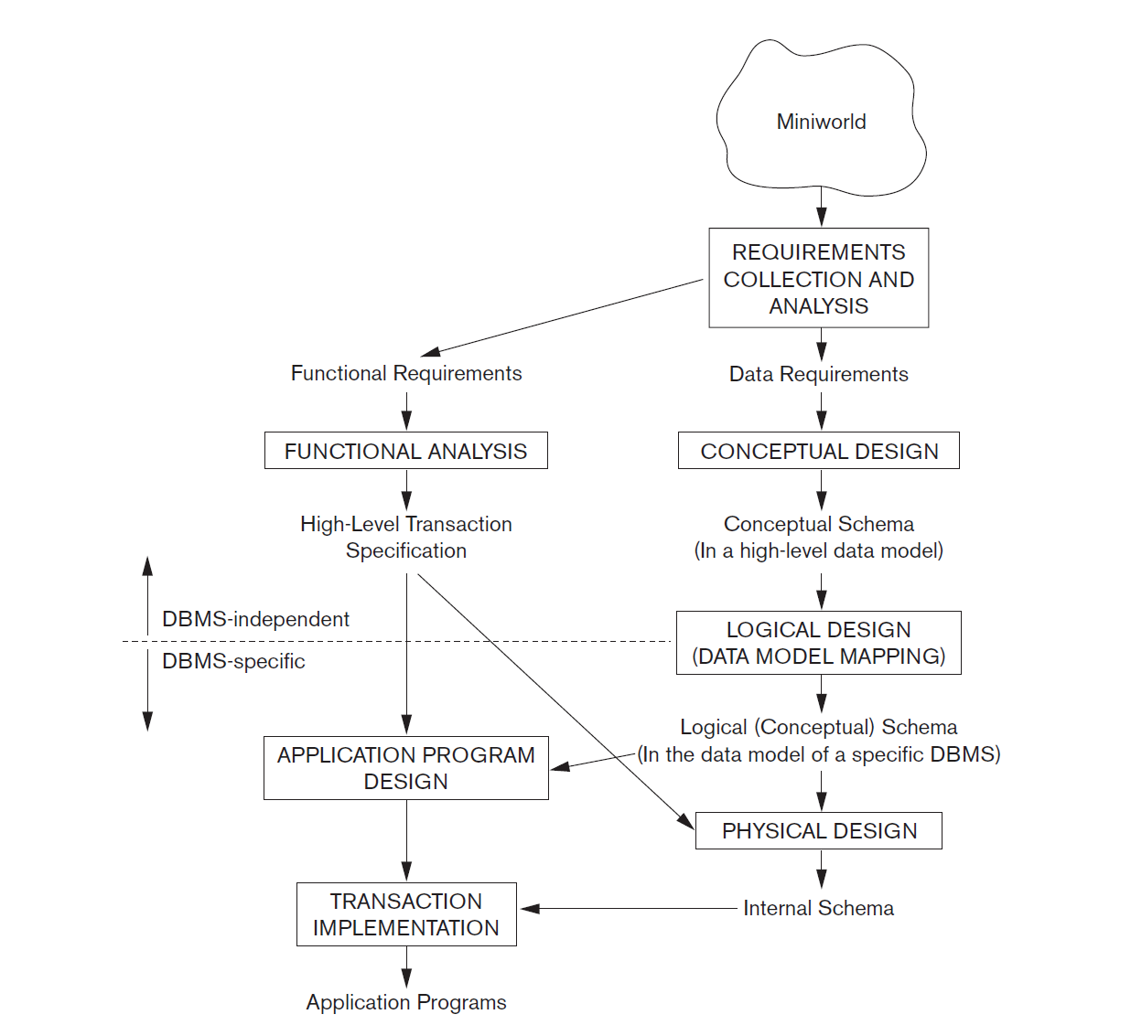
Entity Relationship Model
Main Phases of Database Design
Source: Ramez Elmasri and Shamkant B. Navathe, Fundamentals of Database Systems

Slide 9
Entity Relationship Model
The ER Model is a high-level conceptual data model used to represent the structure of a database at the conceptual design phase
The ER model concepts are designed to be closer to the user’s perception of data and are not meant to describe the way in which data will be stored in the computer.
Key purpose: Identify entities (things of interest), attributes (properties of those entities), and relationships (associations among entities) along with relevant constraints.
The output is often an ER diagram (ERD) which visually depicts these.

Slide 10
Entities & Entity Types / Entity Sets
Entity: an object in the real world that is distinguishable from other objects (physical or conceptual).
  For example: a particular student, a department, a car.
An entity is an object that exists and is distinguishable from other objects.
Each entity has attributes—the particular properties that describe it.
  For example, an EMPLOYEE entity may be described by the employee’s name, age, address, salary, and job.
An entity has a set of properties, and the values for some set of properties must uniquely identify an entity.
For instance, a person may have a person id property whose value uniquely identifies that person. Thus, the value 677-89-9011 for person id would uniquely identify one particular person in the university.

Slide 11
Entities & Entity Types / Entity Sets
An entity set is a set of entities of the same type that share the same properties or attributes.
The set of all people who are instructors at a given university, for example, can be deﬁned as the entity set instructor.
Similarly, the entity set student might represent the set of all students in the university.
Entity sets do not need to be disjoint.
  For example, it is possible to deﬁne the entity set person consisting of all people in a university. A person entity may be an instructor entity, a student entity, both, or neither.

Slide 12
Key Attributes of an Entity Type
A key attribute uniquely identifies each entity within an entity set.
It enforces a uniqueness constraint — no two entities can share the same key value.
Must be minimal — no extra attributes should be included.
Composite key: Formed when multiple attributes together uniquely identify an entity.
Example:
  Name is a key for COMPANY (no duplicate company names).
  SSN is a key for PERSON (unique Social Security number).

Slide 13
Types of Attributes in ER Model
Several Types of attributes occur in the ER Model
  Simple versus composite attributes
  Single valued versus multivalued attributes
  Stored versus derived attribute

Slide 14
Simple (Atomic) vs. Composite Attributes
Composite attributes can be divided into smaller subparts that represent more basic attributes with independent meanings.
  Example: Address → Street_address, City, Province, Postal_Code
  Values: ‘120 Tinkune Road’, ‘Kathmandu’, ‘Bagmati Province’, ‘44600’
Simple (Atomic) attributes cannot be divided further.
Example: Postal_Code is a simple attribute.
Composite attributes can form a hierarchy.
If the attribute is only used as a whole, there is no need to subdivide it.
  Example: Address can remain a simple attribute if its parts are not referenced separately.

Slide 15
Single-Valued vs. Multivalued Attributes
Single-valued attributes have only one value for a particular entity.
  Example: Age of a person → one value only (e.g., 25 years).
Multivalued attributes can have multiple values for the same entity.
  Examples: Colors attribute of a car → Red, White
  College_Degrees attribute of a person → BBA, MBA
Different entities may have different numbers of values for a multivalued attribute.
  Example:
    One person → no degree
    Another → one degree (BSc)
    Another → multiple degrees (BSc, MSc)

Slide 16
Stored vs. Derived Attributes
Stored attributes are those whose values are physically saved in the database.
Example:
  Birth_Date of a person → stored directly.
Derived attributes are calculated or derived from other attributes or related entities.
Example:
  Age can be derived from the Birth_Date and the current date.

Slide 17
NULL Values
Sometimes an entity may not have an applicable value for an attribute.
  Example: Apartment_Number applies only to apartment addresses, not to single houses.
A special value called NULL is used in such cases.
  Example:
  A single-family house → Apartment_Number = NULL
  A person without a degree → College_Degrees = NULL

Slide 18
Complex Attributes
Complex attributes are combinations of composite and multivalued attributes.
They can include multiple components and multiple values at the same time.
They are used when an attribute has several layers of structure or repeated groups of data.
Example:
  An Address attribute that stores multiple addresses (home, office) for a person. Each address can have components such as Street, City, Province, and Postal_Code.
  Thus, Address is both multivalued (many addresses) and composite (each address has subparts).

Slide 19
Value Sets (Domains) of Attributes
Every simple attribute of an entity type is associated with a value set (domain).
A value set defines the range or type of values that can be assigned to an attribute.
Example:
  For EMPLOYEE.Age → integers between 16 and 70.
  For EMPLOYEE.Name → alphabetic strings separated by spaces (e.g., “Sita Sharma”).

Slide 20
Relationships Among Entity Types
When an attribute of one entity type refers to another entity type, an implicit relationship exists.
In the ER Model, such references should be represented as relationships, not attributes.
For Example: An Employee works in a Department

Slide 21
Relationship Types
A relationship type defines a set of associations among entity types in an Entity–Relationship (ER) model.
It describes how entities from one or more entity sets are related to each other.
Definition:
A relationship type R among n entity types E₁,E₂,…,E_{n} defines a set of associations or relationships r_{i} involving entities e₁∈E₁,e₂∈E₂,…,e_{n}∈E_{n}
Example Consider two entity types:
  STUDENT(Student_ID, Name, Major)
  COURSE(Course_ID, Title, Credits)
  We can define a relationship type: ENROLLS(Student, Course)

Slide 22
Degree of Relationship
The degree of a relationship type refers to the number of entity types that participate in that relationship.
It indicates how many entity sets are connected by the relationship.
we have 4 degrees of relationships.
  Unary
  Binary
  Ternary
  N-ary

Slide 23
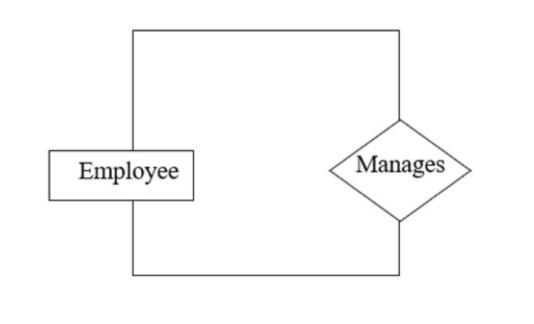
Unary Relationship
A relationship involving only one entity type.
  Example: MANAGES(Employee, Employee)
  One employee manages another employee.
  Both entities belong to the Employee entity set.
It expresses a relationship within the same entity set.

Slide 24
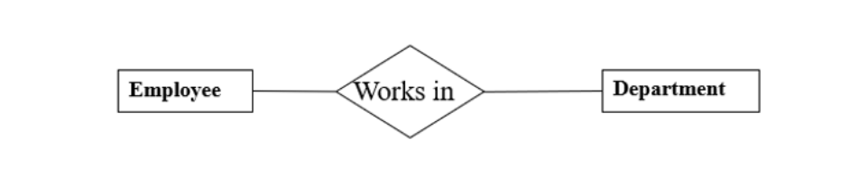
Binary Relationship
A relationship between two entity types — the most common case in database modeling.
  Example WORKS_FOR(Employee, Department)
  Each employee works for one department.
  The relationship connects the Employee and Department entity sets.
Most relationships in real-world systems are binary.

Slide 25
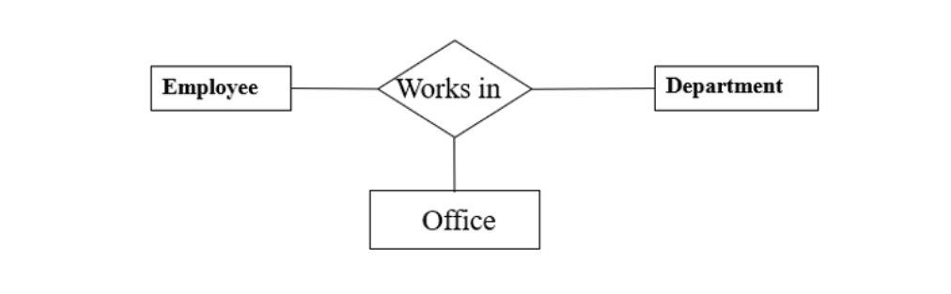
Ternary Relationship
A relationship involving three entity types.
  Examples Works In(Employee, Department, Office)
  An employee works in an office, but the employee should be working in a specific department.
  So, the employee works in a department in an office.

Slide 26
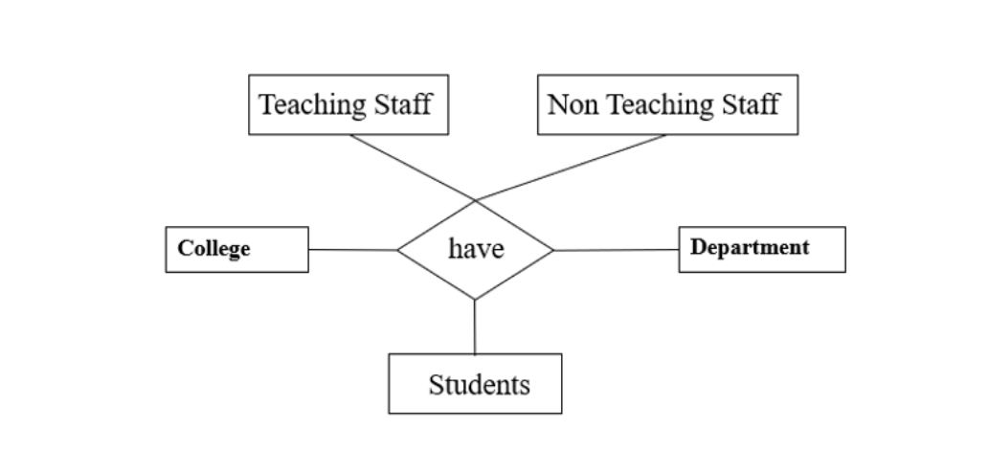
N-ary Relationship
A general case where n entity sets participate.
Though possible, relationships beyond degree 3 are uncommon usually broken down into binary relationships for simplicity.

Slide 27
Cardinality Ration in ER Model
Cardinality in an Entity-Relationship (ER) model refers to the numerical relationship between entities—specifically, it defines how many instances of one entity can be associated with instances of another.
For Example:
  1 Person can have only one NID and one NID is associated with only one person
  1 Book can have multiple authors
  Multiple Student Can Enroll in Multiple Classes

Slide 28
Types of Cardinality
One-to-One (1:1)
Definition: Each entity in Entity A is related to at most one entity in Entity B, and vice versa.
  Example: President ↔ Country Each country has one president, and each president governs only one country.
  Example: NID ↔ Person Each person can only have one NID and vice versa
One-to-Many (1:N)
Definition: Each entity in Entity A can be associated with many entities in Entity B, but each entity in B is related to at most one entity in A.
  Example (Nepal):Department → EmployeeEach department can have many employees, but each employee belongs to only one department.
Many-to-Many (M:N)
Definition: Each entity in Entity A can be associated with many entities in Entity B, and vice versa.
  Example: Student ↔ Course at a University. A student can enroll in multiple courses, and each course can have many students.

Slide 29
Strong and Weak Entity
Strong Entity
Definition: An entity that has a primary key to uniquely identify each instance.
Exists independently of other entities.
Weak Entity
Definition: An entity that does not have a primary key of its own.
Depends on a strong entity for identification.
Identified by a partial key combined with the primary key of the related strong entity.
  Student_Course_Enrollment
    Depends on Student and Course entities.
    Attributes: Enrollment_Date, GradePartial Key: Enrollment_Number (only unique per student)

Slide 30
ER Diagram
An ER diagram is a graphical representation of a database’s structure.
It shows entities, attributes, and relationships among data in a Mini world or system.
Helps visualize how data is organized and interrelated.
Serves as a blueprint for designing a database.

Slide 31
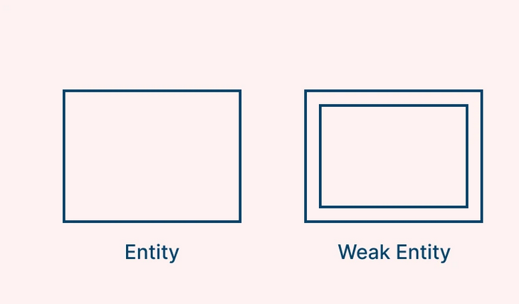
Symbols in ER Diagram
Entity Symbols
Entities are symbolized by rectangles and are objects intended for storing specific information.
A single rectangle is used for strong entity and double rectangle is used for weak entity

Slide 32
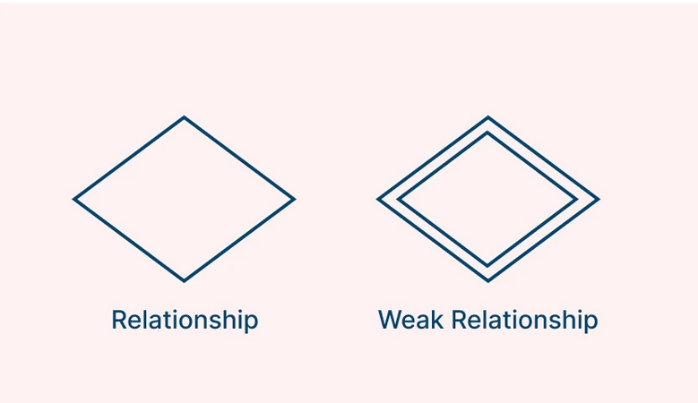
Symbols in ER Diagram
Relationship Symbols
The interactivity between two entities is described by a relationship which is visually represented as a diamond symbol. In the case of a double diamond (a diamond within a diamond), this denotes a ‘weak relationship’ which exists between a weak entity and its parent

Slide 33
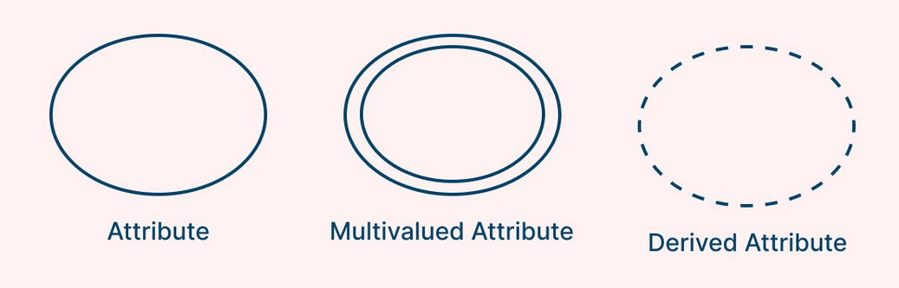
Symbols in ER Diagram
Attributes Symbols
Ellipses (ovals) symbolize attributes, detailing the properties and characteristics of entities
A single ellipse denotes a simple attribute
Double ellipse (an ellipse within an ellipse) highlights multivalued attributes
A single ellipse with dotted lines represents Derived Attribute

Slide 34
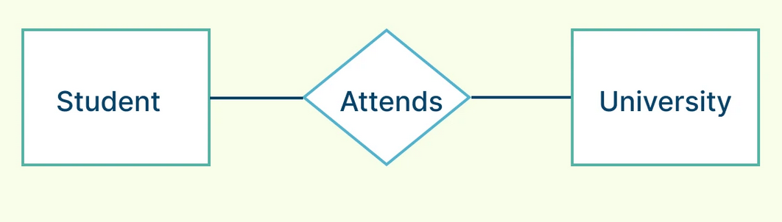
Symbols in ER Diagram
Connecting Lines
Solid lines are used to connect the various ER diagram symbols

Slide 35
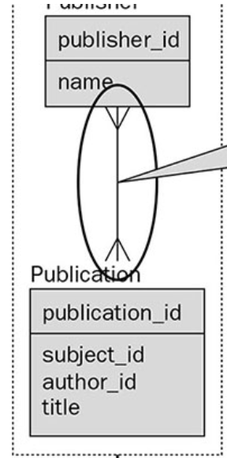
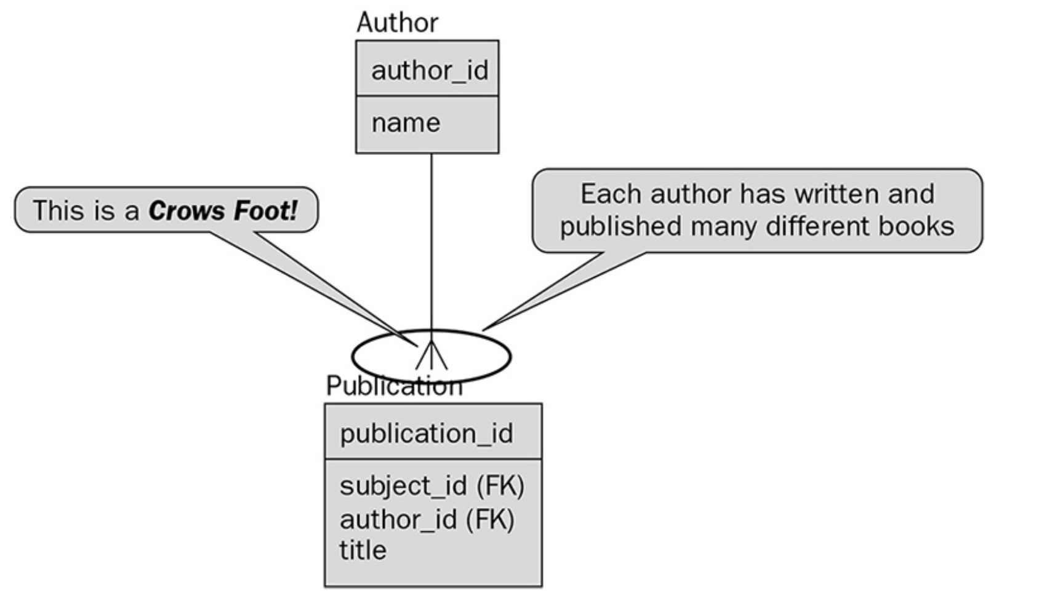
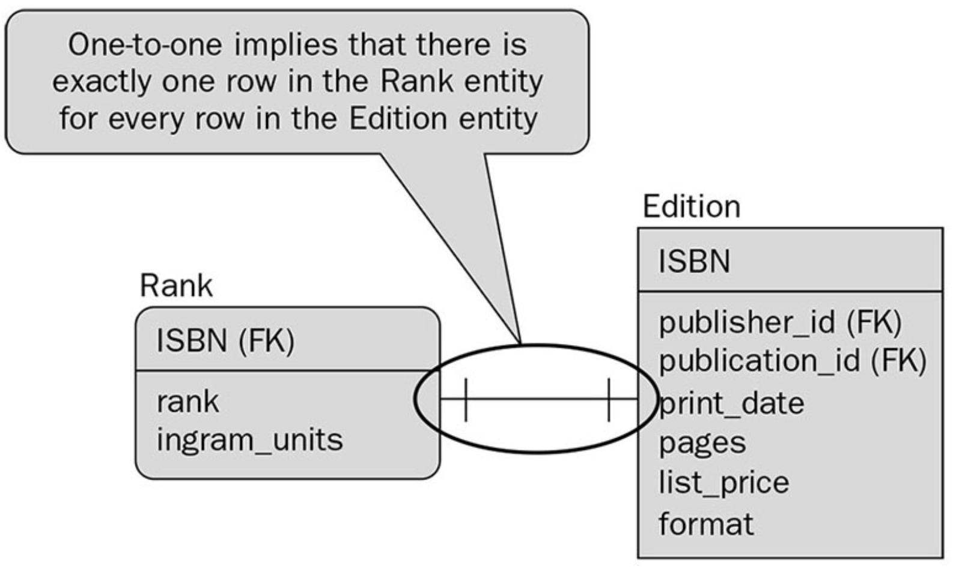
Symbols in ER Diagram
Cardinality
For Cardinality we will be using Crow’s Foot Notation.

Slide 36
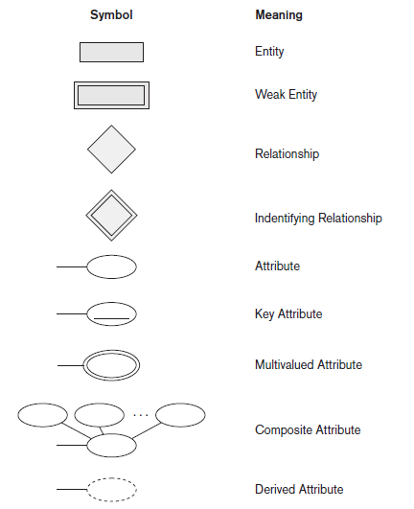
Symbols in ER Diagram

Slide 37
ER Diagram
Draw an ER Diagram for a Hospital Management System where a Doctor checks the Patient. The Patient buys medicine from pharmacy.

Slide 38
ER Diagram
“A librarian, identified by his or her staff number, name, and office number, is responsible for managing several library sections. Each section has a unique code and a name, and it contains a number of books. A book is identified by its ISBN, title, and publication year, and it can be written by one or more authors. Because of limited copies, a single book may have multiple copies (each identified by a copy number) that can be borrowed by students or staff.
A student, identified by student number and name, can borrow several books, but each book copy can be issued to only one student at a time. For every borrowing transaction, the issue date and return date are recorded. A librarian supervises all borrowing transactions that occur in their section.

Slide 39
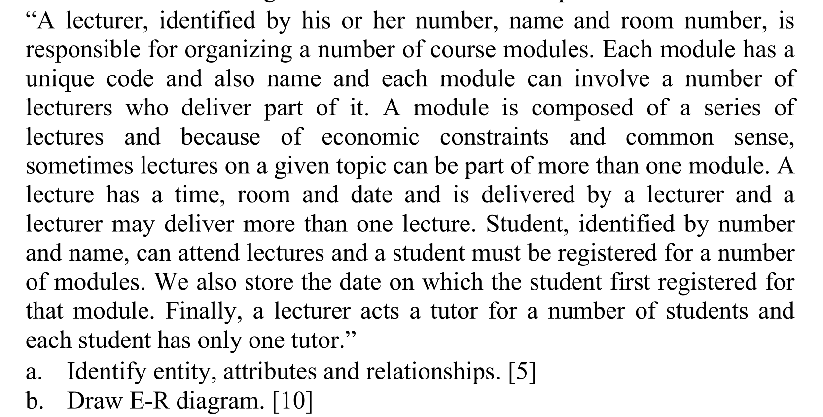
ER Diagram

Slide 40
Extended E-R Features
Although the basic E-R concepts can model most database features, some aspects of a database may be more aptly expressed by certain extensions to the basic E-R model.
Capture details that go beyond basic entities, relationships, and attributes.
We will discuss about
  specialization
  generalization
  aggregation

Slide 41
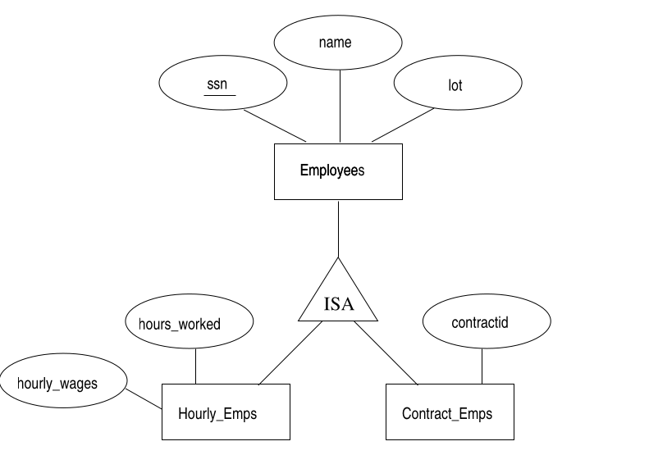
Specialization and Generalization

Slide 42
Specialization and Generalization
Specialization is the process of identifying subsets of an entity set (the superclass) that share some distinguishing characteristic.
Typically the superclass is defined first, the subclasses are defined next, and subclass-specific attributes and relationship sets are then added.
Generalization consists of identifying some common characteristics of a collection of entity sets and creating a new entity set that contains entities possessing these common characteristics.
Typically the subclasses are defined first, the superclass is defined next, and any relationship sets that involve the superclass are then defined.

Slide 43
Extended ER Diagram
A company maintains information about its employees, who may be either hourly-paid or contract-based. Each employee is assigned to a department, and customers interact with employees through these departments for services or product inquiries.

Slide 44
Aggregation in ER Model
Aggregation allows us to indicate that a relationship set (identified through a dashed box) participates in another relationship set.

Slide 45
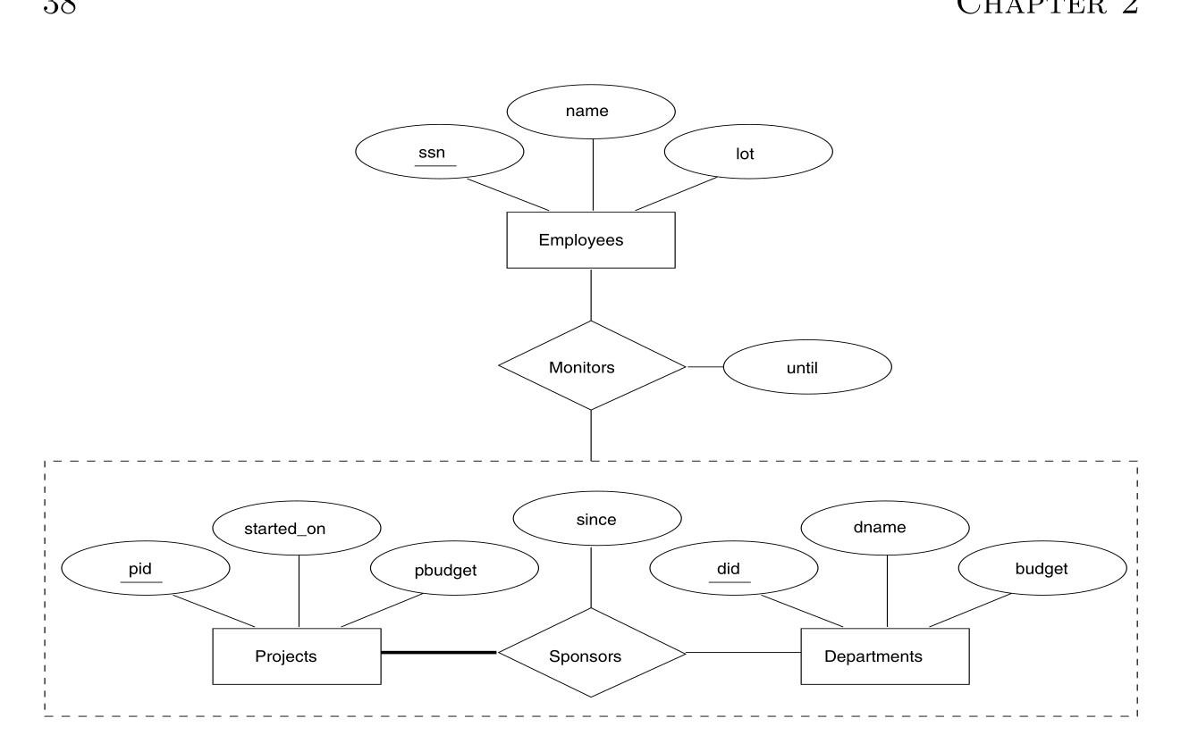

Slide 46
ER to Relational Mapping
The ER model represents the conceptual design of a database focusing on entities, relationships, and constraints.
The Relational model represents the logical design, which can be implemented in a DBMS like MySQL or PostgreSQL.
Mapping is required to convert the conceptual ER diagram into relational tables that can store real data.

Slide 47
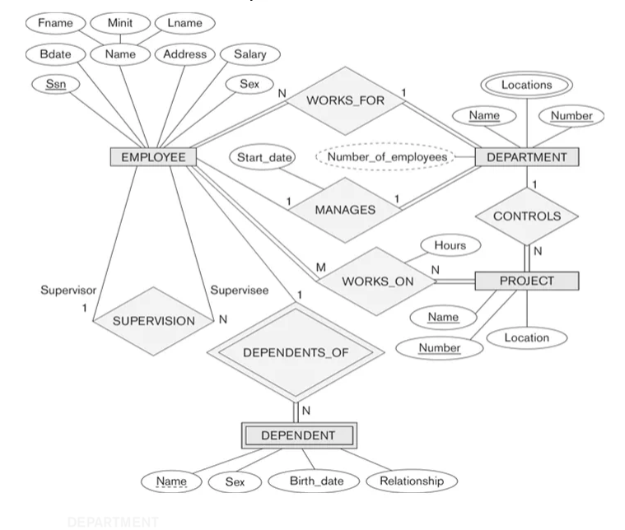
Steps in ER to Relational Mapping
ERD of a Company
Source: Fundamentals of Database Systems (Ramez Elmasri, Shamkant B. Navathe)

Slide 48
Step 1: Mapping Strong Entity
Figure out all the regular/strong entity from the diagram and then create a corresponding relation(table) that includes all the simple attributes.
For composite attribute flatten it into the simple component attributes
Choose one of the attributes as a primary key. If composite, the simple attributes together form the primary key.
For the given ER-Diagram we have Employee, Department and Project as strong/regular entity, as they are enclosed in single rectangle.

Slide 49
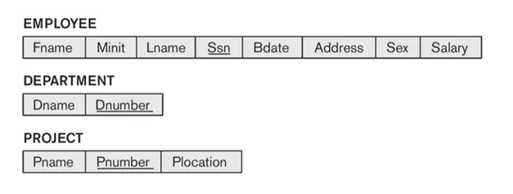

Slide 50
Step 2: Mapping Weak Entity
Figure out the weak entity types from the diagram and create a corresponding relation(table) that includes all its simple attributes.
Add as foreign key, all of the primary key attributes in the entity corresponding to the owner entity.
The primary key is a combination of all the primary key attributes from the owner and the primary key of the weak entity.
For the given ER-Diagram we have Dependent as a weak entity, as it is enclosed in a double rectangle that is indicative of an entity being weak.

Slide 51
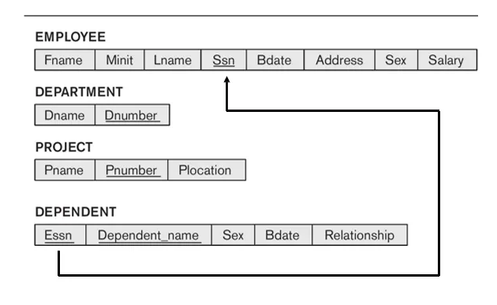

Slide 52
Step 3: Mapping Cardinality
1:1 Relationship: Add the primary key of one entity as a foreign key in the other.
1:N Relationship: Add the primary key of the one side as a foreign key in the many side.
M:N Relationship: Create a new table with foreign keys of both entities as composite primary key.

Slide 53
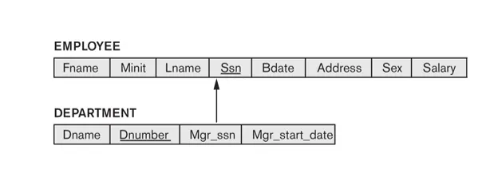
1:1 Relationship

Slide 54
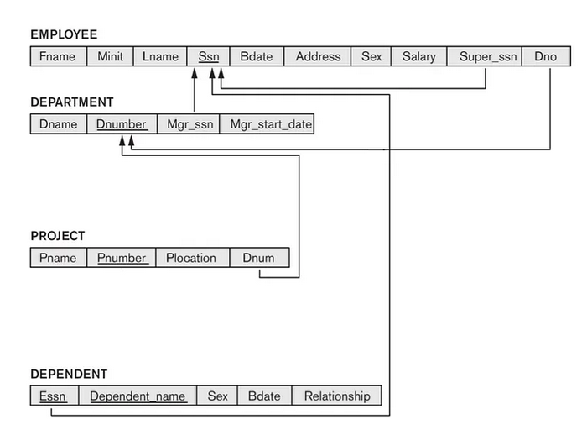
1:N Relationship

Slide 55
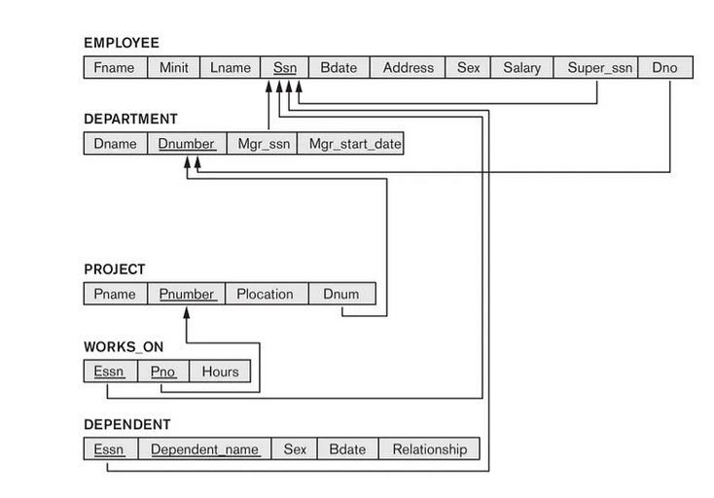
M to N Relationship

Slide 56
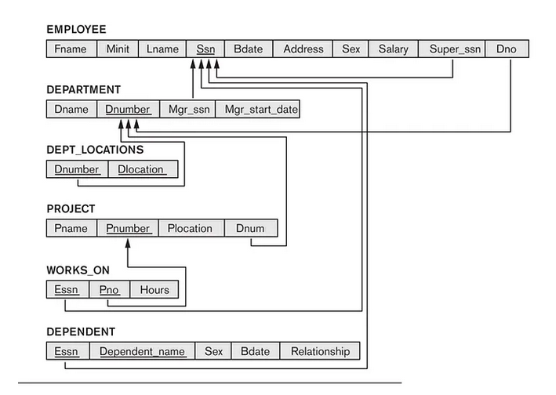
Step 4: Mapping Multi Valued Attribute
Create a separate table.
Include the attribute and the primary key of the original entity.

Slide 57
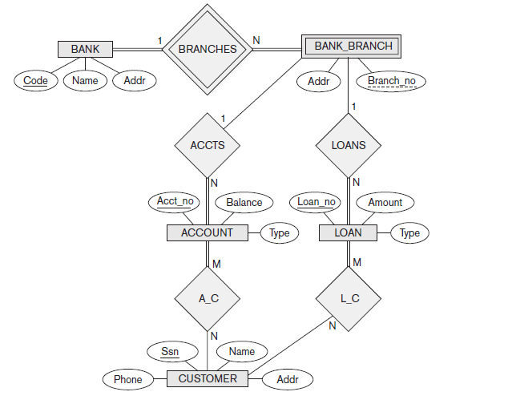
Exercise
Map the ER Diagram to Relational Model

Slide 58
Exercise
Design an Entity–Relationship (ER) Diagram for a Movie Database and Map it to Relational Model that stores information about movies, actors, directors, genres, and production companies.
Each movie is identified by title and year of release.
Each movie has a length in minutes.
Each has a production company, and each is classified under one or more genres (such as horror, action, drama, and so forth).
Each movie has one or more directors, and one or more actors appear in it.
Actors are identified by name and date of birth and appear in one or more movies. Each actor has a role in the movie.
Production companies are identified by name and each has an address.

