Slide 1
Unit-3: Normalization

Slide 2
Contents
Introduction to Normalization
Anomalies in Relational Model
Database Keys
Database Constraints
Importance of Normalization
Functional Dependencies
Normal Forms (1NF, 2NF, 3NF, BCNF)

Slide 3
Normalization in Relational Database Design
Normalization is a systematic method used during relational database design.
Its main objective is to produce a set of well-structured relation schemas.
These schemas should:
  Store data without unnecessary redundancy
  Prevent anomalies (insert, update, delete problems)
  Ensure data consistency and integrity
  Allow efficient and easy retrieval of information

Slide 4
Normalization in Relational Database Design
Consider the following STUDENT_COURSE table
This table has redundancy
  Student name “Sita” is repeated 2 times
  For every student and course, the instructor details are repeated
StudentID | StudentName | Course | Instructor | InstructorPhone
101 | Sita | DBMS | Dr. Sharma | 9841000001
101 | Sita | AI | Dr. Niraula | 9841000002
102 | Ram | DBMS | Dr. Sharma | 9841000001

Slide 5
Normalization in Relational Database Design
We can decompose the STUDENT_COUURSE table into four tables
StudentID | StudentName
101 | Sita
102 | Ram
StudentID | Course
101 | DBMS
101 | AI
102 | DBMS
Instructor | InstructorPhone
Dr. Sharma | 9841000001
Dr. Niraula | 9841000002
Course | Instructor
DBMS | Dr. Sharma
AI | Dr. Niraula

Slide 6
Anomalies in the Relational Model
When a relation is not properly normalized, it often stores more than one kind of information in the same table.
This leads to redundancy
Redundancy creates anomalies – unexpected problems when inserting, deleting and updating data
We will use this table to illustrate different types of anomalies
StudentID | StudentName | Course | Instructor
101 | Sita | DBMS | Dr. Sharma
101 | Sita | AI | Dr. Niraula
102 | Ram | DBMS | Dr. Sharma

Slide 7
Insertion Anomalies
An insert anomaly occurs when certain data cannot be inserted into a table without the presence of other data.
Example
Suppose a new course "Machine Learning" is introduced, taught by Dr. Shrestha, but no student has enrolled yet.
In the STUDENT_COURSE table, you cannot insert:
StudentID | StudentName | Course | Instructor
? | ? | Machine Learning | Dr. Shrestha

Slide 8
Deletion Anomalies
A delete anomaly occurs when the deletion of a record results in unintentionally losing other valuable information.
Example
  Suppose only one student (Sita) was enrolled in the AI course.
  If we delete Sita’s enrollment:
  | 101 | Sita | AI | Dr. Niraula |
  Then we also lose the fact that the AI course exists and that Dr. Niraula teaches it.
Deleting a student’s record should not erase course information, but because everything is stored together, deleting one fact removes another.

Slide 9
Modification Anomalies (Update Anomalies)
An update anomaly happens when data needs to be changed in multiple places; if one copy is missed, data becomes inconsistent.
Example
  Instructor for DBMS changes from Dr. Sharma → Dr. Khadka.
  We must update every row where Course = DBMS:
  | 101 | Sita | DBMS | Dr. Sharma |
  | 102 | Ram | DBMS | Dr. Sharma |
  If we update only the first row:
  | 101 | Sita | DBMS | Dr. Khadka |
  | 102 | Ram | DBMS | Dr. Sharma |
  Now the instructor information is inconsistent.
The instructor's name is repeated unnecessarily across multiple student records.

Slide 10
Anomalies Summary
Anomaly | What happens? | Example
Insert Anomaly | Cannot insert data without other data | Cannot insert a new course unless a student enrolls
Delete Anomaly | Deleting one fact deletes another important fact | Removing last student in AI removes the existence of AI course
Update Anomaly | Must update redundant data in many places → inconsistency | Changing DBMS instructor requires changes in multiple rows

Slide 11
Domain, Attributes, Tuples and Relations
A domain (D) is a set of atomic values.
Atomic means each value is indivisible within the relational model.
Domains are usually defined by specifying a data type (e.g., INTEGER, VARCHAR).
Giving each domain a meaningful name helps interpret the values clearly.
Example:
  Domain: age
  Data Type: INTEGER
  Atomic Values: 18, 25, 40

Slide 12
Relation Schema
A relation schema R is written as: R(A₁, A₂, … , Aₙ)
It consists of:
  A relation name (R)
  A list of attributes (A₁ to Aₙ)
Each attribute Aᵢ represents a role played by a domain D.
  The domain of attribute Aᵢ is written as dom(Aᵢ).
A relation schema describes the structure of a relation.
The degree (arity) of a relation = number of attributes (n).
Example:
STUDENT(RollNo, Name, Age, Dept) Degree = 4

Slide 13
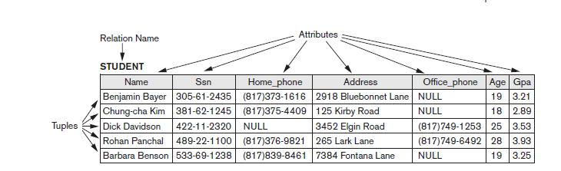
Attributes, Tuples and Relation

Slide 14
Constraints in DBMS
Constraints in DBMS (Database Management Systems) encompass rules or conditions applied to database data, ensuring
  data integrity
  Consistency
  Adherence to business rules
Within relational databases, there are primarily four types of constraints, commonly referred to as relational constraints. These include:
  Domain Constraints
  Key Constraints
  Entity Integrity Constraints
  Referential Integrity Constraints

Slide 15
Domain Constraint
Define the valid values that an attribute (column) can hold.
Specify the data type (e.g., integer, string, date) and any additional restrictions (e.g., range of values, allowed patterns).
Types of Domain Constraints
  A check constraint in a Database Management System (DBMS) is a way to enforce certain conditions on the values that are stored in a database.
  The NOT NULL constraint in a Database Management System (DBMS) is used to ensure that a column in a table cannot contain any NULL values

Slide 16
Key Constraint
A key constraint in a Database Management System (DBMS) refers to a set of rules applied to one or more columns in a database table to ensure the uniqueness and integrity of data.
Keys are used to uniquely identify rows in a table, and they play a fundamental role in establishing relationships between tables.
There can be only one primary key in a table.
The primary key must be unique and can not be NULL

Slide 17
Entity Integrity Constraints
The primary key of a table cannot be NULL.
If the key is NULL, the row cannot be uniquely identified.

Slide 18
Referential Integrity Constraints
The referential integrity constraint is established when a foreign key references the primary key of another table, requiring the referencing attribute to be a subset of the referred attribute.
A foreign key value must either:
  match an existing primary key value in the parent table, or
  be NULL (if allowed)
Example
  STUDENT(StudentID, Name)
  ENROLL(StudentID, CourseID)
  ENROLL.StudentID must exist in STUDENT.StudentID.
  You cannot enroll a non-existing student.

Slide 19
Keys in Relational Model
A key is an attribute (column) or a set of attributes that helps uniquely identify a row (tuple) in a relation (table).
A key of a relation R is a set of attributes K such that:
  Uniqueness: No two distinct tuples in R have the same values for attributes in K.
  Minimality: If any attribute is removed from K, the uniqueness property is lost.
Example: In STUDENT Relation StudentID can be key since no two tuples have same StudentID
StudentID | Name | Email | Phone
101 | Rina | rina@gmail.com | 981234
102 | Arjun | arjun@gmail.com | 980111

Slide 20
Super Key
A super key is any set of attributes that uniquely identifies tuples in a relation.
A super key is a set of one or more attributes that, taken collectively, allow us to identify uniquely a tuple in the relation.
May contain extra attributes.
Examples
  {StudentID}
  {Email}
  {Phone}
  {StudentID, Name} → still unique → Super key
  {StudentID,Email}

Slide 21
Candidate Key
A candidate key is a minimal super key.
It has no redundant attributes.
Example
In STUDENT(StudentID, Email, Name):
  {StudentID}
  {Email}
Both uniquely identify a student and are minimal. So, we have two candidate keys.

Slide 22
Primary Key
A primary key is the candidate key chosen by the database designer to uniquely identify tuples in a relation.
Characteristics
  must be unique
  cannot be NULL
  stable (should not change over time)
Example
  If the candidate keys are:
  StudentID
  Email
  The designer selects StudentID → Primary Key.

Slide 23
Alternate Key
When a relation has multiple candidate keys, those not chosen as the primary key are called alternate keys.
Example
  Candidate keys:
    StudentID
    Email
Primary key chosen → StudentID
Alternate key → Email

Slide 24
Composite Key
A composite key is a key made up of two or more attributes.
Example
REGISTRATION(StudentID, CourseID, Semester)
(StudentID, CourseID, Semester) → Composite Key

Slide 25
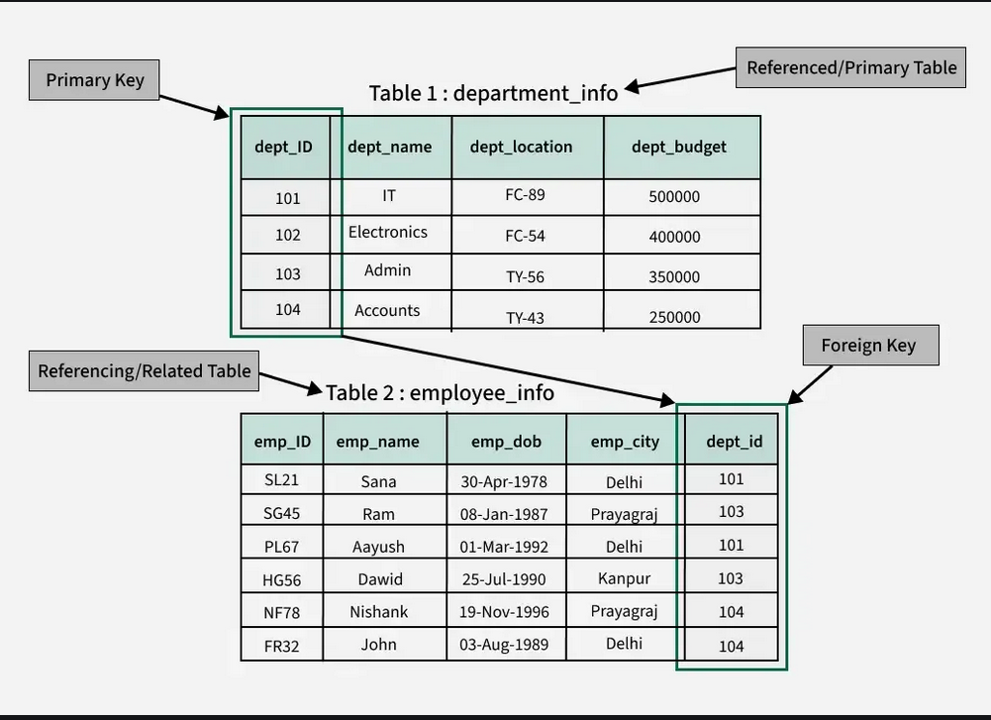
Foreign Key
Attribute in one relation that refers to the primary key of another relation.
Source: https://www.geeksforgeeks.org/dbms/foreign-key-in-dbms/

Slide 26
Unique Key
A unique key is an attribute that must have unique values
Can contain NULL (unlike primary key).
In STUDENT table, Email if provided should be unique

Slide 27
Summary
Key Type | Meaning | Example
Super Key | Any unique attribute set | {StudentID, Name}
Candidate Key | Minimal super key | {StudentID}, {Email}
Primary Key | Chosen identifier | StudentID
Alternate Key | Other candidate keys | Email
Composite Key | Multiple attributes | (StudentID, CourseID, Semester)
Foreign Key | References another table | ENROLL.StudentID
Unique Key | Unique but nullable | Email

Slide 28
Normal Forms
Normal forms in a database management system (DBMS) are a set of guidelines used to organize data in a way that reduces redundancy and improves data integrity. The main normal forms include
First Normal Form (1NF)
Second Normal Form (2NF)
Third Normal Form (3NF)
Boyce-Codd Normal Form (BCNF)

Slide 29
First Normal Form
A table is in 1NF if it satisfies the following conditions:
  All columns contain atomic values (i.e., indivisible values).
  Each row is unique (i.e., no duplicate rows).
  No duplicated rows or columns
  Example:
  Not in 1NF In 1NF
StudentID | Name | PhoneNumbers
101 | Rina | 981234, 982222
StudentID | Phone
101 | 981234
101 | 982222

Slide 30
Functional Dependency
Consider a relation schema r(R) and attribute sets α ⊆ R and β ⊆ R.
Given an instance of r(R), the instance satisfies the functional dependency: α → β
α uniquely determines β
if, for every pair of tuples t₁ and t₂:
  If t₁[α] = t₂[α], then t₁[β] = t₂[β]

Slide 31
Example: Checking Functional Dependency
Check FD:
Take tuples where SID = 101:
Same SID → Same Name and Dept
SID → Name, Dept holds in this instance.
Relation: Student(SID, Name, Dept)
Assume the dependency SID → Name, Dept
SID | Name | Dept
101 | Alex | CS
102 | Bela | EE
103 | Chris | CS
101 | Alex | CS
SID | Name | Dept
101 | Alex | CS
101 | Alex | CS
SID | Name | Dept
101 | Alex | CS
101 | Alex | EE
If tuples had:
Then dependency SID → Dept would be violated

Slide 32
Class Exercise
Using the table above:
Identify all functional dependencies between the attributes.
Determine the candidate key(s) for this relation.
StudentID | StudentName | Email | CourseCode | CourseName | Instructor
S101 | Rina Sharma | rina@snu.edu | CS201 | Data Structures | Dr. Mehta
S102 | Amit Rana | amit@snu.edu | CS201 | Data Structures | Dr. Mehta
S101 | Rina Sharma | rina@snu.edu | MA110 | Calculus I | Dr. Gupta
S103 | Sita Adhikari | sita@snu.edu | CS201 | Data Structures | Dr. Mehta
S102 | Amit Rana | amit@snu.edu | MA110 | Calculus I | Dr. Gupta

Slide 33
Types of Functional Dependency
student_id | name | phone
1 | Ram | 98123
2 | Sita | 98222
1. Trivial Functional Dependency
Y⊆X⇒X→Y
Example: student_id, name → name
2. Non-Trivial Functional Dependency
Y is not Subset of X
Example: student_id → phone

Slide 34
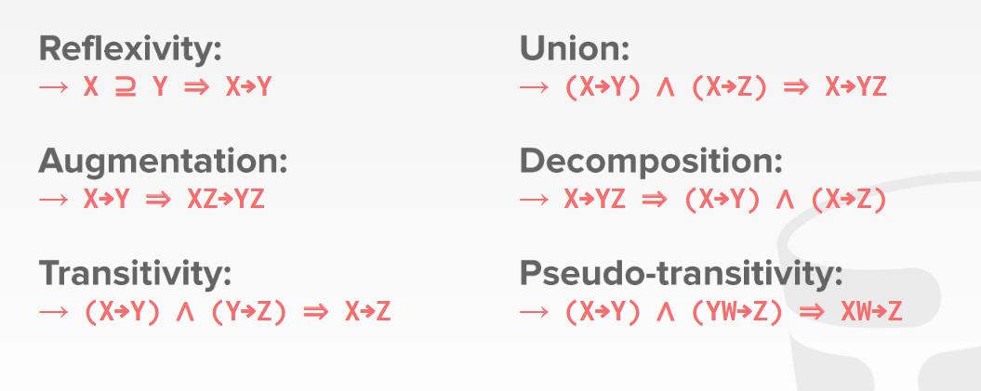
Armstrong’s Axioms
Source: https://15445.courses.cs.cmu.edu/fall2017/slides/04-functionaldependencies.pdf

Slide 35
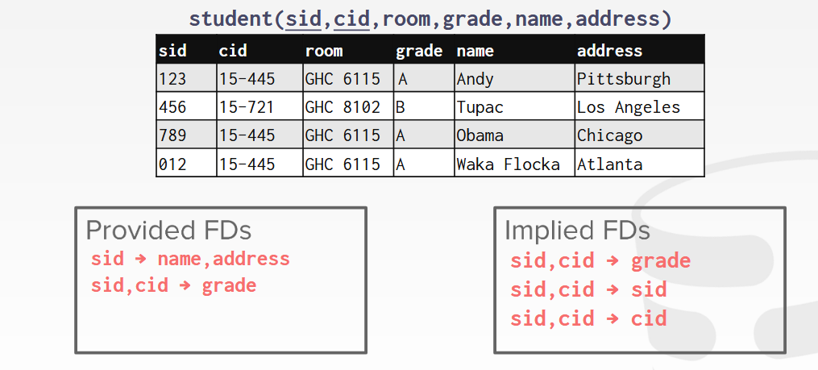
Closures

Slide 36
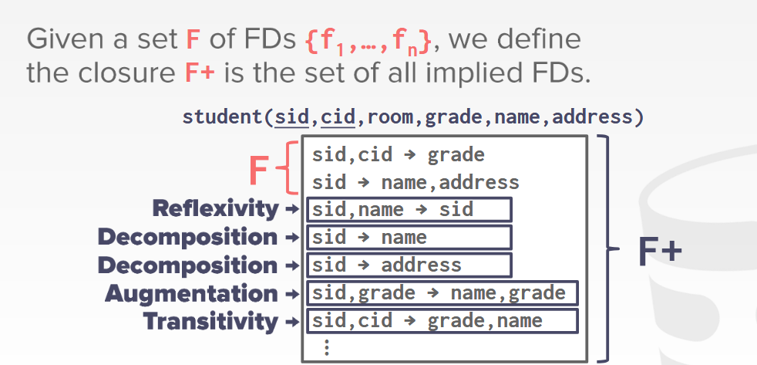
Closures

Slide 37
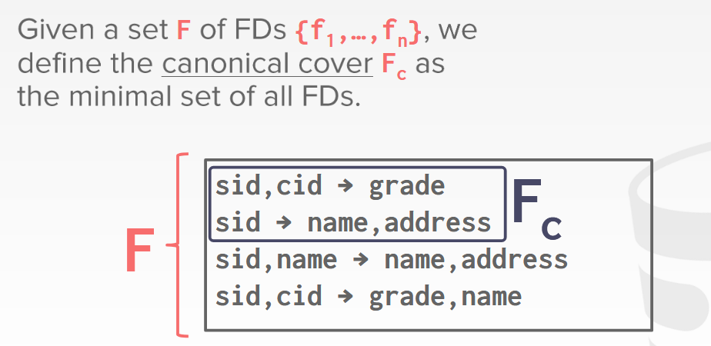
Canonical Cover

Slide 38
Second Normal Form (2NF)
A table (Relation) is in 2NF if
Table is in 1NF
Every non-key attribute is fully functionally dependent on the whole primary key (i.e., no partial dependencies on a part of a composite key).

Slide 39
Example
Assume a sales system with a composite primary key (OrderID, ProductID).
(Primary key: OrderID + ProductID)
This table is in 1NF (atomic values, unique rows).
But it is not in 2NF.
OrderID | ProductID | ProductDate | CustomerName | ProductName | UnitPrice | Quantity
5001 | P10 | 2025-11-20 | Alice | Widget A | 10.00 | 2
5001 | P20 | 2025-11-20 | Alice | Gadget X | 25.00 | 1
5002 | P10 | 2025-11-21 | Bob | Widget A | 10.00 | 5

Slide 40
Example
Primary key is composite: (OrderID, ProductID).
Attributes ProductName and UnitPrice depend only on ProductID, not on the full composite key (OrderID, ProductID).
This is a partial dependency → violates 2NF.
CustomerName and ProductDate depend only on OrderID (also partial in the sense they don't need ProductID), so they are also partial dependencies.
Functional dependencies visible:
  (OrderID, ProductID) → Quantity (OK, depends on whole PK)
  ProductID → ProductName, UnitPrice (partial dependency)
  OrderID → CustomerName, ProductDate (partial dependency)

Slide 41
Decompose to 2NF
Goal: Remove attributes that depend on part of the composite key by creating separate tables.
Decomposition:
Orders(OrderID, ProductDate, CustomerName)
  Primary key: OrderID
Products(ProductID, ProductName, UnitPrice)
  Primary key: ProductID
OrderItems(OrderID, ProductID, Quantity)
  Primary key: (OrderID, ProductID) (foreign keys to Orders and Products)
After decomposition, non-key attributes in each table depend fully on that table’s primary key.

Slide 42
Example Rows After Decomposition
Orders
OrderID | ProductDate | CustomerName
5001 | 2025-11-20 | Alice
5002 | 2025-11-21 | Bob
Products
ProductID | ProductName | UnitPrice
P10 | Widget A | 10.00
P20 | Gadget X | 25.00
OrderItems
OrderID | ProductID | Quantity
5001 | P10 | 2
5001 | P20 | 1
5002 | P10 | 5

Slide 43
Class Exrecise
A university maintains a STUDENT_ENROLLMENT table with the following attributes:
The primary key of the table is StudentID+CourseCode
Check if the table is in 2NF or not. If not decompose it into 2NF
StudentID | StudentName | Email | CourseCode | CourseName | Instructor
S101 | Rina Sharma | rina@snu.edu | CS201 | Data Structures | Dr. Mehta
S102 | Amit Rana | amit@snu.edu | CS201 | Data Structures | Dr. Mehta
S101 | Rina Sharma | rina@snu.edu | MA110 | Calculus I | Dr. Gupta
S103 | Sita Adhikari | sita@snu.edu | CS201 | Data Structures | Dr. Mehta
S102 | Amit Rana | amit@snu.edu | MA110 | Calculus I | Dr. Gupta

Slide 44
Third Normal Form(3NF)
A relation is in 3NF if:
  It is already in 2NF, and
  No non-key attribute depends transitively on the primary key
Key Idea
Every non-key attribute should depend only on the primary key and not on each other

Slide 45
Example
Functional Dependencies
emp_id → emp_name, dept_id
dept_id → dept_name
Primary Key: emp_id
emp_name and dept_id depend on emp_id
But dept_name depends on dept_id, not directly on emp_id
emp_id | emp_name | dept_id | dept_name
101 | Alice | D1 | HR
102 | Bob | D2 | Finance
103 | John | D1 | HR

Slide 46
Example
Employee
emp_id | emp_name | dept_id
101 | Alice | D1
102 | Bob | D2
103 | John | D1
Department
dept_id | dept_name
D1 | HR
D2 | Finance

Slide 47
Exercise
Check if the Relation is in 3NF or not. If not decompose it into 3NF tables
product_id | product_name | category_id | category_name | category_manager
P01 | Laptop | C1 | Electronics | Sarah Thomas
P02 | Mouse | C1 | Electronics | Sarah Thomas
P03 | Shampoo | C2 | Personal Care | John Miller

Slide 48
BCNF
A relation schema R is in BCNF with respect to a set of functional dependencies F if, for every functional dependency
α→β(where α,β⊆R) at least one of the following holds:
α → β is a trivial FD
(i.e., β ⊆ α)
α is a superkey of the relation
Stronger form of 3NF.
Prevents non-key attributes from determining other attributes.

Slide 49
Example
Relation: Student (SID, Major, Advisor)
SID | Major | Advisor
123 | Physics | Faculty-1
123 | Music | Faculty-2
456 | Bio | Faculty-3
789 | Physics | Faculty-4
999 | Physics | Faculty-1
Functional Dependencies (FDs) extracted from the table
SID, Major → Advisor
A student taking a particular major has a fixed advisor.
Advisor → Major
Each advisor advises exactly one major.

Slide 50
BCNF Decomposition
1. Advisor–Major relation
2. Student–Advisor relation
Advisor | Major
Faculty-1 | Physics
Faculty-2 | Music
Faculty-3 | Bio
Faculty-4 | Physics
SID | Advisor
123 | Faculty-1
123 | Faculty-2
456 | Faculty-3
789 | Faculty-4
999 | Faculty-1

Slide 51
Example
Most_Popular_Movies_Of_The_Year
(Release_Year, Popularity_Ranking) → Movie_Name, Release_Year_And_Month
Release_Year | Popularity_Ranking | Movie_Name | Release_Year_And_Month
2008 | 1 | The Dark Knight | 2008-07
2008 | 2 | Indiana Jones and the Kingdom… | 2008-05
2008 | 3 | Kung Fu Panda | 2008-06
2009 | 1 | Avatar | 2009-12
2009 | 2 | Harry Potter and the Half-Blood Prince | 2009-07
2009 | 3 | Ice Age: Dawn of the Dinosaurs | 2009-07

Slide 52
Example Decomposition
Release_Year_And_Month | Release_Year
2008-07 | 2008
2008-05 | 2008
2008-06 | 2008
2009-12 | 2009
2009-07 | 2009
Release_Year | Popularity_Ranking | Movie_Name | Release_Year_And_Month
2008 | 1 | The Dark Knight | 2008-07
2008 | 2 | Indiana Jones… | 2008-05
2008 | 3 | Kung Fu Panda | 2008-06
2009 | 1 | Avatar | 2009-12
2009 | 2 | Harry Potter… | 2009-07
2009 | 3 | Ice Age | 2009-07

