Slide 1
Unit 3: Object oriented analysis
Understand and create domain and concept models.
Identify key classes, their attributes, and methods.
Model object behavior using state and activity diagrams.

Slide 2
Introduction to Object-Oriented Analysis (OOA)
What is Object-Oriented Analysis?
  A process of discovering and defining the core requirements of a system from an object-oriented perspective.
  Focuses on what the system must do, not how it will do it (which is design).
  The goal is to create a model of the problem domain.
Core Outputs of OOA:
  A Conceptual Model of the system.
  Identified Classes & Objects.
  Defined Interactions and Behaviors.

Slide 3
3.1 Domain Modeling & Concept Modeling Relationships
Domain Model
A visual representation of real-world concepts and their relationships within a problem domain.
A domain model is a visual representation of conceptual classes or real-situation objects in a domain.
It is a conceptual model, not a software component model.
Often presented as a set of class diagrams (without methods).
“Domain Model” means a representation of real-situation conceptual classes, not of software objects.
The term does not mean a set of diagrams describing software classes, the domain layer of a software architecture, or software objects with responsibilities.

Slide 4
Cont..
Purpose:
  To establish a common vocabulary between developers and domain experts.
  To identify the key entities ("things") in the system and how they are connected.
provides a
  conceptual perspective. It may show:
  ■ domain objects or conceptual classes
  ■ associations between conceptual classes
  ■ attributes of conceptual classes
Example Domain: Library System
Concepts: Book, Member, Librarian, Loan, Reservation
Relationships: A Member borrows a Book. A Book can have a Reservation.

Slide 5
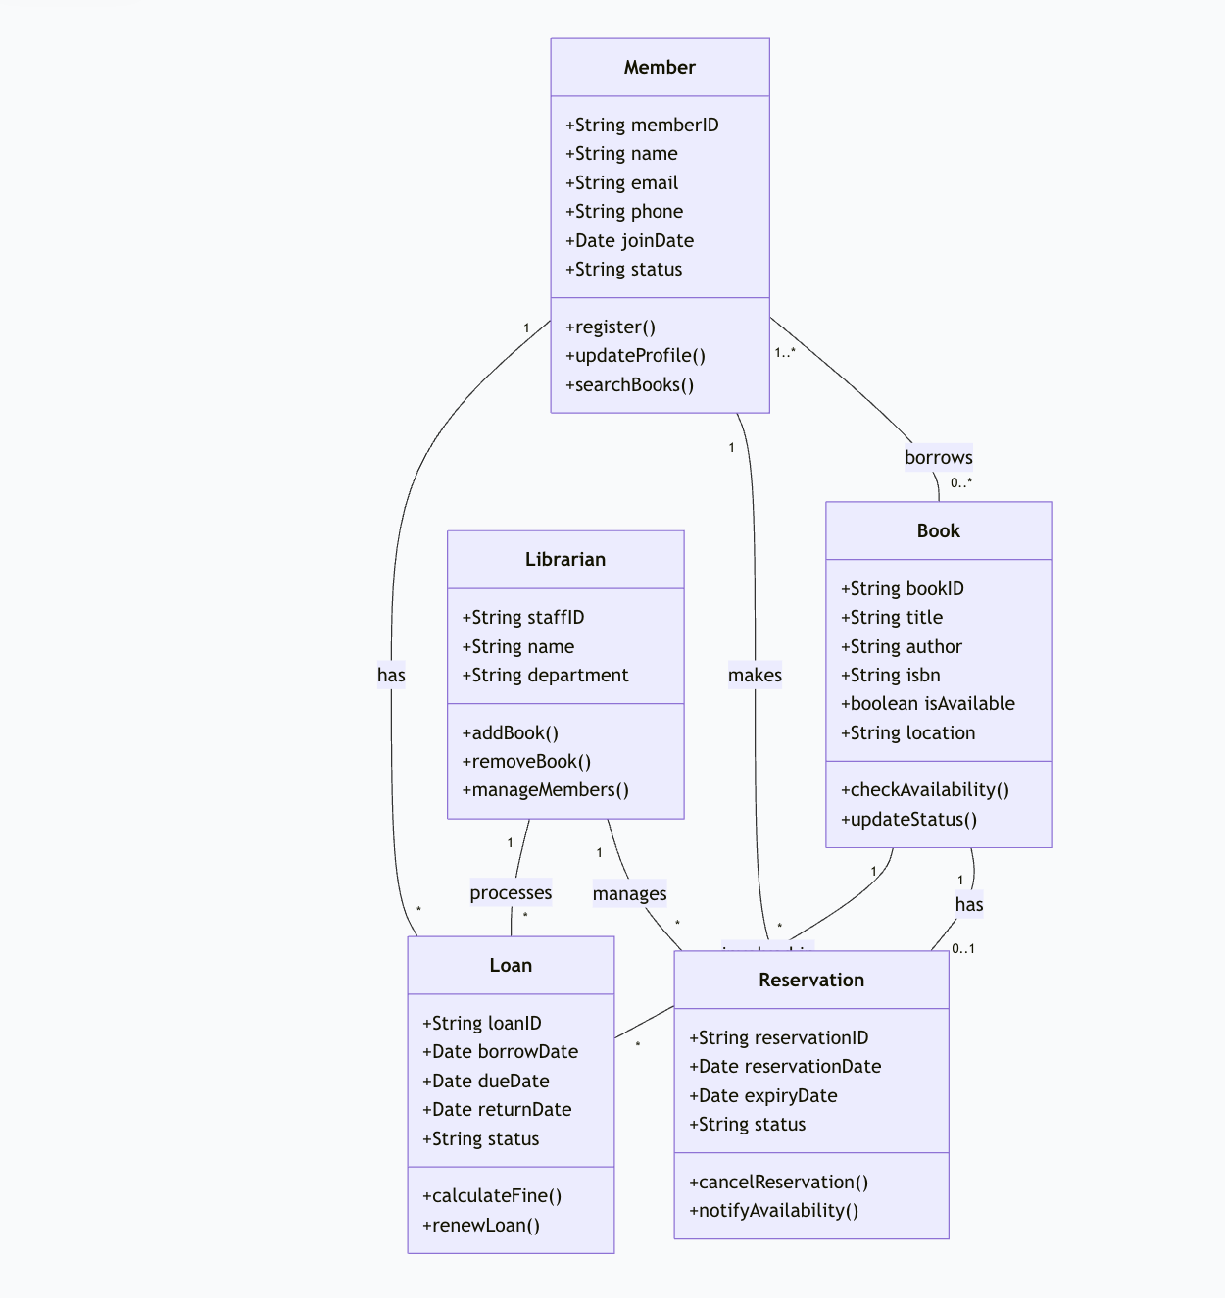
Business Rules & Constraints
1. Membership Rules
A member can have maximum 5 active loans at a time
Members must have unique email and memberID
Member status must be "Active" to borrow books
2. Loan Rules
Loan duration: 14 days
Maximum renewals: 2 times
Fine calculation: $0.50 per day overdue
3. Reservation Rules
A book can have only one active reservation at a time
Reservation expires after 3 days if not fulfilled
A member can have maximum 3 active reservations
4. Book Rules
A book can be loaned only if isAvailable = true
Books with reservations must be held for the reserving member

Slide 6
3.2 Identifying Classes, Attributes, and Methods
Objective
To learn how to identify key classes from system requirements.
To define attributes and methods for each class.
To prepare for Object Modeling and Design stages.

Slide 7
What are Classes?
A class represents a concept, entity, or object in the problem domain.`
It defines a blueprint for objects.
Example:
Student, Book, Account, Order

Slide 8
How to Identify Classes
Techniques:
Noun Identification Technique
  Extract nouns from requirement statements.
  Example: “A student borrows a book from the library.”
  → Possible classes: Student, Book, Library
Domain Knowledge
  Use existing understanding of the problem domain.
Use Case Analysis
  Derive classes based on actors and use case interactions.

Slide 9
Attributes
Definition: Properties or data members that describe the class.
Purpose: Store the state of an object.
Example:
  Student: name, rollNo, email
  Book: title, author, ISBN

Slide 10
Identifying Attributes
Steps:
Look for descriptive words (adjectives or possessive nouns).
  “A book has a title and author.”
Identify data items that need to be recorded.
Ensure attributes are relevant and unique to the class.

Slide 11
Methods
Definition: Actions or behaviors that a class can perform.
Represent operations or services offered by the class.
Example:
  Student: register(), borrowBook()
  Book: issue(), returnBook()

Slide 12
Identifying Methods
Approach:
Analyze verbs in use cases or requirements.
  “A student borrows a book.” → borrowBook()
Associate actions with the appropriate class.
Include only relevant operations.

Slide 13
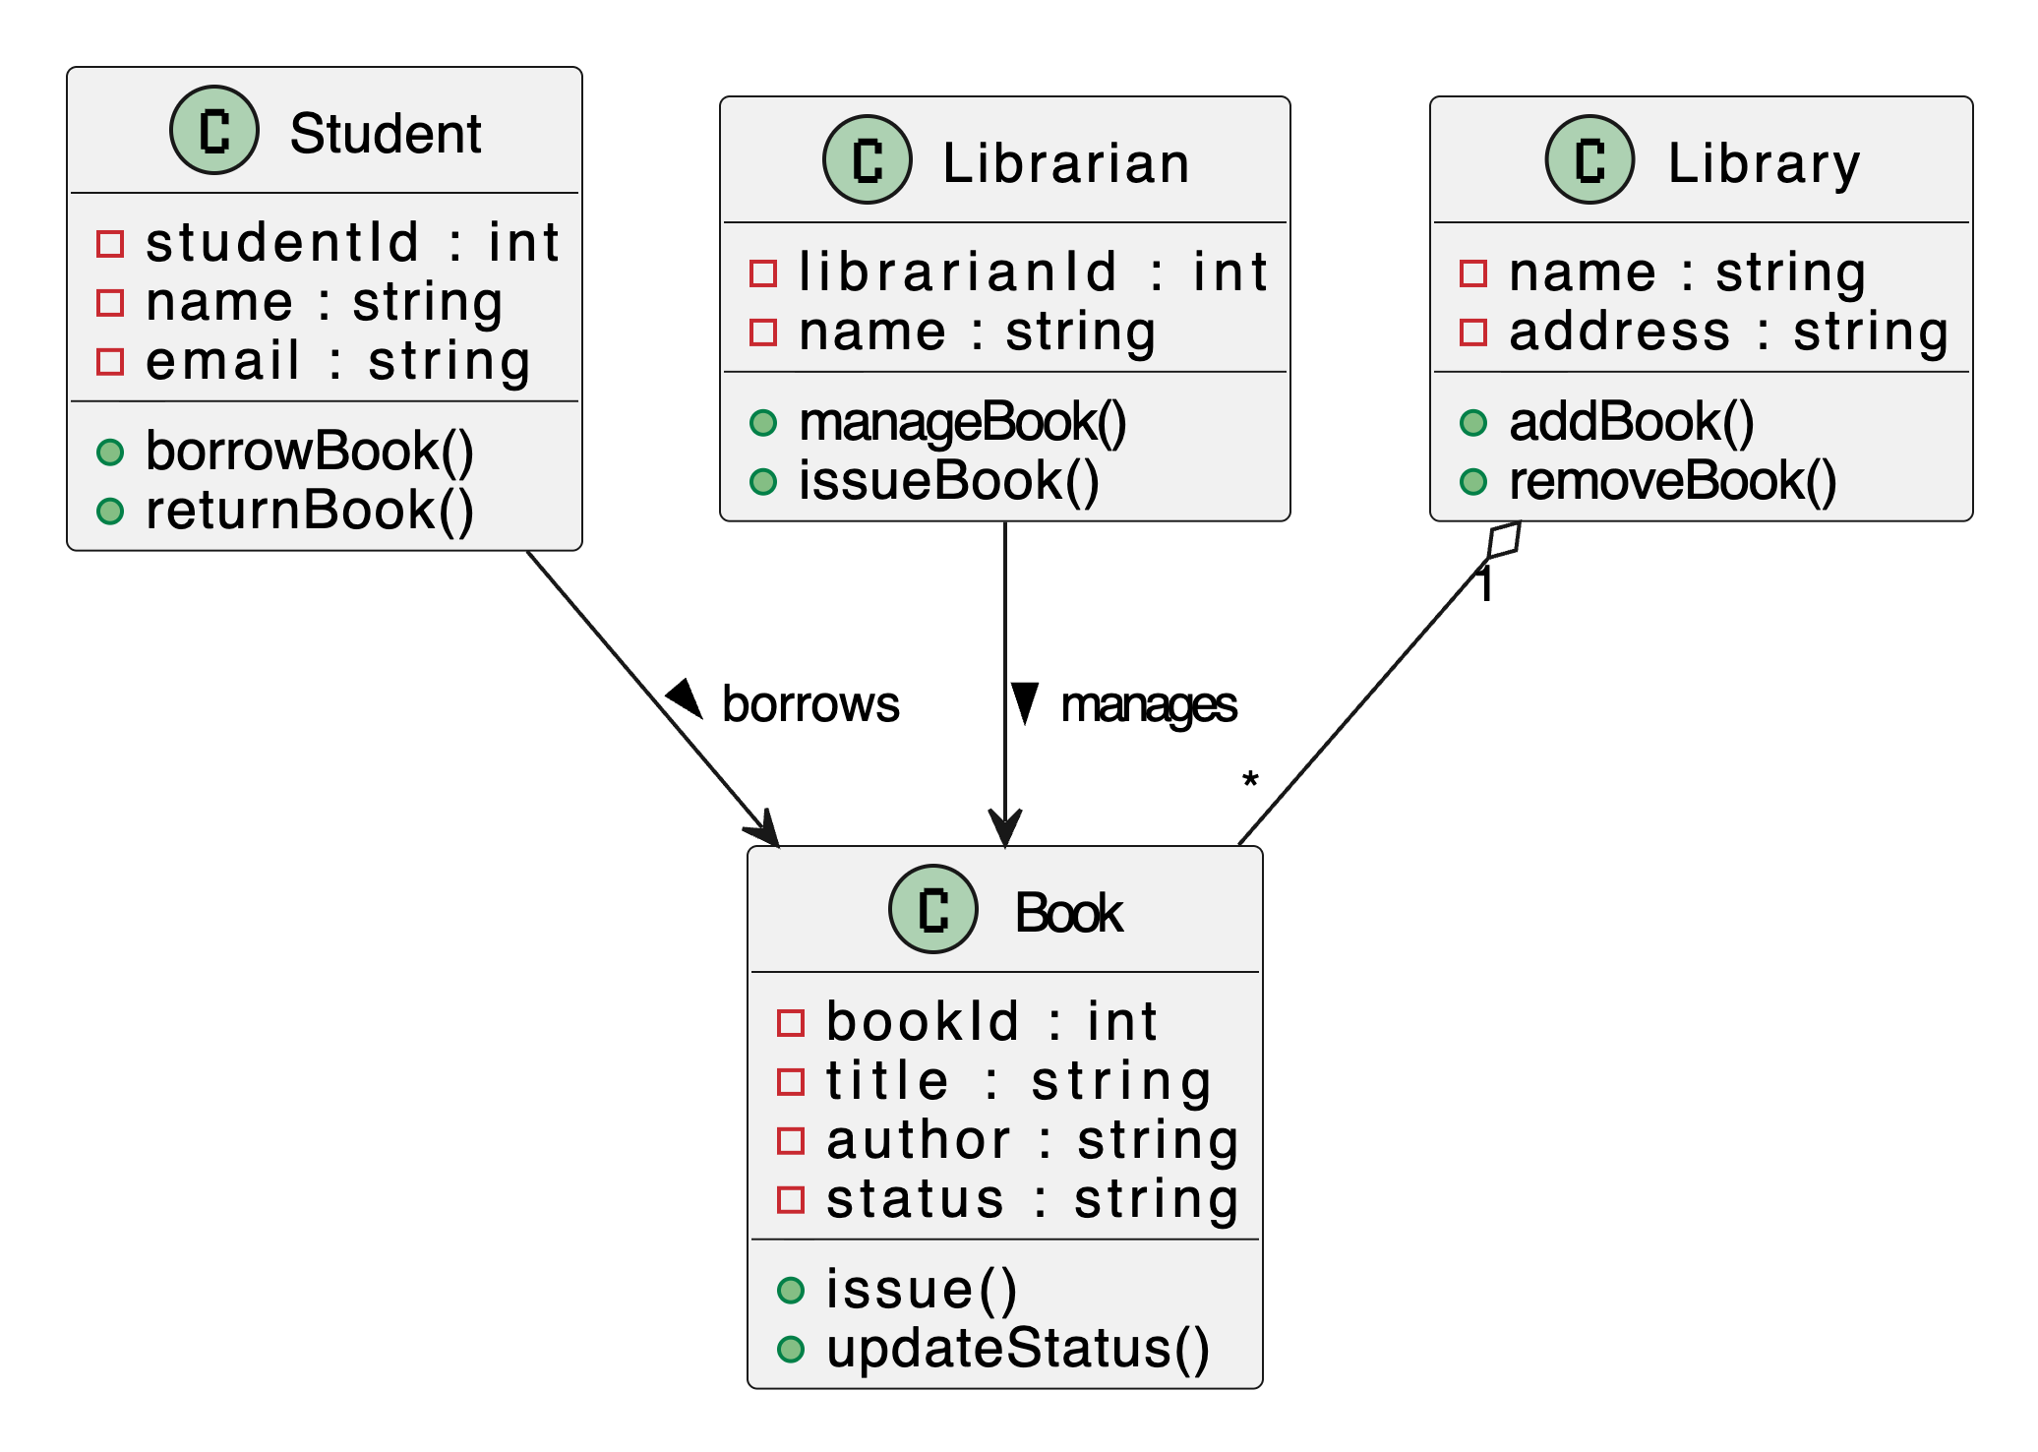
Example – Library Management System
Class | Attributes | Methods
Student | studentId, name, email | borrowBook(), returnBook()
Book | bookId, title, author | issue(), updateStatus()
Librarian | librarianId, name | manageBook(), issueBook()

Slide 14
Best Practices
✅ Keep classes focused (Single Responsibility Principle).
✅ Attributes should be relevant and necessary.
✅ Methods should represent clear system actions.
✅ Use consistent naming conventions.

Slide 15
Activity – Identify Classes from a Use Case
Use Case:
“A student borrows a book using their ID card and returns it after use.”
Your Task:
  Identify potential classes.
  Define attributes and methods for each.
  Draw a simple class diagram using PlantUML or UML tool.
Practice Exercise
Scenario:
In a Restaurant Management System, customers place orders and waiters serve them.
🔹 Identify at least 3 classes
🔹 Define attributes and methods
🔹 Create a simple UML class diagram

Slide 16
3.3 Behavior Modeling using State Diagrams and Activity Diagrams
Learning Objectives
  By the end of this topic, you will be able to:
  Understand the concept of behavior modeling in OOA.
  Explain State Diagrams and Activity Diagrams.
  Identify how objects behave over time and how processes flow.
  Create UML diagrams to model dynamic behavior.

Slide 17
What is Behavior Modeling?
Describes how objects act and react in the system.
Focuses on the dynamic aspects of the system.
Helps in understanding system workflows and object transitions.
💡 It complements structural models (Class diagrams) by showing system behavior.

Slide 18
Types of Behavioral Models
State Diagrams – Show how an object changes states based on events.
Activity Diagrams – Represent the workflow of operations or processes.

Slide 19
State Diagram – Overview
Key notations
Element | Symbol / Meaning
Start State | ● (Filled circle)
State | Rounded rectangle with state name
Transition | Arrow between states
End State | ⊙ (Circle with border)
Depicts states of an object and transitions between them.
Each state represents a condition or situation of an object.
Transitions occur in response to events or conditions.

Slide 20
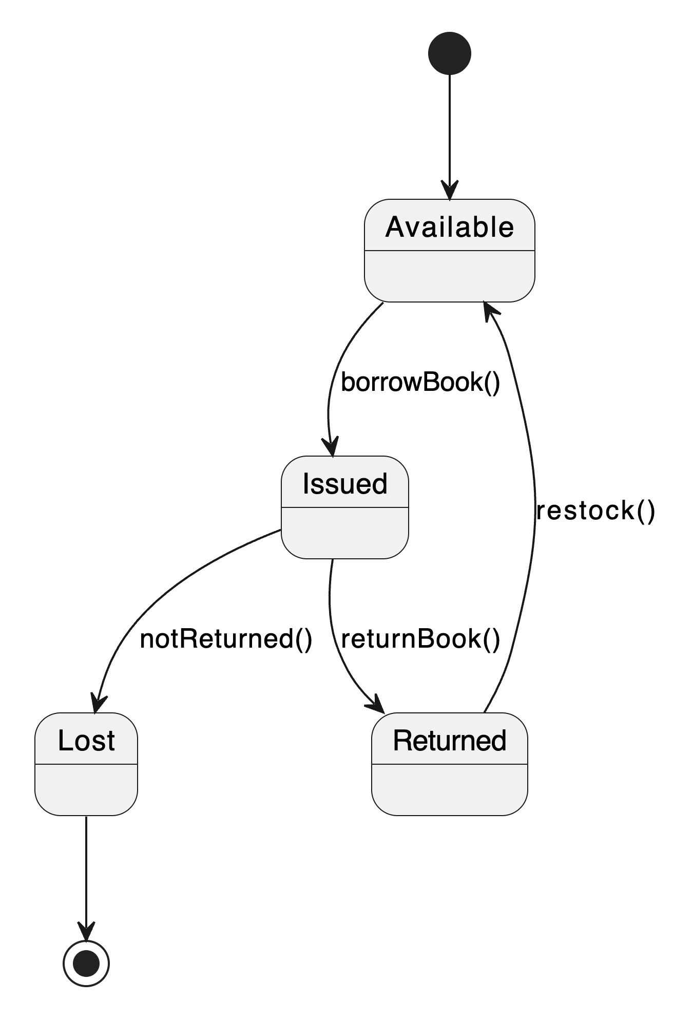
Example – Library Book State Diagram
Scenario: A book moves through various states during its lifecycle.
Explanation:
  The book starts as Available.
  When borrowed → becomes Issued.
  After return → Returned, then again Available.
  If not returned → Lost.

Slide 21
Activity Diagram – Overview
Key elements
Symbol | Meaning
● | Start (Initial node)
⊙ | End (Final node)
Rounded box | Activity (Action performed)
Diamond | Decision/Condition
Arrow | Flow (Transition)
Bar | Synchronization (Fork/Join for parallel actions)
Models workflow or control flow of actions.
Represents the sequence of operations in a process.
Useful for modeling business processes or system activities.
💡 Focuses on the actions and decisions that drive system flow.

Slide 22
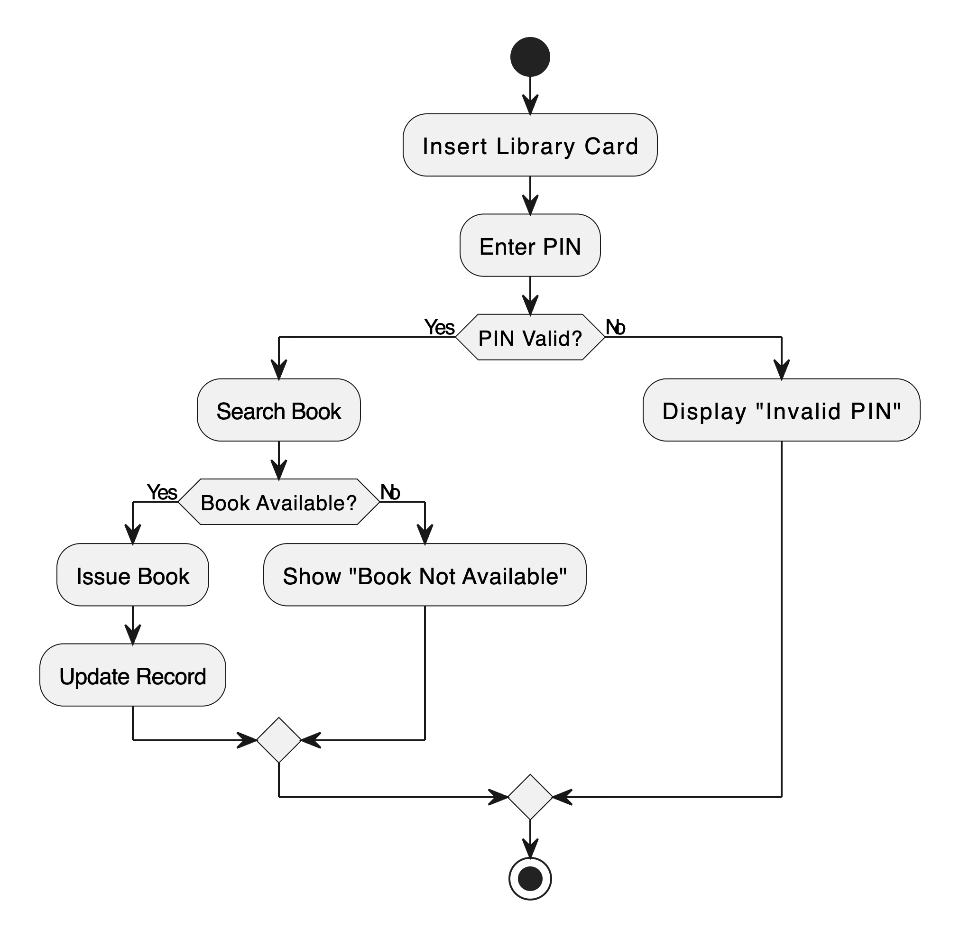
Example – Book Borrowing Activity
Scenario: A student borrows a book from the library.
Explanation:
The activity diagram shows the flow from card insertion to successful book issue or failure case.

Slide 23
Comparing the Two Diagrams
Aspect | State Diagram | Activity Diagram
Focus | State changes of an object | Flow of activities or processes
Best Used For | Modeling object life cycles | Modeling business logic or workflows
Example | Book states (Available → Issued → Returned) | Borrowing a book step-by-step

Slide 24
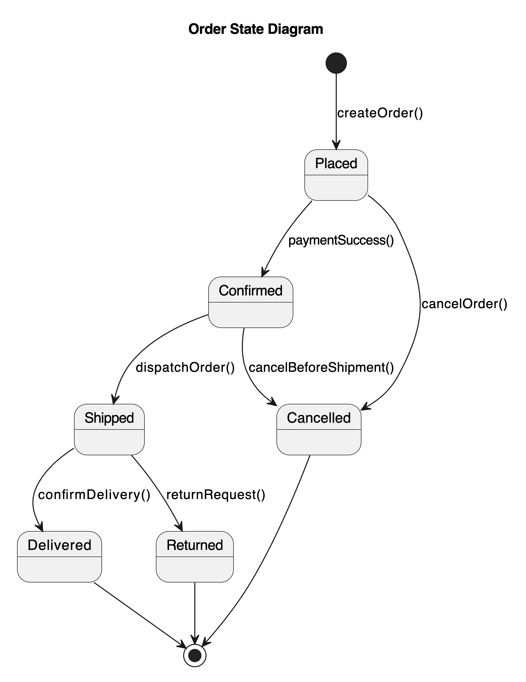
Practice Exercise
Scenario: Online Order Processing System
Steps:
Identify states for an Order object (e.g., Placed → Confirmed → Shipped → Delivered).
Draw a State Diagram.
Draw an Activity Diagram showing payment and shipment flow.

Slide 25
