Slide 1
Data Science with Deep Learning
DS101-3
From dataset understanding to result presentation and how to employ deep acyclic graph models in Predictive Analytics
Lec. Andrei Ionut DAMIAN
As. Laurentiu PICIU

Slide 2
Operational stuff
Papers: slack
Optional papers: slack
Own data projects: slack
Assigned projects: slack ☺

Slide 3
Machine Learning vs Deep Learning
Lame vs Cool: old vs new?

Slide 4
Machine Learning vs Deep Learning
Lame vs Cool: old vs new?
Explainability vs Raw data processing: Tree vs NN

Slide 5
Machine Learning vs Deep Learning
Lame vs Cool: old vs new?
Explainability vs Raw data processing: Tree vs NN
Truth: Feature based Learning vs Raw Data Learning (Representation Learning)

Slide 6
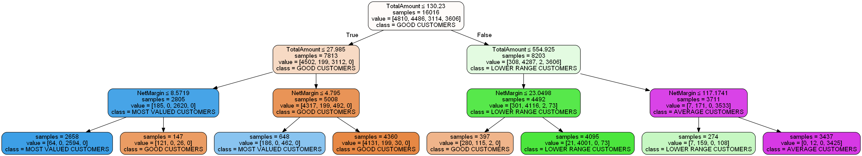
Machine Learning

Slide 7
Deep Learning
No tree ☹
But…

Slide 8
Deep Learning
Problem: generate complex feature
Most important words in dict (V)
Assign random position in 128-dim space (new input encoding X !!!)

Slide 9
Deep Learning
Problem: generate complex feature
Most important words in dict (V)
Assign random position in 128-dim space (new input encoding X !!!)
Each word in space is multiplied by softmax matrix (128 x V)
Back-prop until (including) actual feature !!! (dL/dx)

Slide 10
Deep Learning
Problem: generate complex feature
Most important words in dict (V)
Assign random position in 128-dim space (new input encoding X !!!)
Each word in space is multiplied by softmax matrix (128 x V)
Back-prop until (including) actual feature !!! (dL/dx)
Results: Optimize positions X in 128-dim space

Slide 11
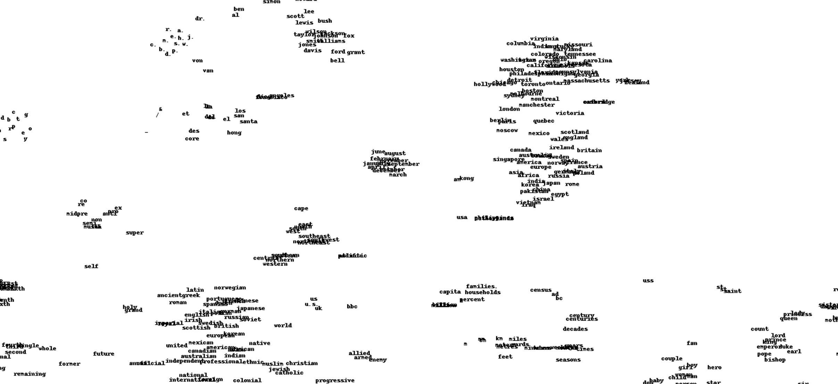
Deep Learning

Slide 12
Deep Learning
We can model many features this way:
Neighbours
Towns
Customers
Products,
etc
Take away: Direct explainability vs Indirect explainability

Slide 13
Deep Learning
Model features such as customer in Machine Learning
Say 1,000,000 customers
Create one-hot array for each customer ? Not really …
So, shallow machine learning conclusion: intractable problem.

Slide 14
Discussion
Projects
Data
Papers!
Skype meetings (Fridays)!

