Slide 1
Data Science with Deep Learning
DS101-4
From dataset understanding to result presentation and how to employ deep acyclic graph models in Predictive Analytics
Lec. Andrei Ionut DAMIAN
As. Laurentiu PICIU

Slide 2
Operational stuff
Online meetings: doodle
Mandatory papers: clear ?
Optional papers: ideas ?
Assigned projects: home vs given?

Slide 3
Data Science Tool Box
Persistence: Pandas, pickle
Visual clarity: bokeh
Replicability: logs (txt), git, etc

Slide 4
Data Science (DL) Tool Box
Observation -> Target/Conclusion?
Observations-> phenomenon -> Target/Conclusion?
Observation -> Action -> Observation/Reward?

Slide 5
Data Science (DL) Tool Box
Observation -> Target:
Vanilla Neural Networks
Convolutional Neural Network ( “compress” some features in a higher-level feature)
Multi-column Neural Networks

Slide 6
Data Science (DL) Tool Box
Observation -> Target:
Vanilla Neural Networks
Convolutional Neural Network ( “compress” some features in a higher-level feature)
Multi-column Neural Networks
Cost functions!

Slide 7
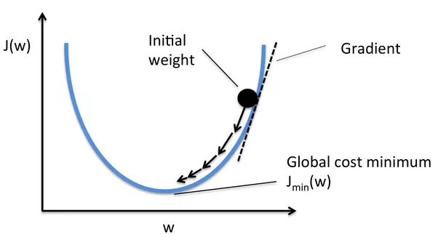
The Cost Function

Slide 8
Data Science (DL) Tool Box
Cost functions
Classic cost functions:
Classification: cross-entropy: -sum(ylog(ypred)) or binary -(ylogy+ (1-y)log(y-1))
Regression: sum(y – ypred)**2 or sum(abs(y-ypre))
KWL Cost functions
alpha * sum(y – ypred1) + beta * sum(y – ypred2) – gamma * sqrt(ypred3)

Slide 9
Data Science (DL) Tool Box
Cost functions:
Classic cost functions
Classification: cross-entropy: -sum(ylog(ypred)) or binary -(ylogy+ (1-y)log(y-1))
Regression: sum(y – ypred)**2 or sum(abs(y-ypre))
KWL Cost functions
alpha * sum(y – ypred1) + beta * sum(y – ypred2) – gamma * sqrt(ypred3)

Slide 10
Data Science (DL) Tool Box
Observations-> phenomenon -> Target/Conclusion?
Non-DL: Moving averages, linear auto-regressive models, Markov Chain?
Recurrent Neural Networks:
Vanilla RNN
LSTM/GRU
Complex DAG architectures

Slide 11
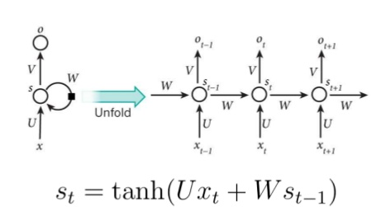
RNN remember

Slide 12
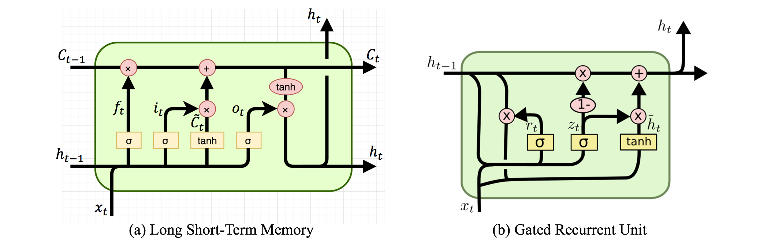
LSTM & GRU

Slide 13
Data Science (DL) Tool Box
Bits, pieces, bells and whistles: What else is important?
Multi-dimensional encoding and decoding
Model size vs speed
Complexity vs available data

Slide 14
Data Science (DL) Tool Box
Embeddings: multi-dimensional encoding:
Factors, categories: embeddings

Slide 15
Data Science (DL) Tool Box
Embeddings: multi-dimensional encoding:
Factors, categories: embeddings
Un-supervision: more embeddings

Slide 16
Data Science (DL) Tool Box
Embeddings: multi-dimensional encoding:
Factors, categories: embeddings
Un-supervision: more embeddings
Explain-ability: embeddings

Slide 17
Data Science (DL) Tool Box
Intuition:
Neighbor. A, B, C, D are in random uniform hypersphere
Ap. with x1 sqm and x2 rooms in neighbor. A costs Y
Ap. with approx. x1 sqm and approx. x2 rooms in neighbor. B costs Y-/+eps
Ap. with k1 sqm and k2 rooms in neighbor. C costs S
Ap. with approx. k1 sqm and approx. k2 rooms in neighbor. D costs S-/+eps
Model forces A and B to match close values -> same area in space
Model forces C and D to match close values -> same area in space

Slide 18
Data Science (DL) Tool Box
Mini-project:
At least 3 stocks (TSLA, AAPL, MSFT, GOOG, IBM, crypto, etc)
Scrap at least 2 years worth of data or find datasets (2016-2017)
Construct simple LSTM based model
Predict T prices based on T prices (Predict from T+1 up to T+t+1 based on T up to T+t)

