Slide 1
Data Science with Deep Learning
DS102-8
From dataset understanding to result presentation and how to employ deep acyclic graph models in Predictive Analytics
Lec. Andrei Ionut DAMIAN
As. Alexandru PURDILA

Slide 2
Operational stuff
Mandatory paper: today (15’) – who ?
Projects examination dates CLEAR 😟: 2020-01-16

Slide 3
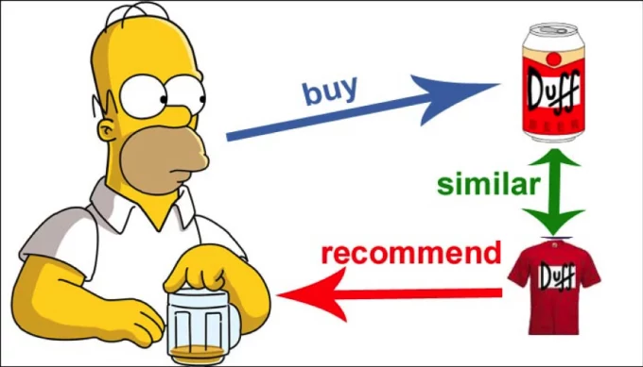
Framing the problem: Recommender systems

Slide 4

Framing the problem
Recommender Systems:
Amazon.com
Netflix
Microsoft
Google
FarFetch.com
Wallmart
Tesco
Yahoo
...
Emag

Slide 5
Framing the problem
A new framing: Customer propensity to buy a certain product:
Many problems to ask
Many issues to solve
Different views can yield quite different results and performance
At the end of the day the real life use is what counts

Slide 6
Framing the problem
Customer propensity to buy a certain product
Individual vs group vs all?
Individual consumer a potential candidate for modelling?
Group similar customers so we can save processing time?
Drop customers, analyze only buying trends?
All these questions change the actual model pipeline

Slide 7
Framing the problem
Customer propensity to buy a certain product
Individual vs group vs all?
Regression vs Classification?
Are we going to need a prediction of quantity or value?
Better a probability of buying the product/service ?
Direct model impact

Slide 8
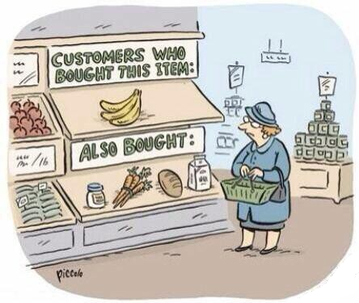
Framing the problem: Recommender system

Slide 9
Framing the problem
Customer propensity to buy a certain product
Individual vs group vs all?
Regression vs Classification?
When or how much?
Do we aim for when the customer will buy?
Or if / how much will do?
Data flow is impacted. Model could actually be agnostic!

Slide 10
Framing the problem
Customer propensity to buy a certain product
Individual vs group vs all?
Regression vs Classification?
When or how much?
Simple vs complex?
Simple collaborative filtering
Complex neural network or generative model?
Again, model-changing decisions

Slide 11
Framing the problem
Customer propensity to buy a certain product
Individual vs group vs all?
Regression vs Classification?
When or how much?
Simple vs complex?
Features correlation vs time-series oriented?
More model architecture decision but also data flow!

Slide 12
Framing the problem
Customer propensity to buy a certain product
Individual vs group vs all?
Regression vs Classification?
When or how much?
Simple vs complex?
Features correlation vs time-series oriented?
Latent patterns vs fixed customer model?
One model per customer or better learn inter-customer patterns?

