Slide 1
Data Science with Deep Learning
DS103-7
From dataset understanding to result presentation and how to employ deep acyclic graph models in Predictive Analytics
Lec. Andrei Ionut DAMIAN
As. Alexandru PURDILA

Slide 2
Operational stuff
Projects Q&A

Slide 3
Full lifecycles in Data Science
We (should) know how to:
Load and clean data
Direct connection in Oracle, MS SQL, MongoDB, MySQL, etc
Use offline CSV
In-memory Pandas (including production-grade projects) & Redis
…even Excel/Google Sheets
Manual analysis of data
Last but not least face-2-face interaction with the actual users / producers of data

Slide 4
Full lifecycles in Data Science
We (should) know how to:
Load and clean data
Transform variables in more advanced features (and analytics indicators)
Maybe we need special indicators that are usually computed with stats – such as RFM
Maybe we can reshape the whole data-flow and frame the problem in other way (maybe that churn prediction is dependent of whole customer history not only past year actions)

Slide 5
Full lifecycles in Data Science
We (should) know how to:
Load and clean data
Transform variables in more advanced features (and analytics indicators)
Perform simple experiments (such as clustering, visualizations)
Use the usual suspects such as k-Means, t-SNE
Plot offline with pyplot or online with Bokeh or Plotly (even production grade)

Slide 6
Full lifecycles in Data Science
We (should) know how to:
Load and clean data
Transform variables in more advanced features (and analytics indicators)
Perform simple experiments (such as clustering, visualizations)
Better define our modeling objective
By now we should better understand the requirements and the data
Try to view the problem from different angles. Don’t view the Data Science project as a “classification problem” or “regression problem”

Slide 7
Full lifecycles in Data Science
We (should) know how to:
Load and clean data
Transform variables in more advanced features (and analytics indicators)
Perform simple experiments (such as clustering, visualizations)
Better define our modeling objective
Experiment with baseline Machine Learning
Always try (if possible) to start simple – (Logistic) Regression, kNN, SVM, ARIMA – where the problem to be solved allows classical Machine Learning

Slide 8
Full lifecycles in Data Science
We (should) know how to:
Load and clean data
Transform variables in more advanced features (and analytics indicators)
Perform simple experiments (such as clustering, visualizations)
Better define our modeling objective
Experiment with baseline Machine Learning
Dive deeper with Deep Learning and search for optimal solution
Never fall in love with your model architecture. Experiment beyond grid-searching!

Slide 9
Full lifecycles in Data Science
We (should) know how to:
Load and clean data
Transform variables in more advanced features (and analytics indicators)
Perform simple experiments (such as clustering, visualizations)
Better define our modeling objective
Experiment with baseline Machine Learning
Dive deeper with Deep Learning and search for optimal solution
Deploy

Slide 10
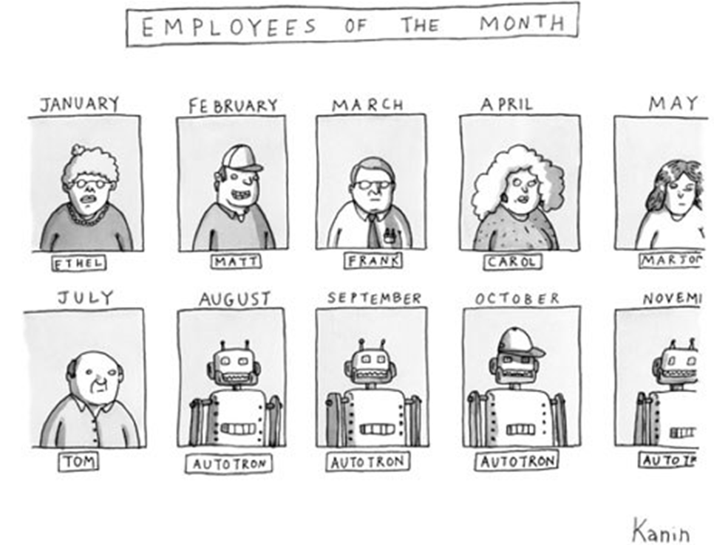
Full lifecycles in Data Science
So, we have done experiments, prepared models and executed them and deployed. Are we done?

Slide 11
Full lifecycles in Data Science
The reality: No, we are not done!
The beneficiary usually doesn’t know what is needed!
Multiple iteration through requirements it is a must
Assume the customer “does not get prediction” nor “inference”
Usually the beneficiary understands the problem with you
Don’t get stuck: don’t fall in love with architectures or approaches

Slide 12
Full lifecycles in Data Science
The reality: No, we are not done!
The beneficiary usually doesn’t know what is needed!
The Data Scientist is not trained in real life!
Data usually means Iris, MNIST, CIFAR, ImageNet, WINES, Titanic, IMDB, World Bank, Twitter, Stocks, etc, etc, etc
Data Scientist training usually involves only executing steps NOT understanding the problem

Slide 13
Full lifecycles in Data Science
The reality: No, we are not done!
The beneficiary usually doesn’t know what is needed!
The Data Scientist is not trained in real life!
The real-life demands ongoing adaptation
Even if we did everything right it will become obsolete
There certainly is a (much) better model than yours ☹ waiting…

