Slide 1
Data Science with Deep Learning
DS105-02-6
From dataset understanding to result presentation and how to employ deep acyclic graph models in Predictive Analytics
Lec. Andrei Ionut DAMIAN
As. Beatrice MILIK

Slide 2
Operational stuff
Lets check the Google Sheets ☺
Mandatory paper: today (15’) – who ?
Projects examination dates CLEAR 😟:
Good data
Preferably not from Kaggle, UCLA, etc.
Scrap it from website or take it from work
Full pipeline: ETL, pre-proc, modeling and finally serving

Slide 3
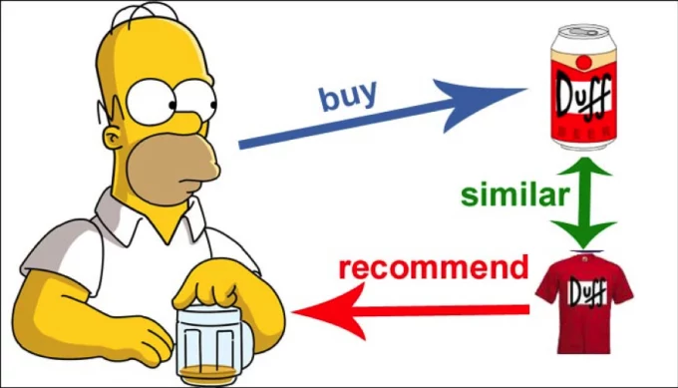
Framing the problem: Recommender systems

Slide 4
Framing the problem
A new framing: Customer propensity to buy a certain product:
Many problems to ask
Many issues to solve
Different views can yield quite different results and performance
At the end of the day the real life use is what counts

Slide 5
Framing the problem
Customer propensity to buy a certain product
Individual vs group vs all?
Individual consumer a potential candidate for modelling?
Group similar customers so we can save processing time?
Drop customers, analyze only buying trends?
All these questions change the actual model pipeline

Slide 6
Framing the problem
Customer propensity to buy a certain product
Individual vs group vs all?
Regression vs Classification?
Are we going to need a prediction of quantity or value?
Better a probability of buying the product/service ?
Direct model impact

Slide 7
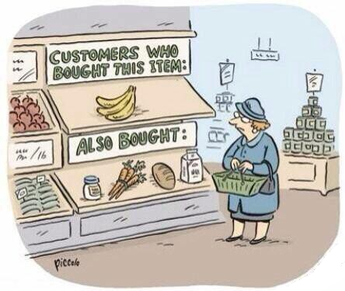
Framing the problem: Recommender system

Slide 8
Framing the problem
Customer propensity to buy a certain product
Individual vs group vs all?
Regression vs Classification?
When or how much?
Do we aim for when the customer will buy?
Or if / how much will do?
Data flow is impacted. Model could actually be agnostic!

Slide 9
Framing the problem
Customer propensity to buy a certain product
Individual vs group vs all?
Regression vs Classification?
When or how much?
Simple vs complex?
Simple collaborative filtering
Complex neural network or generative model?
Again, model-changing decisions

Slide 10
Framing the problem
Customer propensity to buy a certain product
Individual vs group vs all?
Regression vs Classification?
When or how much?
Simple vs complex?
Features correlation vs time-series oriented?
More model architecture decision but also data flow!

Slide 11
Framing the problem
Customer propensity to buy a certain product
Individual vs group vs all?
Regression vs Classification?
When or how much?
Simple vs complex?
Features correlation vs time-series oriented?
Latent patterns vs fixed customer model?
One model per customer or better learn inter-customer patterns?

Slide 12
Framing the problem: Hands-on
Beyond recommender systems…
We generate the data
We pre-process the data
We create a simple linear regression model
Do we have good results?
Can we improve?
Quick review!
Next steps: “Fork” the experiment
Next steps: Simple neural model
Next steps: Explain-ability & byproducts

Slide 13
Framing the problem
Hands on

