Slide 1
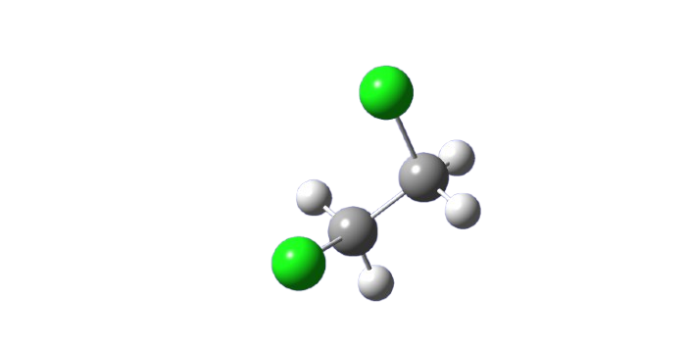
1,2 -dichloroethane
Nurefşan Nazlı YÜZÜKIRMIZI- 280102002

Slide 2
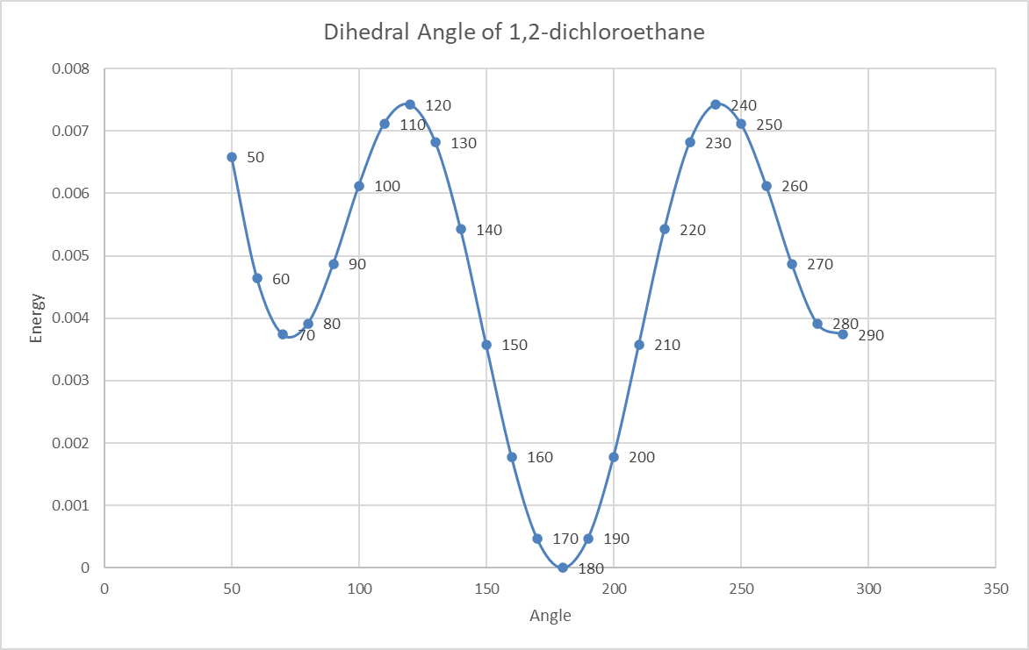
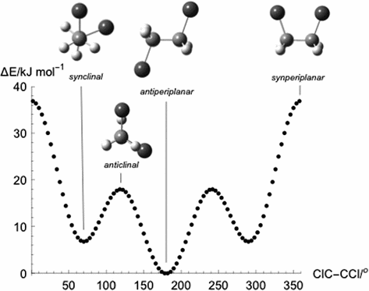
Calculated | Literature
Dihedral Angle Between Cl-C-C-Cl : 180˚ | Dihedral Angle Between Cl-C-C-Cl : 180˚
Angle Between C-C-Cl:112˚ | Angle Between C-C-Cl:109˚
Angle Between C-C-H:110˚ | Angle Between C-C-H:113.2˚
Bond distance Between C-C: 1.5Å | Bond distance Between C-C: 1.5Å
Bond distance Between C-H: 1.1Å | Bond distance Between C-H: 1.1Å
Bond distance Between C-Cl: 1.9Å | Bond distance Between C-Cl: 1.8Å
Calculated with zero correction
Literature

Slide 3
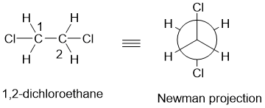
Result
METHOD
# opt hf/6-31g geom=connectivity

Slide 4
References
Gonzalez, Miguel. (2011). Force fields and molecular dynamics simulations. École thématique de la Société Française de la Neutronique. 12. 169-200. 10.1051/sfn/201112009.
Teixeira-Dias, J.J.C. (2017). Molecular Structure. In: Molecular Physical Chemistry. Springer, Cham. https://doi.org/10.1007/978-3-319-41093-7_5
National Institute of Standards and Technology (NIST). (n.d.). Experimental data on 2-butanol. Retrieved November 15, 2024, from https://cccbdb.nist.gov/exp2x.asp?casno=107062&charge=0

Slide 5
TEŞEKKÜRLER

