Slide 1
Conformational analysis, intramolecular hydrogen bonding, and vibrational assignment of 4,4-dimethyl-1 phenylpentane-1,3-dione
Nurefşan Nazlı Yüzükırmızı
280102002

Slide 2
Introduction
Aim:
To study 4,4 dimethyl-1-phenylpentane-1,3-dione (DMPD)'s structure, molecular structure, conformational stabilities, and intramolecular hydrogen bonding (IHB). And result was compared with Benzoylacetone (BA) and 5,5-Dimethylhexane-2,4-dione (DMHD).

Slide 3
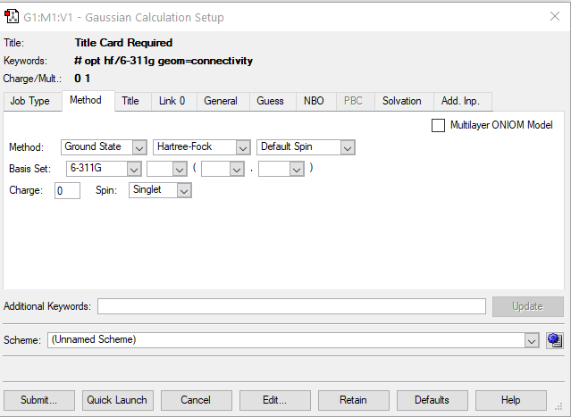
Methods
Theoretical Methods That Applied:
Theoretical Methods in Article:
Density Functional Theory (DFT) calculations.
Geometries optimized using B3LYP and MP2 levels.
AIM was applied to obtain electron density at the hydrogen bond critical points and Orbital populations, and Wiberg bond orders calculated with NBO analyses.
Experimental Methods:
NMR spectroscopy for chemical shifts.
IR and Raman spectroscopy for vibrational analysis.

Slide 4
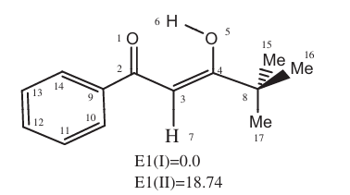
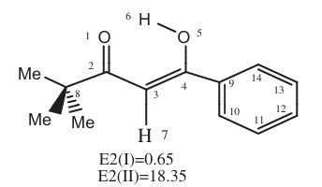
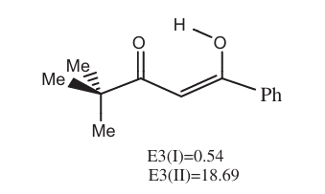
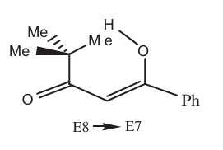
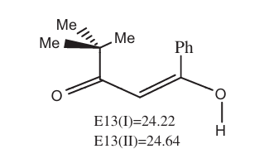
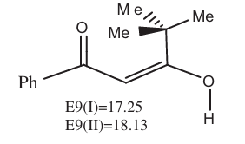
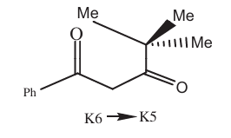
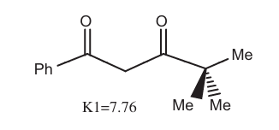
Selected Molecules in DMPD

Slide 5
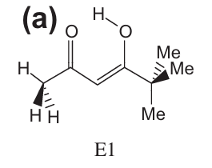
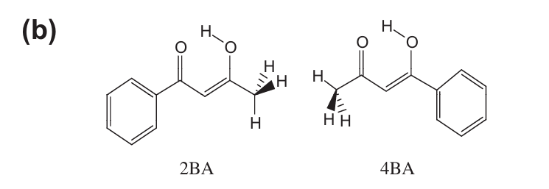
Molecules:
a) DMHD b)the stable cis-enol forms BA

Slide 6
Calculated Bond Distance and Angle
 | DMPD |  |  |  | BA |  |  | DMHD
Bond distance (Å) | E1 | E2 | E3 | Average | 2BA | 4BA | Average | E1
O…O | 2.84 | 2.81 | 2.81 | 2.8 | 2.6 | 2.7 | 2.65 | 2.6
C4-O5 | 1.37 | 1.36 | 1.36 | 1.4 | 1.36 | 1.36 | 1.36 | 1.36
O1=C2 | 1.22 | 1.22 | 1.22 | 1.2 | 1.22 | 1.21 | 1.215 | 1.21
O1…H6 | 3.71 | 3.63 | 3.62 | 3.7 | 3.54 | 3.66 | 3.6 | 3.56
C2-C3 | 1.47 | 1.47 | 1.47 | 1.5 | 1.47 | 1.47 | 1.47 | 1.47
C3=C4 | 1.33 | 1.33 | 1.33 | 1.3 | 1.35 | 1.35 | 1.35 | 1.35
C4-C8/C2-C8 | 1.53 | 1.53 | 1.53 | 1.5 | 1.49 | 1.51 | 1.5 | 1.51
C2-C9/C4-C9 | 1.5 | 1.48 | 1.48 | 1.5 | 1.51 | 1.49 | 1.5 | 1.54
Bond Angles (˚)
O1C2C3 | 123 | 122 | 122 | 122.3 | 122 | 124 | 123 | 125
O1C2C9/O5C4C9 | 119 | 115 | 115 | 116.3 | 120 | 116 | 118 | 116
O5C4C8/O1C2C8 | 115 | 120 | 120 | 118.3 | 116 | 116 | 116 | 116
C9C2C3/C9C4C3 | 117 | 123 | 123 | 121.0 | 117 | 124 | 120.5 | 126
C3C4C8/C3C2C8 | 126 | 117 | 117 | 120.0 | 125 | 115 | 120 | 114
C4O5H6 | 115 | 114 | 115 | 114.7 | 113 | 112 | 112.5 | 113
O1C2H6 | 76 | 71 | 71 | 72.7 | 68 | 72 | 70 | 70
O1H6O5 | 19 | 26 | 26 | 23.7 | 15 | 14 | 14.5 | 16
C3C4O5 | 119 | 121 | 121 | 120.3 | 118 | 119 | 118.5 | 117

Slide 7
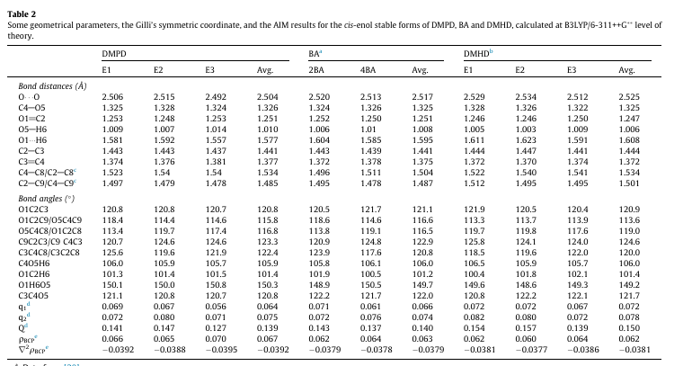
Article result

Slide 8
DMPD:
Bond Distances:
Most values are consistent with previous data except for O1...H6, which is unusually large (3.7 Å) compared to the old value (1.577 Å).
Bond Angles:
Significant discrepancies in O1C2H6 and O1H6O5, where the new values are much lower and likely artifacts.
BA:
Bond Distances:
Consistent across most values with slight increases in O...O (2.65 Å vs. 2.51 Å) and C4--C8 (1.5 Å vs. 1.504 Å).
Bond Angles:
Generally consistent but shows slight deviations in C9C2C3/C9C4C3 and C4O5H6.
DMHD:
Bond Distances:
Matches well except for C3--C4, which is lower in the new data (1.35 Å vs. 1.525 Å).
Bond Angles:
Significant differences in O5C4C8/O1C2C8 and C3C4C8/C3C2C8, where the new values are lower.
The average error percentage for each result compared to previous data. : 3.48%, 2.17%, 5.12%

Slide 9
Calculated Energies
 |  | E(RHF)
 | Molecule Label | hartree | kcal/mol
DMPD | E1 | -651.1823651 | -408623
 | E2 | -651.1822917 | -408623
 | E3 | -651.1822917 | -408623
 | E8 | -651.1786129 | -408621
 | E9 | -647.7002987 | -406438
 | E13 | -651.1859407 | -408625
 | K1 | -651.2005057 | -408634
 | K6 | -651.0819823 | -408560
BA | 2BA | -534.1100018 | -335159
 | 4BA | -534.1094925 | -335159
DMHD | E1 (DMHD) | -460.7034116 | -289096
K1 form has least energy.
E9 form has most energy.
DMPD molecule has least energy.
DMHD molecule has most energy.

Slide 10
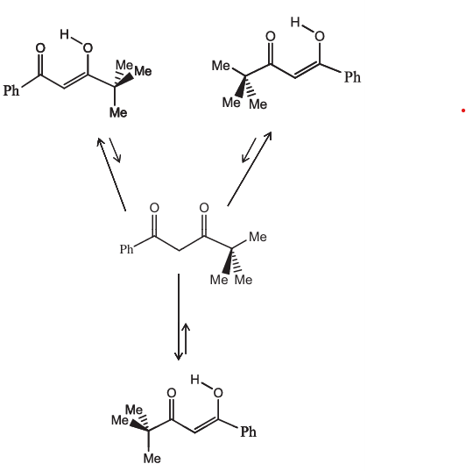
In the article Results: Conformational Stability
DMPD exists in stable cis-enol forms: E1, E2, and E3.
Energy differences between forms are negligible (<1 kcal/mol).
Intramolecular hydrogen bond strength: 16.8 kcal/mol.
t-Butyl and phenyl groups increase stability via steric and resonance effects.
Results: Intramolecular hydrogen bonding (IHB) Comparison
Hydrogen bond strength comparison:
DMPD > BA > DMHD.

Slide 11
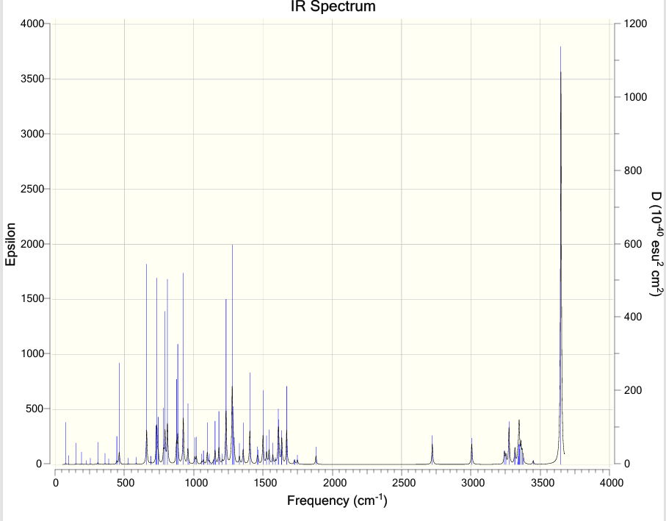
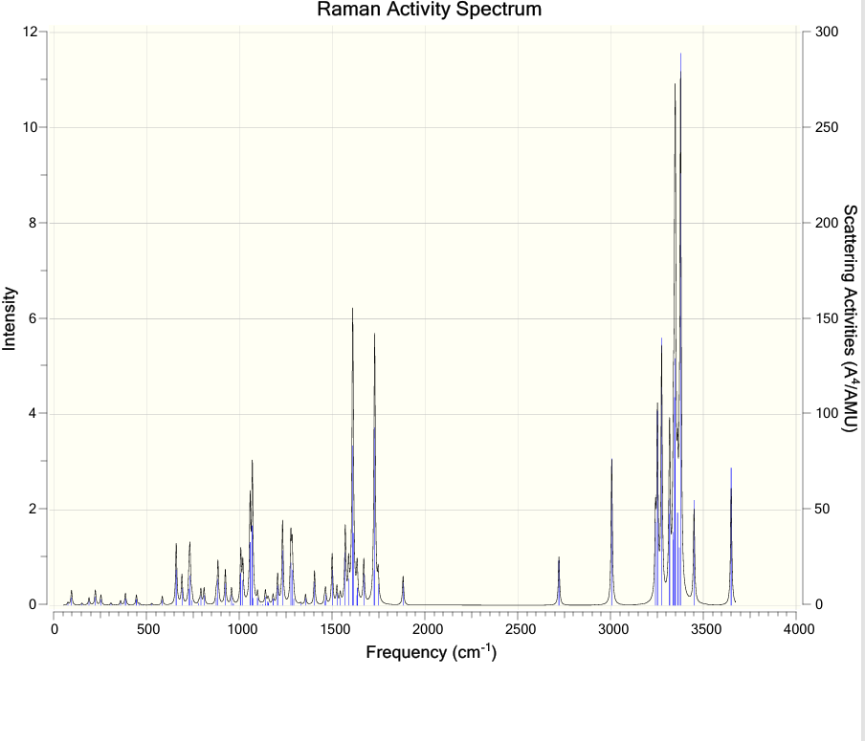
Raman and IR E1
Raman:
3377.72 cm-1 = Benzene Ring (CH)
3275.57 cm-1 = CH and OH streching
1730.01 cm-1= C-C
1233.47cm-1= C-C=C-O
IR:
3349.47 cm-1= CH streching
1671.08 cm-1= C=C, C=O, C-O

Slide 12
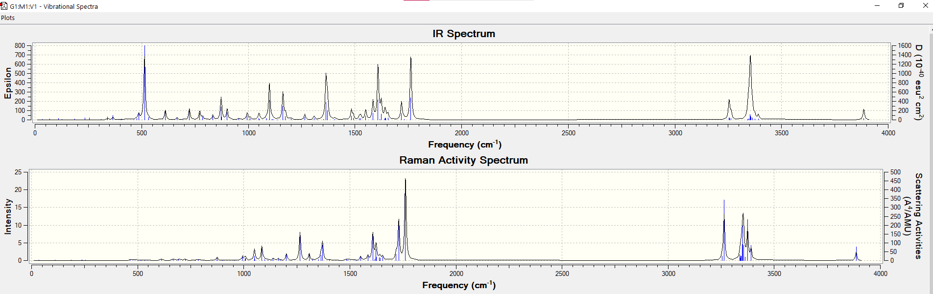
Raman and IR E2
IR:
513.629 cm-1= O-H
1099.01cm-1= C-C
172.17 cm-1= C=C, C=O
3255.27cm-1= CH3
3356.42 cm-1= CH
Raman:
3263.94 cm-1= CH3
3886.05 cm-1= O-H
1762.17cm-1= C=C
1265.13cm-1= C-C

Slide 13
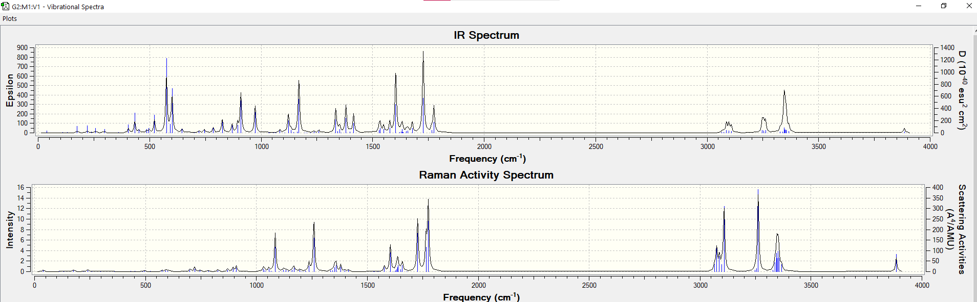
Raman and IR E3
IR:
3097.86 cm-1= Benzene group C-H
3261.81cm-1= Methyl Group C-H
1726.9cm-1= C=C
1603.68cm-1= C=O
Raman:
3261.81 cm-1= CH3
3108.31 cm-1= Benzene group C-H
1726.9 cm-1= C=C, C=O

Slide 14
IR and Raman Result Comparison
Source | Band Position (cm⁻¹) | Assignment | Explanation
Raman | 3377.72 | Benzene Ring (C-H) | Matches experimental data, inconsistent with theoretical (theoretical is lower).
 | 3275.57 | C-H and O-H stretching | Matches experimental data, inconsistent with theoretical (lower theoretical value).
 | 1730.01 | C-C | Matches experimental data, inconsistent with theoretical.
 | 1233.47 | C-C=C-O | Consistent with both experimental and theoretical data.
IR | 3349.47 | C-H stretching | Matches experimental data, slightly inconsistent with theoretical (lower expected).
 | 1671.08 | C=C, C=O, C-O | Consistent with both experimental and theoretical data.
IR | 513.629 | O-H | Inconsistent with experimental (too low); theoretical predicts much higher (2630 cm⁻¹).
 | 1099.01 | C-C | Matches experimental data; theoretical data unavailable.
 | 172.17 | C=C, C=O | Inconsistent with both experimental and theoretical (too low).
 | 3255.27 | CH₃ | Matches experimental and theoretical data.
 | 3356.42 | C-H | Matches both experimental and theoretical data.
Raman | 3263.94 | CH₃ | Matches both experimental and theoretical data.
 | 3886.05 | O-H | Inconsistent with experimental (too high); not supported by theoretical values.
 | 1762.17 | C=C | Matches both experimental and theoretical data.
 | 1265.13 | C-C | Matches both experimental and theoretical data.
IR | 3097.86 | Benzene group C-H | Matches both experimental and theoretical data.
 | 3261.81 | Methyl Group C-H | Matches both experimental and theoretical data.
 | 1726.9 | C=C | Matches both experimental and theoretical data.
 | 1603.68 | C=O | Matches both experimental and theoretical data.
Raman | 3261.81 | CH₃ | Matches both experimental and theoretical data.
 | 3108.31 | Benzene group C-H | Matches both experimental and theoretical data.
 | 1726.9 | C=C, C=O | Matches both experimental and theoretical data.
Experimental and Theoretical Discrepancies:
O-H stretching bands at 3886.05 cm⁻¹ (too high) and 513.629 cm⁻¹ (too low) show clear inconsistencies.
The low-frequency deformation mode at 172.17 cm⁻¹ is absent in theoretical predictions.

Slide 15
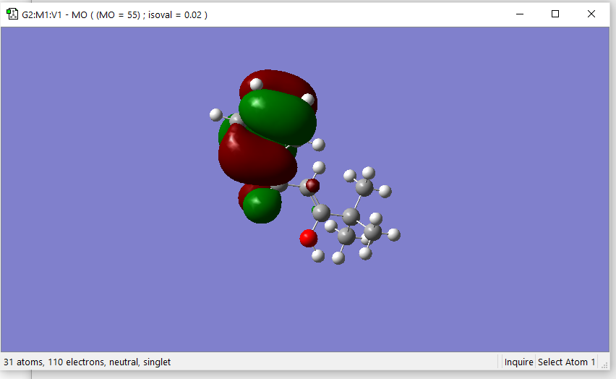
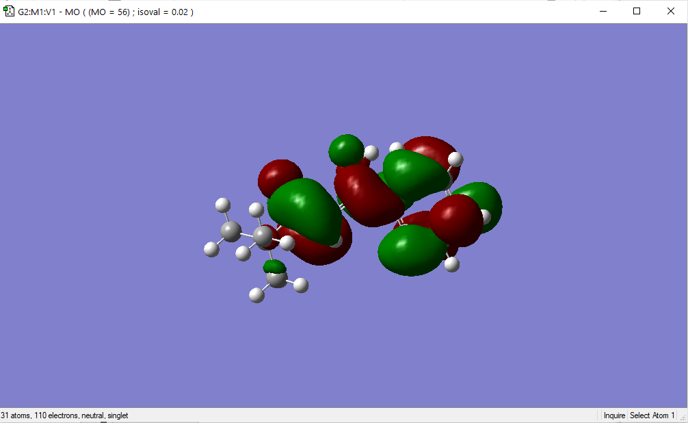
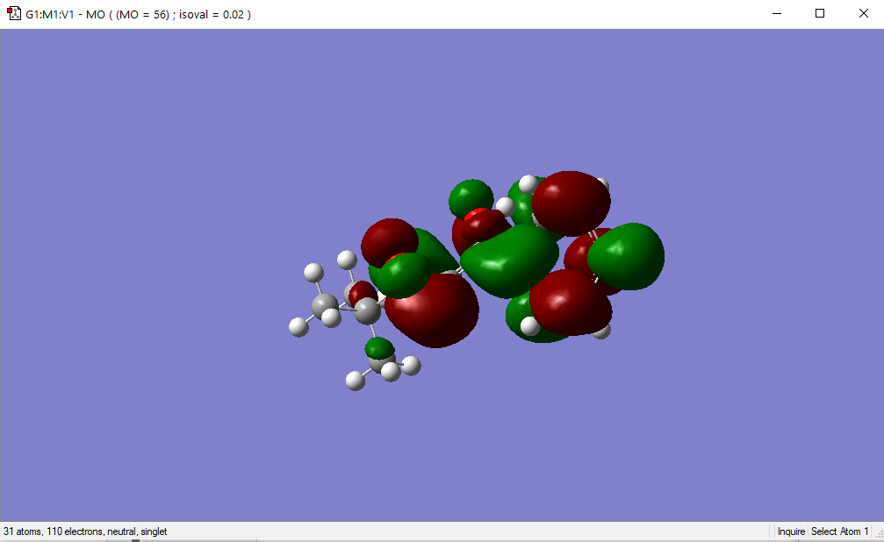
HOMO-LUMO: DMPD E1,E2,E3

Slide 16
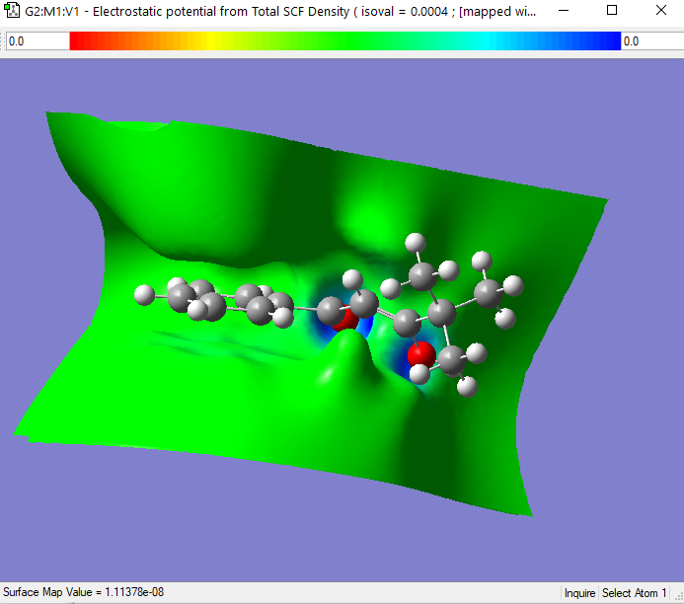
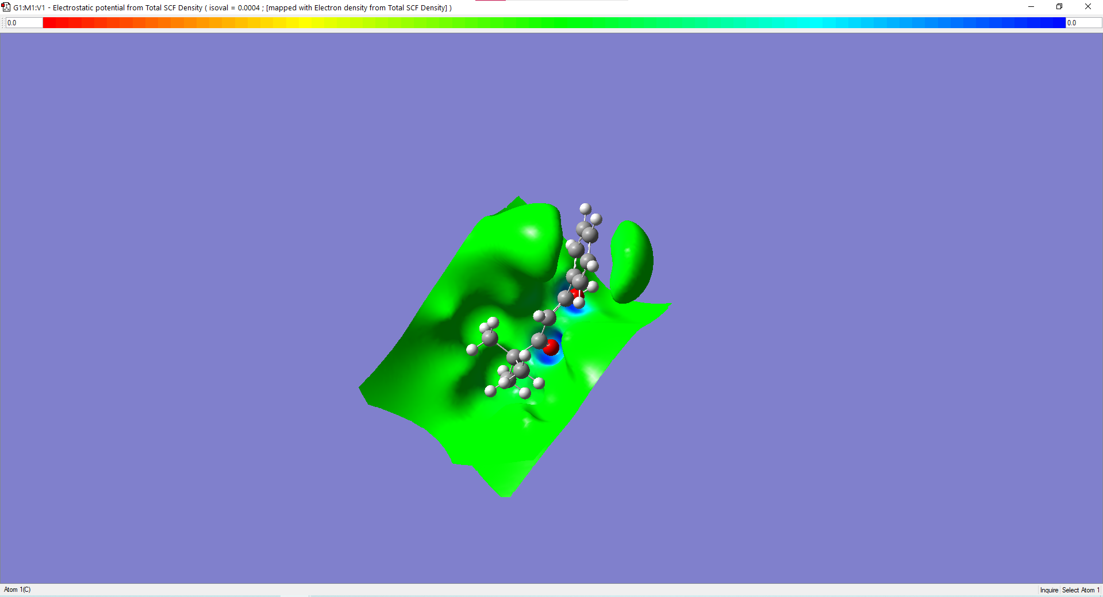
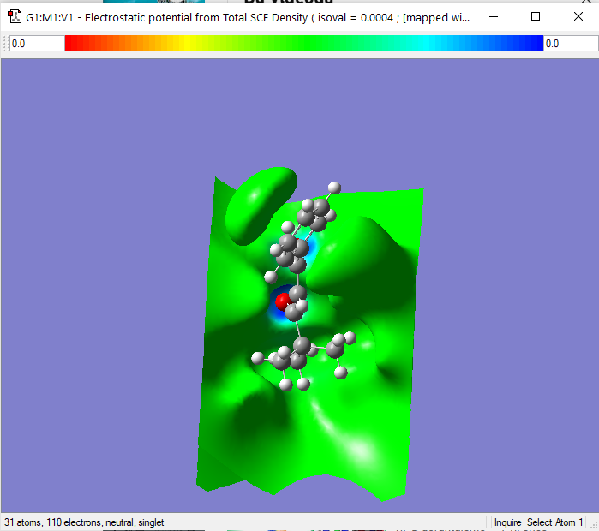
Electron Density: DMPD E1, E2, E3

Slide 17
Conclusion
Stable Forms:
DMPD mainly exists in three stable cis-enol forms: E1, E2, and E3.
The energy differences between these forms are very small (<1 kcal/mol), showing they are all almost equally stable.
Intramolecular Hydrogen Bonding (IHB):
DMPD has stronger IHB (16.8 kcal/mol) compared to benzoylacetone (BA) and 5,5-dimethylhexane-2,4-dione (DMHD).
This is due to the effects of the phenyl and tert-butyl groups, which increase stability through resonance and steric effects.
Vibrational Analysis:
Both IR and Raman results showed some differences between experimental and theoretical data.
For example, the O-H stretching frequencies were higher in theoretical results, and low-frequency deformation modes were missing in the theoretical analysis.
Comparison of My Results and the Article:
Your bond distances for DMPD are mostly consistent with the article, but the O1…H6 bond length shows a large discrepancy (3.7 Å vs. 1.577 Å).
The calculated bond angles also differ slightly, especially in O1C2H6 and O1H6O5, suggesting some possible artifacts in the methods.
Energy calculations confirmed the article’s trend that DMPD has lower energy and is more stable compared to BA and DMHD. But most stable cis enol forms is not E1,E2,E3.
Conformational Stability:
My results support the article’s conclusion that steric and resonance effects of substituents play a key role in stabilizing the molecule.
Final Remarks:
This study confirms the strong IHB and stable conformations of DMPD, with results mostly in agreement with the article. The differences in bond lengths, angles, and spectroscopic data highlight the importance of improving computational methods for better accuracy. Further studies could include different computational levels or solvent effects to explore these variations more deeply.

Slide 18

Thank You!

