Slide 1
Bond-Energy Relation in Chlorine Molecule
Nurefşan Nazlı YÜZÜKIRMIZI
280102002

Slide 2
Purpose
To create an energy diagram depending on the distance between the atoms of the chlorine molecule and to understand the relationship.

Slide 3
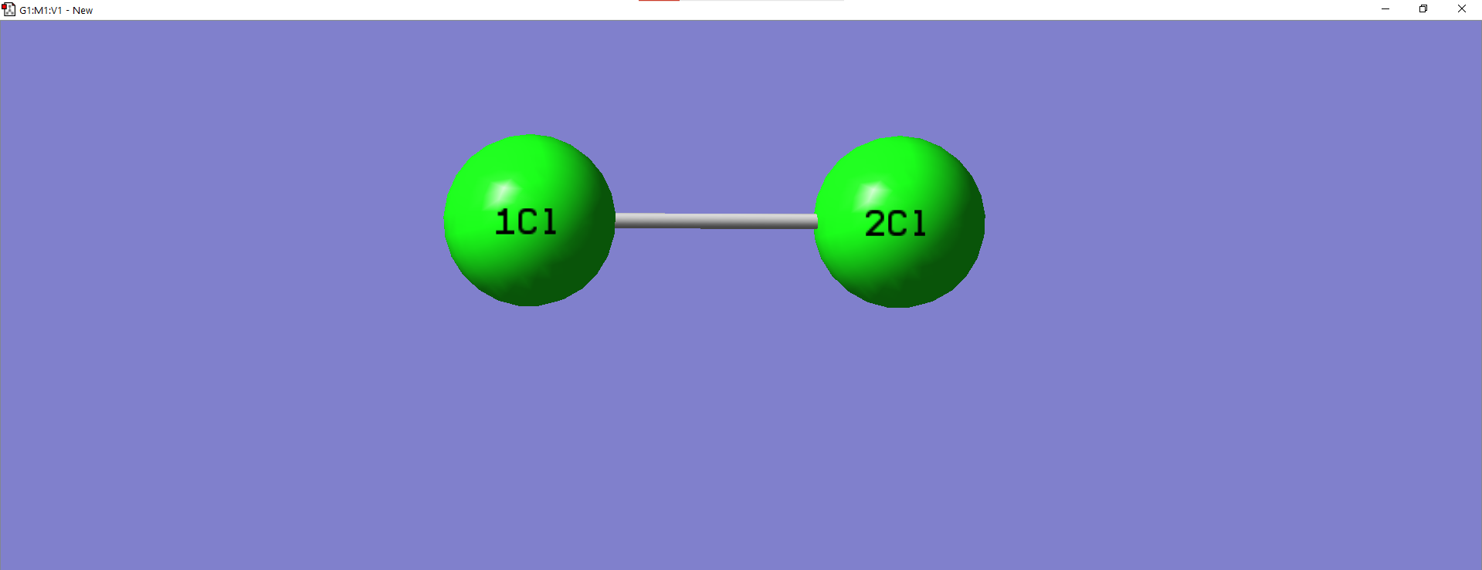
Chlorine Molecule

Slide 4

Results were followed on this screen

Slide 5
Results in Excel

Slide 6
Graph

Slide 7
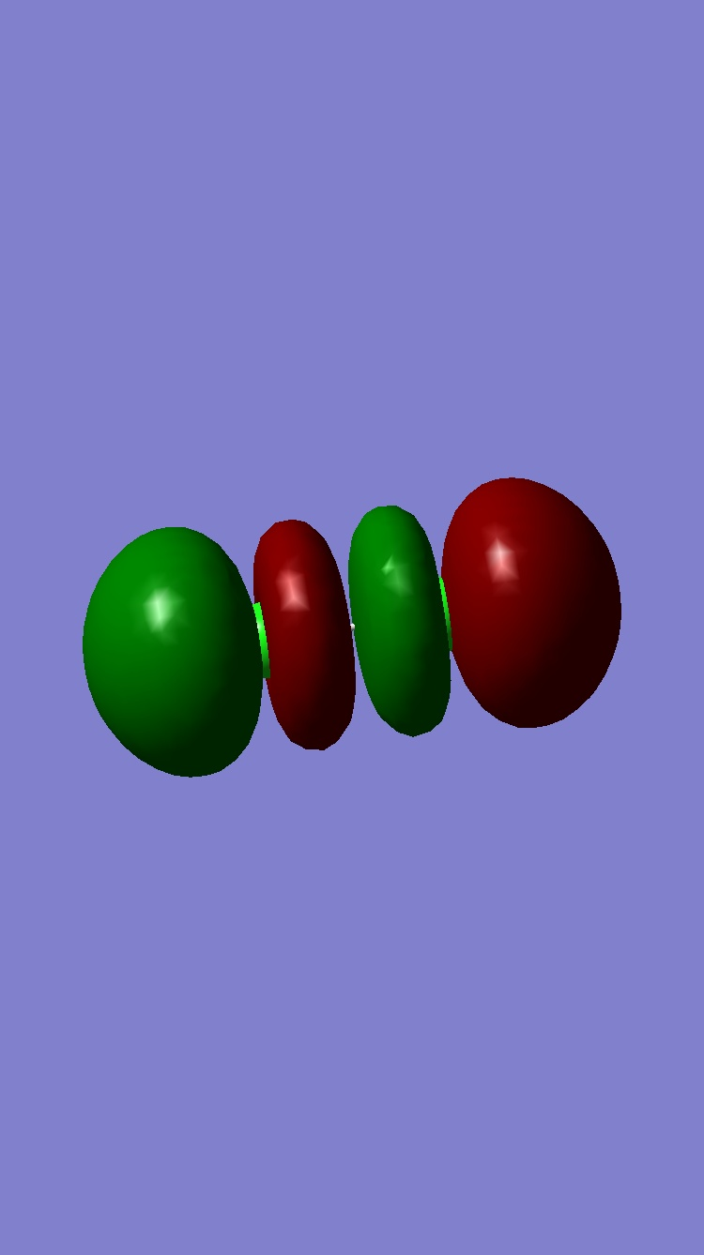
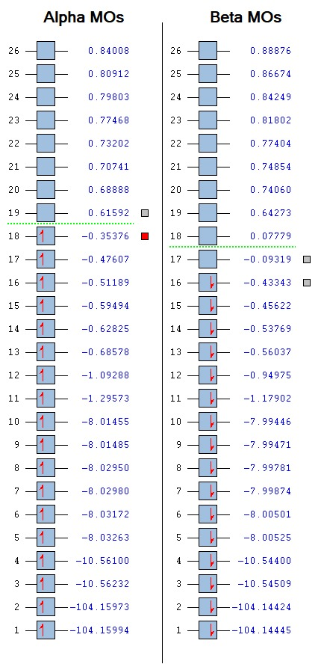

Slide 8
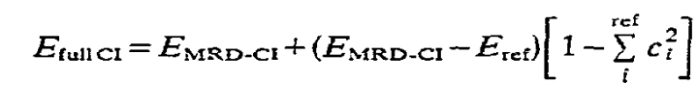
Behind the results

Slide 9
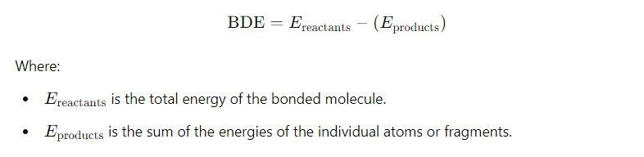
The bond dissociation energy (BDE)

Slide 10
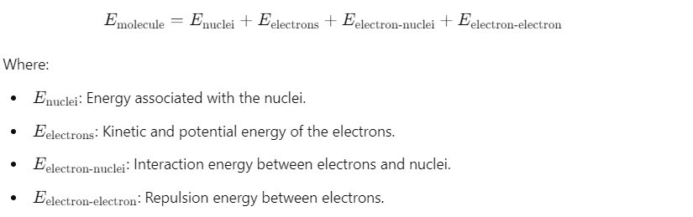
The total energy of a molecule
E_molecule​ , is calculated using quantum mechanical principles, primarily through the Hartree-Fock method or Density Functional Theory (DFT)

Slide 11

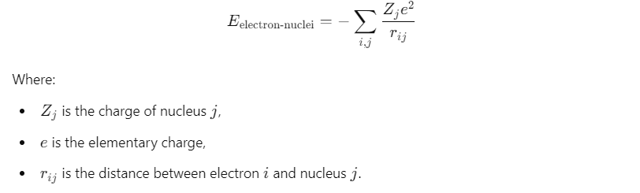
Nuclear Energy (𝐸_nuclei)
Electron-Nuclei Interaction Energy (E_electron-nuclei​ )

Slide 12

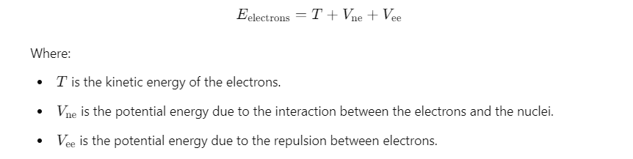
Electron-Electron Repulsion Energy (E_electron-electron​ )
Electronic Energy (E_electrons​ )

Slide 13
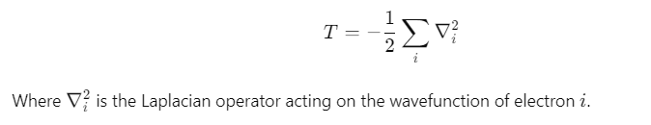

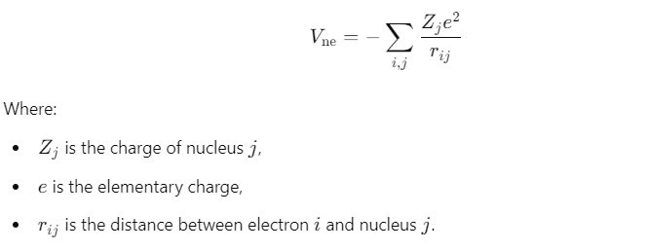
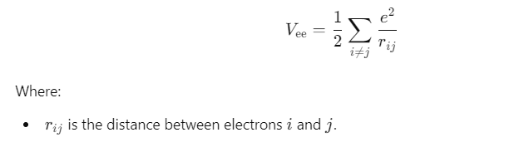
Kinetic Energy of Electrons (𝑇)
Electron-Nuclei Interaction Energy (𝑉_ne​ )
Electron-Electron Repulsion Energy (𝑉_ee )

Slide 14
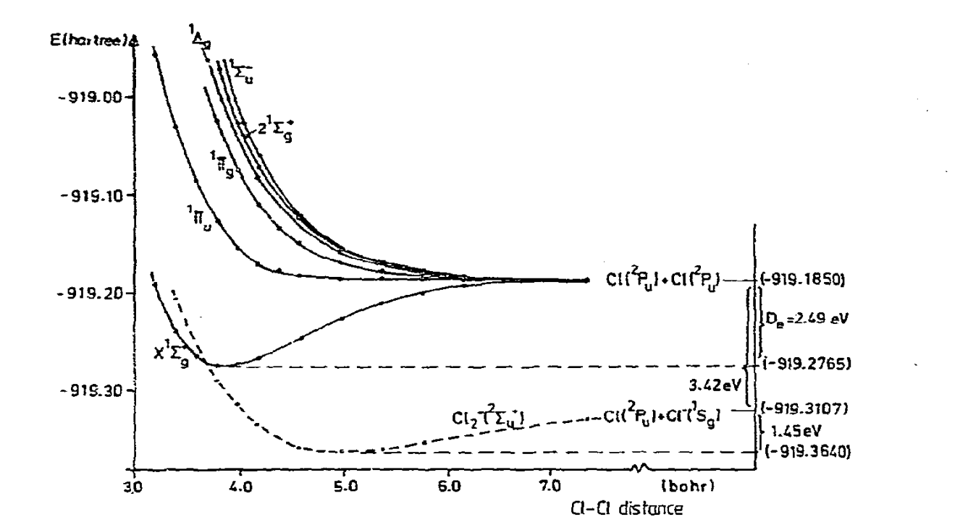
Comparison with Literature

Slide 15
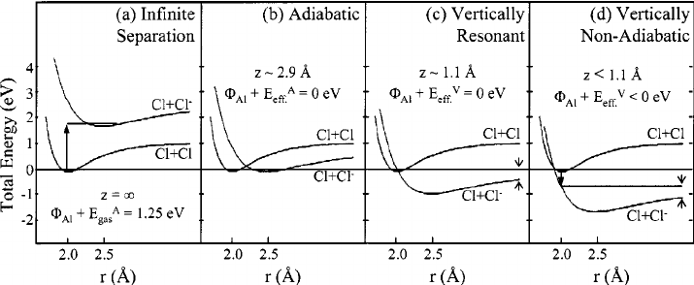

Slide 16
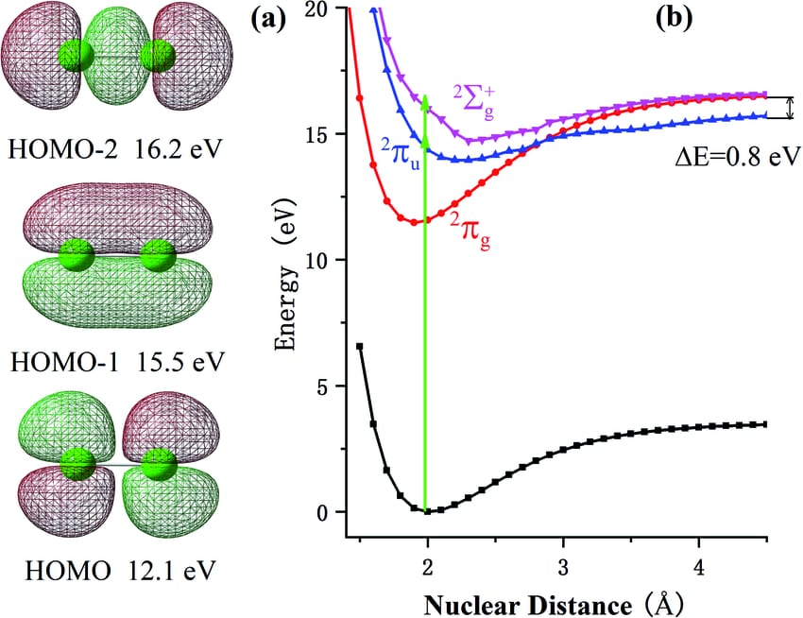

Slide 17
Conclusion
As a result, the energy between the atoms of the chlorine molecule was calculated when they moved away from each other by using the 6-21G settings as the method in the Energy type in the program.

Slide 18
References
Poon, G. C., Grassman, T. J., Gumy, J. C., & Kummel, A. C. (2003). Direct and precursor-mediated hyperthermal abstractive chemisorption of Cl₂ on Al(111). Journal of Chemical Physics, 119(18), 12145–12151. https://doi.org/10.1063/1.1615471
Wool, R. P. (2008). Twinkling fractal theory of the glass transition. Journal of Polymer Science Part B: Polymer Physics, 46(24), 2468–2472. https://doi.org/10.1002/polb.21596
Peyerimhoff, S. D., & Buenker, R. J. (1981). Electronically excited and ionized states of the chlorine molecule. Chemical Physics, 57(3), 279–296. https://doi.org/10.1016/0301-0104(81)80208-X
Zhang, J., Li, Z., & Yang, Y. (2020). Multi-ionization of the Cl₂ molecule in the near-infrared femtosecond laser field. RSC Advances, 10(1), 332-337. https://doi.org/10.1039/C9RA06746A

