Slide 1

Computational Chemistry Week 4, Homework #2 Hydrogen Sulfide (H₂S)
Nurefşan Nazlı YÜZÜKIRMIZI
280102002

Slide 2
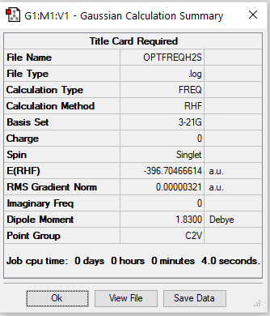
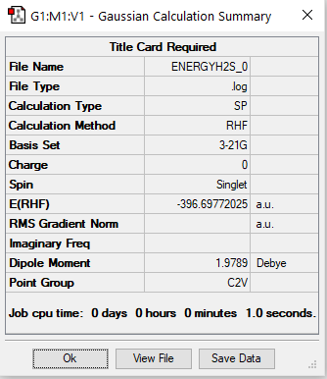
Optımızatıon and frequency
energy

Slide 3
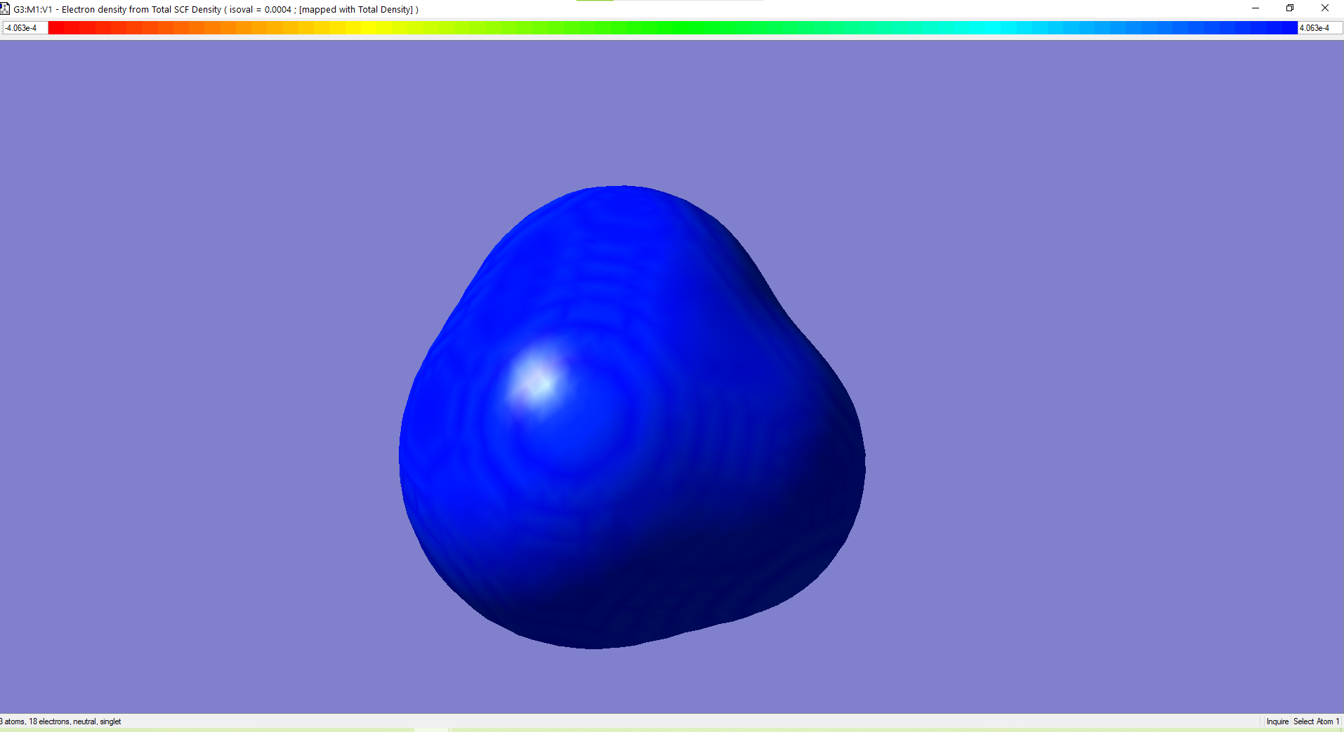
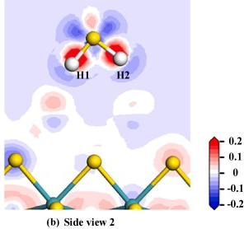
Electron Density

Slide 4
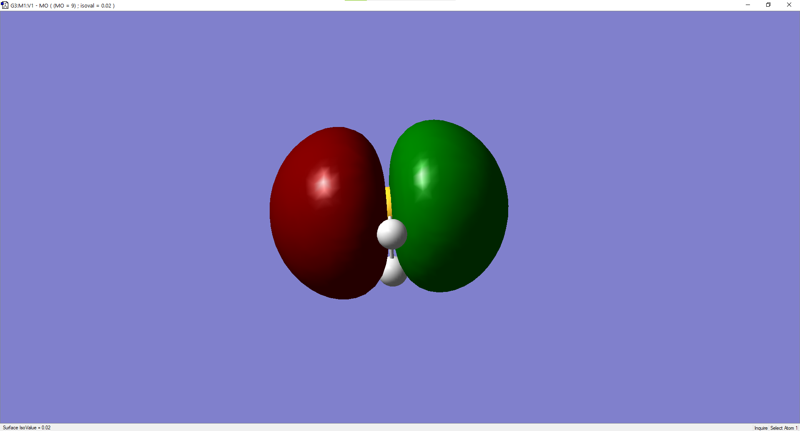
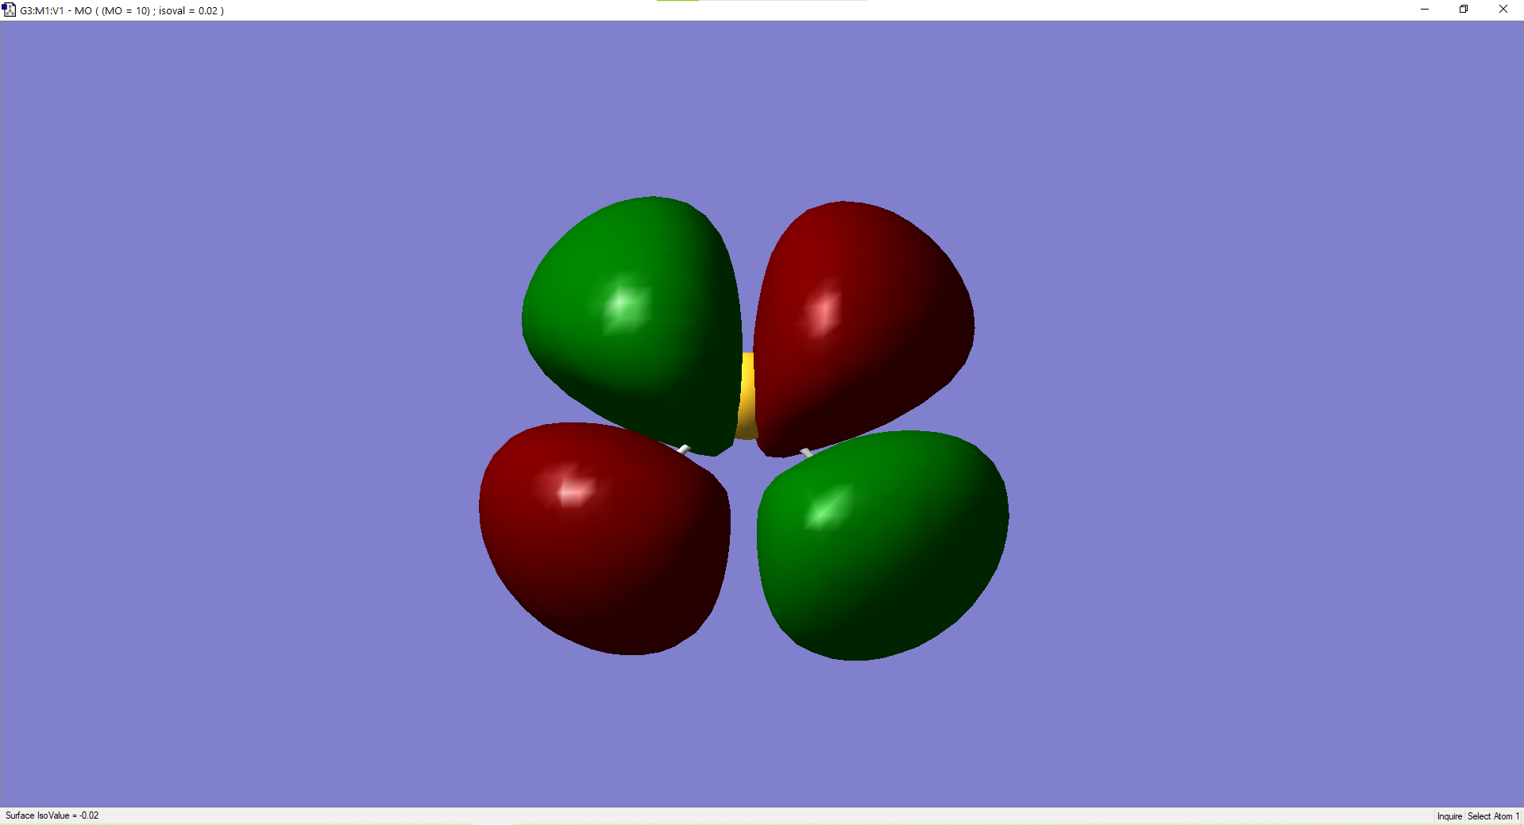
HOMO-LUMO
MO=9
MO=10

Slide 5
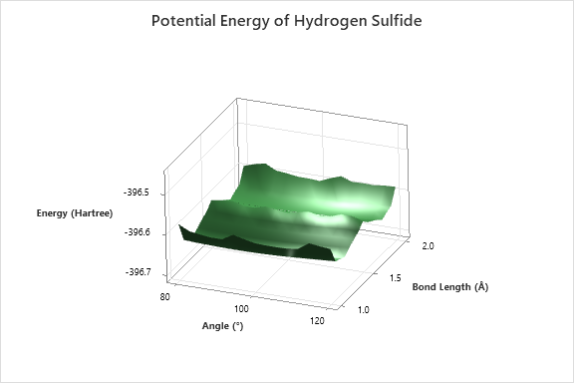
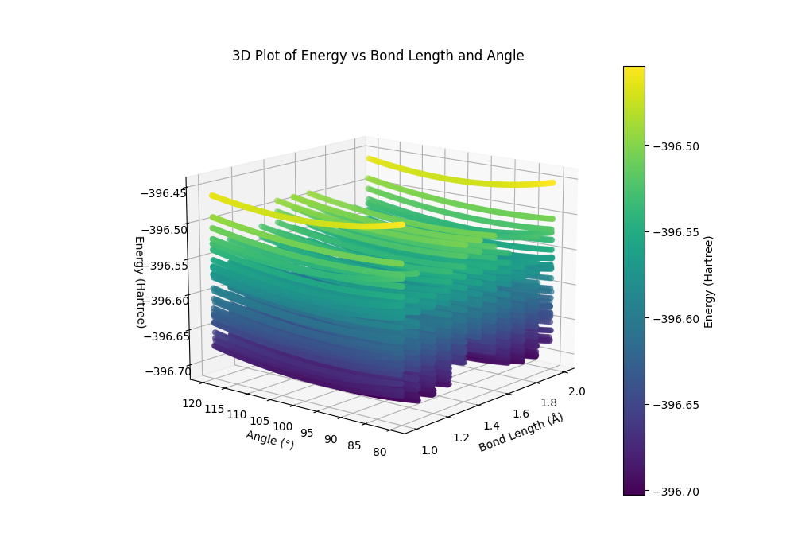

Slide 6
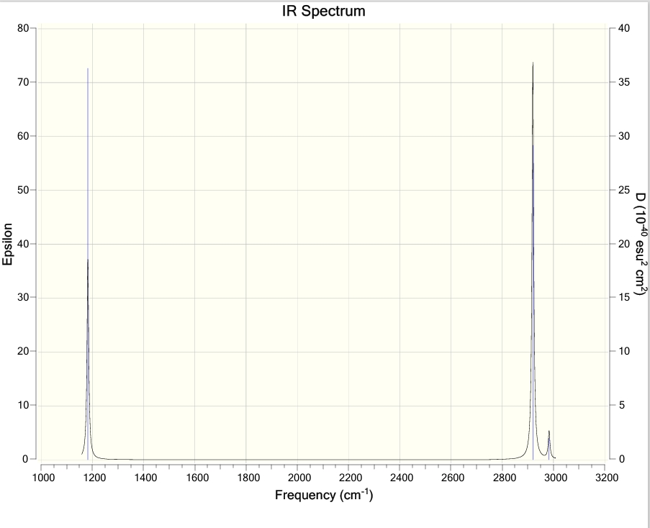
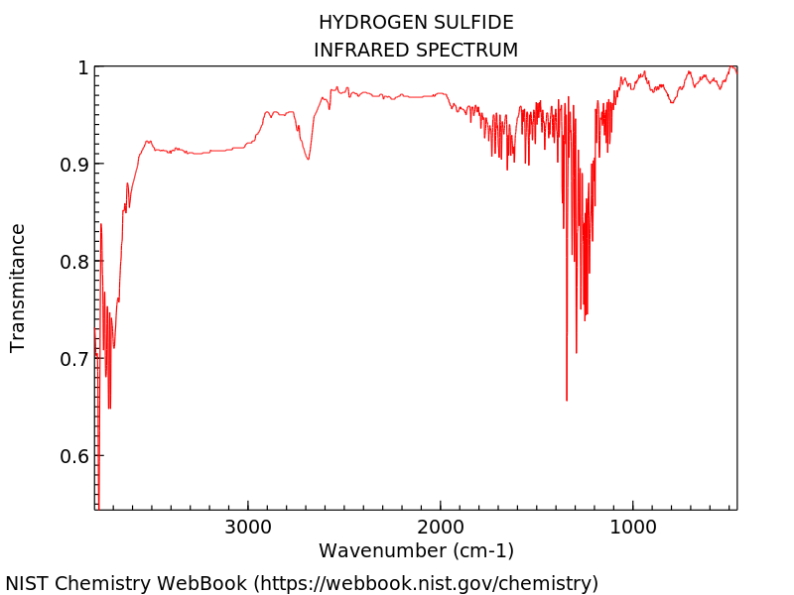
While the peak at 1200 overlaps, the peak at 2900 does not overlap with the value it should be.

Slide 7
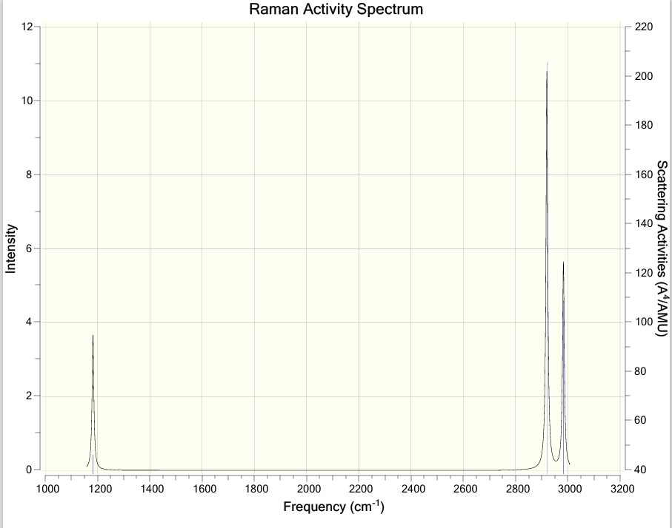
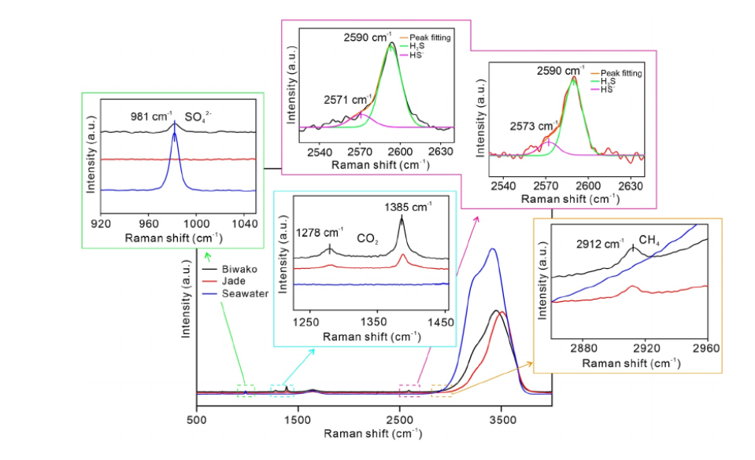
H2S (∼2,590cm ⁻¹), HS − (∼2,573cm ⁻¹)
Peaks does not overlap with the value it should be.

Slide 8
H₂S | Hartree | Kj/mol | Angle=109.5˚
Potential energy 1 | 0.068746 | 180.4933 | Bond Lenght Between 1Å and 2 Å
Potential energy 2 | 0.055213 | 144.9614
Total | 0.123959 | 325.4546
Literature Value (H2S) |  | 381.5804
Literature Value (HS) |  | 340
Average Bond Length (Literature) | 1.38 Å
Calculated Bond Lenght 1 | 1.2 Å
Calculated Bond Lenght 2 | 1.8 Å
Error 1 | 13.04%
Error 2 | 30.43%
Error for H2S |  | 14.71%
Error for HS | 46.91% | 57.36%

Slide 9
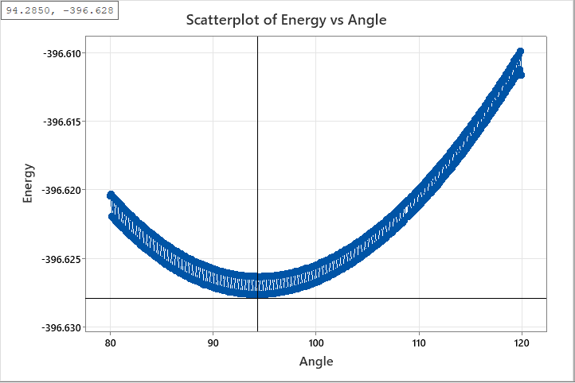
Literature value for Angle is 92.1˚ . A value close to the true value was obtained with a margin of error of 2.4%.

Slide 10
References
Lai, K. & Salumbides, Edcel & Beyer, M. & Ubachs, Wim. (2021). Precision measurement of quasi-bound resonances in H$_2$ and the H + H scattering length. 10.48550/arXiv.2112.00817.
Blanksby, S.J., & Ellison, G.B. (2003). Bond dissociation energies of organic molecules. Accounts of chemical research, 36 4, 255-63 .
T. L. Cottrell, The Strengths of Chemical Bonds, 2d ed., Butterworth, London, 1958; B. deB. Darwent, National
Standard Reference Data Series, NationalBureau of Standards, no. 31, Washington, 1970; S. W. Benson, J. Chem. Educ. 42:502 (1965); and J. A. Kerr, Chem. Rev. 66:465 (1966).
Li, Lianfu & Li, Zimeng & Zhong, Richen & Du, Zengfeng & Luan, Zhendong & Xi, Shichuan & Zhang, Xin. (2023). Direct H2S, HS and pH Measurements of High‐Temperature Hydrothermal Vent Fluids With In Situ Raman Spectroscopy. Geophysical Research Letters. 50. 10.1029/2023GL103195.
Bokhimi X. (2019). Atomic and Electronic Properties of a 155 H2S Cluster under Pressure. ACS omega, 4(6), 10524–10533. https://doi.org/10.1021/acsomega.9b00705

