Slide 1
UV-Visible Spectroscopy in Computational Chemistry
Nurefşan Nazlı Yüzükırmızı 280102002

Slide 2
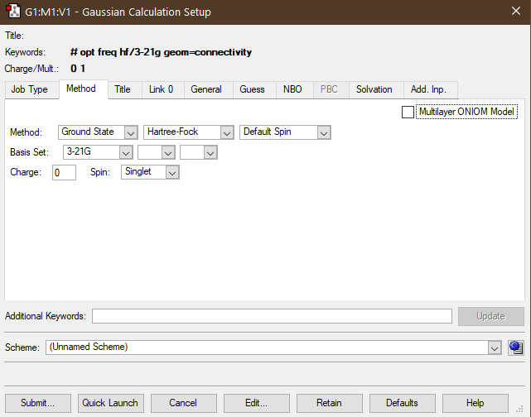
Method for Optimization

Slide 3
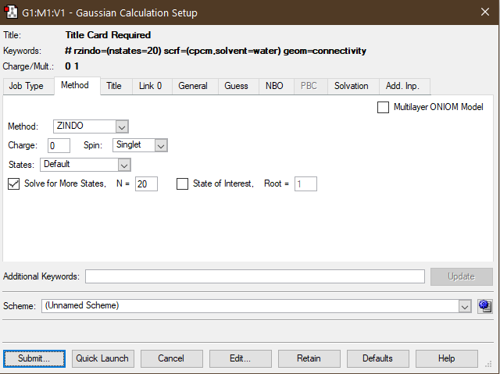
Method For UV-Vis Calculation
Solution was water.

Slide 4
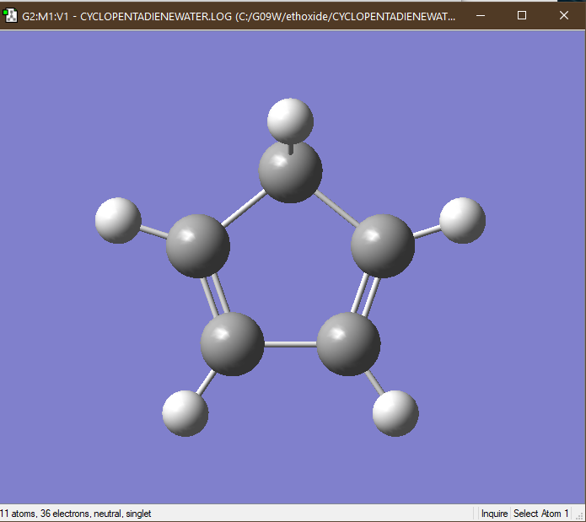
1,3-Cyclopentadiene

Slide 5
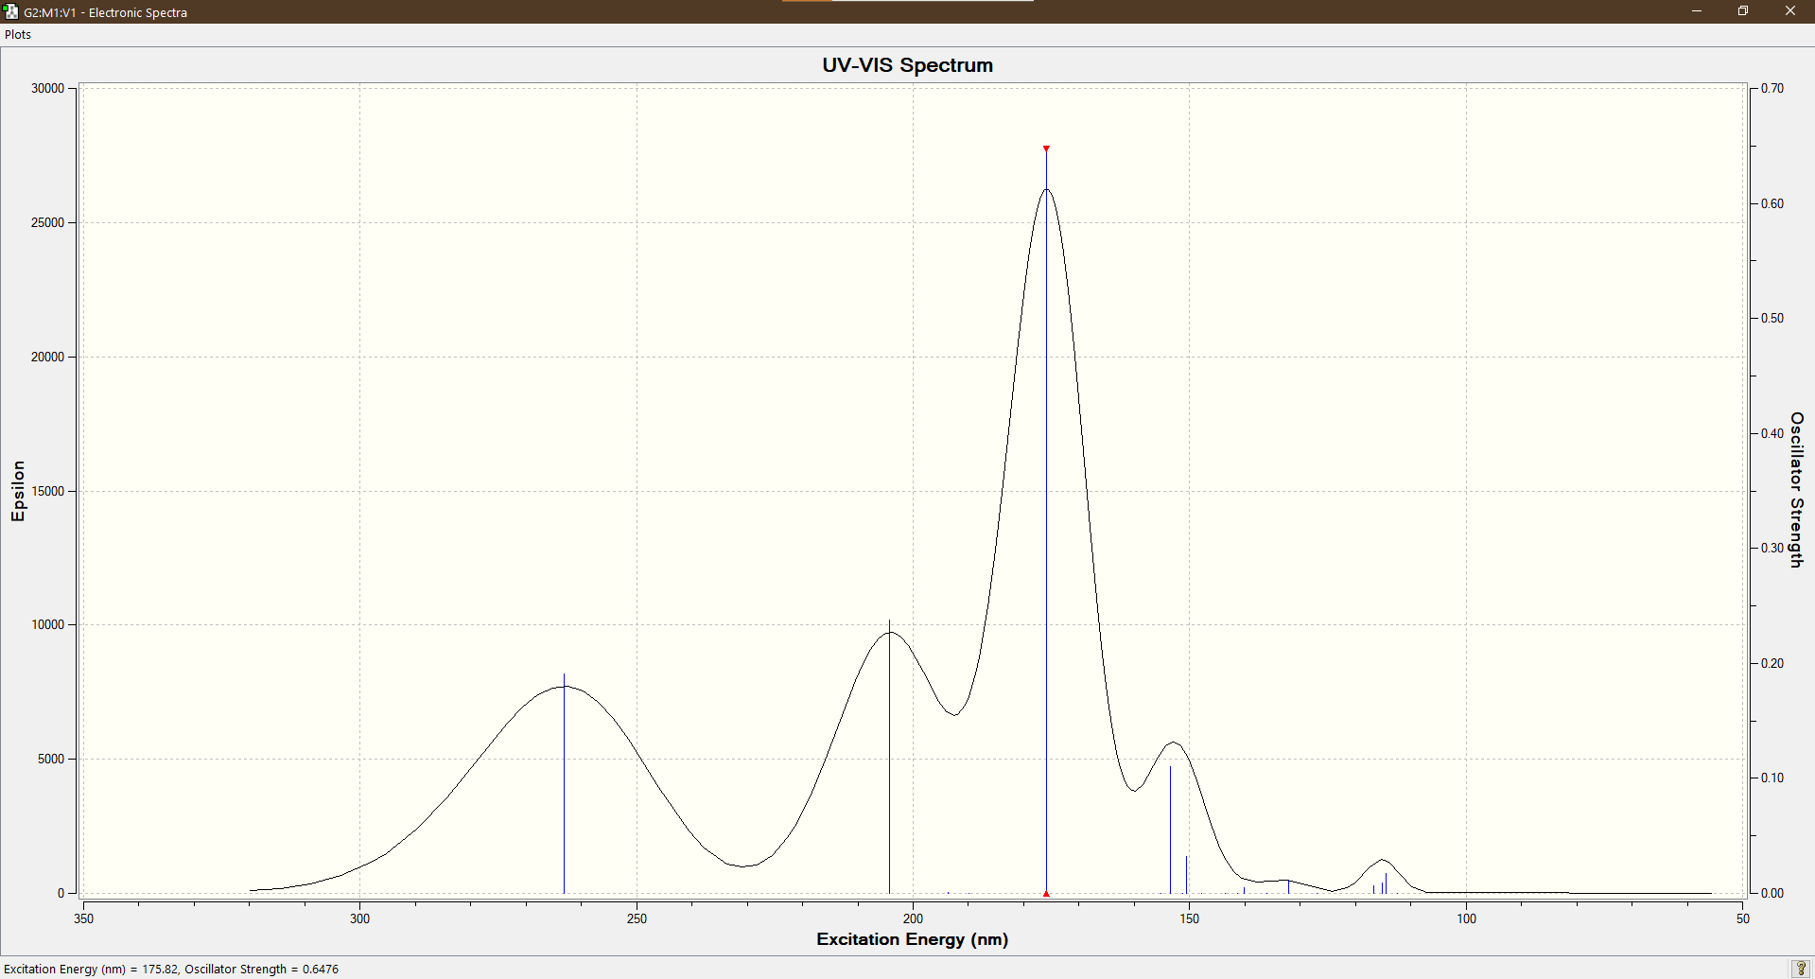
UV-Vis 1,3-Cyclopentadiene

Slide 6
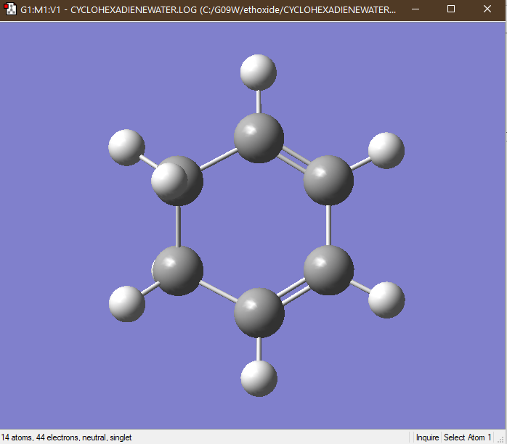
1,3-Cyclohexadiene

Slide 7
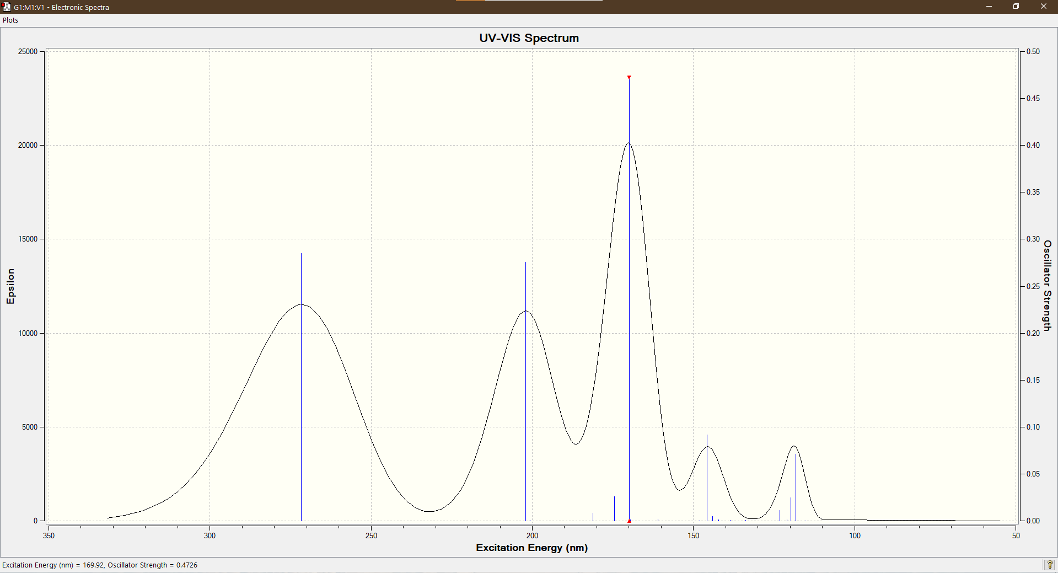
UV-Vis 1,3-Cyclohexadiene

Slide 8
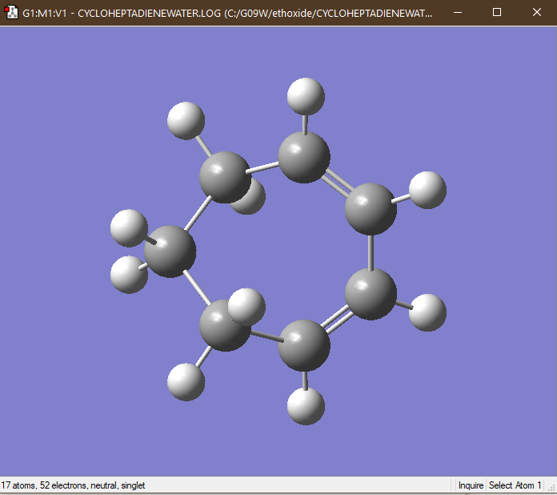
1,3-Cycloheptadiene

Slide 9
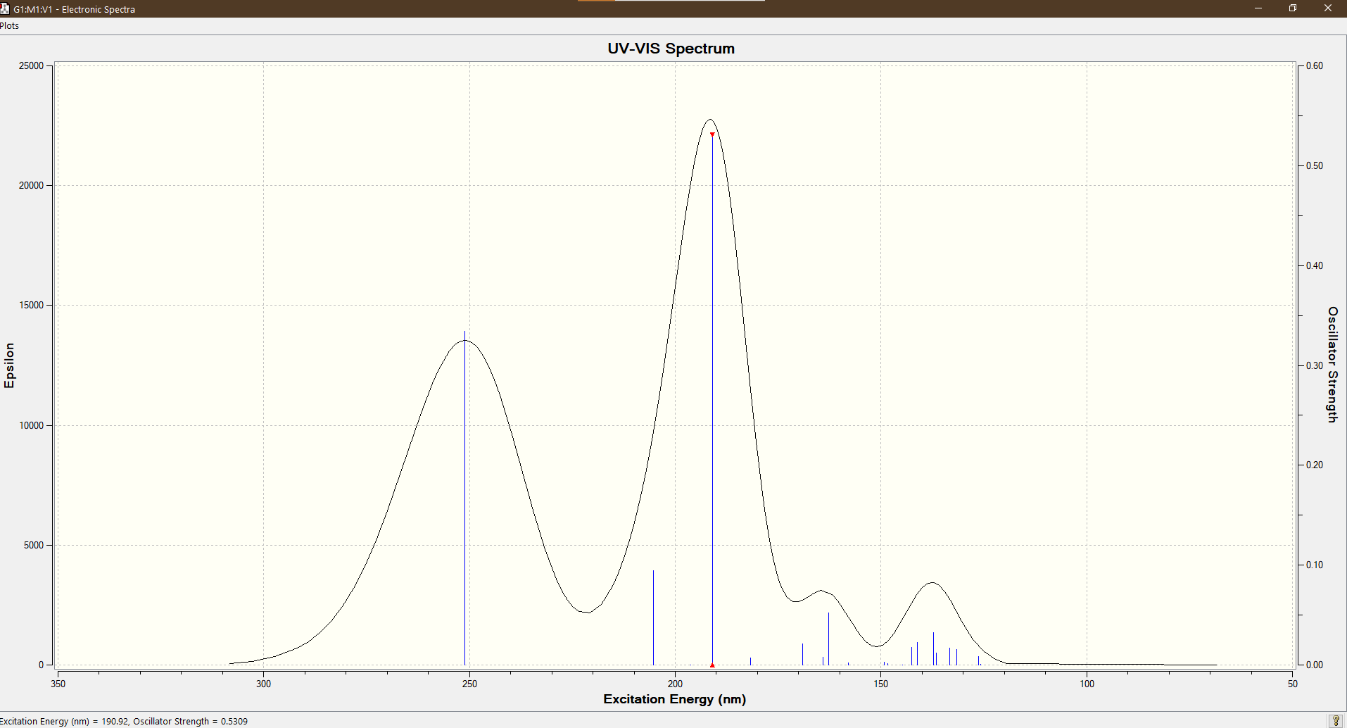
UV-Vis 1,3-Cycloheptadiene

Slide 10
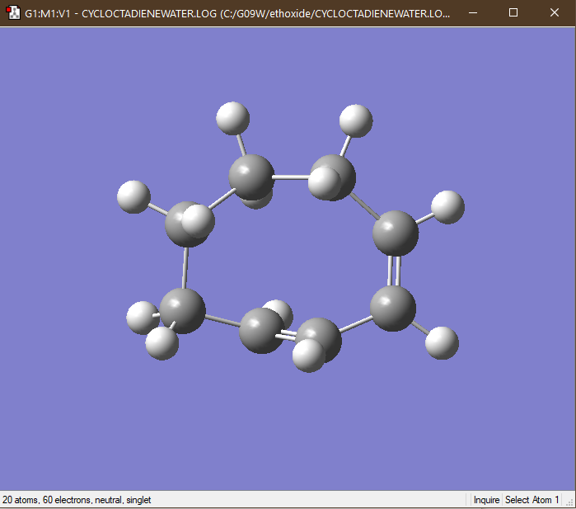
1,3-Cyclooctadiene

Slide 11
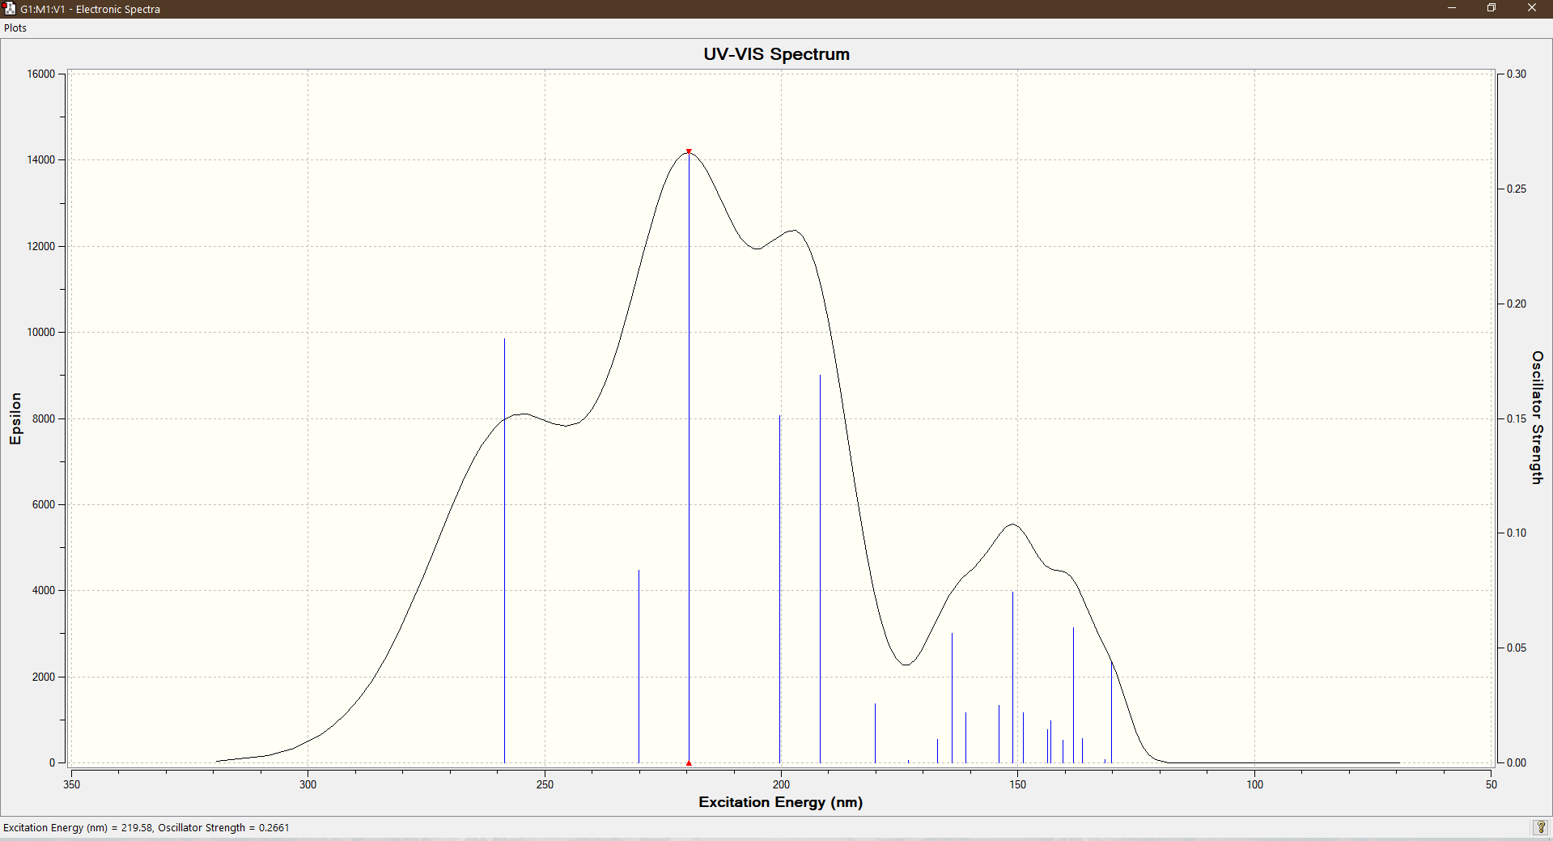
UV-Vis 1,3-Cyclooctadiene

Slide 12
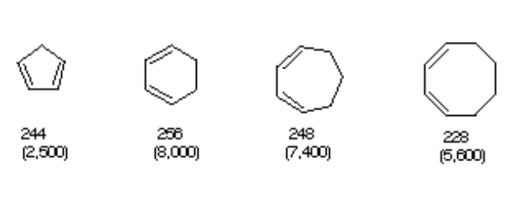
Literature Values

Slide 13
Comparision
Molecule | Excitaiton Energy Max (nm) | Epsilon Max | Literature Excitaiton Energy Max (nm) | Literature Epsilon Max
1,3-Cyclopentadiene | 176 | 26000 | 244 | 2500
1,3-Cyclohexadiene | 176 | 20018 | 256 | 8000
1,3-Cycloheptadiene | 190 | 23000 | 248 | 7400
1,3-Cyclooctadiene | 220 | 14000 | 228 | 5600

Slide 14
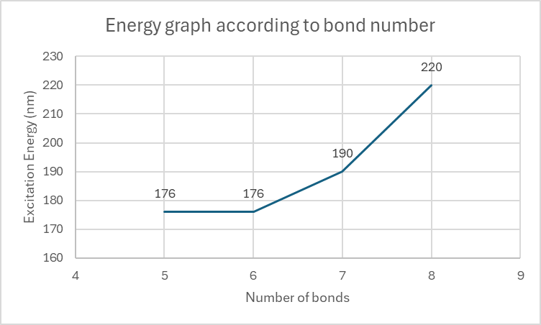

Slide 15
References
Reusch, W. (n.d.). Ultraviolet-Visible (UV-Vis) spectroscopy. Michigan State University. Retrieved December 11, 2024, from https://www2.chemistry.msu.edu/faculty/reusch/virttxtjml/spectrpy/uv-vis/uvspec.htm
NIST Chemistry WebBook. (n.d.). Benzoic acid: UV/Visible spectrum. National Institute of Standards and Technology. Retrieved December 11, 2024, from https://webbook.nist.gov/cgi/cbook.cgi?ID=C542927&Mask=400
ResearchGate. (n.d.). UV-Vis spectra of 1 in cyclohexane, toluene, THF, dichloromethane, and DMF. Retrieved December 11, 2024, from https://www.researchgate.net/figure/Fig-S1-UV-Vis-spectra-of-1-in-cyclohexane-toluene-THF-dichloromethane-DMF-and_fig3_269287195

Slide 16
Thank You For Listening

