Slide 1

Homework 5 Calculation of Excited Energy For 4-(2,5-Dimethyl-1-pyrrolyl)benzonitrile (DMABN)
CHEM491
Nurefşan Nazlı Yüzükırmızı
280102002

Slide 2
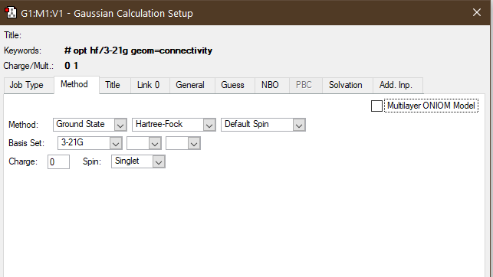
Method for Optimization

Slide 3
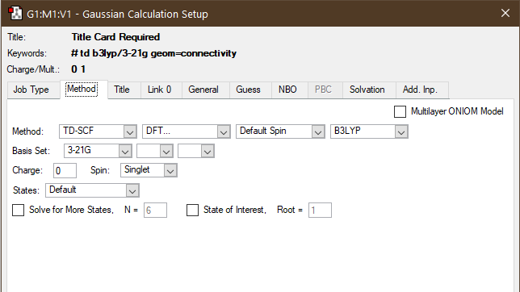
Method For Energy

Slide 4
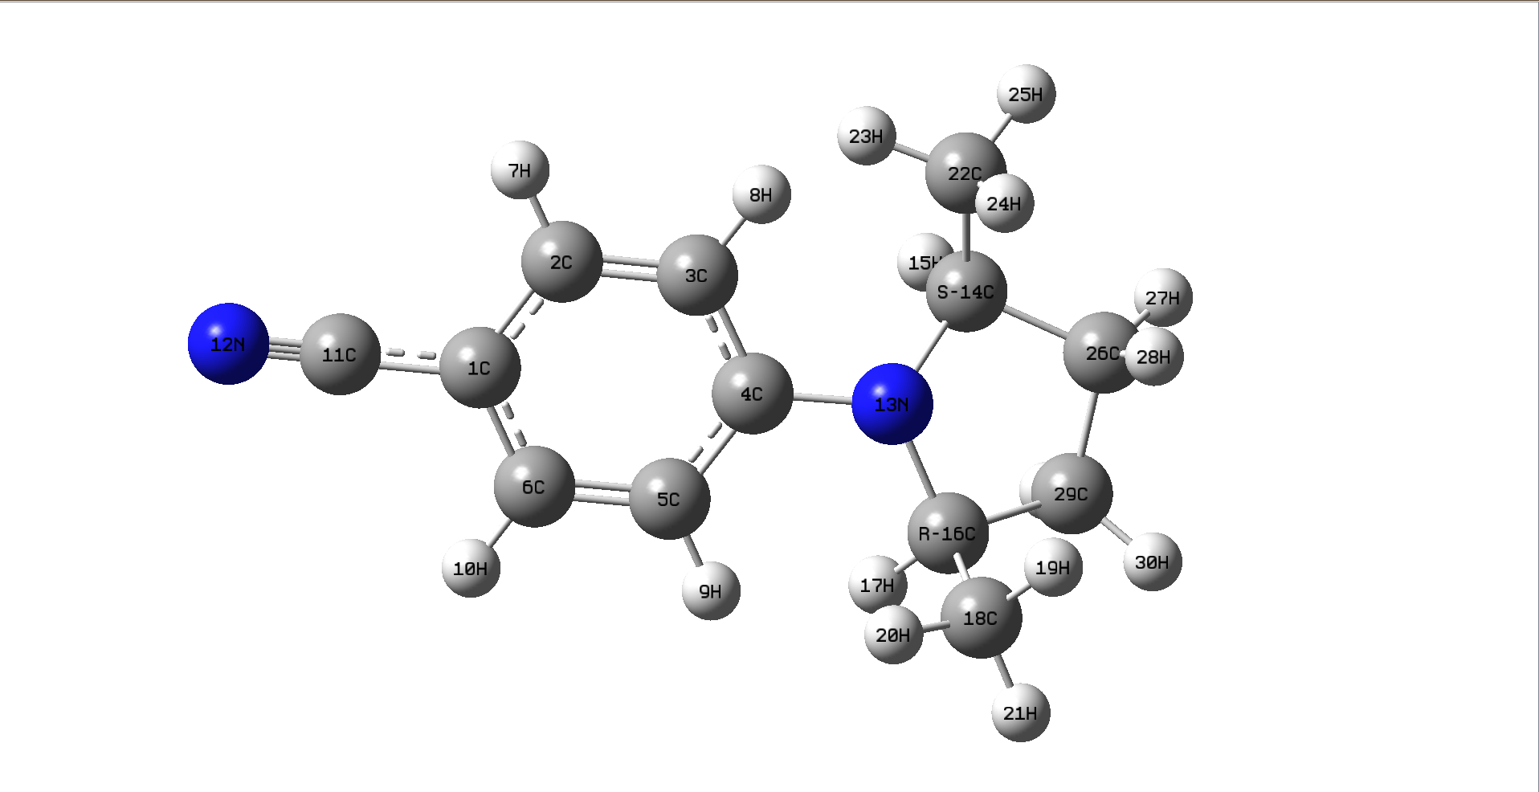
Molecule Structure

Slide 5
Molecule Result After Optimization
Molecule Dihedral Angle 5-4-13-16 | -71
Molecule Angle Between 4-3-16 | 122
E(RHF) | -607.11

Slide 6
Result After Energy Calculation
f results | Excited State 1: eV | Angle
0.2926 | 4.4312 eV | 20
0.1475 | 3.9900 eV | 40
0.0179 | 3.5975 eV | 60
0.018 | 3.5932 eV | 80
0.152 | 4.0100 eV | 100
0.3168 | 4.4852 eV | 120
0.0218 | 4.6312 eV | 140
0.0186 | 4.6480 eV | 160
0.0243 | 4.5960 eV | 180
0.1443 | 3.9715 eV | 200
0.1443 | 3.9715 eV | 220
0.0176 | 3.5756 eV | 240
0.0179 | 3.5725 eV | 260
0.1506 | 3.9975 eV | 280
0.3281 | 4.4853 eV | 300
0.021 | 4.6350 eV | 320
0.0189 | 4.6493 eV | 340
0.0277 | 4.5980 eV | 360
54→55
HOMO to LUMO
On angle 160, 54→55: Excited State 2: Singlet-A 4.8930 eV 253.39 nm

Slide 7
Results After Energy Calculations
Angle(˚) | ∆E (eV) | E_{s0} (eV) | E_{s1} (eV)
10 | 19.14649 | -16630.2 | -16611
20 | 18.26348 | -16630 | -16611.8
40 | 18.91138 | -16630.2 | -16611.3
60 | 19.09778 | -16630.2 | -16611.1
80 | 19.10648 | -16630.2 | -16611.1
100 | 18.92199 | -16630.2 | -16611.3
120 | 18.41504 | -16630.3 | -16611.8
140 | 3.355438 | -16630.3 | -16626.9
160 | 5.295883 | -16630 | -16624.7
180 | 4.337769 | -16629.8 | -16625.5
200 | 18.72471 | -16630 | -16611.3
220 | 18.89886 | -16630.2 | -16611.3
240 | 19.09696 | -16630.2 | -16611.1
260 | 19.10567 | -16630.2 | -16611.1
280 | 18.91764 | -16630.2 | -16611.3
300 | 18.65559 | -16630.3 | -16611.6
320 | 2.875701 | -16630.2 | -16627.4
340 | 5.302686 | -16629.9 | -16624.6
360 | 4.871113 | -16629.7 | -16624.9

Slide 8
Graph

Slide 9
Graphs

Slide 10
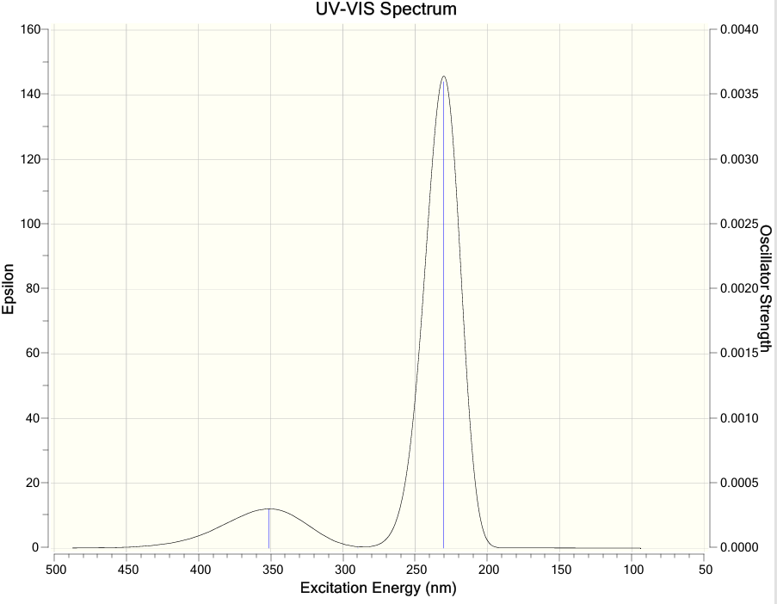
Excitation Energy:
First peak: 351nm
Second peak: 230nm

Slide 11


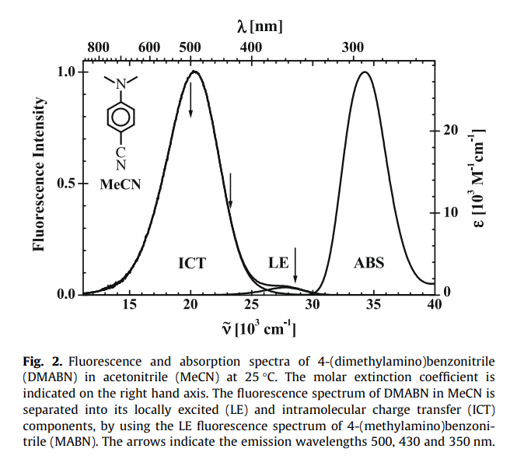


Literature result in UV-Vis

Slide 12

Thank You! Happy New Year ☺

