Slide 1


Applied Malaria Modeling Network (AMMNet)
Presents
Training on Malaria Modeling in R & RStudio
Wednesday, August 28,
2024
1

Slide 2



Data Visualization & Malaria Modeling Techniques in R & RStudio
Dennis K. Muriithi, Ph.D.
Wednesday, August 28,
2024
2

Slide 3
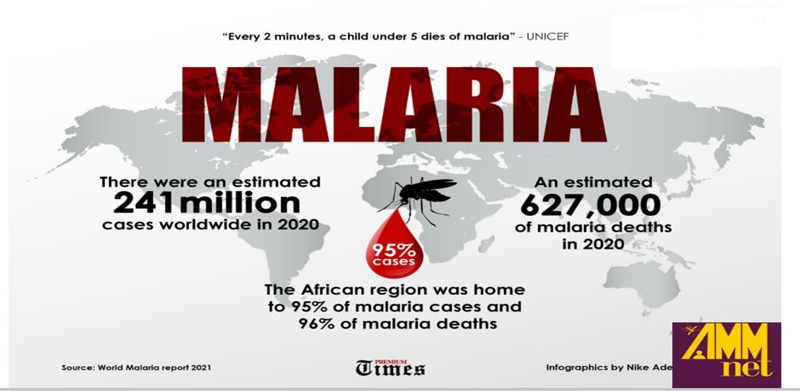

Slide 4
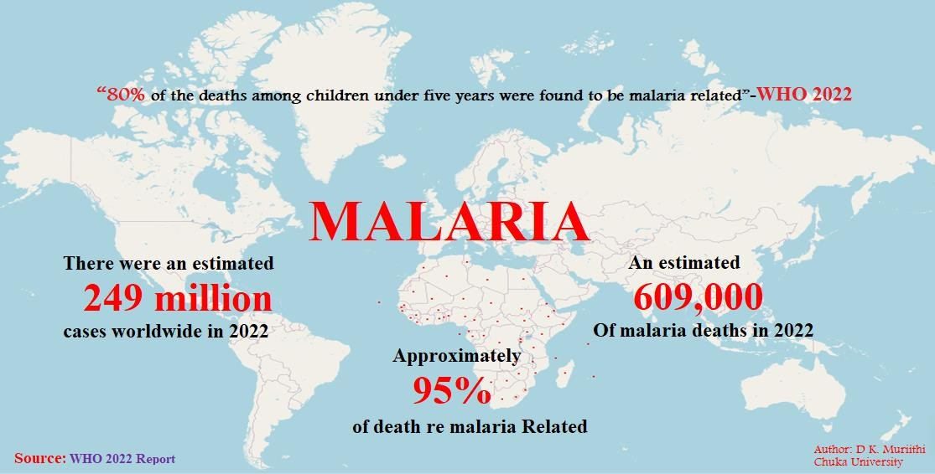

Slide 5
DATA VISUALIZATION: Turning Data into Stories
This is the art and science of communicating information clearly and effectively
through visual representations.
It involves transforming raw data into meaningful and understandable graphics, charts, and maps.
Why is it important?
Clarity: Complex data becomes easy to understand
Insights: Patterns, trends, and outliers become visible
Storytelling: Data-driven narratives can be created
Decision Making: Informed choices can be made based on visual evidence
Focus will be on the 20% that is useful 80% of the time

Slide 6
Types of Data Visualization
Charts: Bar charts, line charts, pie charts, area charts, etc
Graphs: Scatter plots, bubble charts, histograms, box plots, etc
Maps: Geographic data visualization
Infographics: Combining visuals with text for storytelling
Dashboards: Interactive displays of multiple visualizations.

Slide 7
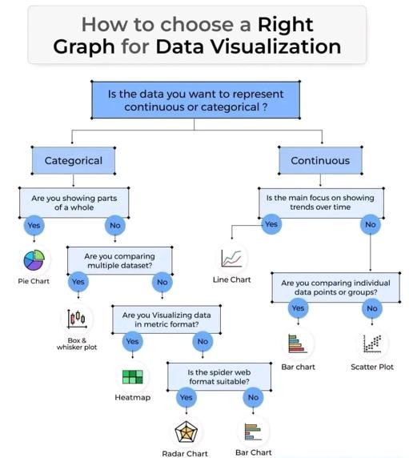

Slide 8
DATA VISUALIZATION
In R, there are three main plotting systems:
Base graphics
ggplot2
Leaflet & tmap

Slide 9
Prerequisites
Install R & RStudio
Install ggplot2, leaflet &tmap package on your R environment
The repository on Github has files for the source, data and other important materials.
URL: https://github.com/CUDataanalytics/CUAMMnet

Slide 10
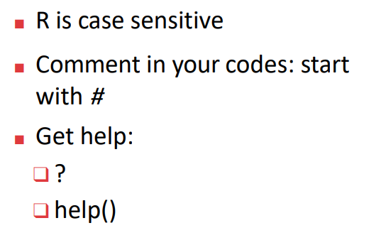

Slide 11
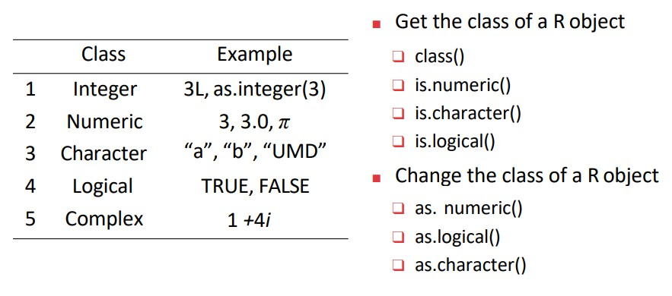

Slide 12
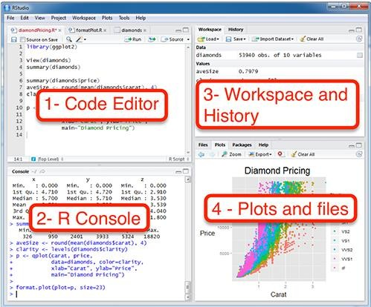

Slide 13
Malaria Modeling using Machine Learning Algorithms
Machine Learning (ML), sometimes referred to as Statistical Learning, is a subfield of artificial intelligence (AI) that focuses on the development of algorithms capable of learning and making predictions or decisions based on inputs and data.
The process of developing a machine learning model begins with the collection &
preprocessing of data
Data preprocessing includes data cleaning, transformation, organization, imputation & labeling

Slide 14
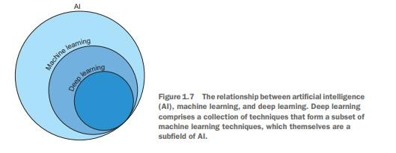
The relationship between AI, Machine Learning, and Deep Learning is summarized below
Credit: Hefin I. Rhys(2020) All rights reserved
Wednesday, August 28,
14
2024

Slide 15
Types of Machine Learning
All machine learning algorithms can be categorized by their learning type and the
task they perform. There are three learning types:
Supervised learning where models learn from labeled data…….
Classification
Regression
Unsupervised learning discovers hidden patterns within unlabeled data, useful in…
Dimension reduction
Clustering
Reinforcement learning teaches agents to make decisions by trial and error,
valuable in autonomous systems

Slide 16
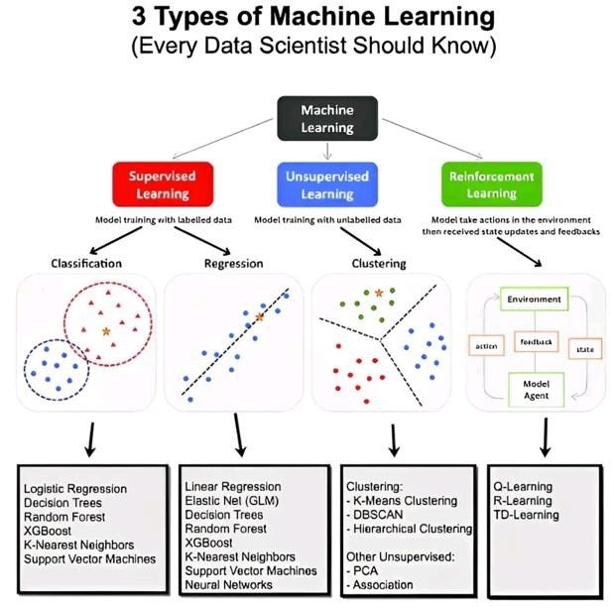

Slide 17
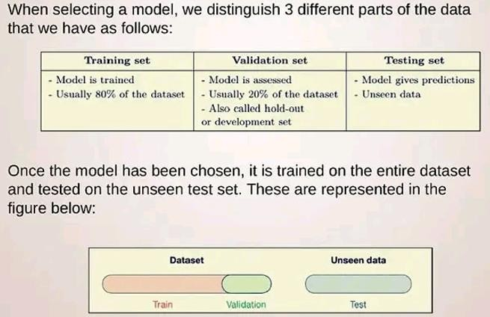
Model Training and Testing

Slide 18
Cross Validation (CV)
CV is a powerful statistical technique used to assess the performance and generalization ability of machine learning models.
It helps to ensure that the model generalizes well to unseen data by testing it on different subsets of the data.
The primary goal of cross-validation is to prevent overfitting, ensuring that the model performs well on unseen data.
Common cross-validation approaches:
Holdout cross-validation
K-fold cross-validation
❖
Leave-one-out cross-validation

Slide 19
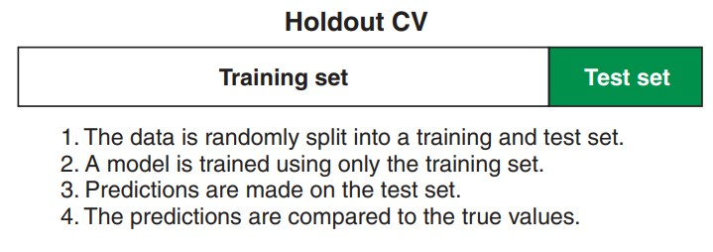
Holdout Cross-Validation

Slide 20
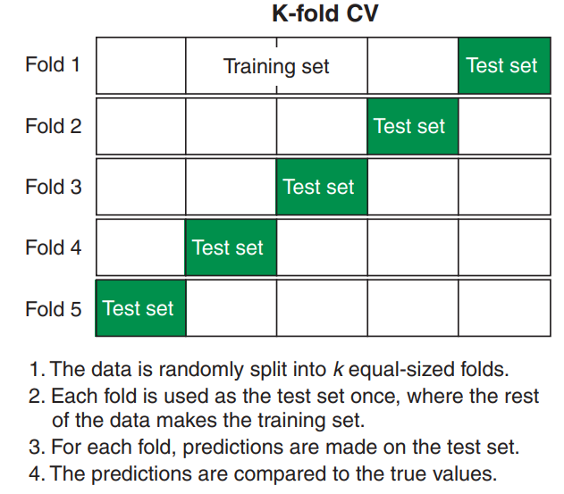
K-fold Cross-Validation

Slide 21
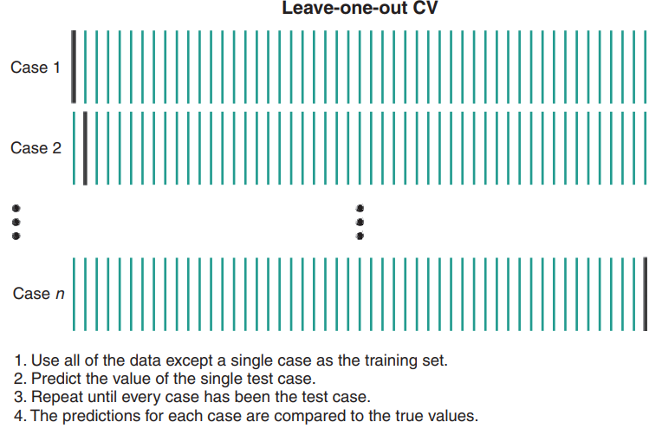
Leave-one-out Cross-Validation

Slide 22
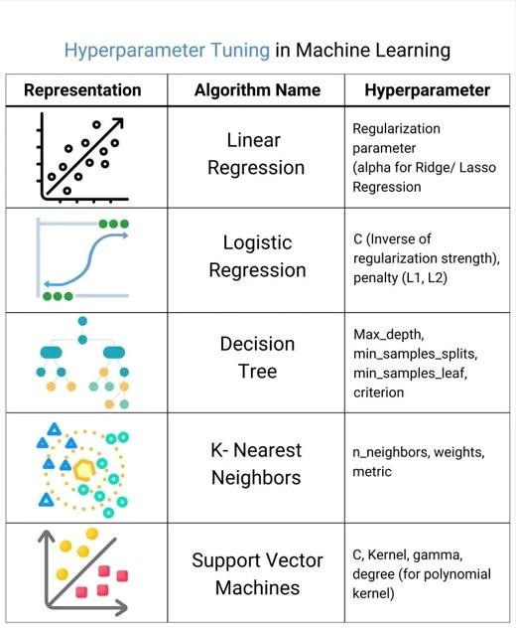

Slide 23
What is Imbalance Data?
Refers to datasets where the classes are not represented equally.
This issue can manifest in various real-world scenarios, such as fraud detection, medical diagnosis, text classification, and image recognition.
Data imbalance is a common and critical challenge in the field of machine learning.
This imbalance can lead to biased models that perform well on the majority class but poorly on the minority class.
Machine learning algorithms are designed to optimize overall accuracy, which means they tend to favor the majority class.
As a result, the minority class is underrepresented in the model's learning process, leading to skewed predictions and poor generalization to the minority class.

Slide 24
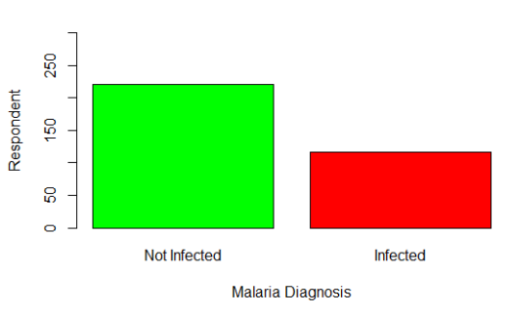
Example of Imbalance Malaria Data

Slide 25
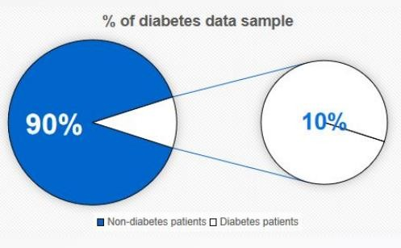
Example of Imbalance Diabetes Data

Slide 26
Key Points About Imbalanced Data
Class Distribution: One class (majority) has many more instances than the other (minority).
Impact on Models: Standard machine learning algorithms may become biased toward the
majority class, resulting in poor performance on the minority class.
Evaluation Metrics: Accuracy is not a reliable metric for imbalanced datasets. Instead, metrics such as precision, recall, F1-score, and area under the ROC curve (AUC-ROC) are more informative.
Techniques to Handle Imbalance:
Resampling: Techniques like oversampling the minority class (e.g., SMOTE) or
undersampling the majority class.
Algorithmic Adjustments: Modifying algorithms to account for imbalance, such as adjusting class weights.
Synthetic Data Generation: Creating synthetic samples for the minority class.
Anomaly Detection Methods: Treating the minority class as anomalies or outliers

Slide 27
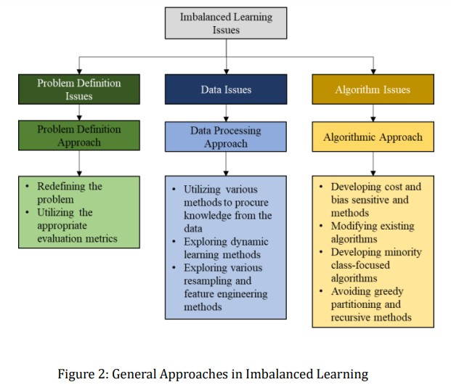

Slide 28
Consequences of Imbalance Data
Model Bias: Imbalanced data can lead to model bias, where the model is influenced by the majority class. It may struggle to make accurate predictions for the minority class.
High Accuracy, Low Performance: A model trained on imbalanced malaria data may appear to have high accuracy but may perform poorly on minority classes.
Missed Insights: Data imbalance can result in the loss of important insights and patterns present in the minority class, leading to missed opportunities or critical errors

Slide 29
In practical terms, models trained on imbalanced datasets may show a high accuracy rate, but they are ineffective at identifying and correctly classifying instances of the minority class.
To address the challenges posed by data imbalance, various techniques and strategies have been developed.
These methods aim to rebalance the dataset, adjust the model's learning process, or use specialized evaluation metrics that better reflect the performance on imbalanced data.
The selection of the most appropriate approach depends on the specific problem, the dataset, and the desired outcome.
During this training, we will explore different techniques for handling data
imbalance in machine learning and discuss when and how to use them effectively
for malaria modeling

Slide 30
Resampling Techniques for Handling Malaria Imbalance Data
Resampling techniques are a common set of strategies used to address data imbalance in machine learning.
These techniques involve modifying the dataset by either increasing the number
of minority class samples (over-sampling) or class samples (under-sampling).
Key resampling techniques:
Over-sampling
Under-sampling
Combined(Hybrid) Resampling
reducing the number of majority

Slide 31
Oversampling:
Random Over-sampling:
In this method, random instances from the minority class are duplicated until a more balanced distribution is achieved. While this can balance the class distribution, it may lead to overfitting.
SMOTE (Synthetic Minority Over-sampling Technique):
SMOTE generates synthetic instances for the minority class by interpolating between neighboring instances. This approach creates new, realistic data points and helps prevent overfitting compared to random oversampling.
ADASYN (Adaptive Synthetic Sampling)
Description: An extension of SMOTE that focuses on generating more synthetic data for minority class
Advantages: Improves the focus on difficult minority class examples, potentially enhancing model performance.
Disadvantages: Similar to SMOTE, it can introduce noise if not applied carefully.
SMOTEN
SVM-SMOTE
Random oversampler
K-means-SMOTE

Slide 32
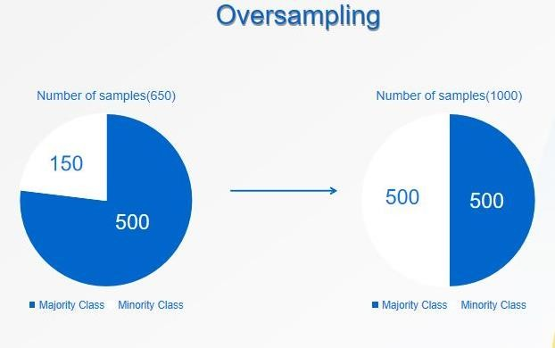

Slide 33
Undersampling
Random Under-sampling
Description: Involves reducing the number of instances in the majority class to balance the dataset. This is done by randomly selecting and removing examples from the majority class until the class distribution is balanced Advantages: Reduces the size of the dataset, making the training process faster.
Disadvantages: Can lead to loss of valuable information and under-fitting.
Tomek Links
Description: Under-sampling technique used to identify and remove overlapping instances in a dataset Advantages: Helps clean the boundary between classes, improving model performance.
Disadvantages: Only removes a small number of majority class examples, may not fully balance the dataset.
Random under-sampler
NearMiss
condensed Nearest Neighbour
Edited Nearest Neaghbour

Slide 34
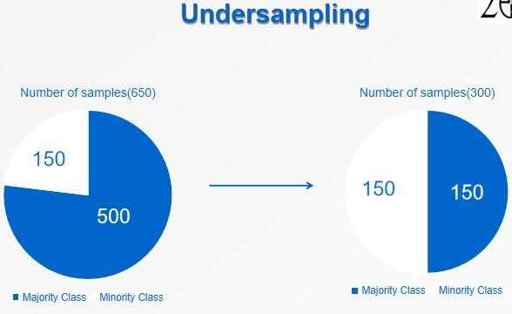

Slide 35
Combined Resampling
Hybrid Methods
Combining resampling techniques is a powerful strategy for addressing data imbalance in machine learning
Involves using both oversampling and undersampling techniques to handle imbalanced datasets.
This method leverages the strengths of both approaches to create a more balanced and representative dataset for training machine learning models
Advantages: Can provide a more balanced and effective approach. Disadvantages: More complex to implement and require _{W}c_{ed}a_{ne}r_{sda}e_{y,} f_{Au}u_{gus}l_{t 28}t, uning.
2024
35

Slide 36
Benefits of Combining Resampling Techniques
Balanced Dataset: More balanced representation of classes can lead to better model
Class Boundaries: Cleaning the class boundaries can enhance the classifier's
ability to distinguish between classes.
Robust Models: Models trained on a combined resampled dataset can generalize better to unseen data.
Enhanced Model Performance: Models trained on balanced, informative datasets often demonstrate better performance, particularly when working with imbalanced data

Slide 37
Considerations
The choice of combining resampling techniques should be guided by the characteristics of the dataset and the specific problem. It may not be the best approach for all situations.
Depending on the problem, you can also experiment with different combinations of oversampling and undersampling techniques to find the most effective balance.
Care must be taken when selecting and fine-tuning the specific resampling methods and their parameters to achieve the desired balance and model performance.

Slide 38
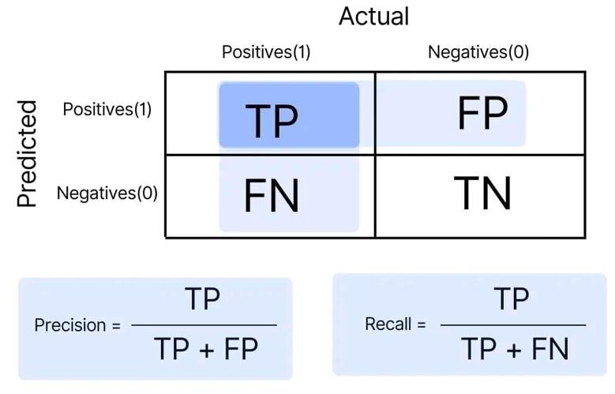
Evaluation Metrics for Handling Data Imbalance
Confusion Matrix

Slide 39
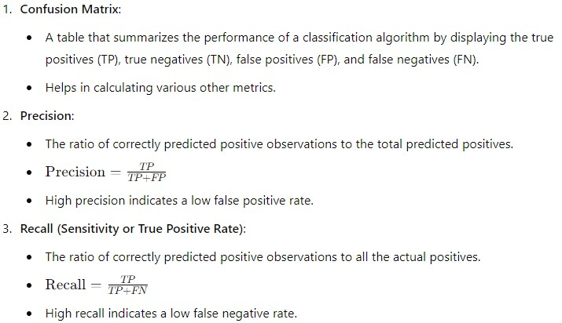
Evaluation Metrics for Handling Data Imbalance

Slide 40
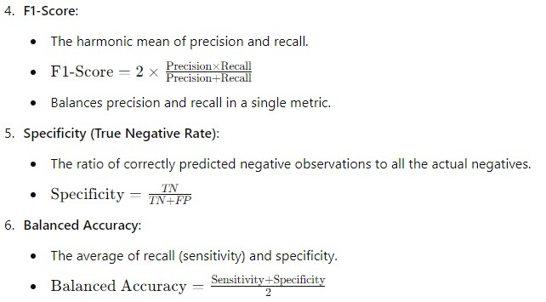

Slide 41
Application of Machine Learning in Malaria Modeling
Disease Diagnosis: ML algorithms can analyze medical images (like blood smears) and predict malaria presence with high accuracy.
Epidemiological Predictions: ML models can forecast malaria outbreaks by analyzing patterns in climate, population movements, and historical data.
Drug Discovery: ML can accelerate the discovery of new antimalarial drugs by predicting which compounds are most likely to be effective.
Treatment Optimization: Personalizing treatment plans based on patient data to improve outcomes and reduce drug resistance.
Vector Control: ML models can predict mosquito population dynamics and breeding sites, aiding
in targeted vector control measures.

Slide 42

Applications to Malaria Modeling/Diagnosis

Slide 43
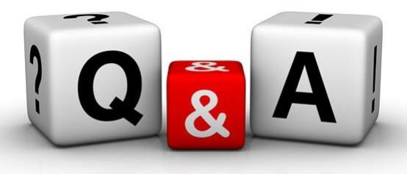

Slide 44
Important Resources
1. Introduction to Statistical Learning, 2nd edition https://www.statlearning.com/

