Slide 1
INFO 5602 Information Visualization
Individual Project Presentation
(My Dashboard Report)
Student Name: Luna McBride

Slide 2
Table of Contents
Context/environment for dashboard design and development
Motivation for dashboard
3 key research questions that my dashboard seeks to answer
Medicaid (Real-world) data source and discussion
Why Medicaid Data?
Downsides of Medicaid Data
Presentation and discussion of dashboard
Answers to 3 key research questions and any recommendations
URL/ web link for online hosted dashboard (optional)

Slide 3
Context/environment for dashboard design and development
Built using Power BI and Excel
Restricted only to using them
Power BI is pretty restrictive
No tick label changes
Pivots created through Power Query
Think outside the box
Notes:
I decided to build the dashboard using Power BI and Excel. The point of this was to get familiar with something new to me, so I restricted myself to only using them (even when I could have done aspects of it in Python or Tableau so much easier.)
This restriction came with a tradeoff, as Power BI is pretty restrictive. It currently does not allow changes to tick labels. I have found evidence online that it used to allow tick label changes however, so it became a bit frustrating. So please keep this in mind when seeing aspects like the “bn” for billion at the end of some of the numbers. It was either that or Power BI would list out the whole number, so this was the better option.
Any pivots or changes I wanted to make display the data better had to be done through Power Query instead of the main Power BI, creating a separation between the moving parts of the program. For an ADHD brain like mine, this led to a lot of “what was I doing again?”
Though I did like creativity needed to get some of the visuals together.

Slide 4
Motivation for dashboard (why this dashboard impacts the real-world)
The dataset deals with Medicaid data
People should know where their tax money is going
The pharmacy is an area very few people seem to know about
Blessing and a curse
I can provide unique insight
I am a former pharmacy technician
I am on a wide variety of medications

Slide 5
3 key research questions that my dashboard seeks to answer
How much money is going toward prescriptions through Medicaid?
Where is that money going?
What does this mean for the pharmaceutical market?

Slide 6
Medicaid (Real-world) data source and discussion
Produced yearly by the Centers for Medicare and Medicaid Services
Produces data yearly
Two years behind
Posted 2022 during this project
Shows:
How much was spent per medication
How many claims per medication
The average unit price
Link: https://data.cms.gov/summary-statistics-on-use-and-payments/medicare-medicaid-spending-by-drug/medicaid-spending-by-drug

Slide 7
Why Medicaid Data?
Publicly available
Less biased than Medicare
Only allowed to people age 65+ and chronically ill
Tends not to have good coverage
No income bias despite qualifying by income
Most patients do not pay
Patients pay little to no money
Results in values that are close to market rate + pharmacy fees

Slide 8
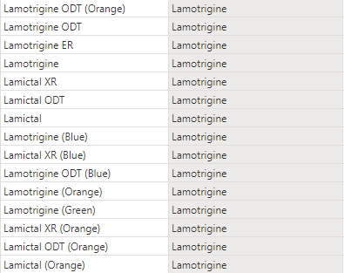
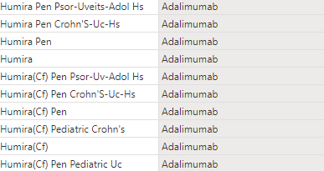
Downsides to Medicaid Data
Not region specific
Many units in Millions or Billions
Medication splitting

Slide 9
Presentation and discussion of dashboard
<Go to Dashboard>

Slide 10
Answers to 3 key research questions and any recommendations
Q: How much money is going toward prescriptions through Medicaid?
A: 87+ Billion Dollars in 2022, 423+ Billion Overall
Q: Where is that money going?
A: A good amount goes to a small subset of expensive medications.
More goes to the top 10 expensive medications than goes to
the top 100 most common medications.
Q: What does this mean for the pharmaceutical market?
A: Manufacturers have incentive to sell high for years
without regard for what the consumer can afford or what the
taxpayer wants to spend. Some of them take full advantage.

Slide 11
URL/ web link for online hosted dashboard
https://app.powerbi.com/groups/me/reports/f74fc7a4-1e86-48d7-a421-3a3ff32d51f6/ReportSectionfec8b8eb98363d3b61c6?experience=power-bi

Slide 12
Further Reading
Humira Price Monopoly: https://www.nytimes.com/2023/01/28/business/humira-abbvie-monopoly.html
Takeda/Shire Vyvanse Exclusivity Lawsuit: https://www.takeda.com/newsroom/shire-news-releases/2014/vyvanse-patents-found-to-be-infringed-and-valid-by-u.s.-district-court
Harvard Analysis of Humira Patent Strategy: https://dash.harvard.edu/bitstream/handle/1/37371412/GC_Thesis_vFinal.pdf?sequence=1#:~:text=Humira%2C%20the%20market%20leader%2C%20is,prevented%20generic%20competition%20until%202023.
Article Announcing Eliquis Exclusivity Ruling: https://www.biospace.com/article/with-court-win-bms-and-pfizer-stave-off-generic-challengers-to-eliquis-for-now/

