Slide 1
INFO 5602 Information Visualization
Individual Project Presentation
Student Name: Luna McBride

Slide 2
Chart 1: Context for “Before” Chart
Why: why was this chart created (by the chart creators)?
This chart was created by Teva to show off headache and migraine reduction from Ajovy.
Who: who was this chart created for?
The chart was created for Ajovy consumers, as it included in the brochure that comes with the product.
What: what did the chart creators want the target audience to know/do?
They want to show off the benefits of migraine reduction that could be attained by using Ajovy.
How: what data/data source did the chart creators use (if you know)?
They did their own clinical research.
Notes:
The chart was created by Teva to show off their amazing Ajovy Migraine Injector pens. These specific charts are used to advertise to chronic migraine sufferers, as they are included in the brochure that comes with every Ajovy pen. The creators wanted the consumer to know they are in good hands by using the product, showing off reduction in migraine days within their research group. The company had to do the studies on their product to get FDA approval anyway, so why not show off the data to their consumers?

Slide 3
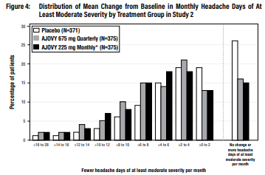
Chart 1: “Before”
Source: https://www.ajovy.com/globalassets/ajovy/getting-started-with-ajovy.pdf
Notes:
This one I found in the brochure included in my Ajovy pen.
Things to note with the original:
The quality of the image was poor even in the brochures. The source provided is on an online version, but I thought to add this chart after seeing it on one of the physical brochures provided with my own Ajovy pen.
The colors do not follow the dark bad light good approach to coloring, making the placebo seem like the favorable outcome.
The no change section is specifically sectioned off with its x label bolded, making it seem like they want to highlight this outcome despite it being the worse case scenario.
The current x axis does not make it clear that these values represent number of migraine days were reduced by using the Ajovy.
The heavy boarders also add to load.

Slide 4
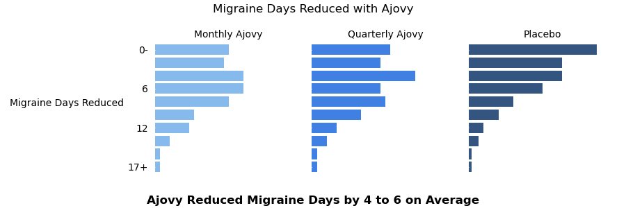
Chart 1: “After”

Slide 5
Chart 1: “Before” and “After”
Notes:
An important factor to note when comparing them here as well is how they had to shrink in order to fit side by side. And while the original was even hard to read when blown up in its original “before” slide, the after chart is still pretty easy to read when shrunk.

Slide 6
Summary of Improvements Made to Chart 1
Faceted the chart so the values could be seen well individually.
Rotated the chart to be horizontal.
Flipped the migraine day reduction.
Made the 0 days or worsening migraine section integrate with the rest of the data
Added a light good dark bad color scheme to show Ajovy as good.
Added color in general.
Made the meaning of the values clearer and more readable.
Rotated the y label to reduce neck strain.
Highlighted the actual reduction in migraine days.
Notes:
I faceted the chart, since the grouping made it nearly impossible to see actual differences for one group versus the others.
I rotated everything to create horizontal bar charts, since width is easier to see differences than height.
I then flipped the day reductions and deemphasized the worsening migraine days, thus collectively moving the more common numbers toward the top.
I added colors to the chart, specifically implementing what I call the “light good dark bad” color scheme that comes from the innate human fear of the dark. It was odd that this section of the brochure was in black and white while the rest of it is in color, so adding color in only adds to the cohesion with the rest of the brochure.
I also made it clearer that the values are referring to the reduction of the number of days with migraine symptoms, as it was not clear in the original. I kept the term “migraine day” intact however, is that is how a lot of migraine sufferers refer to them as.
I also rotated the y label to reduce neck strain and cognitive load.
I went further to highlight the average reduction in bold as the x label. This reduced some of the feeling of emptiness from the initial graph while also better emphasizing what the user should look for in the graph. I originally considered adding KDE graphs on top of each bar chart, but felt this bolding strategy fit the chart better.

Slide 7
Chart 2: Context for “Before” Chart
Why: why was this chart created (by the chart creators)?
This chart was created while tracking the cultural saturation of Ozempic.
Who: who was this chart created for?
The chart was created for the public to show off the prevalence of Ozempic in both prescription numbers and the public eye.
What: what did the chart creators want the target audience to know/do?
The author wanted the audience to know how much Ozempic is being discussed compared to similar medications.
How: what data/data source did the chart creators use (if you know)?
The exact source is not stated, but it was likely scraped.
Notes:
This next chart comes from an article analyzing the prevalence of Ozempic in both prescription numbers and popular culture.
The website it is hosted on, TrackDrugs, is a small site by some pharmacy students to get this information out to the public. The corresponding post on LinkedIn by the site garnered just below 170 reactions. As it is being used as a major statistics source for public opinion, it should be scrutinized just as much as The Wall Street Journal or New York Times.
As for how they got their data, the website does not say. I am bound to assume this specific set was scraped from the internet since it is going based on news articles, but as pharmacy students, they likely have access to more data on pharmacy data than the public.

Slide 8
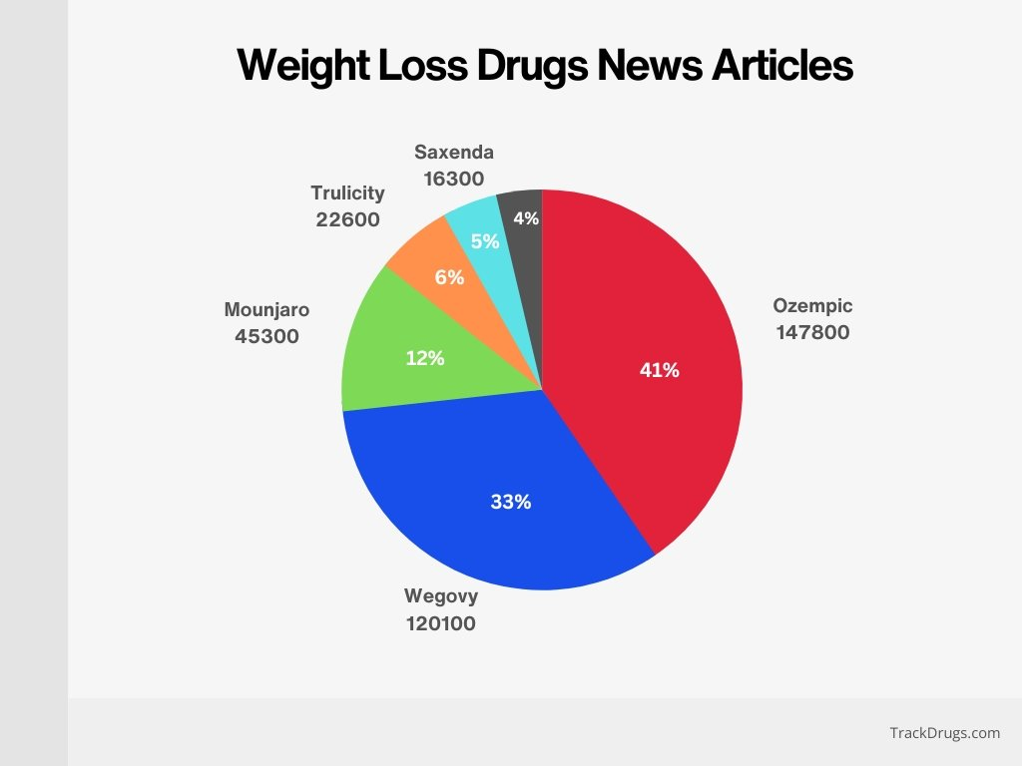
Chart 2: “Before”
Source: https://trackdrugs.com/ozempic-statistics
Notes:
This one I found when I was scrolling LinkedIn and came across an article discussing Ozempic’s rise to power.
Well look what we have here. A pie chart. It adds too many labels, its naming convention flat out cuts off Rybelsus (the gray piece), and the use of numbers and percentages does not add much.

Slide 9
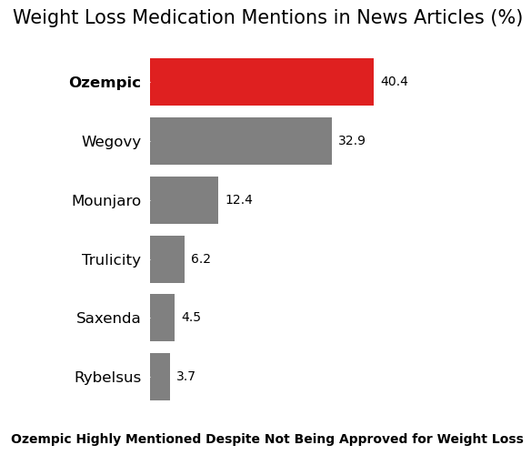
Chart 2: “After”
Notes:
The original may not have highlighted the lack of FDA approval in the chart itself, the rest of the article hammers it home. That is why it felt right to add it as a key point on the bottom there. The other graph felt like it was leading to nothing. There was no call to action despite the text of the article emphasizing the lack of FDA authorization for use in weight loss patients (especially in the section relating to the number of prescription for the product given out to people without diabetes.)

Slide 10
Chart 2: “Before” and “After”
Notes:
As you can see, the new chart has a call to action the other one did not. It uses pre-attentive attributes such as color, size, and bold to both emphasize the important part and separate the aspects of the graph that must be there (like the y label for medication, as I cannot assume everyone knows that everyone knows). And, not to mention, it is no longer a pie chart.

Slide 11
Summary of Improvements Made to Chart 2
No longer a pie chart
Utilizes red to emphasize the Ozempic among the rest
Utilizes gray to deemphasize the rest
Adds a call to action for storytelling
Includes just one of the numbers
Adds motion and closure with its spacing
Uses size to emphasize the title
Uses bold to emphasize important items
Notes:
Good to note, it is no longer a pie chart.
It emphasizes the Ozempic bar using red and takes out the rest using gray
It adds the call to action at the bottom
It uses only the percentages and not both numbers
It adds motion and closure with the graph itself being more centered
The title uses size as emphasis, which adds less load than the bold.
Bold is used to highlight the Ozempic bar and the call to action. It is not as optimal as it could be, as seaborn would not let me bold just the “not being approved for weight loss,” but that is just how it is sometimes.

Slide 12
Chart 3: Context for “Before” Chart
Why: why was this chart created (by the chart creators)?
It was made by Kroger to show the revenue breakdown for investors and potential business partners.
Who: who was this chart created for?
Investors and potential business partners.
What: what did the chart creators want the target audience to know/do?
The author wanted the investors to see their total sales.
How: what data/data source did the chart creators use (if you know)?
Their own sales data. As a big company supplying groceries, it comes with the nature of their operations.
Notes:
This next chart was found in Kroger’s 2023 factbook. The factbook is used to give an overview of the company for investors and potential business partners, so in highlighting that we can see the why and the who.
This chart specifically looks at revenue, so it is meant to show how much is being made as a jumping off point for investors.
As for the how, Kroger is a large company who sells groceries. This data would be coming in even if they were not specifically tracking it.

Slide 13
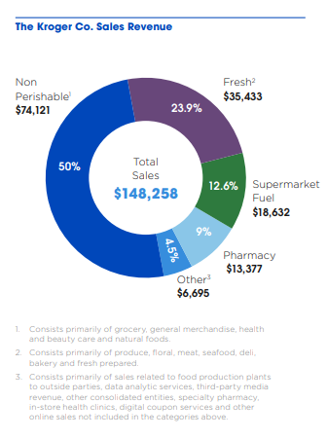
Chart 3: “Before”
Source: https://ir.kroger.com/files/doc_downloads/factbook/2023-pdf-fact-book.pdf
Notes:
My problem with this one (besides the angles and pie/donut chart dilemma,) is the lack of specification of the units alone. Earlier in the factbook, it is shown that the revenue is 148.3 billion. Any company skimming the factbook for this information, though, will lose this context and see a sales figure of 148,258, devaluing the company by not including proper units.

Slide 14
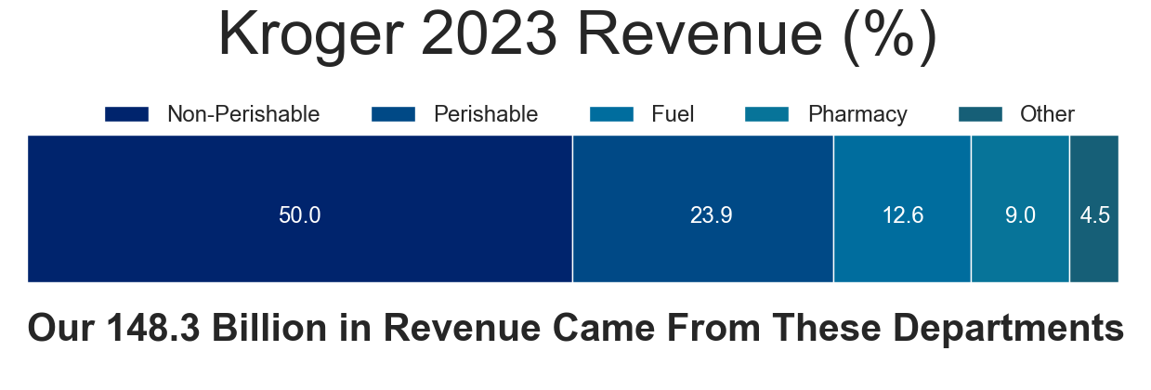
Chart 3: “After”
Notes:
The difficult choice here was to choose between percentages and actual revenue for this chart. I decided on percentages given that the original image was focused more on proportionality of the departments. Also, the percent actually fit in the “Other” column.
The colors were difficult, given that they could not be significantly lighter than one another to trigger the idea of “light good dark bad”. The seaborn ocean_d palette ended up fitting best, as it differentiates more with hue than intensity. Also, the color on the biggest portion is close to Kroger’s logo’s color.

Slide 15
Chart 3: “Before” and “After”
Notes:
I went with an approach to “unfurl the donut” so to speak. This is to show the same idea can be used without needing the angles.
The bottom text on the original was unnecessary. Other makes sense as other, people know what non-perishables are, and they really did not need to use the word fresh instead of perishable. I get the motto “fresh for everyone,” but the whole point is to make everything fresh and inviting. Using fresh for the perishables, therefore, shoots that motto in the foot.
Also, I would like to acknowledge the .0’s on the end of some of the numbers does add some load. I just could not get it to print without those. It is likely a limitation of the weird pandas.plot/matplotlib/seaborn hybrid code I had to use to get the bars to stack like this.

Slide 16
Summary of Improvements Made to Chart 3
Included units on the final number
Lowered the amount of colors
Unfurled the donut
Removed the angles
Improved the wording
Notes:
As for improvements, I added that the 148.3 is in billions of dollars. This was the key complaint I had with it, so I made sure this unit was clear.
I lowered the number of colors, using hue instead of intensity to differentiate them.
I “unfurled the donut” so to speak, making a horizontal stacked bar chart instead of a donut and thus, removing the angles.
I also improved the wording, changing fresh to perishable so that the whole background text on the bottom of the original was not necessary.

