Slide 1
Gamepad driver
Yifu Wang & Noah Goldstein

Slide 2
Motivation
Linux users often need to write their own patches
Important to understand how to access and parse different types of data streams
Gaming on Linux is seriously lacking
FUN!

Slide 3
Goals
Kernel Module:
Detects when xbox controller is plugged in
Reads input data stream from xbox
Parses data as fully state table
Writes events to file
C Program
Reads parsed data written by module
Outputs human readable results

Slide 4
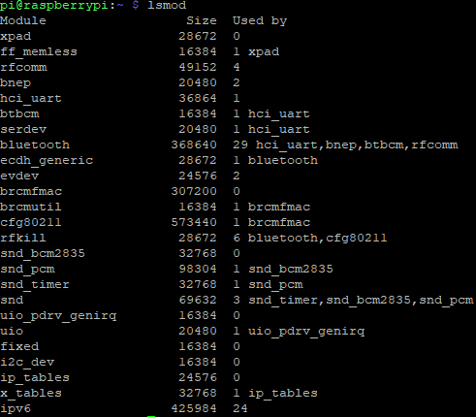
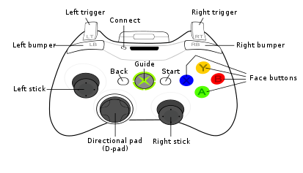
Overview

Slide 5
Overview
Disable joydev module.
Create our module, follow the stander of input device driver.
Detect device plug in/out by hotplug module.
Create & register device into input subsystem.
Handle hardware massages and provide an event stream for user.

Slide 6
Step one – remove old junk
Joydev is a old driver for retro joystic written in 1999.
It only generate button press event, and can not recognize D-pad.

Slide 7
Step two – create the skeleton
linux/input.h – linux input device driver api
linux/usb/input.h – linux usb port/input transform
struct usb_driver – pointers for all kinds of usb operation.
struct input_dev – record the event handler distributed by input subsys.

Slide 8
Life cycle
module_usb_driver – replacement of module_init & module_exit
MODULE_DEVICE_TABLE – what device are supported by this driver
probe – call back when sys find a match.
register device and input
user interrupt handle
suspend/resume and other staffs(not implemented)
disconnect

Slide 9
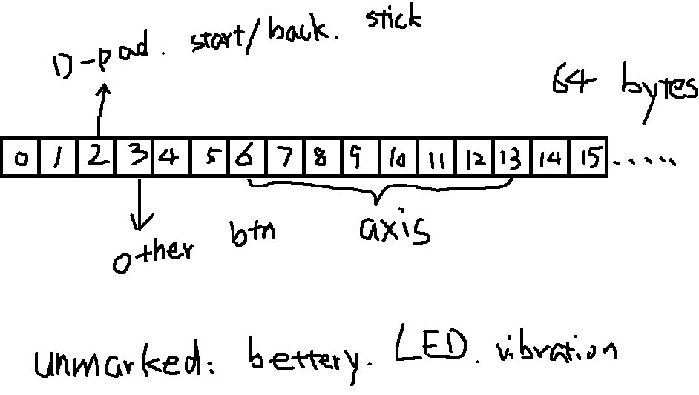
Step three – physical data

Slide 10
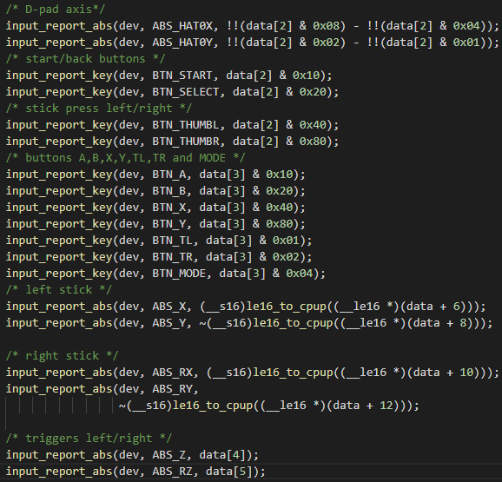
Step three – physical data

Slide 11
Creating UserSpace Reader
Read data from event file
Parse states
Print out human readable form

Slide 12
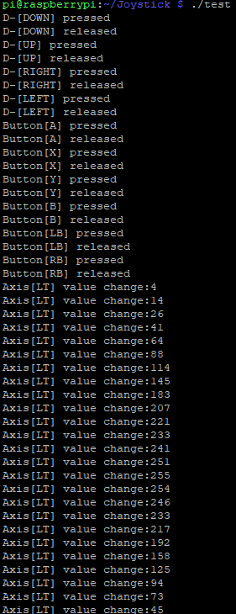
Finished Product

Slide 13
Possible Steps forward
Output: LED, vibrations.
Allow multiplexing of multiple controllers by a single program
Play some video games!

