Slide 1
Gamepad driver
Yifu Wang & Noah Goldstein

Slide 2
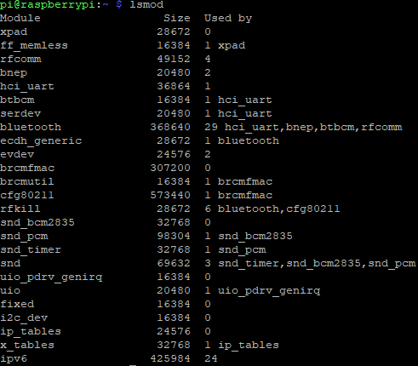
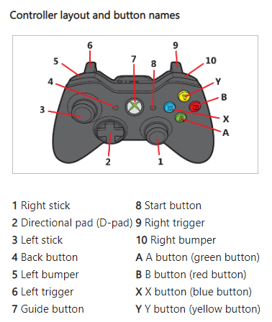
Overview

Slide 3
Overview
Disable joydev module.
Create our module, make it auto-load at boot.
Detect device plug in/out by hotplug module.
Create & register device into input subsystem.
Handle hardware massages and provide an event stream for user.

Slide 4
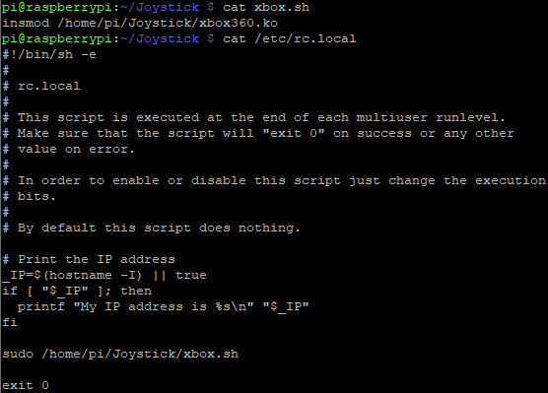
Step one
Step two

Slide 5
Step three

