Slide 1







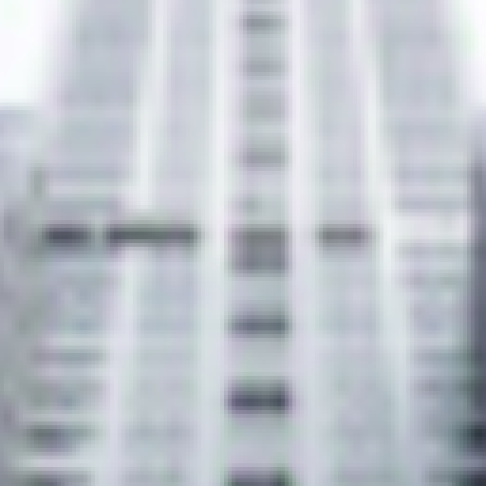



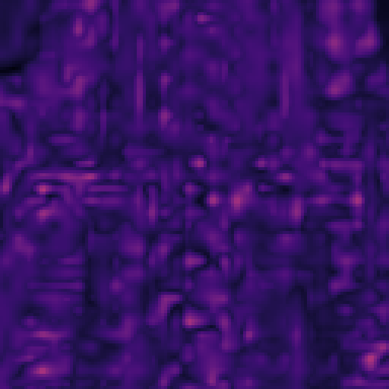
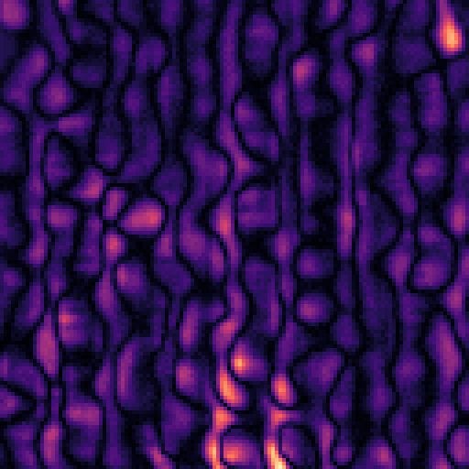
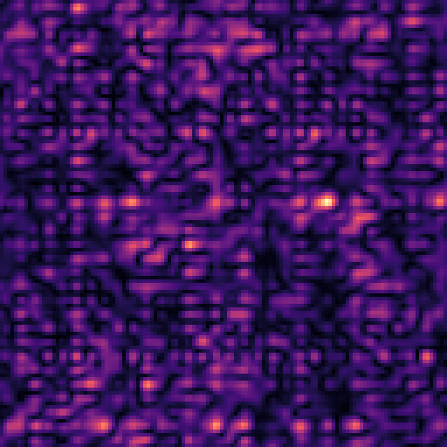
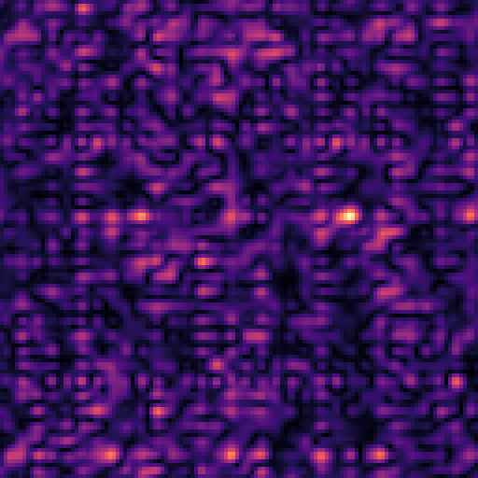





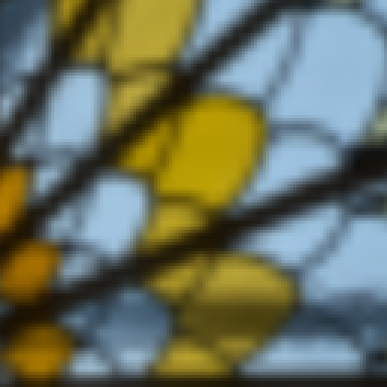
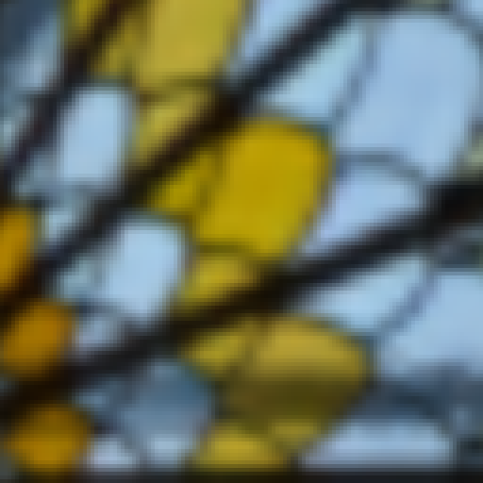



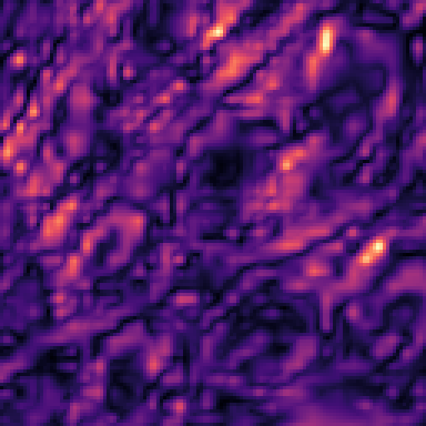
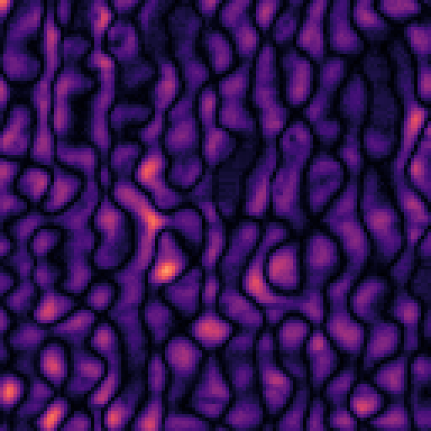
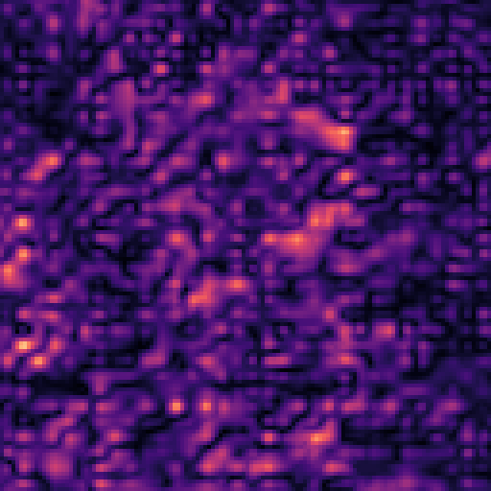
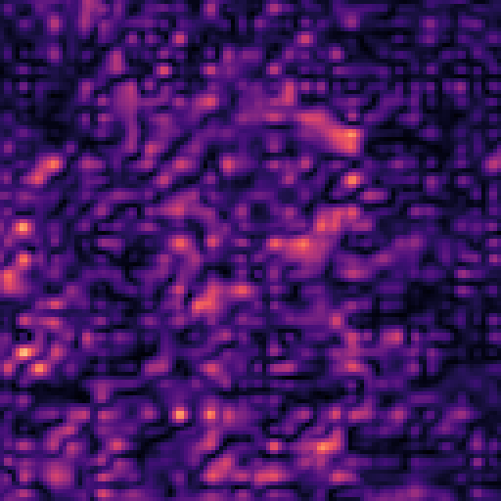
Figure 2 — matched-PSNR qualitative comparison
Original
HiDDeN-64
MaskWM-D_64
MBRS crop-trained global
Ours = Hard Local-Tail + global OKLab
Sample 1
Zoom
Residual ×10
Sample 2
Zoom
Residual ×10
All four methods are shown at validation-calibrated matched-PSNR operating points. HiDDeN-64 and MaskWM-D_64 use frozen external checkpoints with only the global residual-strength scale adjusted. Residual maps use a shared scale within each sample and are amplified ×10 for visualization.

