Slide 1
Principles of Database Systems (CS307) Lecture 13: Transaction
Ran Cheng
Department of Computer Science and Engineering
Southern University of Science and Technology
Most contents are from slides made by Stéphane Faroult and the authors of Database System Concepts (7th Edition).
Their original slides have been modified to adapt to the schedule of CS307 at SUSTech.
Notes:
In this chapter, I will introduce how to retrieve data from one table. Just from one table. I will introduce how to retrieve data from multiple table in next chapter.

Slide 2








Transaction in Real Life
“An exchange of goods for money”
A series of steps
All or nothing
Flickr:BracketingLife (Clarence)

Slide 3
Transaction in Computer
A transaction is a unit of program execution that accesses and possibly updates various data items
A classical example in database: money transfer
E.g., transaction to transfer CNY ¥50 from account A to account B:
1. read(A)
2. A := A – 50
3. write(A)
4. read(B)
5. B := B + 50
6. write(B)

Slide 4
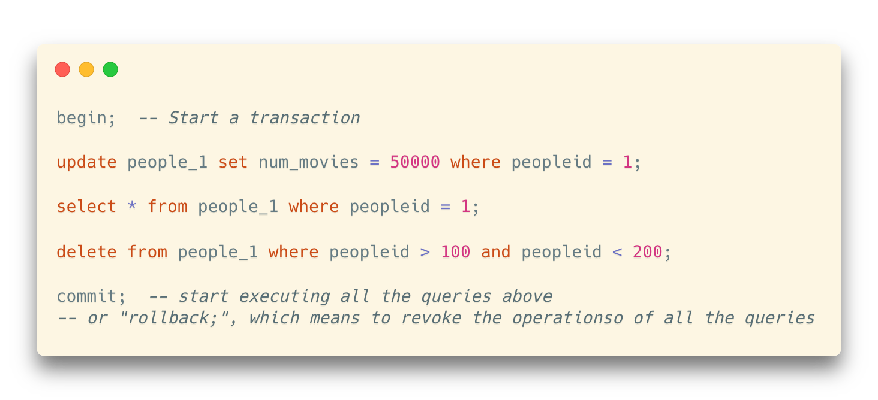
An Example of Transactions in PostgreSQL
BEGIN, COMMIT, ROLLBACK

Slide 5
Transaction in Computer
A transaction is a unit of program execution that accesses and possibly updates various data items
A classical example in database: money transfer
Two main issues to deal with:
Failures of various kinds, such as hardware failures and system crashes
Concurrent execution of multiple transactions
E.g., transaction to transfer CNY ¥50 from account A to account B:
1. read(A)
2. A := A – 50
3. write(A)
4. read(B)
5. B := B + 50
6. write(B)

Slide 6
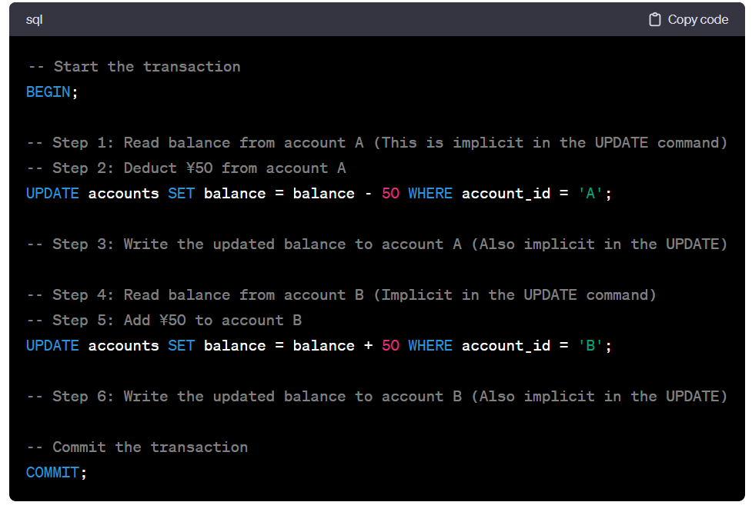
How to perform such Transactions?
The BEGIN statement starts the transaction.
The UPDATE statements implicitly include the reading and writing of the account balances.
The COMMIT statement finalizes the transaction, making all changes permanent.

Slide 7
How it works? -- ACID Properties
A transaction is a unit of program execution that accesses and possibly updates various data items
To preserve the integrity of data the database system must ensure:
Atomicity: Either all operations of the transaction are properly reflected in the database, or none are.
Consistency: Execution of a transaction in isolation preserves the consistency of the database.
Isolation: Although multiple transactions may execute concurrently, each transaction must be unaware of other concurrently executing transactions. Intermediate transaction results must be hidden from other concurrently executed transactions.
That is, for every pair of transactions T_{i} and T_{j}, it appears to T_{i} that either T_{j}, finished execution before T_{i} started, or T_{j} started execution after T_{i} finished.
Durability: After a transaction completes successfully, the changes it has made to the database persist, even if there are system failures.

Slide 8
Requirements in Transactions
Atomicity Requirement
If the transaction fails after step 3 and before step 6, money will be “lost” leading to an inconsistent database state
Failure could be due to software or hardware
The system should ensure that updates of a partially executed transaction are not reflected in the database
e.g., transaction to transfer CNY ¥50 from account A to account B:
1. read(A)
2. A := A – 50
3. write(A)
4. read(B)
5. B := B + 50
6. write(B)

Slide 9

Requirements in Transactions
Consistency Requirement
Explicitly specified integrity constraints such as primary keys and foreign keys
Implicit integrity constraints
e.g., sum of balances of all accounts
In the example: The sum of A and B is unchanged by the execution of the transaction
E.g., transaction to transfer CNY ¥50 from account A to account B:
1. read(A)
2. A := A – 50
3. write(A)
4. read(B)
5. B := B + 50
6. write(B)

Slide 10
Requirements in Transactions
Isolation Requirement
If between steps 3 and 6, another transaction T2 is allowed to access the partially updated database, it will see an inconsistent database
The sum A + B will be less than it should be
Isolation can be ensured trivially by running transactions serially, that is, one after the other
However, executing multiple transactions concurrently has significant benefits
T1 T2
1. read(A)
2. A := A – 50
write(A)
read(A), read(B), print(A+B)
4. read(B)
5. B := B + 50
6. write(B)

Slide 11
Requirements in Transactions
Durability Requirement
Once the user has been notified that the transaction has completed (i.e., the transfer of the ¥50 has taken place), the updates to the database by the transaction must persist even if there are software or hardware failures.
It guarantees that once a transaction has been committed, all the changes made in that transaction are permanent and will persist even in the event of a system failure, such as software crashes or hardware malfunctions.

Slide 12
Requirements in Transactions -- ACID
A transaction is a unit of program execution that accesses and possibly updates various data items
To preserve the integrity of data the database system must ensure:
Atomicity: Either all operations of the transaction are properly reflected in the database, or none are.
Consistency: Execution of a transaction in isolation preserves the consistency of the database.
Isolation: Although multiple transactions may execute concurrently, each transaction must be unaware of other concurrently executing transactions. Intermediate transaction results must be hidden from other concurrently executed transactions.
That is, for every pair of transactions T_{i} and T_{j}, it appears to T_{i} that either T_{j}, finished execution before T_{i} started, or T_{j} started execution after T_{i} finished.
Durability: After a transaction completes successfully, the changes it has made to the database persist, even if there are system failures.

Slide 13
Why ACID properties work?
The properties are underpinned by the Serializability Theory, which is a key concept in transaction processing.

Slide 14
Transaction State
Active
The initial state; the transaction stays in this state while it is executing
Partially committed
After the final statement has been executed.
Failed
After the discovery that normal execution can no longer proceed.
Aborted – after the transaction has been rolled back and the database restored to its state prior to the start of the transaction. Two options after it has been aborted:
Restart the transaction
Can be done only if no internal logical error
Kill the transaction
Committed
After successful completion.

Slide 15
Concurrent Executions
Multiple transactions are allowed to run concurrently in the system. Advantages are:
Increased processor and disk utilization, leading to better transaction throughput
E.g., one transaction can be using the CPU while another is reading from or writing to the disk
Reduced average response time for transactions
Short transactions do not need to wait behind long ones
Concurrency control schemes – mechanisms to achieve isolation
That is, to control the interaction among the concurrent transactions in order to prevent them from destroying the consistency of the database

Slide 16
Schedules
Schedule – a sequences of instructions that specify the chronological order (时间序列) in which instructions of concurrent transactions are executed
A schedule for a set of transactions must consist of all instructions of those transactions
Must preserve the order in which the instructions appear in each individual transaction
A transaction that successfully completes its execution will have a commit instruction as the last statement
By default, transaction assumed to execute commit instruction as its last step
A transaction that fails to successfully complete its execution will have an abort instruction as the last statement

Slide 17
Schedule 1
Let T₁ transfer CNY ¥50 from A to B, and T₂ transfer 10% of the balance from A to B
A serial schedule in which T₁ is followed by T₂ :

Slide 18
Schedule 2
A serial schedule where T₂ is followed by T₁

Slide 19
Schedule 3
Let T₁ and T₂ be the transactions defined previously
The following schedule is not a serial schedule, but it is equivalent to Schedule 1
In Schedules 1, 2 and 3, the sum A + B is preserved.

Slide 20
Schedule 4
The following concurrent schedule does not preserve the value of (A + B)

Slide 21
Serializability
Basic Assumption:
Each transaction preserves database consistency
Thus, serial execution of a set of transactions preserves database consistency
A (possibly concurrent) schedule is serializable if it is equivalent to a serial schedule
Different forms of schedule equivalence give rise to the notions of:
1. Conflict serializability
2. * View serializability

Slide 22
Simplified View of Transactions
We ignore operations other than read and write instructions
We assume that transactions may perform arbitrary computations on data in local buffers in between reads and writes.
Our simplified schedules consist of only read and write instructions.

Slide 23
Conflicting Instructions
Instructions l_{i} and l_{j} , of transactions T_{i} and T_{j} respectively, conflict if and only if there exists any item Q accessed by both l_{i} and l_{j}, and at least one of these instructions wrote Q.
1. l_{i} = read(Q), l_{j} = read(Q). l_{i} and l_{j} don’t conflict
2. l_{i} = read(Q), l_{j} = write(Q). They conflict.
3. l_{i} = write(Q), l_{j} = read(Q). They conflict
4. l_{i} = write(Q), l_{j} = write(Q). They conflict
Intuitively, a conflict between l_{i} and l_{j} forces a (logical) temporal order between them.
If l_{i} and l_{j} are consecutive in a schedule and they do not conflict, their results would remain the same even if they had been interchanged in the schedule.

Slide 24
Conflict Serializability
If a schedule S can be transformed into a schedule S’ by a series of swaps of non-conflicting instructions, we say that S and S’ are conflict equivalent
We say that a schedule S is conflict serializable if it is conflict equivalent to a serial schedule

Slide 25
Conflict Serializability
Schedule 3 can be transformed into Schedule 6, a serial schedule where T₂ follows T₁
… by series of swaps of non-conflicting instructions
Therefore, Schedule 3 is conflict serializable.
Operations on different data
… and hence swappable in temporal order
Schedule 3
Schedule 6

Slide 26
Conflict Serializability
Example of a schedule that is not conflict serializable:
We are unable to swap instructions in the above schedule to obtain either the serial schedule < T₃, T₄ >, or the serial schedule < T₄, T₃ >.

Slide 27
* View Serializability
Let S and S’ be two schedules with the same set of transactions. S and S’ are view equivalent if the following three conditions are met, for each data item Q,
If in schedule S, transaction T_{i} reads the initial value of Q, then in schedule S’ also transaction T_{i} must read the initial value of Q.
If in schedule S transaction T_{i} executes read(Q), and that value was produced by transaction T_{j} (if any), then in schedule S’ also transaction T_{i} must read the value of Q that was produced by the same write(Q) operation of transaction T_{j} .
The transaction (if any) that performs the final write(Q) operation in schedule S must also perform the final write(Q) operation in schedule S’.
As can be seen, view equivalence is also based purely on reads and writes alone.

Slide 28
* View Serializability
A schedule S is view serializable if it is view-equivalent to a serial schedule
Every conflict serializable schedule is also view serializable
Below is a schedule which is view-serializable but not conflict serializable
What serial schedule is above equivalent to?
Every view-serializable schedule that is not conflict serializable has blind writes
Blind write: Write operations without reading it before
Two “blind writes” in T27 and T28
Since the written values were not used anywhere else
Overwrites values from T27 and T28
… and hence, swapping write(Q) in T27 and T28 will not affect the resulting value of Q

Slide 29
Testing for Serializability
Consider some schedule of a set of transactions T₁, T₂, ..., T_{n}
Precedence graph
A directed graph where the vertices are the transactions (names of the transactions)
We draw an arc from T_{i} to T_{j} if the two transactions conflict
which means, in the schedule S, T_{i} must appear earlier than T_{j}
We may label the arc by the item that was accessed.
Conflict – At least one of the following situations exists for a data item Q:
T_{i}: write(Q) -> T_{j}: read(Q)
T_{i}: read(Q) -> T_{j}: write(Q)
T_{i}: write(Q) -> T_{j}: write(Q)

Slide 30
Testing for Serializability
T₁
T₁
T₂
T₂
Schedule 1
Schedule 2

Slide 31
Testing for Serializability
Schedule 4

Slide 32
Testing for Serializability
A schedule is conflict serializable if and only if its precedence graph is acyclic
If the precedence graph is acyclic, the serializability order can be obtained by a topological sorting of the graph
E.g., The topological order of (a) can be (b) and (c)
Cycle-detection: You will learn it in you DSAA course.

Slide 33
Recoverable Schedules
Need to address the effect of transaction failures on concurrently running transactions
Recoverable schedule — if a transaction T_{j} reads a data item previously written by a transaction T_{i} , then the commit operation of T_{i} appears before the commit operation of T_{j}.
The following schedule is not recoverable
If T₈ should abort, T₉ would have read (and possibly shown to the user) an inconsistent database state. Hence, database must ensure that schedules are recoverable.

Slide 34
Weak Levels of Consistency
Some applications are willing to live with weak levels of consistency, allowing schedules that are not serializable
E.g., a read-only transaction that wants to get an approximate total balance of all accounts
Such transactions do not need to be serializable with respect to other transactions
Purpose: Trade-off between accuracy and performance

Slide 35
Levels of Consistency (in SQL-92)
Serializable (Strongest)
Default
Repeatable read — only committed records to be read.
Repeated reads of same record must return same value.
However, a transaction may not be serializable – it may find some records inserted by a transaction but not find others.
Read committed — only committed records can be read.
Successive reads of record may return different (but committed) values.
Read uncommitted (Weakest) — even uncommitted records may be read.

Slide 36
Levels of Consistency
Lower degrees of consistency can be useful for gathering approximate information about the database
Warning: some database systems do not ensure serializable schedules by default
E.g., Oracle (and PostgreSQL prior to version 9) by default support a level of consistency called snapshot isolation (not part of the SQL standard)
Warning 2: All SQL-92 consistency levels infer that dirty writes are prohibited
Dirty write - when one transaction overwrites a value that has previously been written by another still in-flight transaction

