Slide 1
Principles of Database Systems (CS307) Lecture 13: Indexing
Ran Cheng
Department of Computer Science and Engineering
Southern University of Science and Technology
Most contents are from slides made by Stéphane Faroult and the authors of Database System Concepts (7th Edition).
Their original slides have been modified to adapt to the schedule of CS307 at SUSTech.
Notes:
In this chapter, I will introduce how to retrieve data from one table. Just from one table. I will introduce how to retrieve data from multiple table in next chapter.

Slide 2
Intro

Slide 3
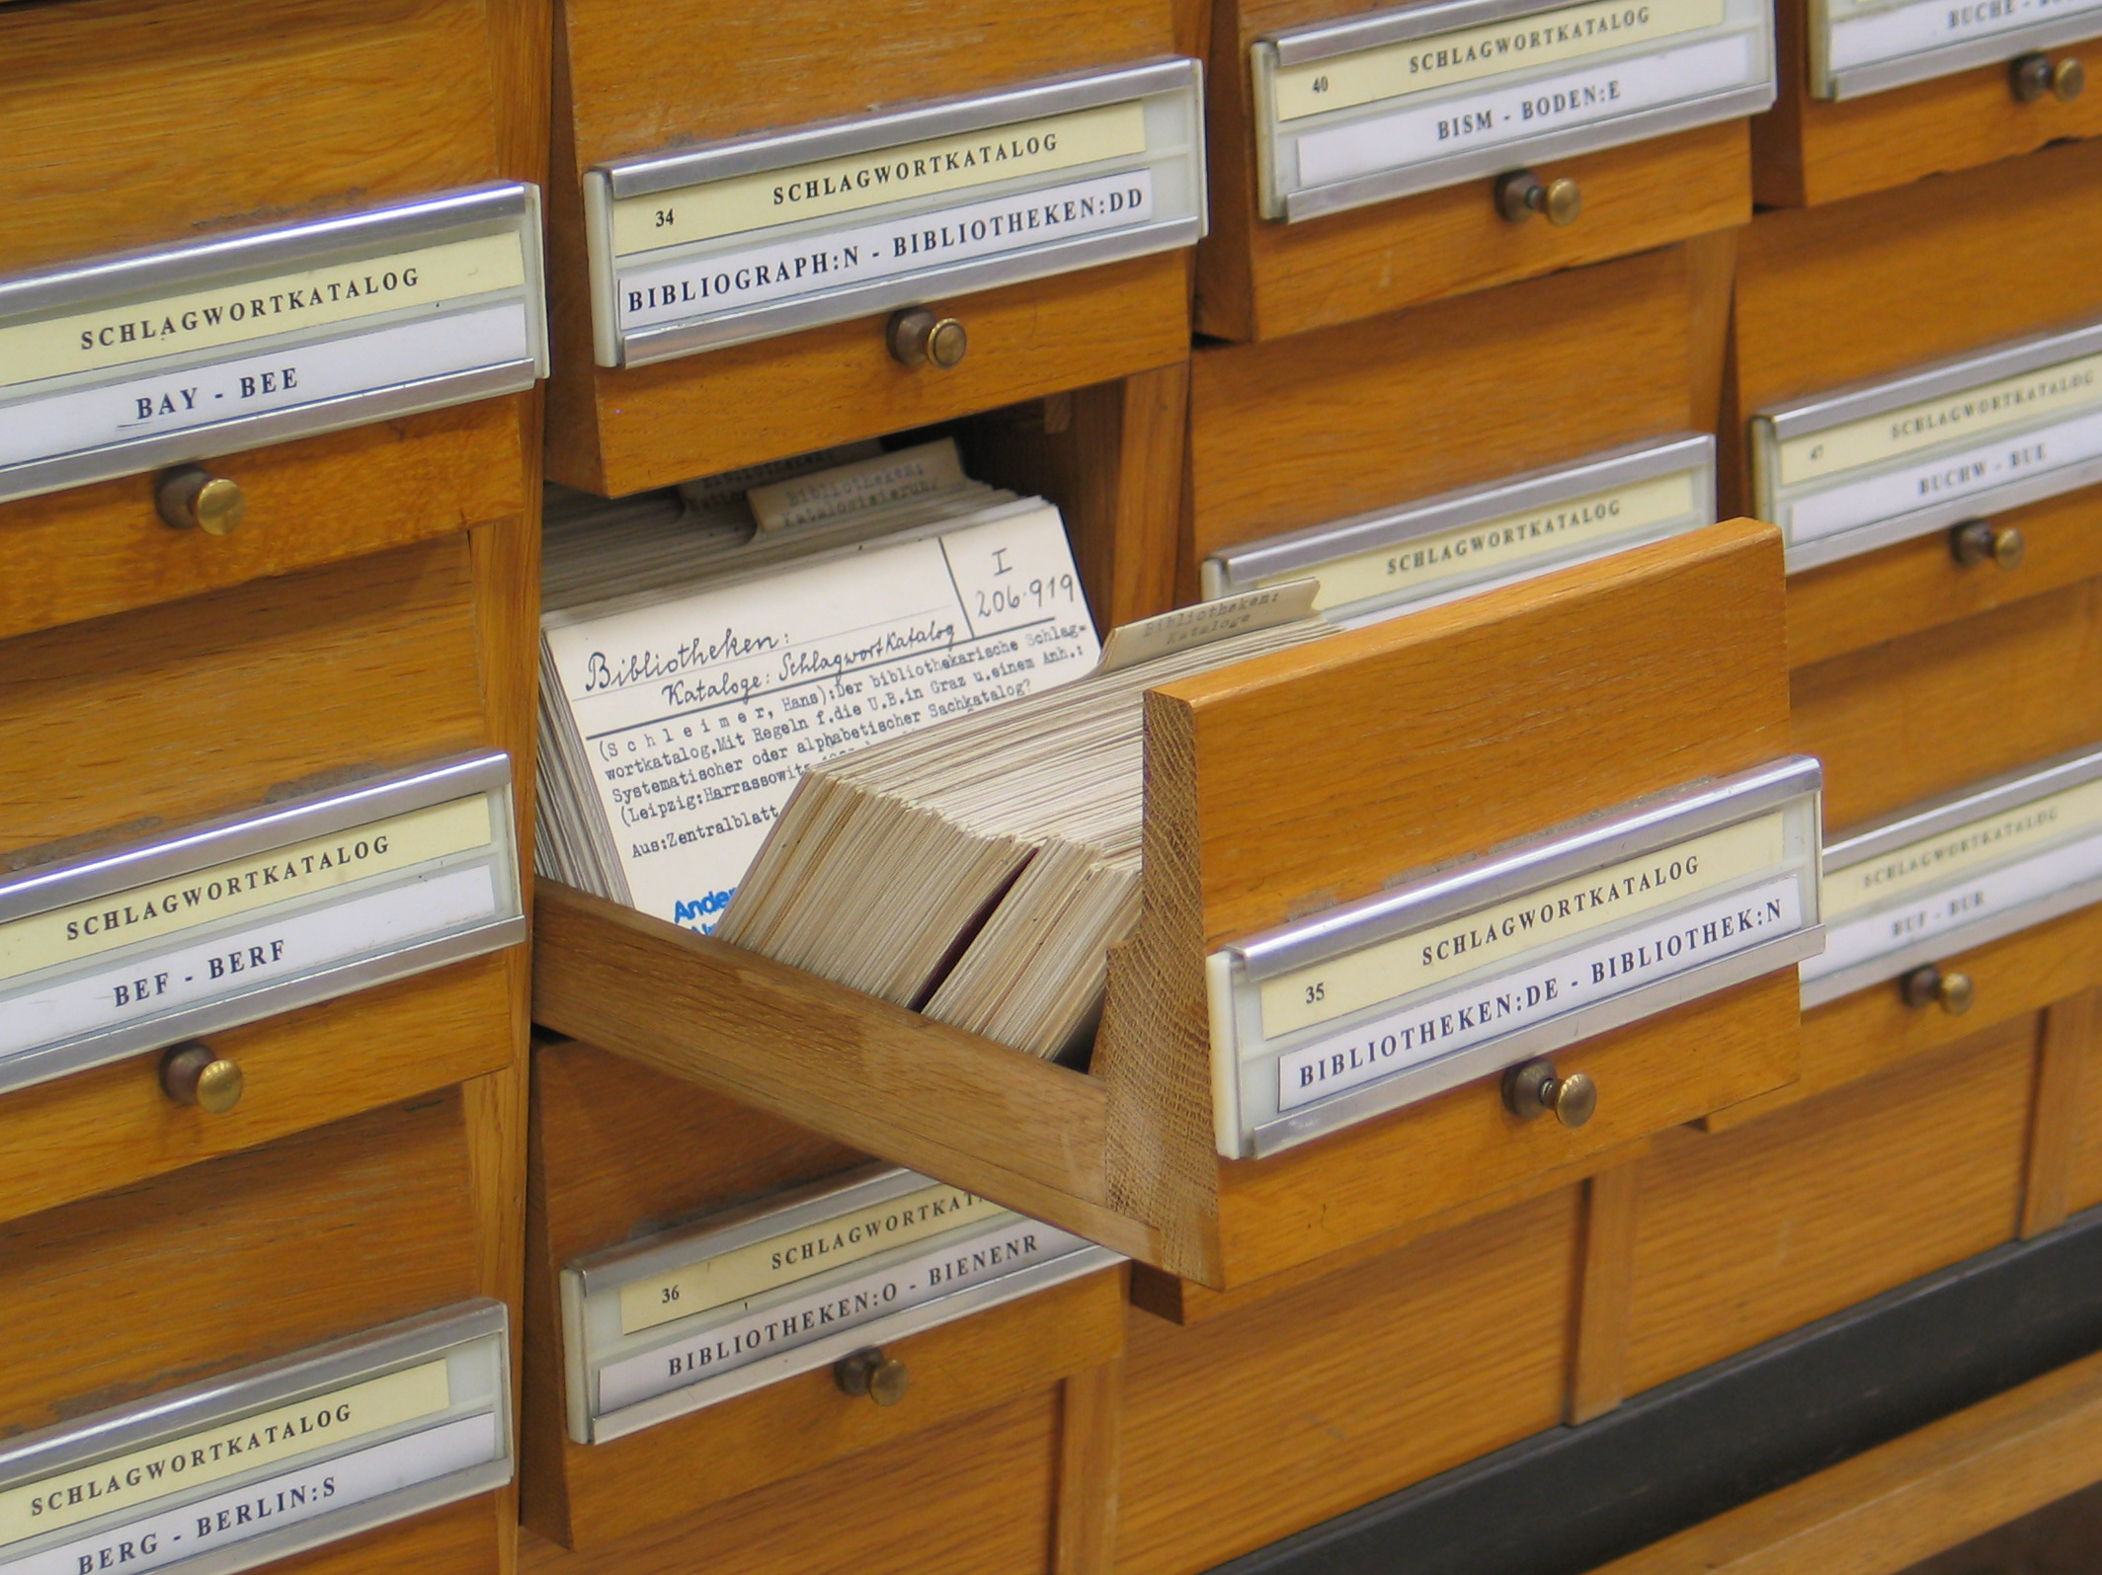
Motivation
Think about an example in a library:
How can we find a book?
Books are on the shelves in a sequential order
We had drawers where you could look for books by author, title or sometimes subject that were telling you what were the "coordinates" of a book.

Slide 4
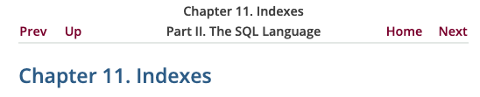
Terminology
Plural of index: indices, or indexes?
Both are correct in English
indices (Latin): Often used in scientific and mathematical context representing the places of an element in an array, vector, matrix, etc.
indexes (American English): Used in publishing for the books
What about database?
A good way: Follow the naming convention of the project or the DBMS
https://www.postgresql.org/docs/current/indexes.html

Slide 5
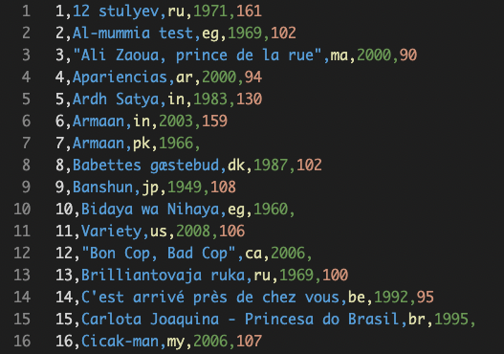
Searching for Record
Remember searching algorithms in Data Structure?
Linear search
Scan all records from top to bottom
Binary search
Divide and conquer
Assumption: Records are sorted by the search key

Slide 6
Searching for Record
Remember searching algorithms in Data Structure?
Linear search
Scan all records from top to bottom
Binary search
Divide and conquer
Assumption: Records are sorted by the search key
E.g., Find movies with IDs larger than 100 and smaller than 200
In the current storage structure, the records are sorted by movieid
So, it will be easy to find a specific movieid with binary search

Slide 7
Searching for Record
Remember searching algorithms in Data Structure?
Linear search
Scan all records from top to bottom
Binary search
Divide and conquer
Assumption: Records are sorted by the search key
However, how can we find data based on the non-sorted columns?
E.g., find all Chinese movies
country
Find the rows where country = ‘cn’
The country codes are not sorted in the current storage structure, so the binary search algorithm cannot be used

Slide 8
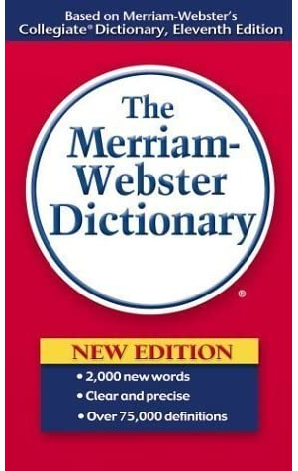

Searching for Record
This happens in real life too
English dictionary
The words are sorted in an alphabetical order
Chinese dictionary
The characters are usually sorted in the alphabetical order of Pinyin

Slide 9
Searching for Record
This happens in real life too
English dictionary
The words are sorted in an alphabetical order
Chinese dictionary
The characters are sorted in the alphabetical order of Pinyin
However, we have other ways of looking up a character
Radicals (偏旁部首)
Number of strokes (数笔画)
Four-corner method (四角号码)

Slide 10
Practical Use

Slide 11
Index in Databases
Concept
An index is a data structure which improves the efficiency of retrieving data with specific values from a database
Usually, indexes locate a row by a series of location indicators
E.g., (filename, block number, offset)

Slide 12
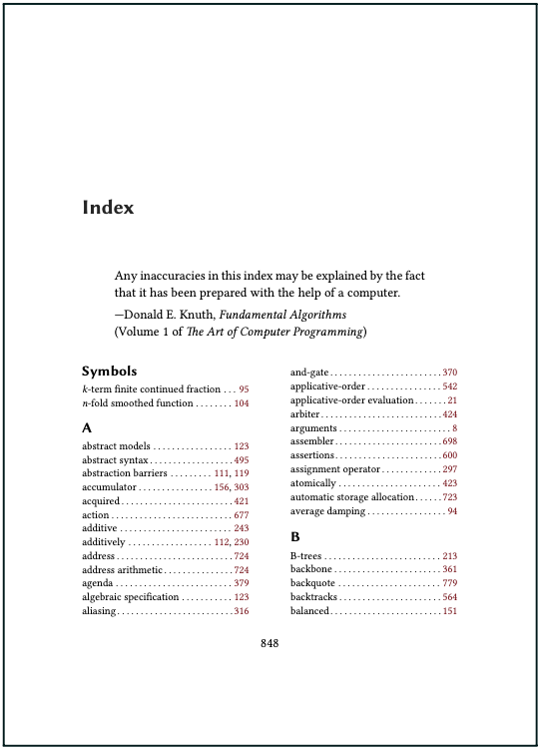

Index in Databases
Concept
An index is a data structure which improves the efficiency of retrieving data with specific values from a database
Usually, indexes locate a row by a series of location indicators
E.g., (filename, block number, offset)
It is like indexes in books
Location indicator: (page, row)

Slide 13

Index in Databases
Actually, we have been benefited from indexes off-the-shelf
In PostgreSQL, indexes are built automatically on columns with primary key or unique constraints

Slide 14
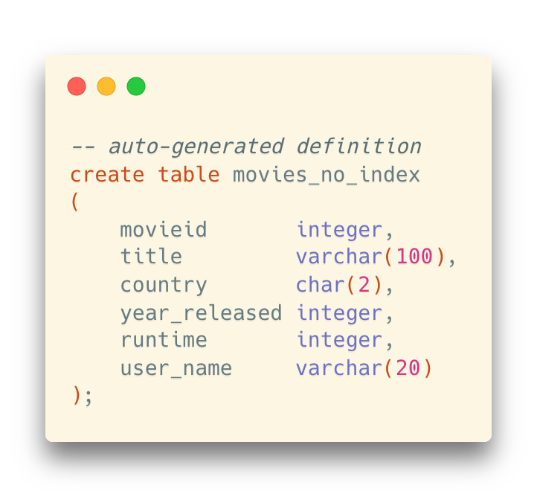
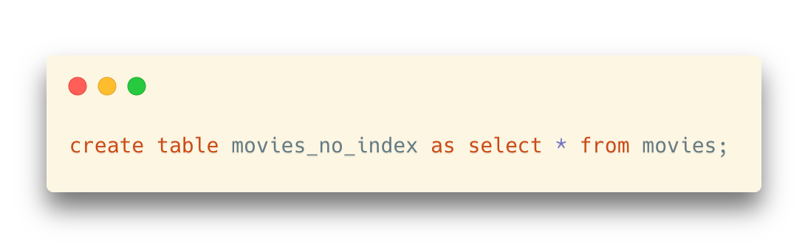
Experiment on Using Indexes
Duplicate a table with no index

Slide 15
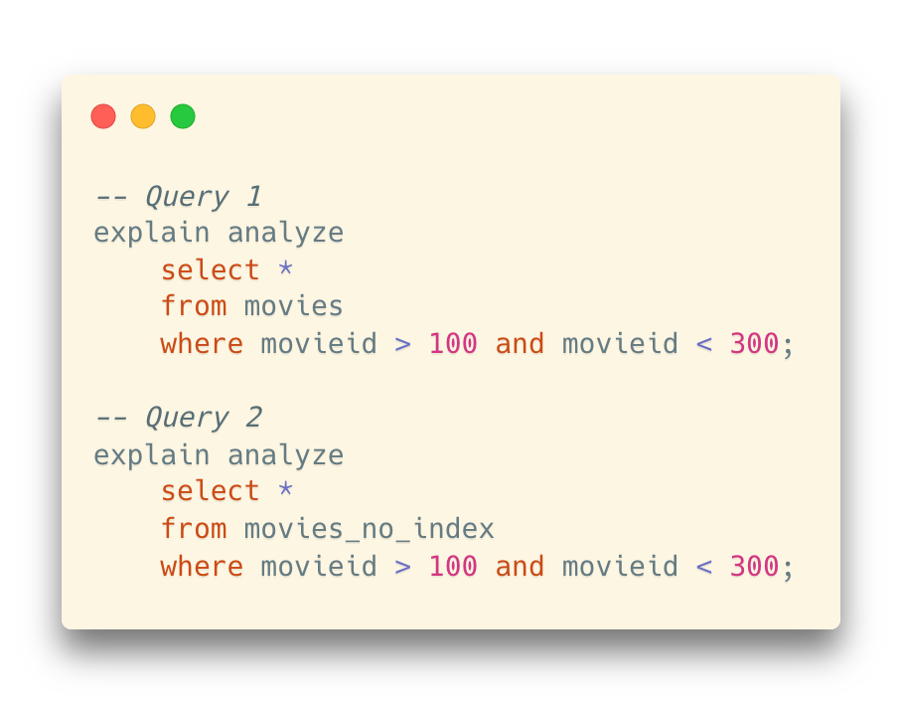
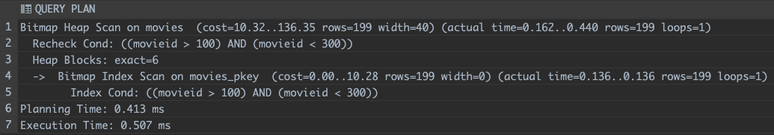
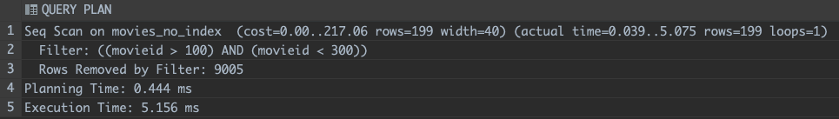
Experiment on Using Indexes
Check the performance on retrieving data
Significant difference between queries on the two tables
Query 1
(on movies)
Query 2
(on movies_no_index)

Slide 16
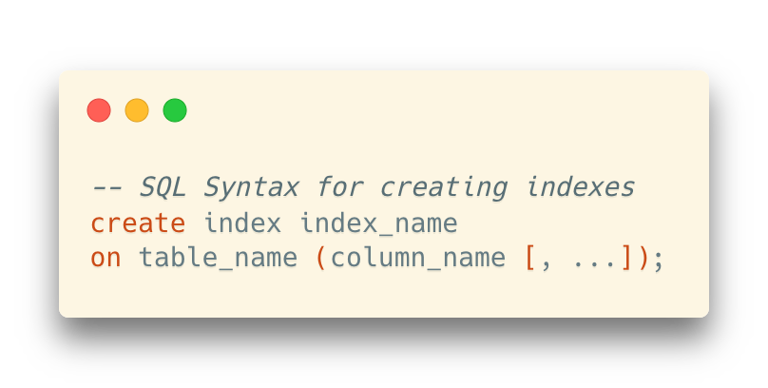
Experiment on Using Indexes
If there is no index on a column (or several columns), we can create one manually

Slide 17
Theoretical Aspects

Slide 18
Index Taxonomy
1) In terms of storage structure, is the index completely separated with the data records?
No ⇒ Integrated index
PK index in a MySQL InnoDB database
PK index in a SQL Server database
Yes ⇒ External index
Indexes in a PostgreSQL database
Indexes in a MySQL MyISAM database

Slide 19
Index Taxonomy
2) Does the index specify the order in which records are stored in the data file?
Yes ⇒ Clustered index (a.k.a. primary index)
No ⇒ Non-clustered index (a.k.a. secondary index)
Salary
A secondary index on the column “salary”
Index record points to a bucket that contains pointers to all the actual records with that particular search-key value
Secondary indices have to be dense

Slide 20
Index Taxonomy
2) Does the index specify the order in which records are stored in the data file?
Yes ⇒ Clustered index (a.k.a. primary index)
No ⇒ Non-clustered index (a.k.a. secondary index)
Salary
A secondary index on the column “salary”
Index record points to a bucket that contains pointers to all the actual records with that particular search-key value
Secondary indices have to be dense
bucket

Slide 21
Index Taxonomy
3) Does every search key in the data file correspond to an index entry?
Yes ⇒ Dense Index
No ⇒ Sparse Index
Dense Index
Sparse Index

Slide 22
Index Taxonomy
4) Does the search key contain more than one attribute?
Yes ⇒ Multi-key index (Multi-column index)
No ⇒ Single-key index (Single-column index)
We mainly focus on single-key index for now

Slide 23
Index Implementation
Data Structures for Indexes
B-tree, B+-tree
Very famous data structures for building indexes
Hash table

Slide 24
B-tree
A B-tree of order m satisfies that
For every node, # of children = # of keys + 1
(Ordered) For a node containing n keys (K₁ <K₂ <K₃ <···<K_{n}) with n+1 children (pointed by P₀, P₁, P₂, . . . , P_{n}), any key k_{sub i} in the sub-tree pointed by P_{i} satisfies that K_{i} < k_{sub i} < K_{i+1}
(Multiway) For an internal node, ⌈m/2⌉ ≤ # of children ≤ m
… except that a root node may have less than ⌈m/2⌉ children
(Always balanced) All leaves appear on the same level

Slide 25
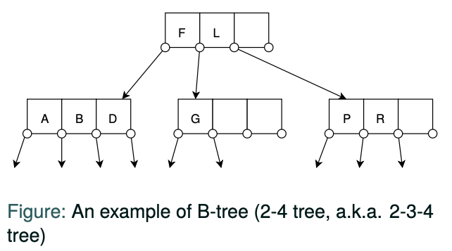
B-tree
A B-tree of order m satisfies that
For every node, # of children = # of keys + 1
(Ordered) For a node containing n keys (K₁ <K₂ <K₃ <···<K_{n}) with n+1 children (pointed by P₀, P₁, P₂, . . . , P_{n}), any key k_{sub i} in the sub-tree pointed by P_{i} satisfies that K_{i} < k_{sub i} < K_{i+1}
(Multiway) For an internal node, ⌈m/2⌉ ≤ # of children ≤ m
… except that a root node may have less than ⌈m/2⌉ children
(Always balanced) All leaves appear on the same level

Slide 26
B-tree
Tree Node
Keys (inside a node)
A B-tree of order m satisfies that
For every node, # of children = # of keys + 1
(Ordered) For a node containing n keys (K₁ <K₂ <K₃ <···<K_{n}) with n+1 children (pointed by P₀, P₁, P₂, . . . , P_{n}), any key k_{sub i} in the sub-tree pointed by P_{i} satisfies that K_{i} < k_{sub i} < K_{i+1}
(Multiway) For an internal node, ⌈m/2⌉ ≤ # of children ≤ m
… except that a root node may have less than ⌈m/2⌉ children
(Always balanced) All leaves appear on the same level

Slide 27
B-tree
A B-tree of order m satisfies that
For every node, # of children = # of keys + 1
(Ordered) For a node containing n keys (K₁ <K₂ <K₃ <···<K_{n}) with n+1 children (pointed by P₀, P₁, P₂, . . . , P_{n}), any key k_{sub i} in the sub-tree pointed by P_{i} satisfies that K_{i} < k_{sub i} < K_{i+1}
(Multiway) For an internal node, ⌈m/2⌉ ≤ # of children ≤ m
… except that a root node may have less than ⌈m/2⌉ children
(Always balanced) All leaves appear on the same level
⌈m/2⌉ is the called the minimum branching factor (a.k.a. minimum degree) of the tree
A B-tree of order m is usually called a “⌈m/2⌉-m tree”, like 2-3 tree, 2-4 tree, 3-5 tree, 3-6 tree, . . .
In practice, the order m is much larger (~100)

Slide 28
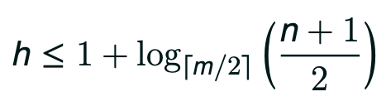
B-tree
Height of a B-tree:
If we take an 50-100 tree with 1M records:
h ≤ 1+log_{100/2}(1000000/2) = 4.354 (i.e., 4 levels)

Slide 29
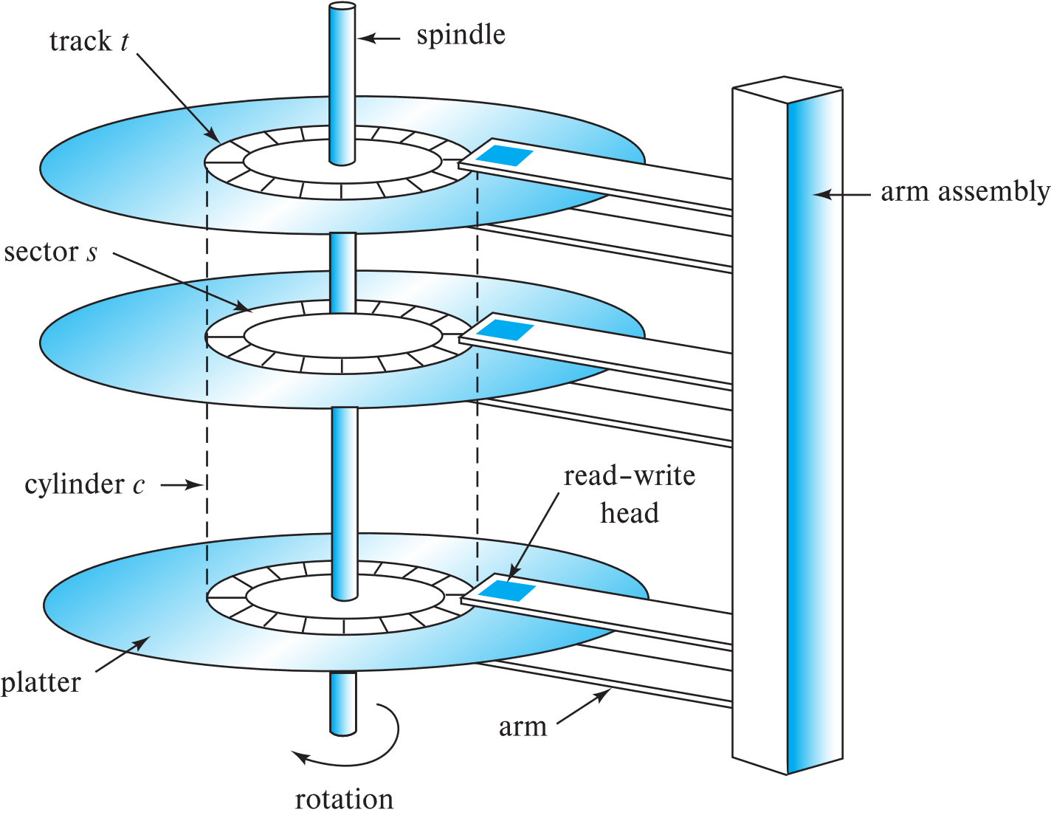
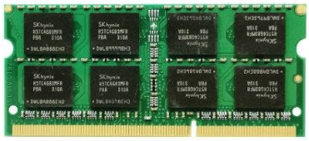
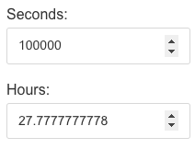
B-tree
Height of a B-tree:
If we take an 50-100 tree with 1M records:
h ≤ 1+log_{100/2}(1000000/2) = 4.354 (i.e., 4 levels)
Why do we use B-trees?
We can set the size of a B-tree node as the disk page size
i.e., m can be chosen with consideration on the page size
The height of the tree -> Number of disk I/Os
The number of disk I/Os can be relatively small
Access time: 5-20ms
1ns = 10⁻⁶ms
Access time: 50-70ns

Slide 30
B-tree
Tree operations:
Search, Insert, Delete
Update (Delete + Insert)
What is special in B-tree
Split and merge nodes

Slide 31
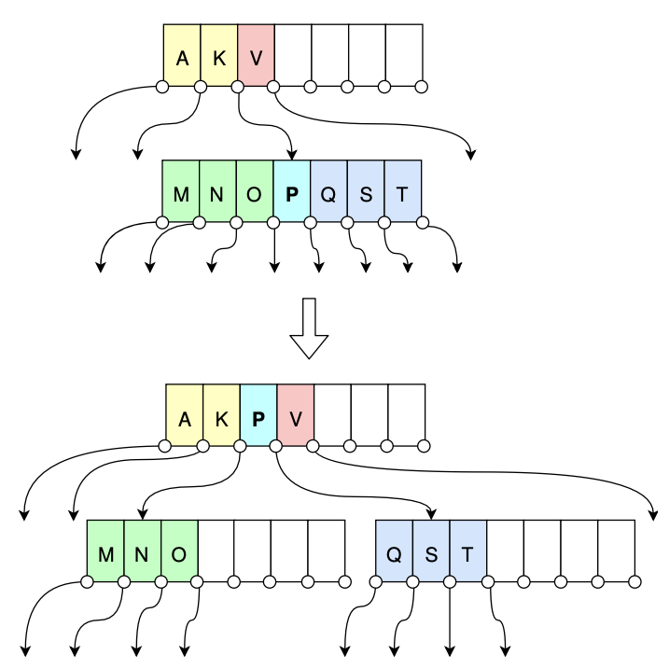
B-tree
Split a node in a B-tree
Example: when m=7
… and we want to insert the record with key=“P”

Slide 32
B-tree
Split a node in a B-tree
Example: when m=7
… and we want to insert the record with key=“P”
The number of children is larger than m (7)
This node will be split into two nodes
The pivot key will be elevated into the parent node

Slide 33
B-tree
Split a node in a B-tree
Example: when m=7
… and we want to insert the record with key=“P”
What if the parent (or even the root) node is also full?
The number of children is larger than m (7)
This node will be split into two nodes
The pivot key will be elevated into the parent node

Slide 34
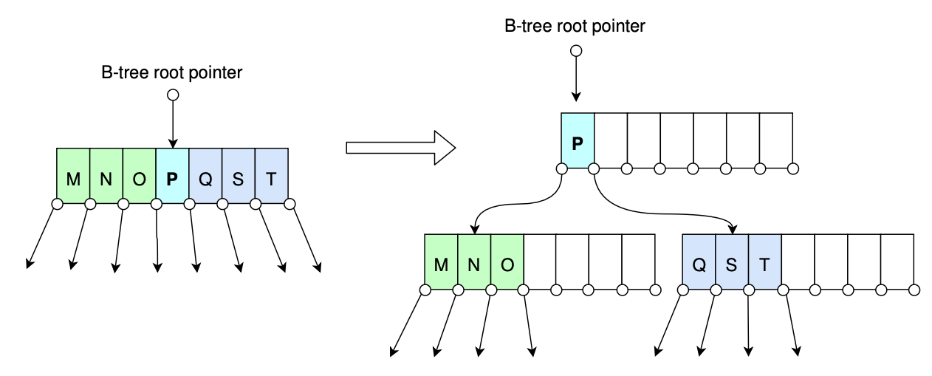
B-tree
Split a node in a B-tree
Example: when m=7
… and we want to insert the record with key=“P”
Split the root node of the B-tree
Note that the height of the B-tree is increased by 1
This is the only way that a B-tree increases its height

Slide 35
B+-tree
A Problem in B-tree: Table traversal when only the B-tree is provided
In B-tree, data are stored on all nodes
What if we want to traverse all records in the table?
select * from letters
For example, we have accessed the node for letter “O”
How can we find the next row?
We must go back to the parent node to access “P” (extra time cost)

Slide 36
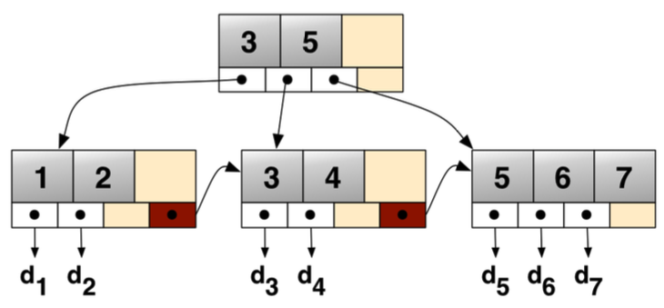
B+-tree
Features of a B+-tree (compared with B-trees)
Data stored only in leaves
Leaves are linked sequentially

Slide 37
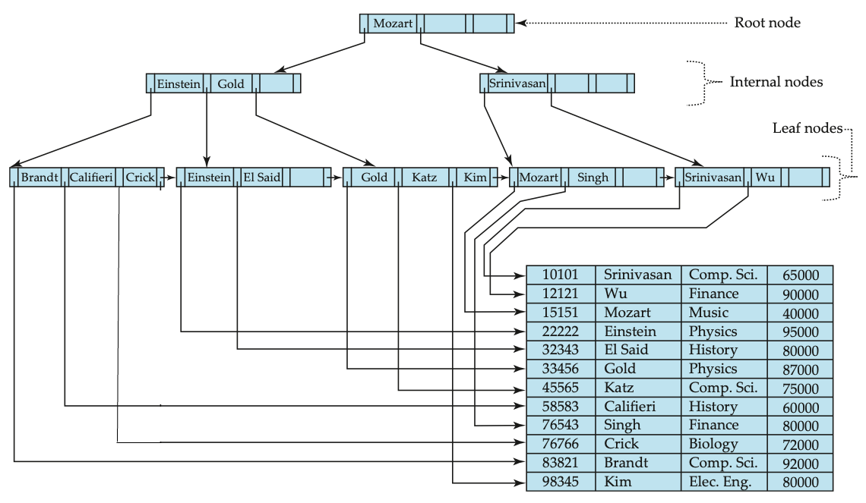
B+-tree
A complete example of a B+-tree
Data stored only in leaves
No need to squeeze data into non-leaf nodes
Leaves are linked sequentially
Faster table traversal from top to bottom
Better support for range queries

Slide 38
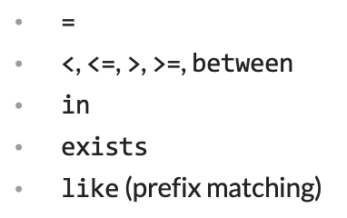
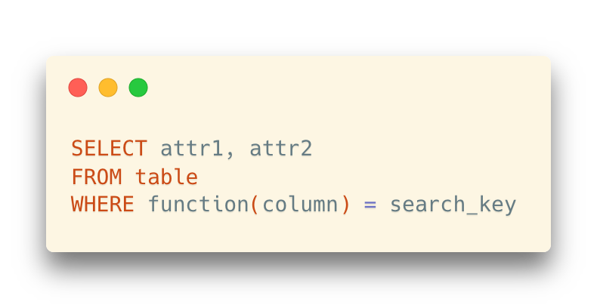
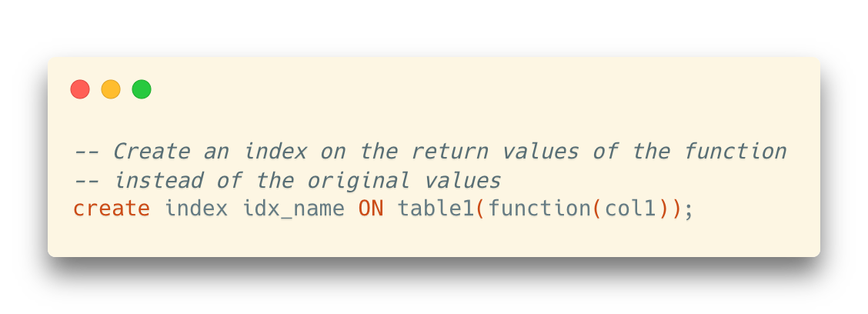
Index It or Not: Where Indexing May Help
Check whether the PK / Unique index helps first
Index those columns frequently appeared as search criteria
Be cautious when the indexed columns need frequent writing operations
Overhead to update indexes in insert, update, and delete opereations
Functions
Note: The expression should be deterministic. For detailed usage, please refer to: https://www.postgresql.org/docs/14/indexes-expressional.html

Slide 39
Index It or Not: Where Indexing May Help
Be cautious when using indexes on a small table
Full scan ≠ Bad scheme
Index retrieval ≠ Good scheme

Slide 40
Hashing
A bucket is a unit of storage containing one or more entries
A bucket is typically a disk block
We obtain the bucket of an entry from its search-key value using a hash function
Hash function h is a function from the set of all search-key values K to the set of all bucket addresses B
Hash function is used to locate entries for access, insertion as well as deletion.
Entries with different search-key values may be mapped to the same bucket
… thus, the entire bucket must be searched sequentially to locate an entry.

Slide 41
Hashing Index & Hashing File Organization
In a hash index, buckets store entries with pointers to records
In a hash file-organization, buckets store records
bucket1
bucket2
15151: block 1, offset 0
32343: block 3, offset 0
58583: block 3, offset 24

Slide 42
Example: How join Works (with the help of indexes)
Some widely used join algorithms
Nested-loop join
Hash join
Sort-merge join

Slide 43
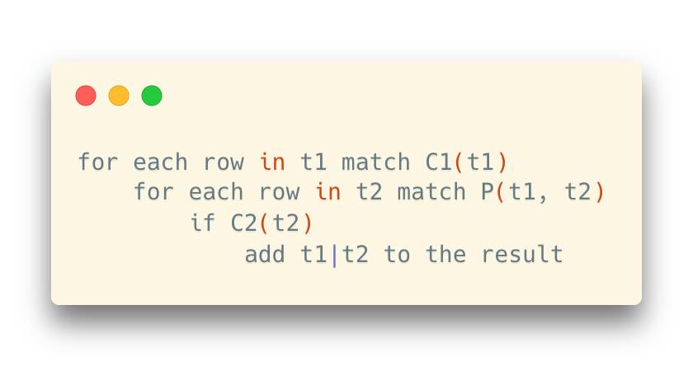
Example: How join Works (with the help of indexes)
Nested (loop) join
Straight-forward linking between records from two tables in a nested-loop manner

Slide 44
Example: How join Works (with the help of indexes)
Hash join
Build a set of buckets for a smaller table to speed up the data lookup
Procedure:
1. Create a hash table for the smaller table t1 in the memory
2. Scan the larger table t2. For each record r,
2.1 Compute the hash value of r.join_attribute
2.2 Map to corresponding rows in t1 using the hash table

Slide 45
Example: How join Works (with the help of indexes)
Sort-merge join (a.k.a. merge join)
Zipper-like joining
Procedure:
1. Sort tables t1 and t2 respectively according to the join attributes
2. Perform an interleaved scan of t1 and t2. When encountering a matched value, join the related rows together.
When there are clustered indexes on the join attributes, step 1, the most expensive operation, can be skipped because t1 and t2 are already sorted in this scenario.

