Slide 1
Principles of Database Systems (CS307) Lecture 2: Introduction to SQL
Ran Cheng
Department of Computer Science and Engineering
Southern University of Science and Technology
Most contents are from slides made by Stéphane Faroult and the authors of Database System Concepts (7th Edition).
Their original slides have been modified to adapt to the schedule of CS307 at SUSTech.

Slide 2
How Do We Manage Data in a Database?
Usually, a special language is needed
Be able to use a language to query a database
Either interactively or from within a program
Query language
Query data
Modify data
Notes:
After we store data into a database, we need a language.
The language can be used to query the data or modify the data. The language should be a query language.

Slide 3
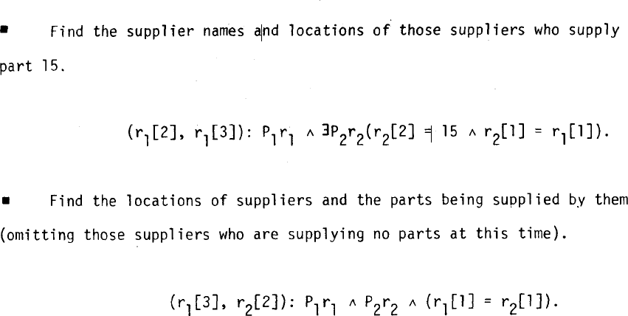

Some History
ALPHA
Codd’s querying language
Codd, E.F., "Data Base Sublanguage Founded on the Relational Calculus", Proc. 1971 ACM-SIGFIDET Workshop on Data Description, Access, and Control, San Diego.
Notes:
At the beginning Codd defined a language. Its name is Alpha.
If you want to find some rows in the table,
Here if you want to find…
You should program like this!
I’m sure the language will make you headache. If I teach this language, maybe many of you will quit the course.

Slide 4
Some History
ALPHA
Codd’s querying language
Codd, E.F., "Data Base Sublanguage Founded on the Relational Calculus", Proc. 1971 ACM-SIGFIDET Workshop on Data Description, Access, and Control, San Diego.
However, it didn’t excite enthusiasm at IBM
Notes:
At the beginning Codd defined a language. Its name is Alpha.
If you want to find some rows in the table,
Here if you want to find…
You should program like this!
I’m sure the language will make you headache. If I teach this language, maybe many of you will quit the course.

Slide 5
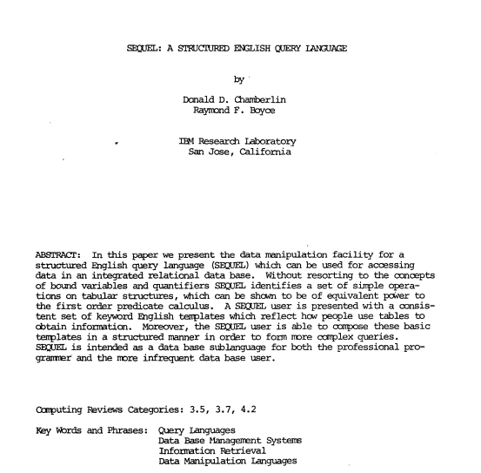

Some History
“SEQUEL: A Structured English Query Language”
IBM Sequel language developed as part of System R project at the IBM San Jose Research Laboratory
An “easy” language, with an English-like syntax
Don Chamberlin
with Ray Boyce (1974)
Donald D. Chamberlin and Raymond F. Boyce. 1974. SEQUEL: A structured English query language. In Proceedings of the 1974 ACM SIGFIDET (now SIGMOD) workshop on Data description, access and control (SIGFIDET '74). Association for Computing Machinery, New York, NY, USA, 249–264. DOI:https://doi.org/10.1145/800296.811515
Notes:
Another one, Mr. Chamberline and Boyce invented another language in 1974.
They worked in IBM. And IBM want an easy language. It can be like English. The name of the language is SEQUEL, and renamed to SQL later.

Slide 6
Some History
SEQUEL was then renamed as Structured Query Language (SQL)
ANSI and ISO standard SQL:
SQL-86
SQL-89
SQL-92
SQL:1999 (language name became Y2K compliant!)
SQL:2003
Commercial systems offer most, if not all, SQL-92 features, plus varying feature sets from later standards and special proprietary features
Not all examples here may work on your particular system.
A huge problem that appears everywhere and many times
Notes:
Y2K problem: year 2000
Similar problem: UNIX timestamp, Chrome and Firefox version 99->100

Slide 7
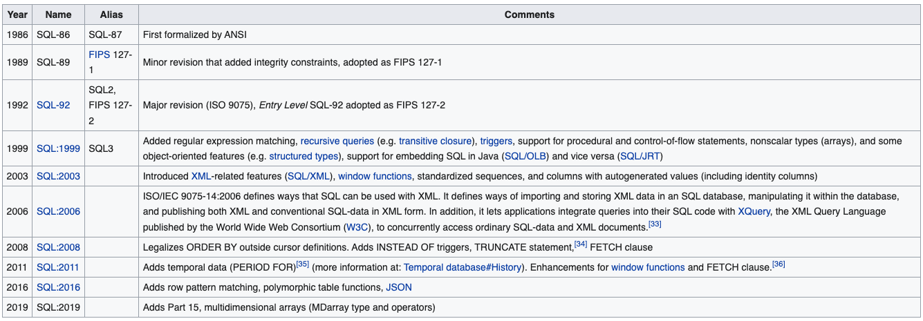
Standardization of SQL
https://en.wikipedia.org/wiki/SQL

Slide 8
Standardization of SQL (any other examples of standardization?)
https://en.wikipedia.org/wiki/SQL

Slide 9
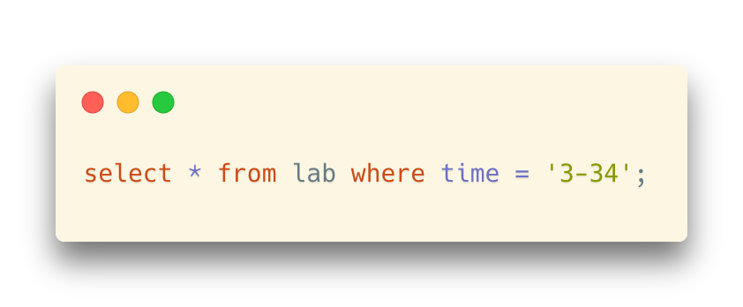
Basic Syntax of SQL
select …
from …
where …
followed by the names of the columns you want to return
followed by the name of the tables that you want to query
followed by filtering conditions
Notes:
The basic syntax of SQL is very simple.
If you want to query data, you can use select command.
Select columns name here.
From table names here,
After where, we can put some filter conditions.

Slide 10
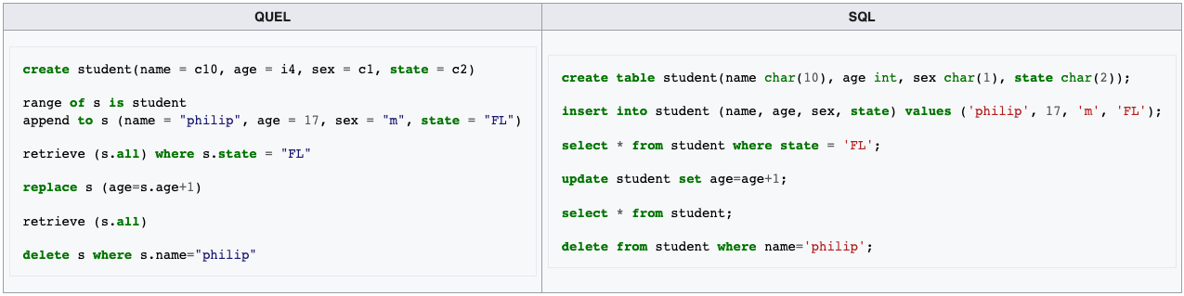

Competing Languages of SQL
QUEL, born at Berkeley, and associated with INGRES, was highly regarded
Ingres is a DBMS (DataBase Management System)
QUEL
Ingres
SEQUEL (SQL)
Postgres
Michael Stonebraker (1943-)
Turing Award 2014
Notes:
Ingres Database (/ɪŋˈɡrɛs/ ing-GRESS) is a proprietary SQL relational database management system intended to support large commercial and government applications.
Ingres began as a research project at the University of California, Berkeley, starting in the early 1970s and ending in 1985.

Slide 11
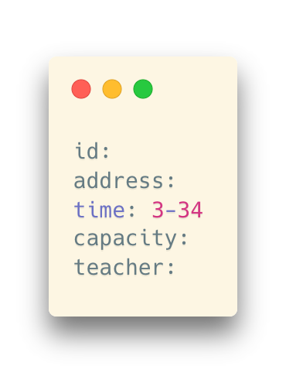

Competing Languages of SQL
QBE (Query by Example)
A visual querying tool (visual but with characters)
Created by IBM as well
Moshé M. Zloof
Notes:
QBE is another one, was created by IBM also.

Slide 12
Two Main Components for a Query Language
From Codd’s seminal paper:
A good database language should allow to deal as easily with contents (data) as containers (tables)
… Something that SQL does reasonably well
Notes:
The three guys, the founders of Oracle company, took SQL and created SQL compatible system.
The success of Oracle helped SQL being a standard.

Slide 13
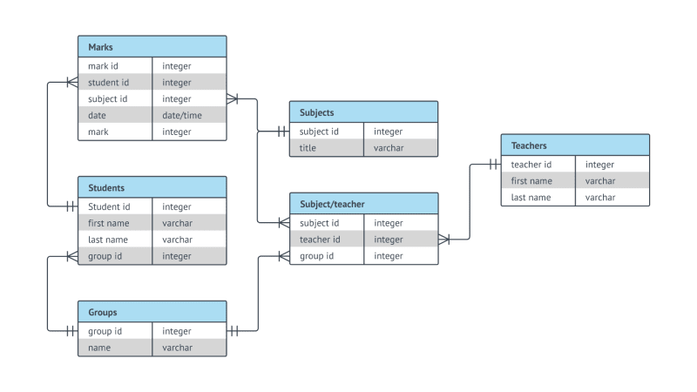
Two Main Components for a Query Language
Data Definition Language (DDL)
The SQL data-definition language (DDL) allows the specification of information about relations, including:
The schema for each relation.
The type of values associated with each attribute.
The Integrity constraints.
The set of indices to be maintained for each relation.
Security and authorization information for each relation.
The physical storage structure of each relation on disk.

Slide 14
Two Main Components for a Query Language
Data Definition Language (DDL)
The SQL data-definition language (DDL) allows the specification of information about relations, including:
The schema for each relation.
The type of values associated with each attribute.
The Integrity constraints.
The set of indices to be maintained for each relation.
Security and authorization information for each relation.
The physical storage structure of each relation on disk.
create
alter
drop

Slide 15
Two Main Components for a Query Language
Data Manipulation Language (DML)
Provides the ability to:
Query information from the database
Insert tuples into, delete tuples from, and modify tuples in the database.
select
insert
delete
update

Slide 16
Something about SQL
Simple?
As you can see, it seems to be simple
But it becomes difficult when you combine operations
We will talk about it later
Standard?
We have mentioned standardization of SQL before
However, NO product fully implements it
Different product implements SQL differently
… and introduces dialects
SQL is one of a few languages where you spend more time thinking about how you are going to do things than actually coding them.
Notes:
SQL language is simple, it’s easy to understand. But it can also be very complex when you combine different operations.
Like the chess go, the rule is simple. The there are huge amount possibility inside. It’s difficult to handle.
SQL is like chess GO, simple and also very complex.

Slide 17
“Tricks” in SQL
SQL ≠ Relational Database
SQL wasn't designed as a "relationally correct" language
In some respects, it is very lax
But easy to use, however
And, easy to misuse
So, using it well is difficult
Sometimes, you will get results even if the SQL is wrong
SQL is not as strict as C or Java; it will not give you error messages if your table cannot fit the requirement of the theory
“Wrong results” without warnings
Notes:
It is must be pointed out here, that SQL is designed for relational db, but its not a relationally correct language.
Its syntax is very lax.

Slide 18
“Tricks” in SQL
SQL ≠ Relational Database
SQL wasn't designed as a "relationally correct" language
In some respects, it is very lax
But easy to use, however
And, easy to misuse
So, using it well is difficult
Sometimes, you will get results even if the SQL is wrong
SQL is not as strict as C or Java; it will not give you error messages if your table cannot fit the requirement of the theory
“Wrong results” without warnings
Be careful when designing your SQL queries
Notes:
It is must be pointed out here, that SQL is designed for relational db, but its not a relationally correct language.
Its syntax is very lax.

Slide 19
“Tricks” in SQL
Key propriety of relations (in Codd's original paper)
This can be enforced for tables in SQL
(But you have to create your tables well)
But it is NOT enforced for query results in SQL
You must be extra-careful if the result of a query is the starting point for another query, which happens often. (i.e., combined queries)
ALL ROWS ARE DISTINCT
Notes:
In a table, the rows should be different. No duplicated rows should be in a table. We can add some CONSTRAINTS to a table to prevent duplicates when we create a table. If we create a table badly, then DBMS cannot prevent duplicates.
The second one is a little more complex, I will explain it in the following part. Just remember to be careful with SQL especially when several commands are combined.

Slide 20
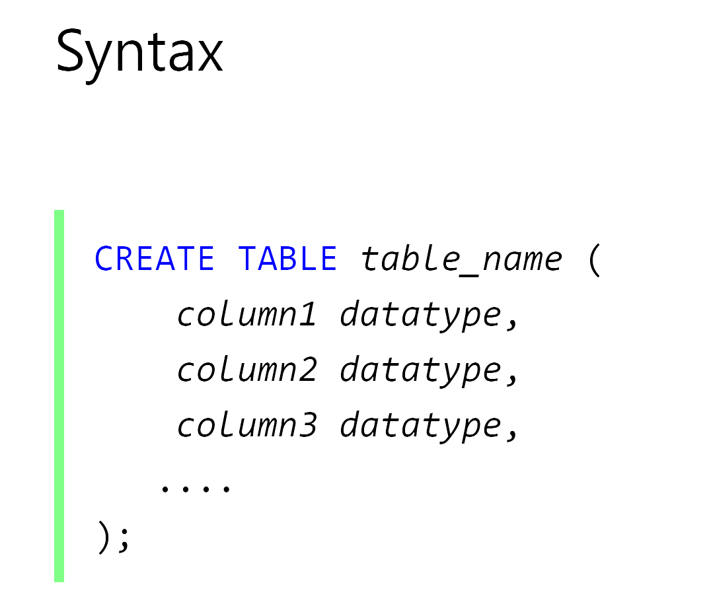
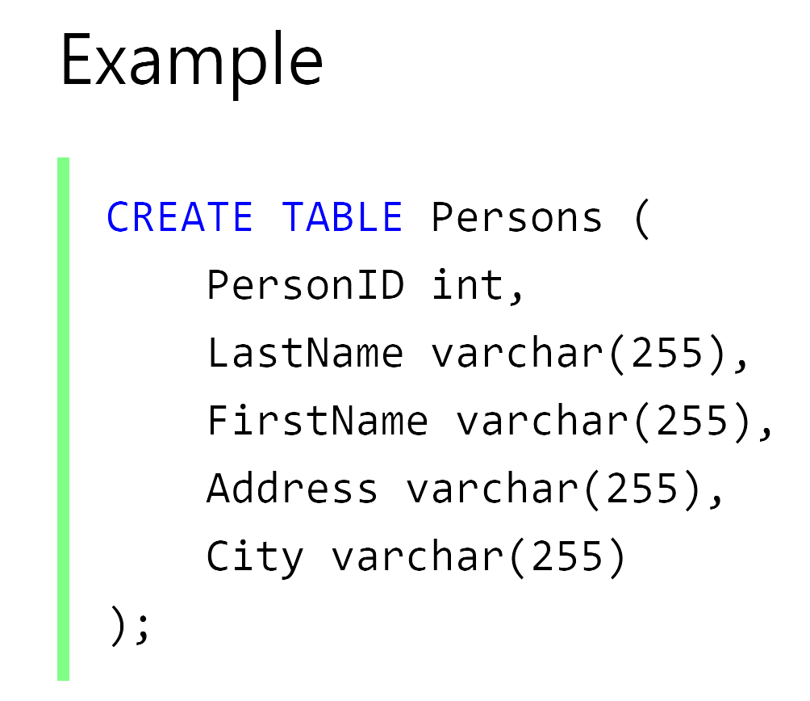
Create Tables
A comma-separated list of a column-name followed by spaces and a datatype specifies the columns in the table

Slide 21
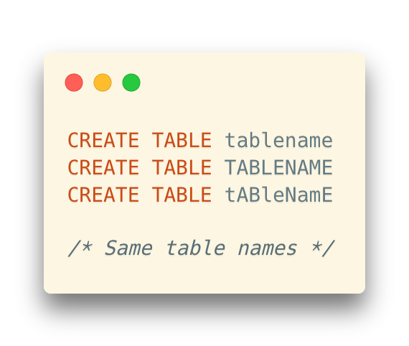
Create Tables
Table names
Case-insensitive (Usually, by default)
But, in some database systems, the case sensitivity is quite different
Try, or find the reference for the specific database system
For example, MariaDB is system-dependent with respect to case sensitivity
https://mariadb.com/kb/en/identifier-case-sensitivity/
Notes:
Same story with identifiers, the names you give to tables or, as you will soon see, columns, aren't case-sensitive.

Slide 22
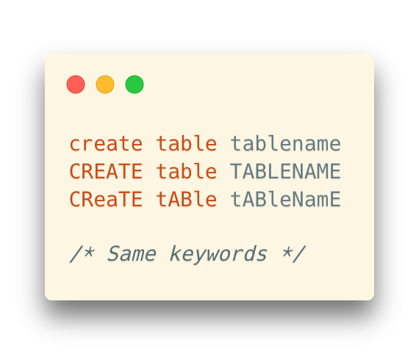
Create Tables
Table names
Case-insensitive (Usually, by default)
But, in some database systems, the case sensitivity is quite different
Try, or find the reference for the specific database system
For example, MariaDB is system-dependent with respect to case sensitivity
Actually, keywords are case-insensitive as well
https://mariadb.com/kb/en/identifier-case-sensitivity/
Notes:
Same story with identifiers, the names you give to tables or, as you will soon see, columns, aren't case-sensitive.

Slide 23
Create Tables
Table names
Case-insensitive (Usually, by default)
But, in some database systems, the case sensitivity is quite different
Try, or find the reference for the specific database system
Naming Convention
Underscores (下划线) as word separators (instead of CamelCase in Java), e.g., user_name
Actually, keywords are case-insensitive as well
Notes:
Same story with identifiers, the names you give to tables or, as you will soon see, columns, aren't case-sensitive.

Slide 24
Create Tables
Table names
Case-insensitive (Usually, by default)
But, in some database systems, the case sensitivity is quite different
Try, or find the reference for the specific database system
Naming Convention
Underscores (下划线) as word separators (instead of CamelCase in Java), e.g., user_name
Be careful with double quotes
… which represents a “case-sensitive” name
Actually, keywords are case-insensitive as well
Notes:
Same story with identifiers, the names you give to tables or, as you will soon see, columns, aren't case-sensitive.

Slide 25
Create Tables
An SQL relation is defined using the create table command:
r is the name of the relation
each Ai is an attribute name in the schema of relation r
Di is the data type of values in the domain of attribute Ai
create table r (
A1 D1, A2 D2, ..., An Dn,
(integrity-constraint1), ..., (integrity-constraintk)
)

Slide 26

Data Types
Text data types
char(length) -- fixed-length strings
varchar(max length) -- non-fixed-length text
varchar2(max length) -- Oracle’s transformation of varchar
clob -- very long text (like GB-level text)
Or, text
Notes:
Datatype names vary with the DBMS. char() is for fixed-size columns (data is padded with spaces if shorter). Used for codes. Oracle understands varchar() and transforms it into its own varchar2(), but it’s slightly different (an empty varchar2() is the same as nothing, not an empty varchar()). varchars don't pad. They are limited in length (a few thousand bytes). CLOB (called TEXT in MySQL) allows to store much bigger text (Gb).
For text datatyples.
Char is for fixed length text. The data will be padded with spaces if the text is shorter than then length.
Varchar is for non-fixed length text. The maximum length can initialized at the beginning.
In Oracle, it’s varchar2.
What ever char or varchar, they are limited in length. If you want to store really long text, you can use clob.

Slide 27
Data Types
Numerical types
int -- Integer (a finite subset of the integers that is machine-dependent)
float(n) -- Floating point number, with user-specified precision of at least n digits
real -- Floating point and double-precision floating point numbers, with machine-dependent precision
numeric(p, d)
Fixed point number, with user-specified precision of p digits, with d digits to the right of decimal point
E.g., numeric(3,1), allows 44.5 to be stores exactly, but not 444.5 or 0.32
In SQL Server, it is also called decimal

Slide 28
Data Types
Date types
date -- YYYY-MM-DD
datetime -- YYYY-MM-DD HH:mm:SS
timestamp -- YYYY-MM-DD HH:mm:SS
But it is in the UNIX timestamp
Value range: 1970-01-01 00:00:01 UTC - 2038-01-19 03:14:07 UTC
More reading about the “Year 2038 Problem” of the timestamp data type: https://en.wikipedia.org/wiki/Year_2038_problem
Notes:
Same kind of mess with date and time datatypes. You also find a datetime2 type with SQL Server. Some subtle differences in ranges of acceptable values, precision, etc. Some products also implement a distinct TIME datatype, or datatypes that represent time intervals.

Slide 29
Data Types
Binary data types
raw(max length)
varbinary(max length)
blob -- binary large object
bytea -- used in PostgreSQL
Notes:
RAW in Oracle, and VARBINARY (SQL Server) are the binary equivalent of VARCHAR. BLOB is the binary equivalent of CLOB (BLOB means Binary Large Object). PostgreSQL calls the binary datatype BYTEA, don't ask me why.

Slide 30
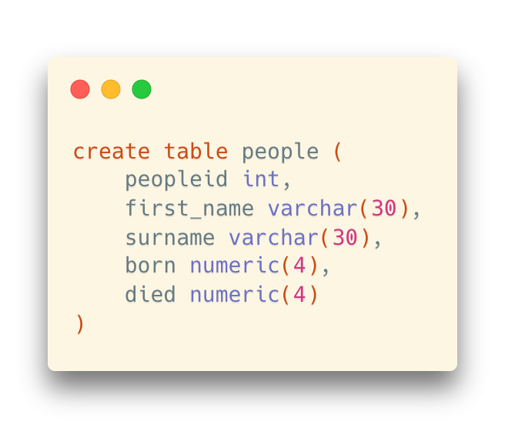
Constraints
Can you find any problem in this statement?

Slide 31
Constraints
Can you find any problem in this statement?
It is valid and can be accepted by most DBMS
But it does nothing to enforce that we have a valid “relation” in Codd’s sense

Slide 32
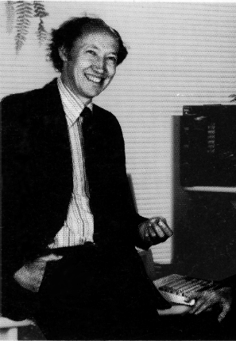
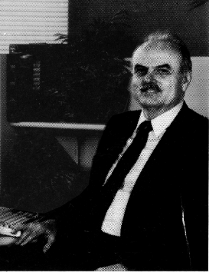
Constraints
Ted Codd and Chris Date
Worked on improving the relational theory
Chris Date’s work
Ensuring that only correct data that fits the theory can enter the database
Data inside the database remains correct
No need to double check for application programs
Chris Date
Ted Codd
Constraints are declarative rules that the DBMS will check every time new data will be added, when data is changed, or even when data is deleted, in order to prevent any inconsistency.
* Any operation that violates a constraint fails and returns an error.

Slide 33
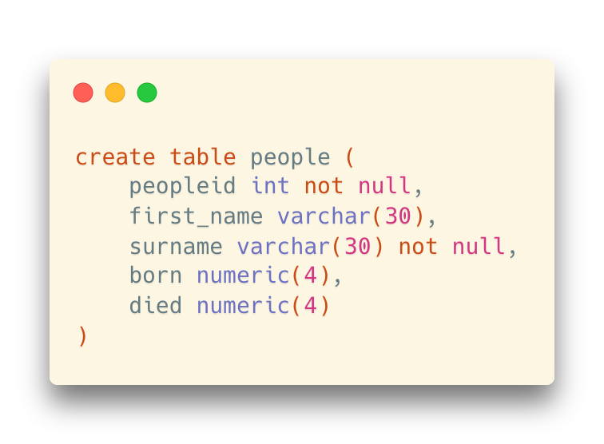
Constraints: Not NULL
NULL values
We don’t want someone with no ID and name
Use not null to indicate that these columns are mandatory
Notes:
We can use NOT NULL to indicate that the value of this column is mandatory. That meas we must set a value for the column, otherwise, the DBMS will report an error.
We should set peopleid and surename cannot be null since the person should have a name.
For died column, maybe the person still alive, we can keep the value of died as null.
What about first_name?

Slide 34
Constraints: Not NULL
NULL values
We don’t want someone with no ID and name
Use not null to indicate that these columns are mandatory
We can still have rows that with NULL values in the columns of born, died, and first_name
Notes:
We indicate that a column is mandatory by saying that NULL isn’t acceptable for this column, which is indicated by NOT NULL after the data type. The more NOT NULL columns, the better, because saying "I don't know" everywhere isn't very interesting. Surname and people identifier are columns that MUST have a value. Unless we only want dead people in our database, we should allow column DIED to take unknown values (we all know it will take a value one day, but we don't know it now). What about first_name?
We can use NOT NULL to indicate that the value of this column is mandatory. That meas we must set a value for the column, otherwise, the DBMS will report an error.
We should set peopleid and surename cannot be null since the person should have a name.
For died column, maybe the person still alive, we can keep the value of died as null.
What about first_name?

Slide 35
Constraints: Not NULL
NULL values
Why is only surname mandatory?
It depends on the requirement. In this movie database case, some actors may be known as their stage names instead of real names. (Lady Gaga vs. Stefani Joanne Angelina Germanotta)
Takeaway: design your table according to the requirements
Notes:
We indicate that a column is mandatory by saying that NULL isn’t acceptable for this column, which is indicated by NOT NULL after the data type. The more NOT NULL columns, the better, because saying "I don't know" everywhere isn't very interesting. Surname and people identifier are columns that MUST have a value. Unless we only want dead people in our database, we should allow column DIED to take unknown values (we all know it will take a value one day, but we don't know it now). What about first_name?
We can use NOT NULL to indicate that the value of this column is mandatory. That meas we must set a value for the column, otherwise, the DBMS will report an error.
We should set peopleid and surename cannot be null since the person should have a name.
For died column, maybe the person still alive, we can keep the value of died as null.
What about first_name?

Slide 36
Constraints: Not NULL
NULL values
Similar to the column born
We can either accept that
A row is created before we have information of that person’s birth date
Or we require that the information should be found before entering the data
Notes:
We indicate that a column is mandatory by saying that NULL isn’t acceptable for this column, which is indicated by NOT NULL after the data type. The more NOT NULL columns, the better, because saying "I don't know" everywhere isn't very interesting. Surname and people identifier are columns that MUST have a value. Unless we only want dead people in our database, we should allow column DIED to take unknown values (we all know it will take a value one day, but we don't know it now). What about first_name?
We can use NOT NULL to indicate that the value of this column is mandatory. That meas we must set a value for the column, otherwise, the DBMS will report an error.
We should set peopleid and surename cannot be null since the person should have a name.
For died column, maybe the person still alive, we can keep the value of died as null.
What about first_name?

Slide 37
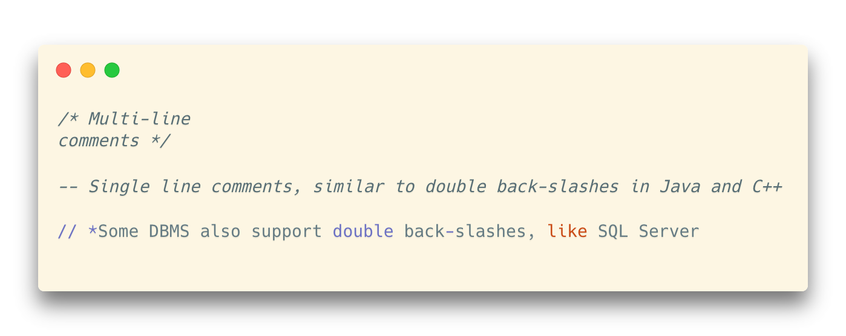
Comments

Slide 38
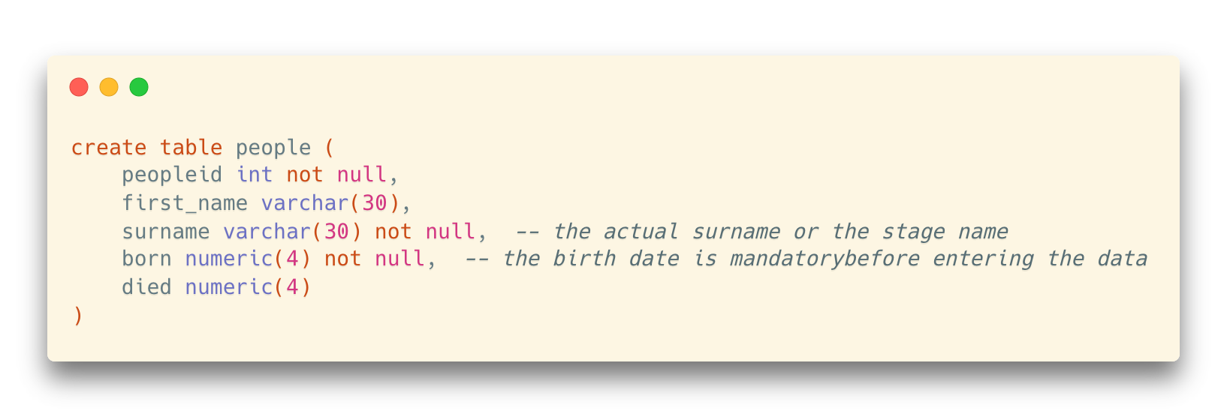
Comments
Add comments to the definition of tables

Slide 39
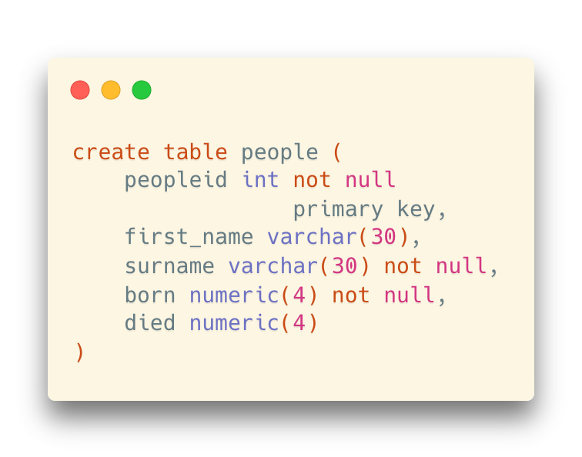
Constraints: Primary Key
The main key for the table, and indicates two things:
the value is mandatory
that the values are unique (no duplicates allowed in the column)

Slide 40
Constraints: Primary Key
The main key for the table, and indicates two things:
the value is mandatory
that the values are unique (no duplicates allowed in the column)
primary key implies not null, so not null here is redundant (but doesn’t hurt)

Slide 41
Constraints: Unique
So far, nothing would prevent us from entering two same rows with different IDs
peopleid | first_name | surname | born | died
1 | Alfred | Hitchcock | 1899 | 1980
2 | Alfred | Hitchcock | 1899 | 1980
3 | …. | … | … | …

Slide 42
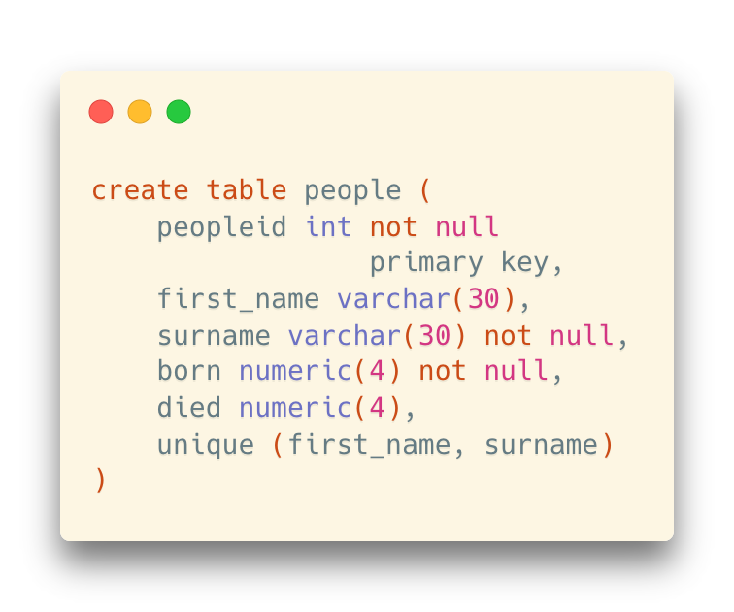
Constraints: Unique
A unique constraint (on a combination of multiple columns)
peopleid | first_name | surname | born | died
1 | Alfred | Hitchcock | 1899 | 1980
2 | Alfred | Hitchcock | 1899 | 1980
3 | …. | … | … | …
The combination of (first_name, surname) cannot be the same for any two rows
But you still can have people with the same first name or surname, respectively
Notes:
So far, nothing would prevent us from entering two Audrey Hepburns with different ids. To ensure we only have one, we must say that the combination (first_name, surname) is unique (for actors ...). Constraints on several columns at once (same story with primary keys) are specified at the end of the list of columns with a comma-delimited list of column names.

Slide 43
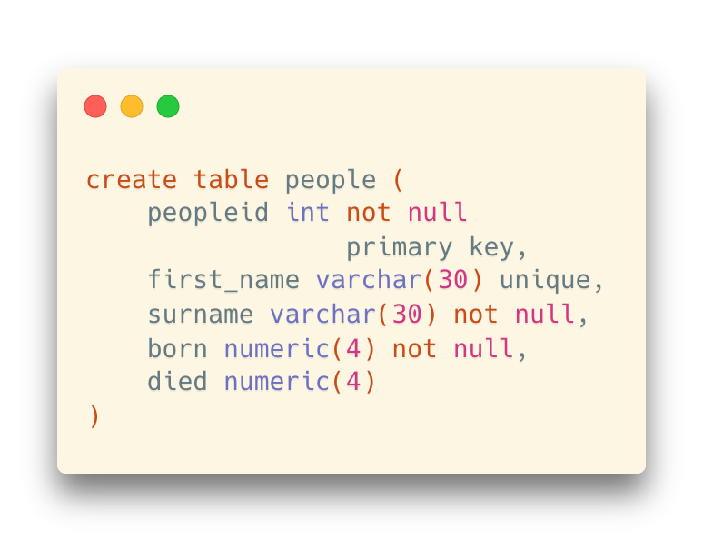
Constraints: Unique
A unique constraint (on a single column)
peopleid | first_name | surname | born | died
1 | Alfred | Hitchcock | 1899 | 1980
2 | Alfred | Hitchcock | 1899 | 1980
3 | …. | … | … | …
No identical first names for any two people here
But it is not what we want in this table

Slide 44
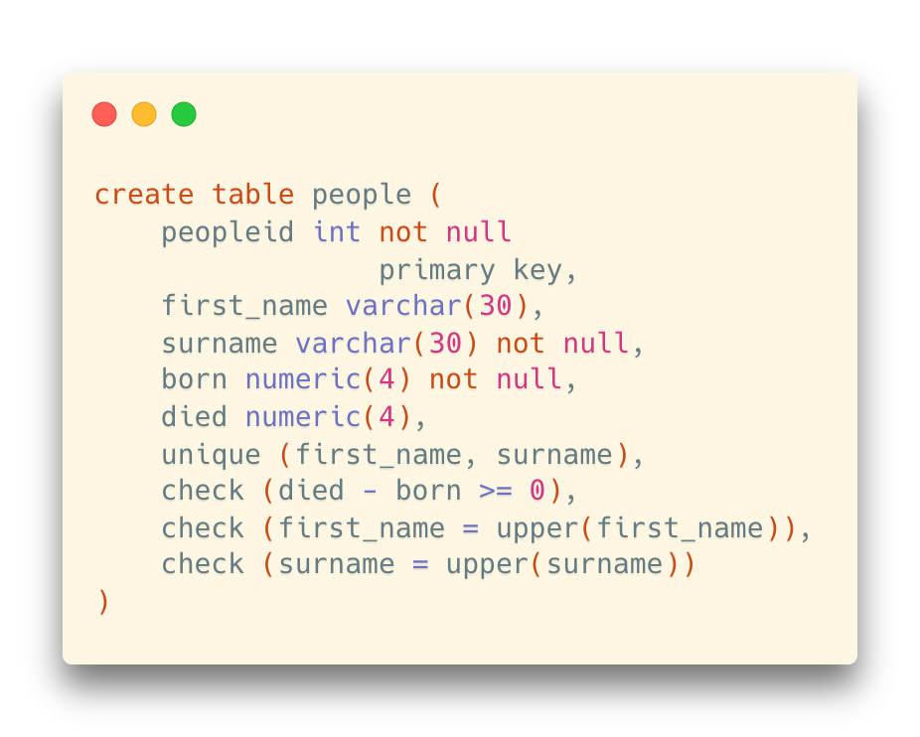
Constraints: Check
A column must satisfy a certain boolean expression test
The most generic constriant type
You must ensure that the person died after born
A useful trick to standardize names
Such that there won’t be rows with the same name of “Alfred Hitchcock”, “ALFRED HITCHCOCK”, and “alfred hitchcock”.
upper(string) is a function in PostgreSQL

Slide 45
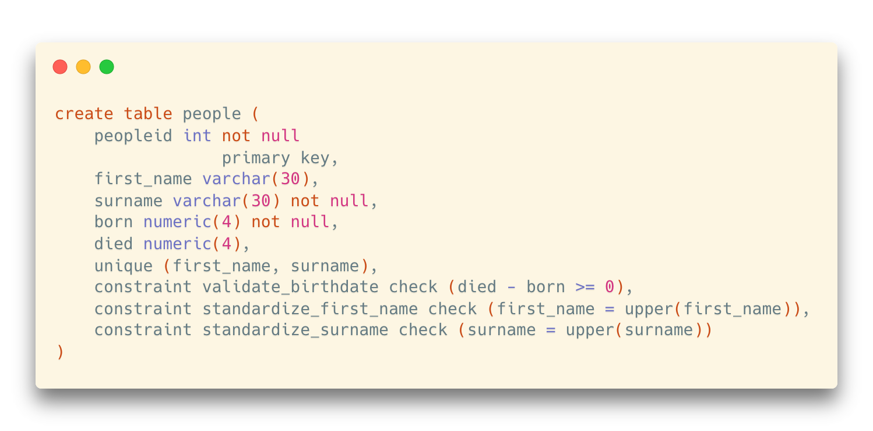
Named Constraints
A name can be assigned to the constraints
… in order to refer to them easier in some other operations
PostgreSQL will give a name to the constraints if you don’t assign a name explicitly

Slide 46
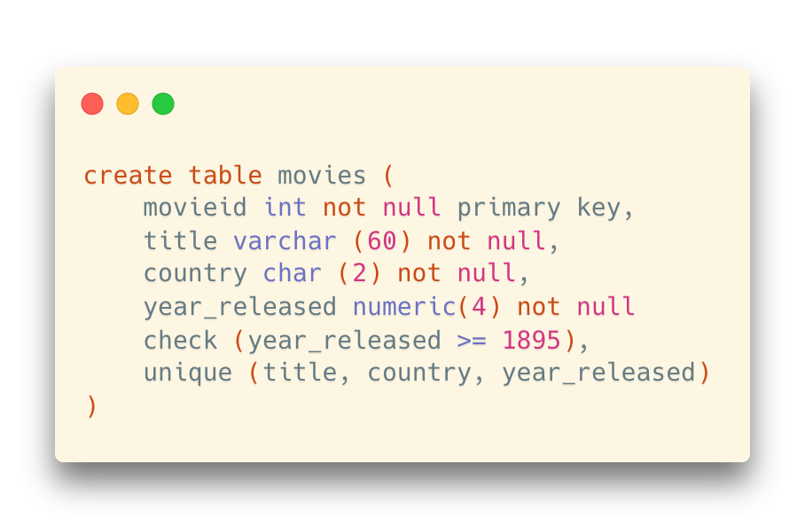
Referential Integrity
Check constaints are static
Once it is written into the table, the criteria cannot be updated automatically
It is very difficult to perform static checks
Too many countries; country names and codes may change
Notes:
In the MOVIES table, COUNTRY is a column that can take a LOT of different values, and listing all of them in a CHECK constraint would be clumsy. Besides, countries disappear (USSR, Yugoslavia) and new countries appear (South Sudan, Croatia, Slovakia). If we have no control, any typo would allow non-existing country codes to slip into the database

Slide 47
Referential Integrity
Check constaints are static
Once it is written into the table, the criteria cannot be updated automatically
country_code | country_name | continent
US | United States | AMERICA
CN | China | ASIA
RU | Russia | EUROPE
Referential Integrity
The country column in movies should be linked with the country_code column in another table (called reference table)
Notes:
In the MOVIES table, COUNTRY is a column that can take a LOT of different values, and listing all of them in a CHECK constraint would be clumsy. Besides, countries disappear (USSR, Yugoslavia) and new countries appear (South Sudan, Croatia, Slovakia). If we have no control, any typo would allow non-existing country codes to slip into the database
The solution is referential integrity, and what is known as a reference table: a country that stores all country codes, and corresponding country names (all codes don't immediately ring a bell), with the code as primary key (and the country name declared as unique). We'll only accept a country code if we find it in this table (which can be modified, with new codes added)

Slide 48
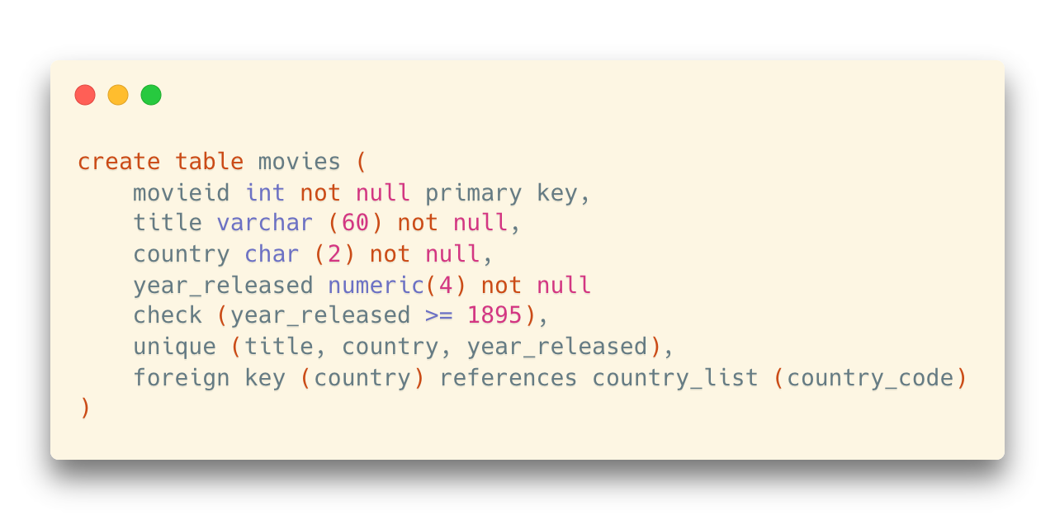
Foreign Key
Format:
foreign key (Am, ..., An ) references r
Meaning of this foreign key:
The country column in this table (movies) refers to the country_code column in the table called country_list
Tip:
country_code should be a key (primary key or unique) in the table country_list

Slide 49
Foreign Key
Format:
foreign key (Am, ..., An ) references r
Movie ID | Movie Title | Country | Year
0 | Citizen Kane | US | 1941
1 | La règle du jeu | FR | 1939
2 | North By Northwest | US | 1959
3 | Singin' in the Rain | US | 1952
4 | Rear Window | US | 1954
Directed By
Director ID | Director_Firstname | Director_Lastname | Born | Died
1 | Alfred | Hitchcock | 1899 | 1980
2 | Orson | Welles | 1915 | 1985
3 | …. | … | … | …
Movie ID | Director ID
0 | 2
1 | 5
2 | 1
Director Entities
Foreign keys required in this table
Movie Entities
Notes:
In table credits, the movieID and personID are foreign keys, because we cannot give credits for a non-existing film or person.
Here both foreign keys are part of the primary key. The three columns together make the primary key.

Slide 50

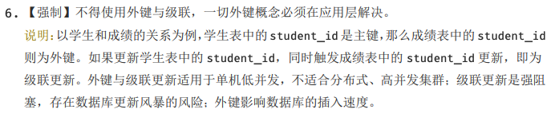
Foreign Key
However, in some cases, foreign key can be a problem
Especially in big data processing applications
E.g., Alibaba Java Coding Guideline (阿里巴巴Java开发手册)
https://ucc.alicdn.com/download/%E9%98%BF%E9%87%8C%E5%B7%B4%E5%B7%B4Java%E5%BC%80%E5%8F%91%E6%89%8B%E5%86%8C1.4.0.pdf

Slide 51
Summary: How to Create Tables
Creating tables requires:
Proper modelling
Defining keys
Determining correct data types
Defining constraints
Boring, but important
No further checks in the application programs; most things are ensured in the database layer
Notes:
When all these are done, you can be sure that data that enters the database will be correct, and will remain so.
The preparatory work may seem (and sometimes is) a bit boring, but the rewards are huge: when programs no longer have to thoroughly check data but only check return codes, they become leaner and are far easier (and cheaper) to maintain. It also ensures, when several applications access the database, that controls are centralized and that one sloppily written small application won't corrupt data for other well written programs.

Slide 52
Updates to Tables
Insert
insert into instructor values ('10211', 'Smith', 'Biology', 66000);
Delete
Remove all tuples from the student relation
delete * from movies

Slide 53
Updates to Tables
Drop Table
drop table r
Alter
alter table r add A D
where A is the name of the attribute (column) to be added to relation r and D is the data type of A.
All existing tuples in the relation are assigned null as the value for the new attribute.
alter table r drop column A
where A is the name of an attribute of relation r
Dropping of attributes not supported by many databases.
(There are some other things that can be “dropped”, including checks, foreign keys, indexes, etc.)

Slide 54
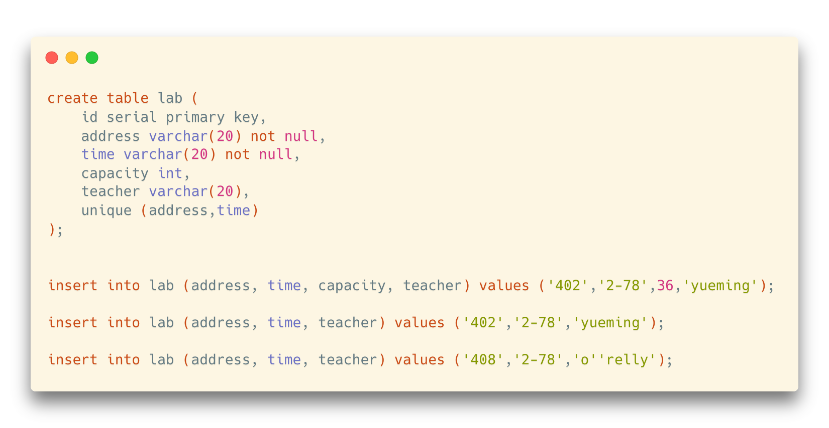
Updates to Tables
More about insert
Values must match column names one by one

Slide 55
Updates to Tables
More about insert
Missing columns and values for “nullable” columns are allowed
… and a NULL willl be inserted
* But if you miss a mandatory column (such as address), an error will occur.
Notes:
Values must match column-names one by one.
If you omit a column name for the list, the column value will be NULL.
If the column is mandatory, the INSERT statement will fail and no data is inserted into the table.

Slide 56
Updates to Tables
More about insert
* Use two single quotes to represent a single quote in the content (i.e., escape charactor)

