Slide 1
Principles of Database Systems (CS307) Lecture 7-8: Application Development; Database Design Using the E-R Model
Ran Cheng
Department of Computer Science and Engineering
Southern University of Science and Technology
Most contents are from slides made by Stéphane Faroult and the authors of Database System Concepts (7th Edition).
Their original slides have been modified to adapt to the schedule of CS307 at SUSTech.
Notes:
In this chapter, I will introduce how to retrieve data from one table. Just from one table. I will introduce how to retrieve data from multiple table in next chapter.

Slide 2
Application Development

Slide 3
Application Programs and User Interfaces
Most database users do not use a query language like SQL
An application program acts as the intermediary between users and the database
Applications split into
front-end
middle layer
backend
Front-end: user interface
Forms
Graphical user interfaces
Many interfaces are Web-based

Slide 4
Application Architecture Evolution
Three distinct era’s of application architecture
Mainframe (1960’s and 70’s)
Personal computer era (1980’s)
Web era (mid 1990’s onwards)
Web and Smartphone era (2010 onwards)
Next generation?

Slide 5
Web Interface
Web browsers have become the de-facto standard user interface to databases
Enable large numbers of users to access databases from anywhere
Avoid the need for downloading/installing specialized code, while providing a good graphical user interface
JavaScript and other scripting languages run in browser, but are downloaded transparently
Examples: banks, airline and rental car reservations, university course registration and grading, and so on.

Slide 6
The World Wide Web
The Web is a distributed information system based on hypertext.
Most Web documents are hypertext documents formatted via the HyperText Markup Language (HTML)
HTML documents contain
text along with font specifications, and other formatting instructions
hypertext links to other documents, which can be associated with regions of the text.
forms, enabling users to enter data which can then be sent back to the Web server

Slide 7
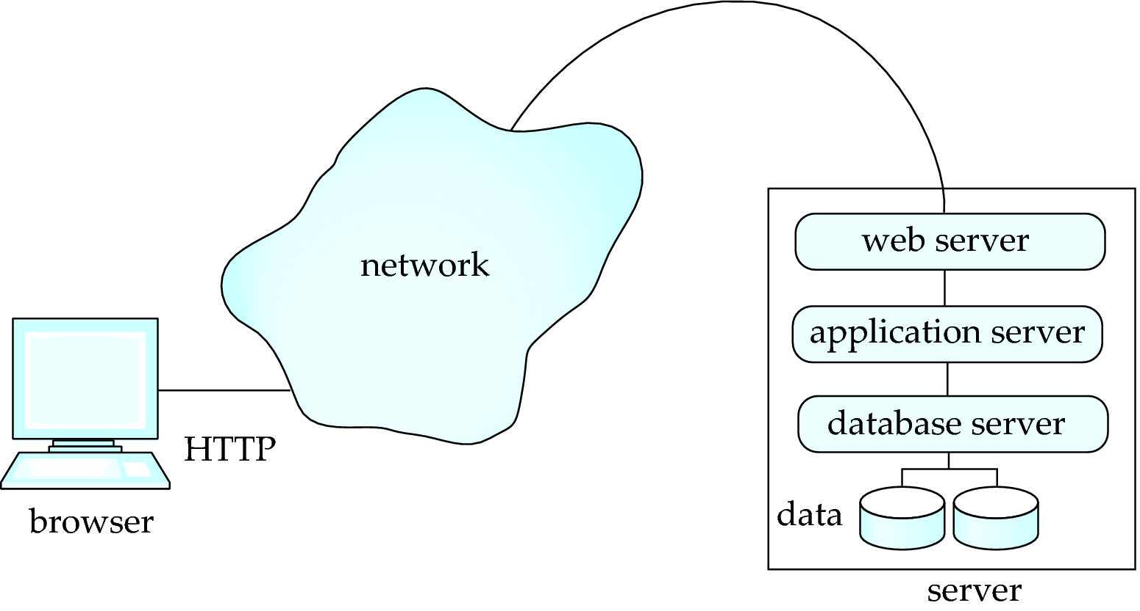
Three-Layer Web Architecture

Slide 8
HTML and HTTP
HTML provides formatting, hypertext link, and multimedia display features
including tables, stylesheets (to alter default formatting), etc.
HTML also provides input features
Select from a set of options
Pop-up menus, radio buttons, check lists
Enter values
Text boxes
Filled in input sent back to the server, to be acted upon by an executable at the server
HyperText Transfer Protocol (HTTP) used for communication with the Web server

Slide 9
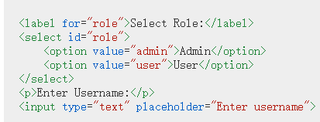
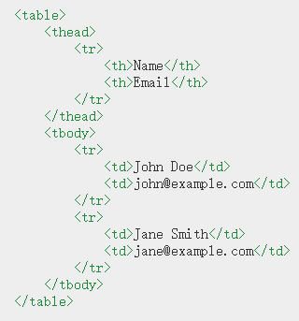

HTML and HTTP

Slide 10
JavaScript
JavaScript very widely used
Forms basis of new generation of Web applications (called Web 2.0 applications) offering rich user interfaces
JavaScript functions can
Check input for validity
Modify the displayed Web page, by altering the underling document object model (DOM) tree representation of the displayed HTML text
Communicate with a Web server to fetch data and modify the current page using fetched data, without needing to reload/refresh the page
Forms basis of AJAX technology used widely in Web 2.0 applications
E.g. on selecting a country in a drop-down menu, the list of states in that country is automatically populated in a linked drop-down menu

Slide 11
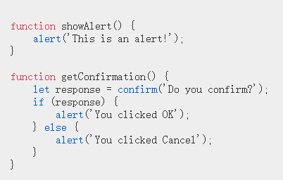


JavaScript

Slide 12
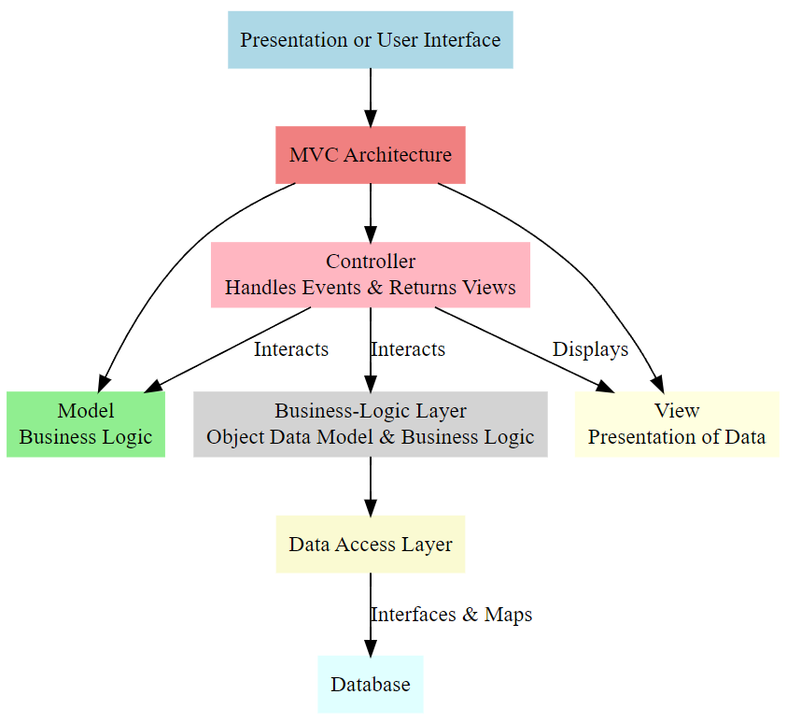
Application Architectures
Application layers
Presentation or user interface
model-view-controller (MVC) architecture
model: business logic
view: presentation of data, depends on display device
controller: receives events, executes actions, and returns a view to the user
business-logic layer
provides high level view of data and actions on data
hides details of data storage schema
data access layer
interfaces between business logic layer and the underlying database

Slide 13
Business Logic Layer
Provides abstractions of entities
Enforces business rules for carrying out actions
Supports workflows which define how a task involving multiple participants is to be carried out
Sequence of steps to carry out task
Error handling
…

Slide 14
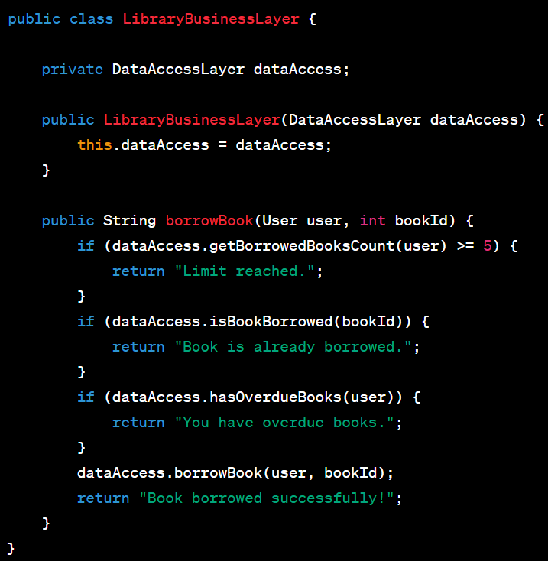
Business Logic Layer
Scenario: 📚 Library system allowing users to borrow books.
Core Business Rules:
📖 Users can borrow up to 5 books at a time.
🚫 Cannot borrow a book already checked out.
❗ Cannot borrow with overdue books.

Slide 15
Object-Relational Mapping (ORM)
ORM allows using object-oriented models in applications while storing data in relational databases.
Benefits:
Seamless integration of object and relational models.
Write application code using objects, store data as relational tables.
Challenges:
Object-oriented databases are NOT widely adopted commercially.
Need to map object data to relational schema.
Example: A Student class in Java maps to a student table.
How ORM Works:
Open a database session.
Use the session to save or query objects.
E.g.: session.save(object) converts the object to table rows.

Slide 16
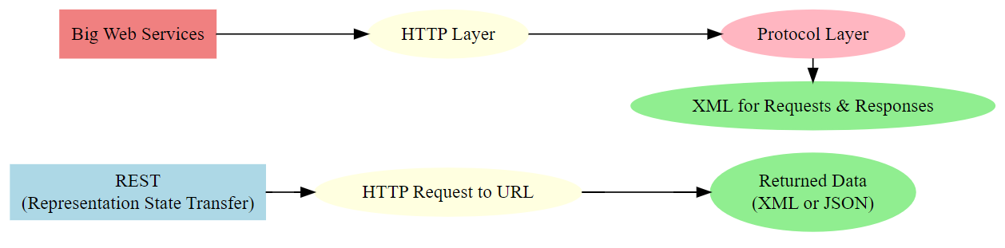
Web Services
Allow data on Web to be accessed using remote procedure call mechanism
Two approaches are widely used
Representation State Transfer (REST): allows use of standard HTTP request to a URL to execute a request and return data
Returned data is encoded either in XML, or in JavaScript Object Notation (JSON)
Big Web Services:
Uses XML representation for sending request data, as well as for returning results
Standard protocol layer built on top of HTTP

Slide 17
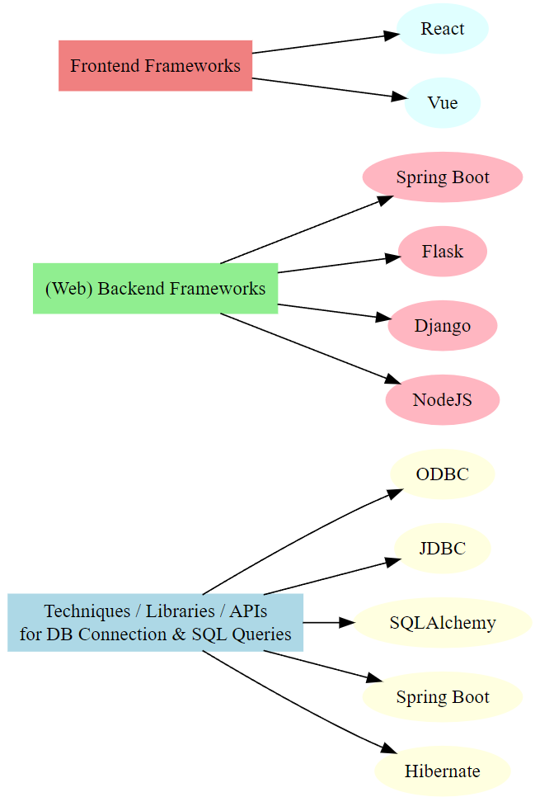
Self Study
Key points:
Techniques / libraries / APIs to connect to a database (e.g. PostgreSQL) and run SQL querys in a program
ODBC, JDBC?
SQLAlchemy? Spring Boot? Hibernate?
(Web) Backend Frameworks
Spring Boot, Flask, Django
NodeJS
Frontend Frameworks
React, Vue

Slide 18
Entity-Relationship Model (E-R Model) Entity-Relationship Diagram (E-R Diagram)

Slide 19
The New Running Example

Slide 20
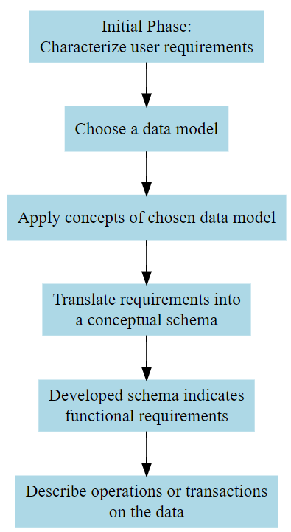
Design Phases
Initial phase: characterize fully the requirements of the prospective database users.
Second phase: choosing a data model
Applying the concepts of the chosen data model
Translating these requirements into a conceptual schema of the database
A fully developed conceptual schema indicates the functional requirements of the enterprise
Describe the kinds of operations (or transactions) that will be performed on the data

Slide 21
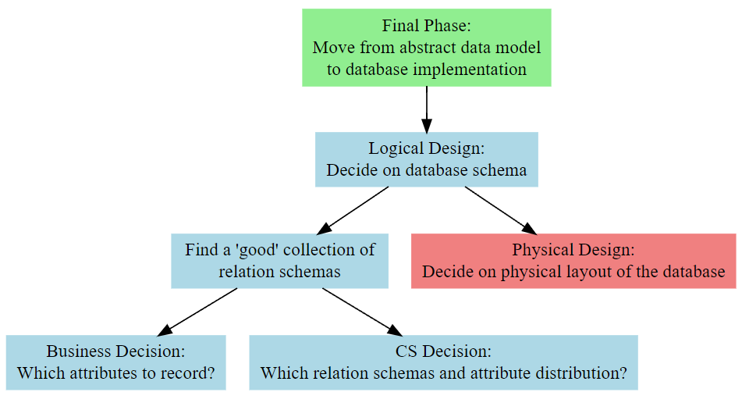
Design Phases
Final Phase: Moving from an abstract data model to the implementation of the database
Logical Design – Deciding on the database schema.
Physical Design – Deciding on the physical layout of the database

Slide 22
Design Phases – Physical Design
File Organization: How data is stored and organized.
Indexing: Mechanisms to speed up data retrieval.
Data Partitioning: Distributing data across storage.
Storage Structures: Data structures for data storage, e.g., B-trees.
Backup & Recovery: Mechanisms to restore data post failures.
…

Slide 23
Design Alternatives
In designing a database schema, we must ensure that we avoid two major pitfalls:
Redundancy: a bad design may result in repeat information
Redundant representation of information may lead to data inconsistency among the various copies of information
Incompleteness: a bad design may make certain aspects of the enterprise difficult or impossible to model
Avoiding bad designs is not enough
There may be many good designs from which we must choose

Slide 24
Design Approaches
Entity Relationship Model (covered in this chapter)
Models an enterprise as a collection of entities and relationships
Entity: a “thing” or “object” in the enterprise that is distinguishable from other objects
Described by a set of attributes
Relationship: an association among several entities
Represented diagrammatically by an entity-relationship diagram (E-R diagram)
Normalization Theory (coming in the next few weeks)
Formalize what designs are bad, and test for them

Slide 25
Entity Sets
An entity is an object that exists and is distinguishable from other objects
Example: specific person, company, event, plant
An entity set is a set of entities of the same type that share the same properties
Example: set of all persons, companies, trees, holidays
An entity is represented by a set of attributes; i.e., descriptive properties possessed by all members of an entity set.
Example:
instructor = (ID, name, salary) course = (course_id, title, credits)
A subset of the attributes form a primary key of the entity set; i.e., uniquely identifying each member of the set.

Slide 26
Representing Entity sets in ER Diagram
Entity sets can be represented graphically as follows:
Rectangles represent entity sets.
Attributes listed inside entity rectangle
Underline indicates primary key attributes

Slide 27
Relationship Sets
A relationship is an association among several entities 44553 (Tom) advisor 22222 (Jack) student entity relationship set instructor entity
A relationship set is a mathematical relation among n ≥ 2 entities, each taken from entity sets
where (e₁, e₂, …, e_{n}) is a relationship
Example: (44553,22222) ∈ advisor

Slide 28
Relationship Sets
Example: we define the relationship set advisor to denote the associations between students and the instructors who act as their advisors.
Pictorially, we draw a line between related entities
What is there are many relationships? Many lines?

Slide 29
Representing Relationship Sets via E-R Diagrams
Diamonds represent relationship sets

Slide 30
Relationship Sets (Cont.)
An attribute can also be associated with a relationship set.
For instance, the advisor relationship set between entity sets instructor and student may have the attribute date which tracks when the student started being associated with the advisor

Slide 31
Relationship Sets with Attributes

Slide 32
Roles
Entity sets of a relationship need not be distinct
That is to say, we can create self-pointing relationships for an entity set
Each occurrence of an entity set plays a “role” in the relationship
Example: A relationship set to represent the prerequisites of a course
E.g., Data Structure depends on Introduction to Programming
The labels “course_id” and “prereq_id” are called roles
Self-related

Slide 33
Degree of a Relationship Set
Binary relationship
Involve two entity sets (or degree two).
Most relationship sets in a database system are binary
Relationships between more than two entity sets are rare (why?)
Example: students work on research projects under the guidance of an instructor.
relationship proj_guide is a ternary (三重的) relationship between instructor, student, and project

Slide 34
Non-binary Relationship Sets
Most relationship sets are binary
There are occasions when it is more convenient to represent relationships as non-binary
E-R Diagram with a Ternary Relationship

Slide 35
Complex Attributes – Tree Structure
Attribute types:
Simple and composite attributes.
Single-valued and multivalued attributes
Example: multivalued attribute: phone_numbers
A person can have 1 or more phone numbers at the same time
Derived attributes
Can be computed from other attributes
Example: age, given date_of_birth
Domain: The set of permitted values for each attribute

Slide 36
Composite Attributes – Tree Structure
Composite attributes allow us to divided attributes into subparts (other attributes)
Sometimes we may only use part of the attributes, where the composite attribute is a good design choice

Slide 37
Cardinality (基数) in Database
Definition:
Cardinality refers to the uniqueness of data values contained in a column.
In the context of databases, it denotes the number of distinct values in a column.
Types:
Low Cardinality: Column has a limited set of unique values (e.g., Gender with values 'Male' or 'Female').
High Cardinality: Column has a large set of unique values (e.g., EmployeeID).
Relevance:
Affects database design, query performance, and indexing strategies.
Essential in understanding relationships between tables in relational databases.

Slide 38
Mapping Cardinality Constraints
Mapping Cardinality（映射基数）
Express the number of entities to which another entity can be associated via a relationship set.
Most useful in describing binary relationship sets
For a binary relationship set, the mapping cardinality must be one of the following types:
One to one
One to many
Many to one
Many to many

Slide 39
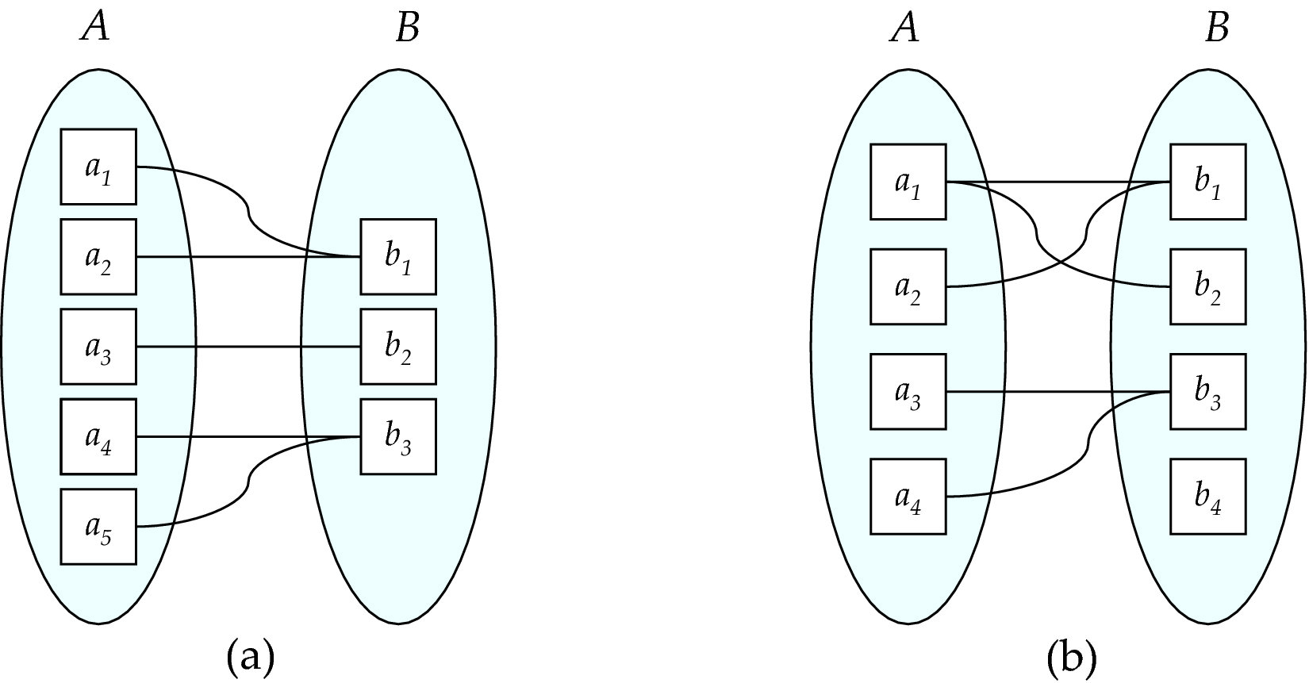
Mapping Cardinalities
Many to one
Many to many
Note: Some elements in A and B may not be mapped to any
elements in the other set
Notes:
映射基数

Slide 40
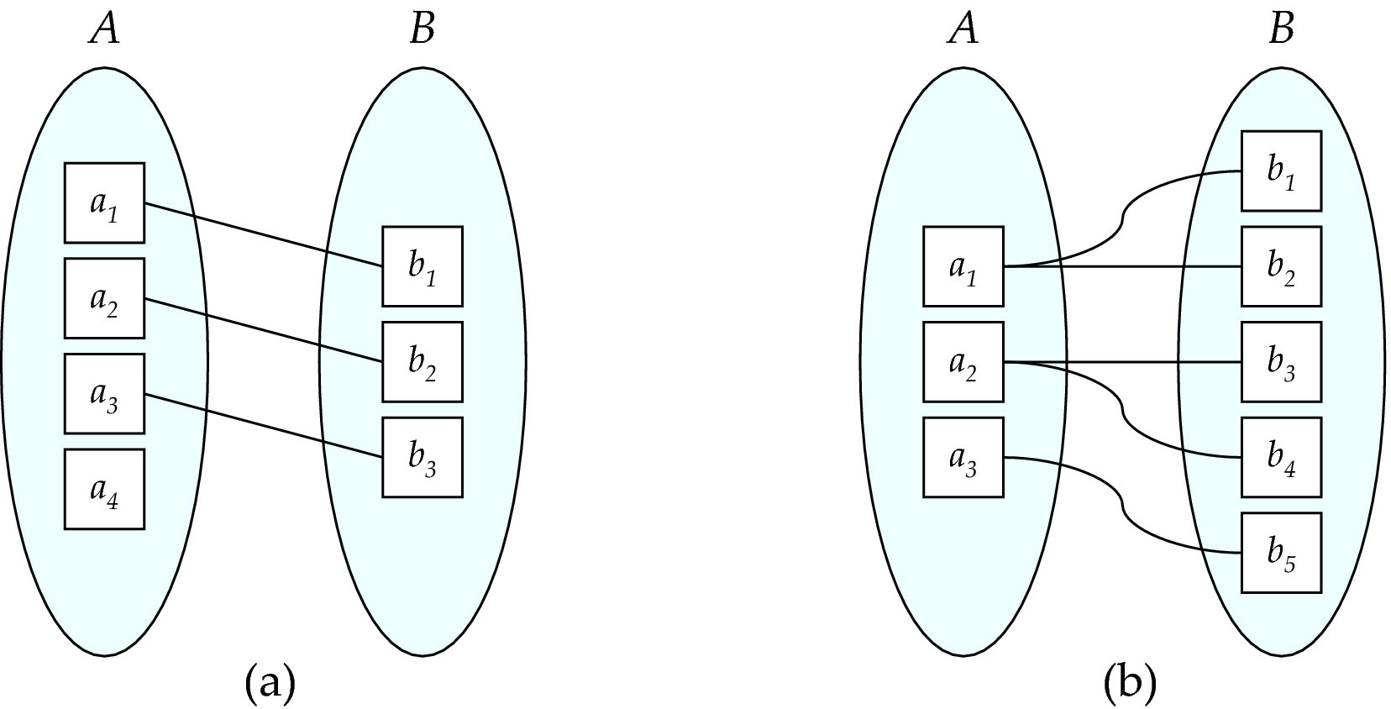
Mapping Cardinalities
One to one
One to many
Note: Some elements in A and B may not be mapped to any
elements in the other set
Notes:
映射基数

Slide 41
Representing Cardinality Constraints in ER Diagram
We express cardinality constraints by:
drawing either a directed line (→), signifying “one,”
or an undirected line (—), signifying “many,”
… between the relationship set and the entity set.
One-to-one relationship between an instructor and a student :
A student is associated with at most one instructor via the relationship advisor

Slide 42
Representing Cardinality Constraints in ER Diagram
One-to-many relationship between an instructor and a student
an instructor is associated with several (including 0) students via advisor
a student is associated with at most one instructor via advisor

Slide 43
Representing Cardinality Constraints in ER Diagram
In a many-to-one relationship between an instructor and a student,
an instructor is associated with at most one student via advisor
and a student is associated with several (including 0) instructors via advisor

Slide 44
Representing Cardinality Constraints in ER Diagram
Many-to-many relationship:
An instructor is associated with several (possibly 0) students via advisor
A student is associated with several (possibly 0) instructors via advisor

Slide 45
Total and Partial Participation
Total participation (indicated by double line)
Every entity in the entity set participates in at least one relationship in the relationship set
Example: Participation of student in advisor relation is total
i.e., every student must have an associated instructor
Partial participation
Some entities may not participate in any relationship in the relationship set
Example: participation of instructor in advisor is partial

Slide 46
Notation for Expressing More Complex Constraints
A line may have an associated minimum and maximum cardinality, shown in the form l..h, where l is the minimum and h the maximum cardinality
A minimum value of 1 indicates total participation.
A maximum value of 1 indicates that the entity participates in at most one relationship
A maximum value of * indicates no limit.
Example
Instructor can advise 0 or more students
A student must have 1 advisor; cannot have multiple advisors

Slide 47
Primary Key
Primary keys provide a way to specify how entities and relations are distinguished

Slide 48
Primary Key for Entity Sets
By definition, individual entities are distinct
From database perspective, the differences among them must be expressed in terms of their attributes.
The values of the attribute values of an entity must be such that they can uniquely identify the entity.
No two entities in an entity set are allowed to have exactly the same value for all attributes
A key for an entity is a set of attributes that suffice to distinguish entities from each other

Slide 49
Primary Key for Relationship Sets
To distinguish among the various relationships of a relationship set, we use the individual primary keys of the entities in the relationship set.
Let R be a relationship set involving entity sets E1, E2, .. En
The primary key for R consists of the union of the primary keys of entity sets E1, E2, ..En
If the relationship set R has attributes a₁, a₂, .., a_{m} associated with it, the primary key of R also includes the attributes a₁, a₂, .., a_{m}
Example: relationship set “advisor”.
The primary key consists of instructor.ID and student.ID
The choice of the primary key for a relationship set depends on the mapping cardinality of the relationship set.

Slide 50
Choice of Primary key for Binary Relationship
Many-to-Many relationships
The preceding union of the primary keys is a minimal superkey and is chosen as the primary key.
One-to-one relationships
The primary key of either one of the participating entity sets forms a minimal superkey, and either one can be chosen as the primary key.
* K is a superkey of R if values for K are sufficient to identify a unique tuple of each possible relation r(R)
Example: {ID} and {ID,name} are both superkeys of instructor.

Slide 51
Choice of Primary key for Binary Relationship
One-to-Many relationships
The primary key of the “Many” side is a minimal superkey and is used as the primary key.
Many-to-one relationships
The primary key of the “Many” side is a minimal superkey and is used as the primary key.

Slide 52
Weak Entity Sets
Consider a section entity, which is uniquely identified by a course_id, semester, year, and sec_id.
Clearly, section entities are related to course entities. Suppose we create a relationship set sec_course between entity sets section and course.
Note that the information in sec_course is redundant, since section already has an attribute course_id, which identifies the course with which the section is related.
One option to deal with this redundancy is to get rid of the relationship sec_course; however, by doing so the relationship between section and course becomes implicit in an attribute, which is not desirable.

Slide 53
Weak Entity Sets
An alternative way to deal with this redundancy is to not store the attribute course_id in the section entity and to only store the remaining attributes section_id, year, and semester.
However, the entity set section then does not have enough attributes to identify a particular section entity uniquely
To deal with this problem, we treat the relationship sec_course as a special relationship that provides extra information, in this case, the course_id, required to identify section entities uniquely.
A weak entity set is one whose existence is dependent on another entity, called its identifying entity
Instead of associating a primary key with a weak entity, we use the identifying entity, along with extra attributes called discriminator to uniquely identify a weak entity.

Slide 54
Weak Entity Sets
An entity set that is not a weak entity set is termed a strong entity set.
Every weak entity must be associated with an identifying entity; that is, the weak entity set is said to be existence dependent on the identifying entity set.
The identifying entity set is said to own the weak entity set that it identifies.
The relationship associating the weak entity set with the identifying entity set is called the identifying relationship
Note that the relational schema we eventually create from the entity set section does have the attribute course_id, for reasons that will become clear later, even though we have dropped the attribute course_id from the entity set section.

Slide 55
Expressing Weak Entity Sets
In E-R diagrams, a weak entity set is depicted via a double rectangle.
We underline the discriminator of a weak entity set with a dashed line.
The relationship set connecting the weak entity set to the identifying strong entity set is depicted by a double diamond.
Primary key for section – (course_id, sec_id, semester, year)

Slide 56
Redundant Attributes
Suppose we have entity sets:
student, with attributes: ID, name, tot_cred, dept_name
department, with attributes: dept_name, building, budget
We model the fact that each student has an associated department using a relationship set stud_dept
The attribute dept_name in student below replicates information present in the relationship and is therefore redundant
and needs to be removed.
BUT: when converting back to tables, in some cases the attribute gets reintroduced.

Slide 57
Reduction to Relation Schemas

Slide 58
Reduction to Relation Schemas
Entity sets and relationship sets can be expressed uniformly as relation schemas that represent the contents of the database.
A database which conforms to an E-R diagram can be represented by a collection of schemas.
For each entity set and relationship set there is a unique schema that is assigned the name of the corresponding entity set or relationship set.
Each schema has a number of columns (generally corresponding to attributes), which have unique names.

Slide 59
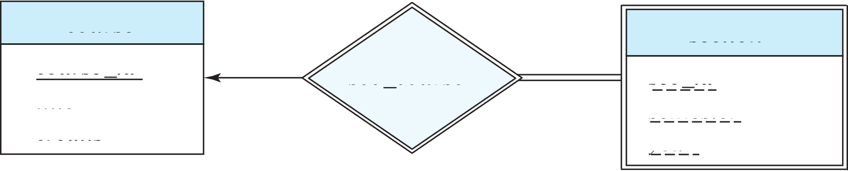
Representing Entity Sets
A strong entity set reduces to a schema with the same attributes
student(ID, name, tot_cred)
A weak entity set becomes a table that includes a column for the primary key of the identifying strong entity set
section (course_id, sec_id, sem, year)
Example

Slide 60
Representation of Entity Sets with Composite Attributes
Composite attributes are flattened out by creating a separate attribute for each component attribute
Example: given entity set instructor with composite attribute name with component attributes first_name and last_name the schema corresponding to the entity set has two attributes name_first_name and name_last_name
Prefix omitted if there is no ambiguity (name_first_name could be first_name)
Ignoring multivalued attributes, extended instructor schema is
instructor(ID, first_name, middle_initial, last_name, street_number, street_name, apt_number, city, state, zip_code, date_of_birth)

Slide 61
Representation of Entity Sets with Multivalued Attributes
A multivalued attribute M of an entity E is represented by a separate schema EM
Schema EM has attributes corresponding to the primary key of E and an attribute corresponding to multivalued attribute M
Example: Multivalued attribute phone_number of instructor is represented by a schema:
inst_phone= ( ID, phone_number)
Each value of the multivalued attribute maps to a separate tuple of the relation on schema EM
For example, an instructor entity with primary key 22222 and phone numbers 456-7890 and 123-4567 maps to two tuples:
(22222, 456-7890) and (22222, 123-4567)

Slide 62
Representing Relationship Sets
A many-to-many relationship set is represented as a schema with attributes for the primary keys of the two participating entity sets, and any descriptive attributes of the relationship set.
Example: schema for relationship set advisor
advisor = (s_id, i_id)

Slide 63
Redundancy of Schemas
Many-to-one and one-to-many relationship sets that are total on the many-side can be represented by adding an extra attribute to the “many” side, containing the primary key of the “one” side
Example: Instead of creating a schema for relationship set inst_dept, add an attribute dept_name to the schema arising from entity set instructor
Example

Slide 64
Redundancy of Schemas
For one-to-one relationship sets, either side can be chosen to act as the “many” side
That is, an extra attribute can be added to either of the tables corresponding to the two entity sets
* If participation is partial on the “many” side, replacing a schema by an extra attribute in the schema corresponding to the “many” side could result in null values

Slide 65
Redundancy of Schemas
The schema corresponding to a relationship set linking a weak entity set to its identifying strong entity set is redundant.
Example: The section schema already contains the attributes that would appear in the sec_course schema

Slide 66
Design Issues

Slide 67
Common Mistakes in E-R Diagrams
Examples of erroneous E-R diagrams
(a) Unnecessary attribute
… which is the primary key of another entity
Problem: data redundancy
The relationships are already presented in the relationship set (stud_dept)

Slide 68
Common Mistakes in E-R Diagrams
Examples of erroneous E-R diagrams
(b) Erroneous relationship attributes
Problem: It cannot represent multiple assignments released in the same section

Slide 69
Common Mistakes in E-R Diagrams
Examples of erroneous E-R diagrams
(b) Erroneous relationship attributes
Problem: It cannot represent multiple assignments released in the same section
Solutions:
1) Weak entity set
2) Composite attributes

Slide 70
Common Mistakes in E-R Diagrams
Examples of erroneous E-R diagrams
(b) Erroneous relationship attributes
Problem: It cannot represent multiple assignments released in the same section
Solutions:
1) Weak entity set
2) Composite attributes

Slide 71
Entities vs. Attributes
Use entity sets or attributes?
Use of phone as an entity allows extra information about phone numbers
… plus multiple phone numbers

Slide 72
Entities vs. Relationships
Use entity sets or relationship sets?
Well, sometimes it is difficult to answer
A possible guideline: Use a relationship set to describe an action that occurs between entities

Slide 73
Entities vs. Relationships
Example: takes

Slide 74
Entities vs. Relationships
Use entity sets or relationship sets?
Well, sometimes it is difficult to answer
A possible guideline: Use a relationship set to describe an action that occurs between entities
Replace the relationship set takes

Slide 75
Entities vs. Relationships
Use entity sets or relationship sets?
Well, sometimes it is difficult to answer
A possible guideline: Use a relationship set to describe an action that occurs between entities
This guideline can be used for designing relationship attributes
For example, attribute date as attribute of advisor or as attribute of student

Slide 76
Binary Vs. Non-Binary Relationships
Although it is possible to replace any non-binary (n-ary, for n > 2) relationship set by a number of distinct binary relationship sets, a n-ary relationship set shows more clearly that several entities participate in a single relationship.

Slide 77
Binary Vs. Non-Binary Relationships
Some relationships that appear to be non-binary may be better represented using binary relationships
For example, a ternary relationship parents, relating a child to his/her father and mother, is best replaced by two binary relationships, father and mother
Using two binary relationships allows partial information (e.g., only mother being known)

Slide 78
Binary Vs. Non-Binary Relationships
Some relationships that appear to be non-binary may be better represented using binary relationships
For example, a ternary relationship parents, relating a child to his/her father and mother, is best replaced by two binary relationships, father and mother
Using two binary relationships allows partial information (e.g., only mother being known)
But there are some relationships that are naturally non-binary
Example: proj_guide

Slide 79
E-R Design Decisions
The use of an attribute or entity set to represent an object
Whether a real-world concept is best expressed by an entity set or a relationship set
The use of a ternary relationship versus a pair of binary relationships
The use of a strong or weak entity set
* Extra:
* The use of specialization/generalization – contributes to modularity in the design
* The use of aggregation – can treat the aggregate entity set as a single unit without concern for the details of its internal structure

Slide 80
Self Study: Alternative ER Notations
Chapter 7.10, Database System Concepts (7th Edition)

Slide 81
Normalization: A First Look

Slide 82
Recall: Design Alternatives
In designing a database schema, we must ensure that we avoid two major pitfalls:
Redundancy: a bad design may result in repeat information
Redundant representation of information may lead to data inconsistency among the various copies of information
Incompleteness: a bad design may make certain aspects of the enterprise difficult or impossible to model
Avoiding bad designs is not enough
There may be a large number of good designs from which we must choose

Slide 83
Recall: Design Alternatives
In designing a database schema, we must ensure that we avoid two major pitfalls:
Redundancy: a bad design may result in repeat information
Redundant representation of information may lead to data inconsistency among the various copies of information
Incompleteness: a bad design may make certain aspects of the enterprise difficult or impossible to model
Avoiding bad designs is not enough
There may be a large number of good designs from which we must choose
Do we have any guidelines on how to get a good design?
Normal Forms!

Slide 84
First Normal Form (1NF)
A relational schema R is in first normal form if the domains of all attributes of R are atomic
Domain is atomic if its elements are considered to be indivisible units
Examples of non-atomic domains:
Set of names, composite attributes
Identification numbers like CS307 that can be broken up into parts
However, in practice, we can also consider it atomic
Non-atomic values complicate storage and encourage redundant (repeated) storage of data

Slide 85
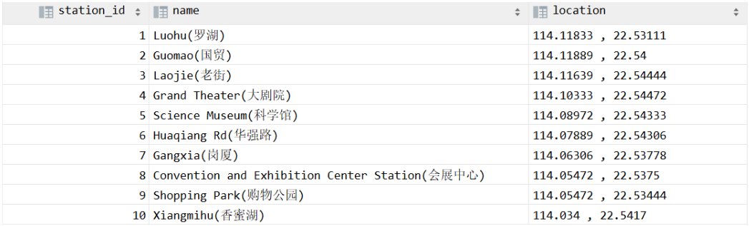
First Normal Form (1NF)
Example: Non-atomic attribute

Slide 86
First Normal Form (1NF)
Another example: Starring
Problems: 1) Redundant names; 2) difficulties in updating/deleting a specific person; 3) extra cost in splitting names; 4) difficulties in making statistics
Movie ID | Movie Title | Country | Year | Director | Starring
0 | Citizen Kane | US | 1941 | welles, o. | Orson Welles, Joseph Cotten
1 | La règle du jeu | FR | 1939 | Renoir, J. | Roland Toutain, Nora Grégor, Marcel Dalio, Jean Renoir
2 | North By Northwest | US | 1959 | HITCHCOCK, A. | Cary Grant, Eva Marie Saint, James Mason
3 | Singin' in the Rain | US | 1952 | Donen/Kelly | Gene Kelly, Debbie Reynolds, Donald O'Connor
4 | Rear Window | US | 1954 | Alfred Hitchcock | James Stewart, Grace Kelly

Slide 87
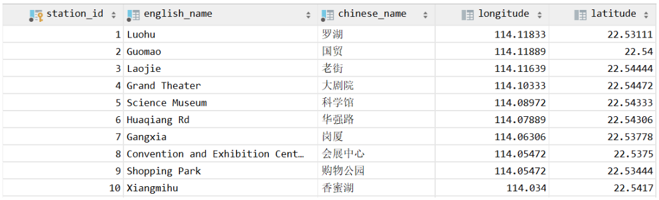
First Normal Form (1NF)
Fix it by splitting the names into two columns

Slide 88
First Normal Form (1NF)
Fix it by treating the column as a multi-valued attribute
Movie ID | Movie Title | Country | Year | Director
0 | Citizen Kane | US | 1941 | welles, o.
1 | La règle du jeu | FR | 1939 | Renoir, J.
2 | North By Northwest | US | 1959 | HITCHCOCK, A.
3 | Singin' in the Rain | US | 1952 | Donen/Kelly
4 | Rear Window | US | 1954 | Alfred Hitchcock
Star ID | Firstname | Lastname | Born | Died
1
2
3
movie_starring

Slide 89
Second Normal Form (2NF)
A relation satisfying 2NF must:
be in 1NF
not have any non-prime attribute that is dependent on any proper subset of any candidate key of the relation
A non-prime attribute of a relation is an attribute that is not a part of any candidate key of the relation.

Slide 90
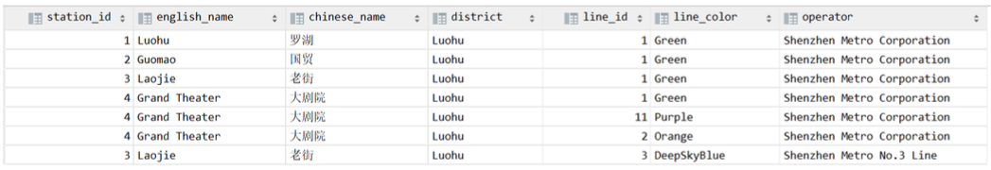
Second Normal Form (2NF)
Example: Consider this table with the composite primary key (station_id, line_id)
The columns line_color and operator are not related to station_id
They are only related to line_id, which is only part of (a subset of) the primary key
Similarly, english_name, chinese_name, and district are not related to line_id
They are only related to station_id, which is only part of (a subset of) the primary key

Slide 91
Second Normal Form (2NF)
Example: Consider this table with the composite primary key (station_id, line_id)
Problem when not meeting 2NF: Insertion and deletion anomaly
We cannot insert a new station with no lines assigned yet (unless using NULLs)
If we delete a line, all stations associated with this line will be deleted as well

Slide 92
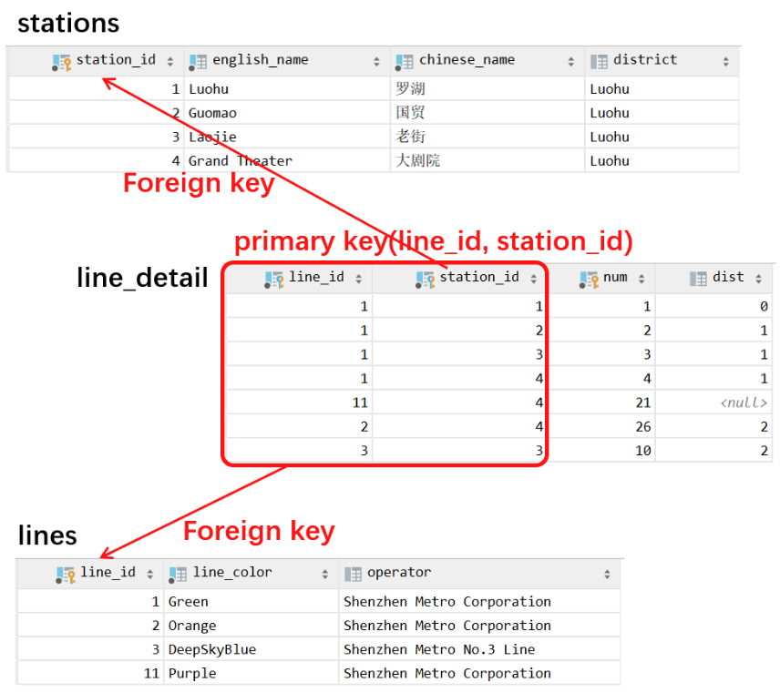
Second Normal Form (2NF)
Fix it by
Splitting the two unrelated parts into two different tables of entities
And create a relationship set (if it is the many-to-many relationship between the two entities)
By the way…
A relation with a single-attribute primary key is automatically in 2NF once it meets 1NF.

Slide 93
Third Normal Form (3NF)
A relation satisfying 3NF must:
be in 2NF
all the attributes in a table are determined only by the candidate keys of that relation and not by any non-prime attributes

Slide 94
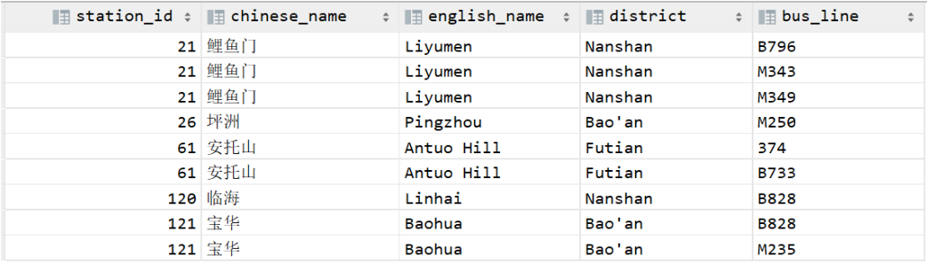
Third Normal Form (3NF)
Example: Consider this table which describes the bus lines and their stops
Primary key (bus_line)
The column station_id depends on the primary key (bus_line)
However, the columns chinese_name, english_name, and district depend on station_id, which is not the primary key.
They only have “indirect/transitive” dependence on the primary key
Problem: Data redundancy

Slide 95
Third Normal Form (3NF)
Example: Consider this table which describes the bus lines and their stops
Primary key (bus_line)
Problem when not meeting 3NF:
Data redundancy: as you can see in the table, the attributes for a station have been stored multiple times
Insertion and deletion anomaly: inserting a new bus line with no station becomes impossible without NULLs; deleting a station/bus line may also delete corresponding bus lines/stations.

Slide 96
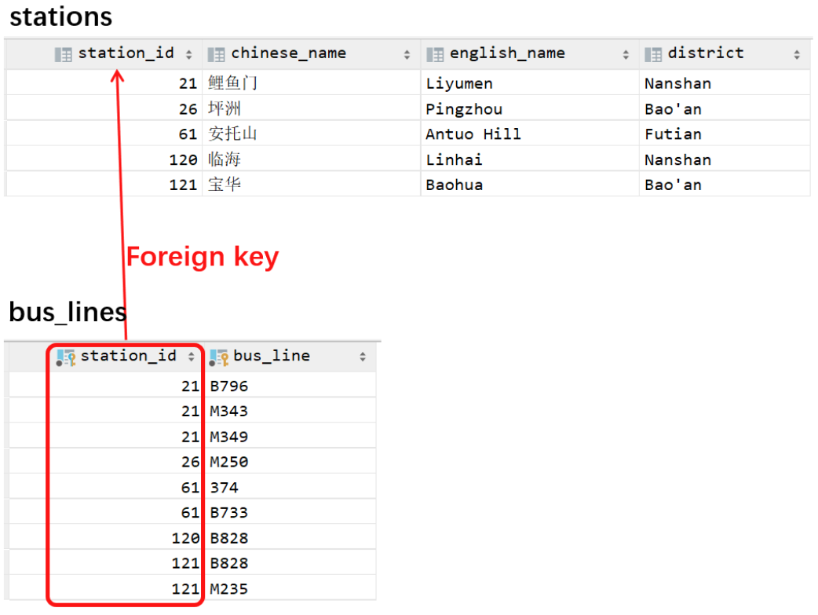
Third Normal Form (3NF)
Fix it by:
Create a new table with station_id as the primary key
i.e., the column which chinese_name, english_name, and district depend on
Move all columns which depend on the new primary key into the new table
… and, only leave the primary key of the new table (station_id) in the original table
(*In practice, if necessary) Add a foreign-key constraint
Not related to relational database modeling, only in implementations

Slide 97
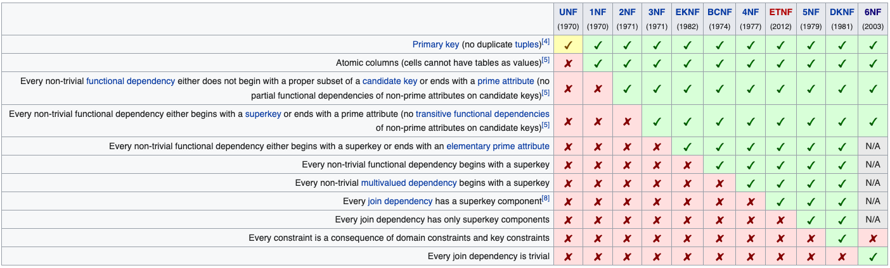
Normalization
In practice, we usually just satisfy 1NF, 2NF and 3NF
https://en.wikipedia.org/wiki/Database_normalization

Slide 98

Normalization
Every non key attribute must provide a fact about the key,
the whole key,
and nothing but the key.
William Kent (1936 – 2005)
William Kent. "A Simple Guide to Five Normal Forms in Relational Database Theory", Communications of the ACM 26 (2), Feb. 1983, pp. 120–125.

