Slide 1
Principles of Database Systems (CS307) Lecture 9: Relational Algebra
Ran Cheng
Department of Computer Science and Engineering
Southern University of Science and Technology
Most contents are from slides made by Stéphane Faroult and the authors of Database System Concepts (7th Edition).
Their original slides have been modified to adapt to the schedule of CS307 at SUSTech.
Notes:
In this chapter, I will introduce how to retrieve data from one table. Just from one table. I will introduce how to retrieve data from multiple table in next chapter.

Slide 2
Relational Algebra
A procedural language consisting of a set of operations that take one or two relations as input and produce a new relation as their result.
6 Basic Operators:
select: σ
project: ∏
union: ∪
set difference: –
Cartesian product: ×
rename: ρ

Slide 3

Cartesian product
The term "Cartesian Product" is derived from the mathematician René Descartes.
His work in coordinate geometry showed how to describe the position of points using ordered pairs of numbers.
In a similar fashion, the Cartesian Product pairs elements from two sets.
“Cogito, ergo sum” (“I think, therefore I am”）

Slide 4
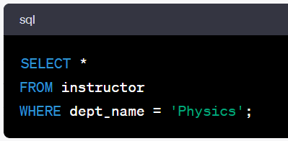
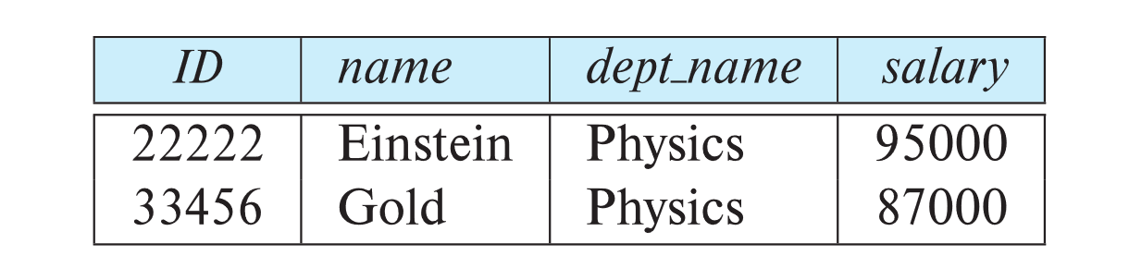
Select Operation
The select operation selects tuples that satisfy a given predicate
Notation: σ _{p} (r)
p is called the selection predicate
SQL: select *
Example
Select those tuples of the instructor relation where the instructor is in the “Physics” department
σ _{dept_name = “Physics”} (instructor)

Slide 5
Select Operation
We allow comparisons using =, ≠, >, ≥. <. ≤ in the selection predicate
We can combine several predicates into a larger predicate by using the connectives:
∧ (and), ∨ (or), ¬ (not)
Example: Find the instructors in Physics with a salary greater than $90,000, we write:
σ dept_name = “Physics”∧ salary > _{90,000} (instructor)
The select predicate may include comparisons between two attributes.
Example, find all departments whose name is the same as their building name:
σ _{dept_name = building} (department)

Slide 6
Project Operation
A unary (一元) operation that returns its argument relation, with certain attributes left out. It is applied to Columns.
Notation: ∏ _{A1,A2,A3 ….Ak} (r)
where A₁, A₂, …, A_{k} are attribute names and r is a relation name.
The result is defined as the relation of k columns obtained by erasing the columns that are not listed
Duplicate rows removed from result, since relations are sets

Slide 7
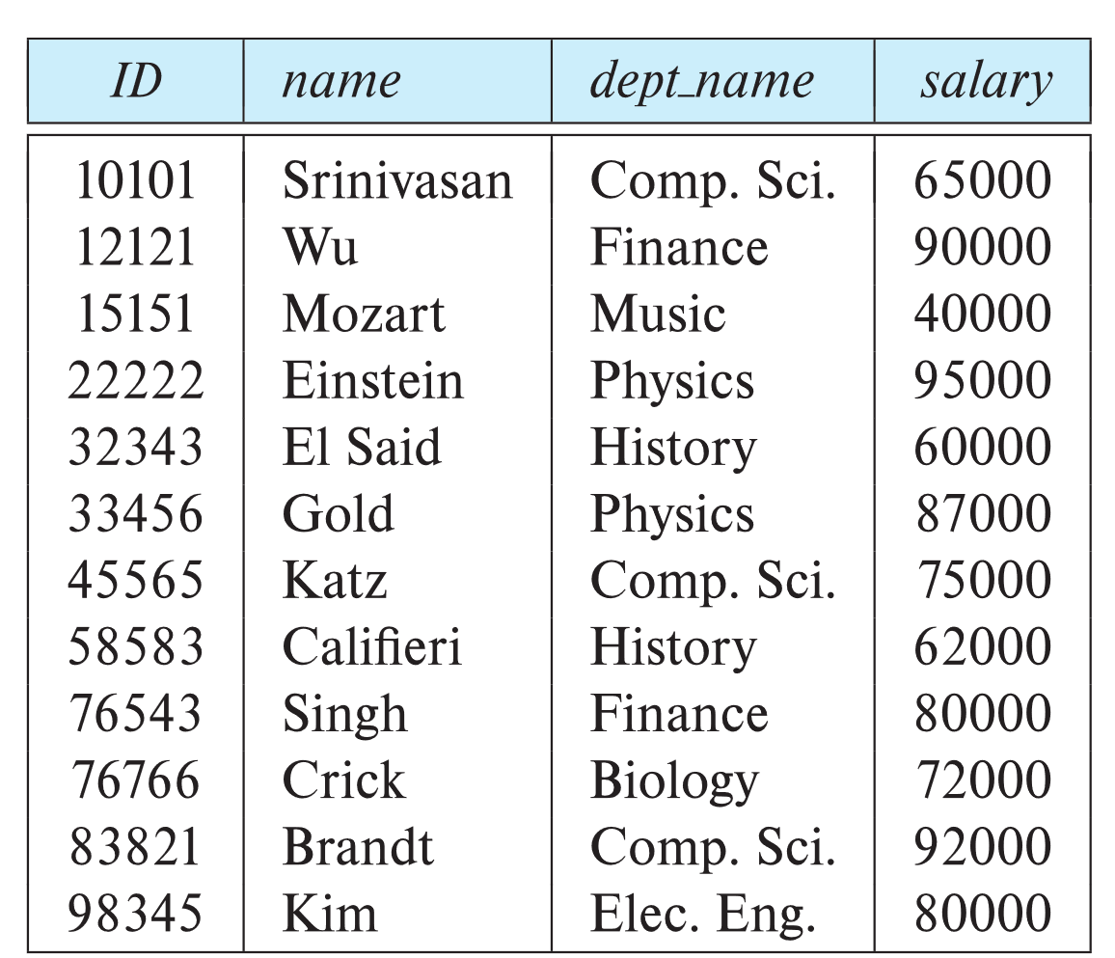
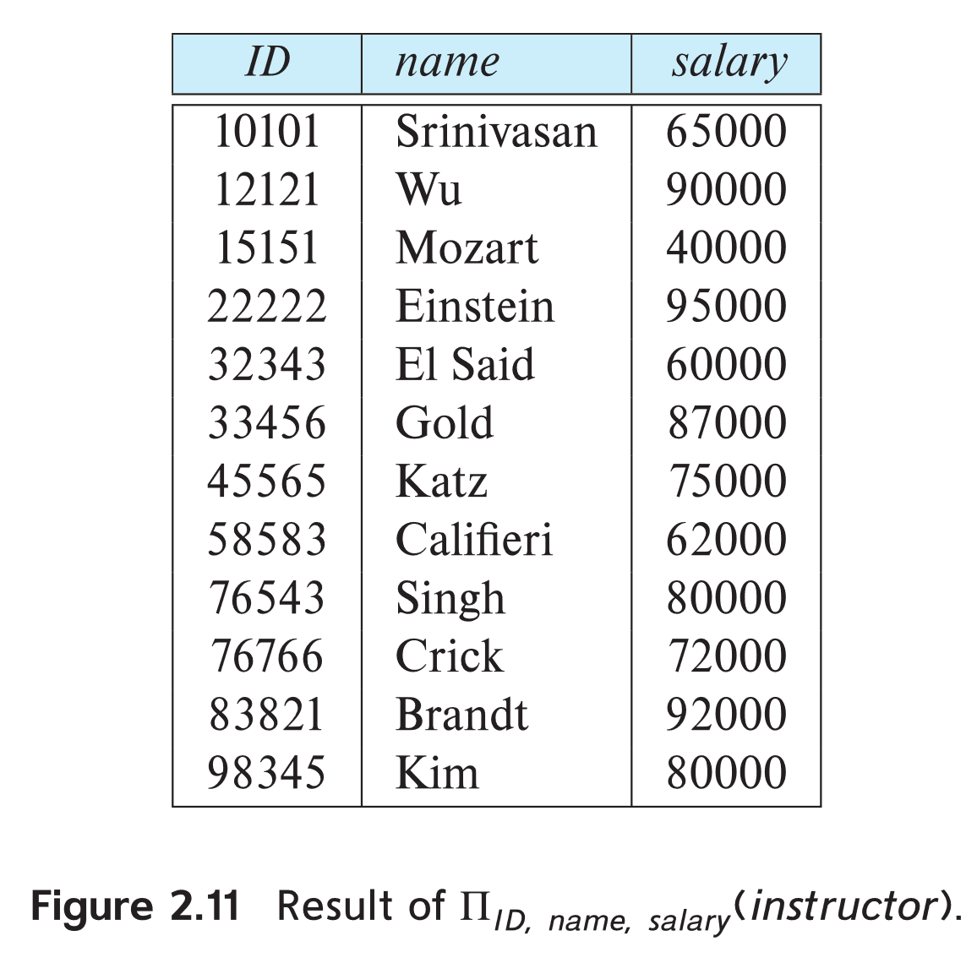
Project Operation
Example: eliminate the dept_name attribute of instructor
Query:
∏_{ID, name, salary} (instructor)

Slide 8
Composition of Relational Operations
The result of a relational-algebra operation is relation
… and therefore, relational-algebra operations can be composed together into a relational-algebra expression
Consider the query: Find the names of all instructors in the Physics department
∏_{name}(σ _{dept_name} _{= “Physics”} (instructor))
Instead of giving the name of a relation as the argument of the projection operation, we give an expression that evaluates to a relation

Slide 9
Cartesian-Product Operation
The Cartesian-product operation (denoted by ×) allows us to combine information from any two relations.
Example: the Cartesian product of the relations instructor and teaches is written as:
instructor × teaches
We construct a tuple of the result out of each possible pair of tuples
… one from the instructor relation and one from the teaches relation (see next slide)
Since the instructor ID appears in both relations, we distinguish between these attributes by attaching to the attribute the name of the relation from which the attribute originally came – using ‘xxx.xxx’ .
instructor.ID
teaches.ID

Slide 10
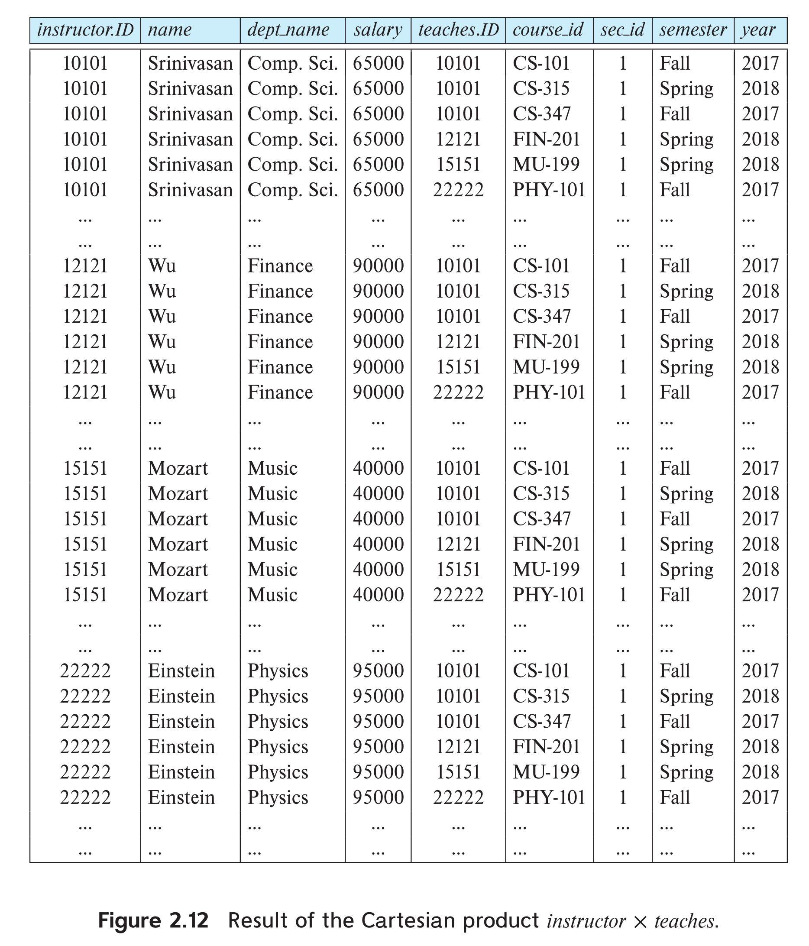
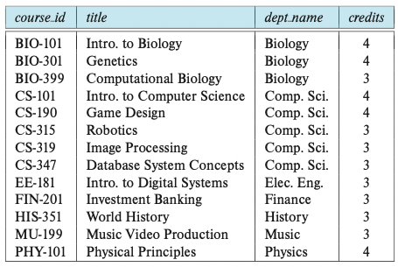
The “instructor × teaches” table

Slide 11
Join Operation
Problem: The Cartesian-Product “instructor × teaches” associates every tuple of instructor with every tuple of teaches
Most of the resulting rows have information about instructors who did NOT teach a particular course

Slide 12
Join Operation
To get only those tuples of “instructor × teaches” that pertain to instructors and the courses that they taught, we write:
σ _{instructor.id = teaches.id} (instructor × teaches)
We get only those tuples of “instructor × teaches” that pertain to instructors and the courses that they taught
i.e., those tuples where instructor.id = teaches.id

Slide 13
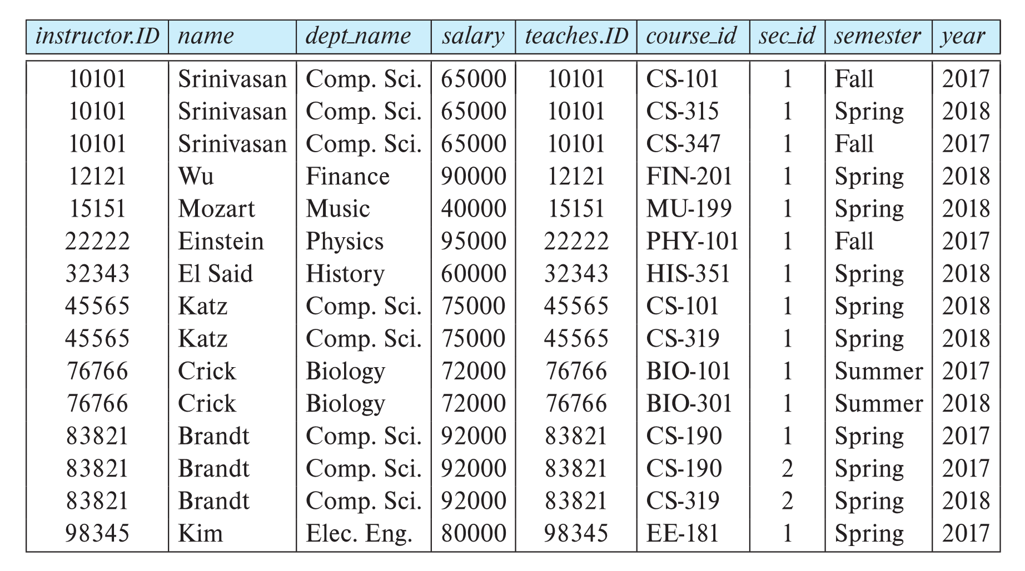
Join Operation
The table corresponding to σ _{instructor.id = teaches.id} (instructor × teaches):

Slide 14

Join Operation
The table corresponding to σ _{instructor.id = teaches.id} (instructor × teaches):
… will NOT include such tuples (rows) with different IDs

Slide 15
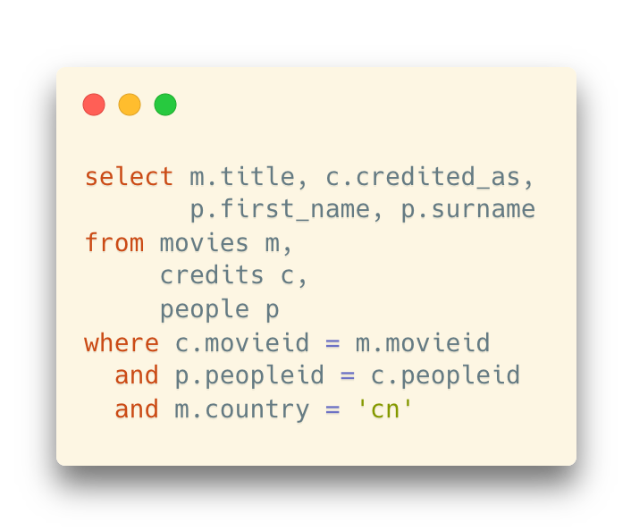
Recall: The Old Way of Writing Joins
Use commas to separate the tables
Example: The solution for the same question in the previous slide
A little bit history:
join was introduced in SQL-1999 (later than this original way)
Problem:
If you forget a comma, it will still work sometimes (interpreted as “renaming”)
The SQL syntax was derived from the form of cartesian products in relational algreba
σ movies.id = credits.id ∧ people.peopleid = credits.peopleid ∧ movies.country = “cn” (Movies × Credits × People)

Slide 16
Recall: The Old Way of Writing Joins
Use commas to separate the tables
Example: The solution for the same question in the previous slide
A little bit history:
join was introduced in SQL-1999 (later than this original way)
Problem:
If you forget a comma, it will still work sometimes (interpreted as “renaming”)
Use commas as the “multiplication signs”
The “select operation” is written as the “where” clause here
The SQL syntax was derived from the form of cartesian products in relational algreba
σ movies.id = credits.id ∧ people.peopleid = credits.peopleid ∧ movies.country = “cn” (Movies × Credits × People)

Slide 17
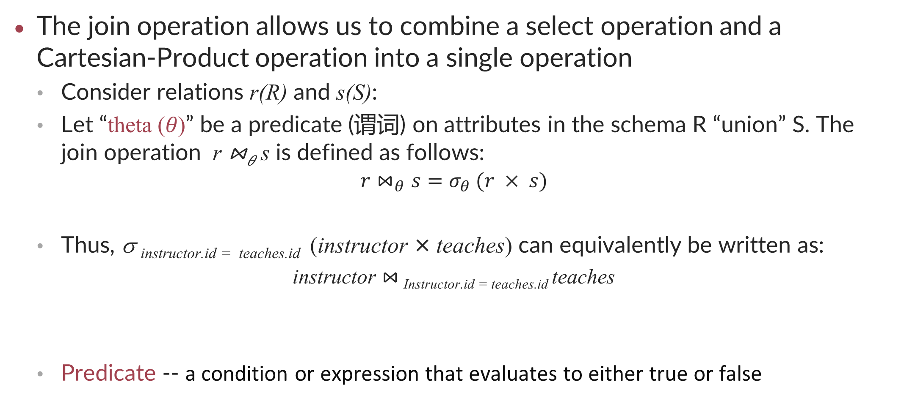
Join Operation
The join operation allows us to combine a select operation and a Cartesian-Product operation into a single operation
Consider relations r(R) and s(S):
Let “theta (𝜃)” be a predicate (谓词) on attributes in the schema R “union” S. The join operation r ⋈_{𝜃} s is defined as follows:
$$r⋈_{θ}s=σ_{θ} (r × s)$$
Thus, σ _{instructor.id = teaches.id} (instructor × teaches) can equivalently be written as:
instructor $⋈_{ }$_{Instructor.id = teaches.id} teaches
Predicate -- a condition or expression that evaluates to either true or false

Slide 18
Union Operation
The union operation allows us to combine two relations
Notation: r ∪ s
For r ∪ s to be valid:
r, s must have the same arity (same number of attributes)
The attribute domains must be compatible
Example: 2nd column of r deals with the same type of values as does the 2nd column of s

Slide 19
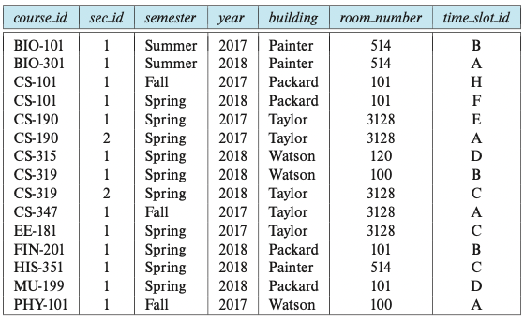
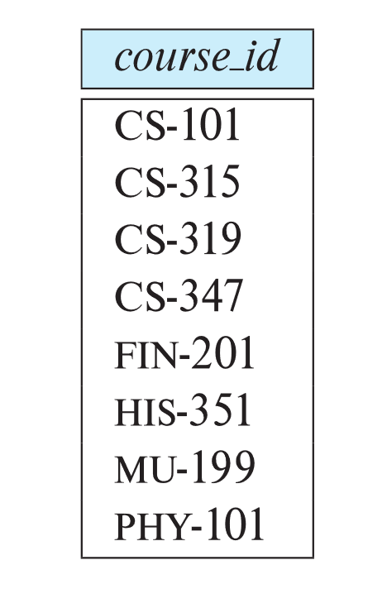
Union Operation
Example: To find all courses taught in the Fall 2017 semester, or in the Spring 2018 semester, or in both
∏_{course_id} (σ _{semester=“Fall” Λ year=2017} (section)) ∪ ∏_{course_id} (σ _{semester=“Spring” Λ year=2018} (section))

Slide 20
Set-Intersection Operation
The set-intersection operation allows us to find tuples that are in both the input relations
Notation: r ∩ s
Assume (same as Union):
r, s have the same arity
Attributes of r and s are compatible

Slide 21
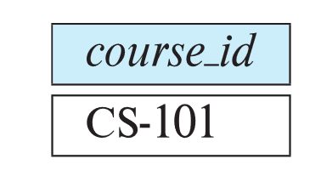
Set-Intersection Operation
Example: Find the set of all courses taught in both the Fall 2017 and the Spring 2018 semesters
∏_{course_id} (σ _{semester=“Fall” Λ year=2017} (section)) ∩ ∏_{course_id} (σ _{semester=“Spring” Λ year=2018} (section))

Slide 22
Set Difference Operation
The set-difference operation allows us to find tuples that are in one relation but are not in another
Notation: r – s
Assume (same as Union and Set Intersection):
r, s have the same arity
Attributes of r and s are compatible

Slide 23

Set Difference Operation
Example: Find all courses taught in the Fall 2017 semester, but not in the Spring 2018 semester
∏_{course_id} (σ _{semester=“Fall” Λ year=2017} (section)) – ∏_{course_id} (σ _{semester=“Spring” Λ year=2018} (section))

Slide 24
The Assignment Operation
It is convenient at times to write a relational-algebra expression by assigning parts of it to temporary relation variables
The assignment operation is denoted by ← and works like assignment in a programming language
Example: Find all instructor in the “Physics” and Music department
Physics ← σ _{dept_name = “Physics”} (instructor)
Music ← σ _{dept_name = “Music”} (instructor)
Physics ∪ Music
With the assignment operation, a query can be written as a sequential program consisting of a series of assignments followed by an expression whose value is displayed as the result of the query.

Slide 25
The Rename Operation
The results of relational-algebra expressions do not have a name that we can use to refer to them
The rename operator, ρ, is provided for that purpose
The expression ρ_{x} (E) returns the result of expression E under the name x
Another form of the rename operation which also renames the columns:
ρ_{x(A1,A2, .. An)} (E)

Slide 26
Equivalent Queries
There is more than one way to write a query in relational algebra – why?
Example: Find information about courses taught by instructors in the Physics department with salary greater than 90,000
Query 1
σ dept_name = “Physics” ∧ salary > 90,000 (instructor)
Query 2
σ _{dept_name = “Physics”} (σ _{salary > 90.000} (instructor))
The two queries are not identical
they are, however, equivalent -- they give the same result on any database

Slide 27
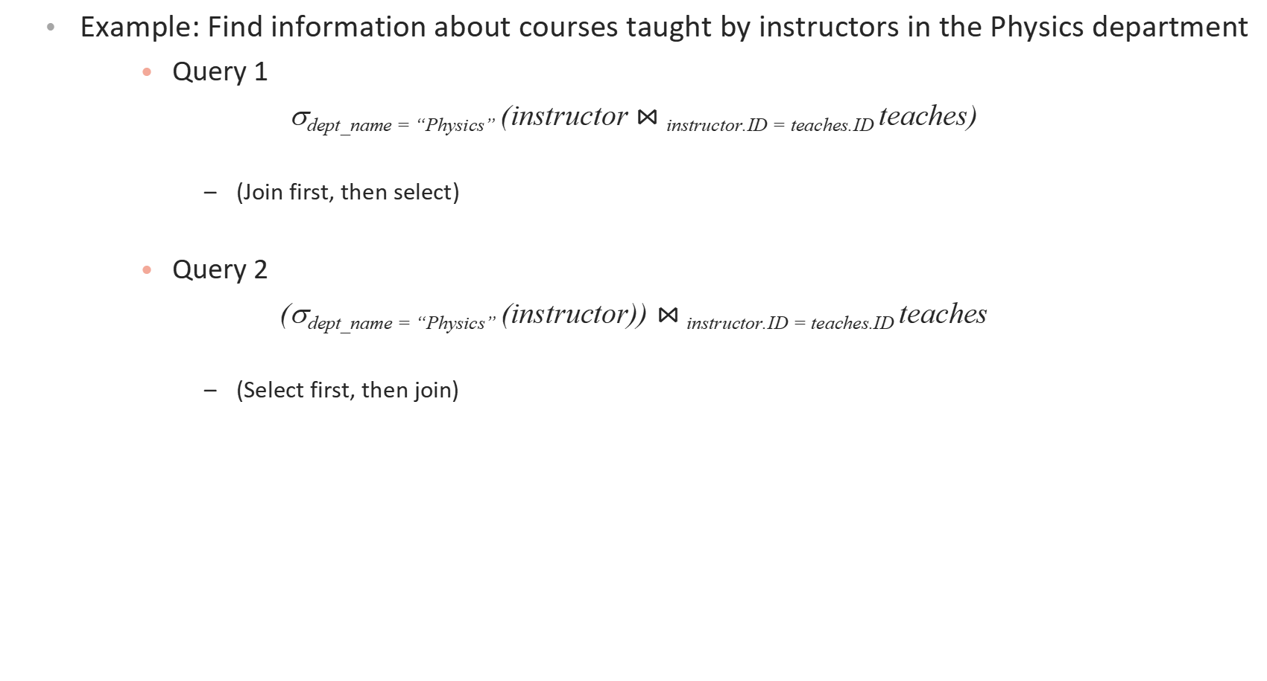
Equivalent Queries
Example: Find information about courses taught by instructors in the Physics department
Query 1
σ_{dept_name = “Physics”} (instructor $⋈_{ }$_{instructor.ID = teaches.ID} teaches)
(Join first, then select)
Query 2
(σ_{dept_name = “Physics”} (instructor)) $⋈_{ }$_{instructor.ID = teaches.ID} teaches
(Select first, then join)

Slide 28
Equivalent Queries
Application of Relational Algebra: Query Optimization
Transform queries into equivalent ones with less computational cost

Slide 29
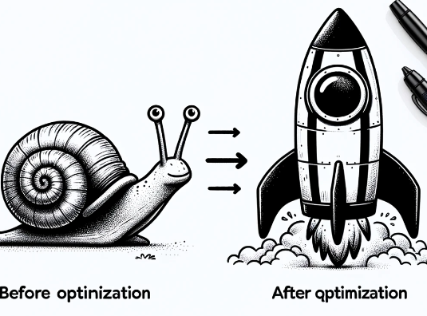
Query Optimization
Definition: Query optimization is the process of improving the efficiency of a query to minimize execution time and resource usage.
Purpose: Optimization aims to provide rapid query results and reduce the load on the database system.
Process: Involves selecting the most efficient way to execute a given query by considering different query plans.
Why It Matters: The speed of data retrieval is critical in high-volume database environments, impacting user experience and system performance.

Slide 30
Query Optimization
The Role of the Database Management System (DBMS)
DBMS Functions: The DBMS translates and executes SQL queries, ensuring data integrity and performance.
Query Optimizer: A core component of the DBMS that determines the most efficient way to execute a query.
Execution Plan: The blueprint created by the optimizer that the database engine follows to retrieve data.
Query Executor: The DBMS component that carries out the execution plan and returns the query results.

Slide 31
Query Optimization
Factors Affecting Query Performance
Database Schema Design: Proper normalization and table design can significantly impact performance.
Index Usage: Correct indexing strategies can reduce data retrieval times.
Statistics: Up-to-date data distribution statistics help the optimizer create efficient query plans.
Query Complexity: Simpler queries typically run faster; complex queries may need optimization techniques to improve performance.

Slide 32
Query Optimization
Writing Efficient SQL Queries
Selective Data Retrieval: Request only the data you need using specific column names instead of '*'.
Join Types: Understand different join operations and use the most appropriate one for your query.
Subquery Usage: Subqueries can be powerful but may lead to inefficiency; consider alternative methods like joins.
Indexing: Use indexes wisely to speed up searches on large tables.

Slide 33
Query Optimization
Tools and Techniques for Query Optimization
Analyzing Tools: Use tools like EXPLAIN PLAN to understand how a query will be executed.
Identifying Bottlenecks: Look for slow parts of your query that could be causing delays.
Optimization Techniques: Apply strategies such as indexing, query refactoring, and materialized views to improve performance.
Regular Maintenance: Keep statistics up-to-date and periodically review query performance.

