Slide 1
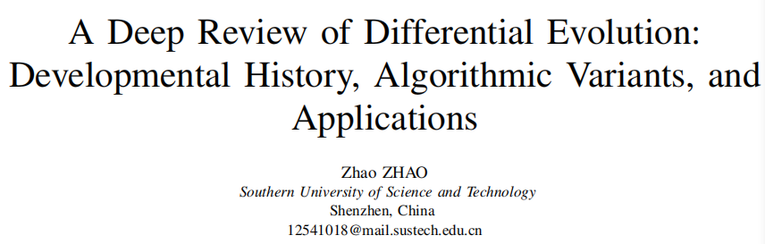
Date: 2025.11.14

Slide 2
Introduction
Challenges in Optimization Problems
- Nonlinear, non-differentiable, multimodal, and high-dimensional problems
- Limitations of traditional gradient-based methods
Advantages of Differential Evolution
- Simple and efficient, with strong global search capability
- Requires no gradient information and is easy to implement

Slide 3
Developmental Line
4 main stages:
Foundational Period (1995-1997)
Strategy Exploration Period (Approx. 1997-2006)
Adaptive Development Period (Approx. 2006-2015)
Frontier Exploration Period (Approx. 2015-Present)

Slide 4
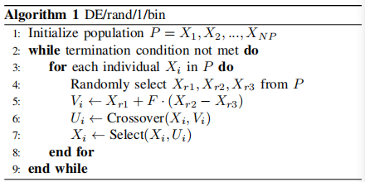
Foundation Period (1995-1997)
Representative Algorithm: DE/rand/1/bin
Algorithm Characteristics:
Random selection of individuals for mutation
Binomial crossover
Greedy selection strategy
Performance:
Strong global search capability
Suitable for various continuous optimization problems

Slide 5
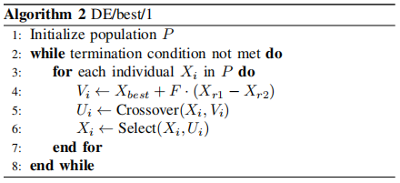
Strategy Exploration Period (Approx. 1997-2006)
Representative Algorithms: DE/best/1, DE/current-to-best/1
Algorithm Comparison:
DE/best/1: Faster convergence but prone to premature convergence
DE/current-to-best/1: Better balanced performance
Research Significance:
Enriched the library of algorithmic strategies
Laid the groundwork for adaptive algorithms

Slide 6
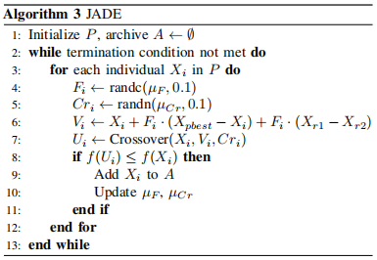
Adaptive Development Period (2006-2015)
Representative Algorithms: JADE
Core Innovations:
Parameter adaptive mechanisms
"Current-to-pbest" strategy
Historical archive mechanism
Advantages of JADE:
Automatic parameter adjustment
Balanced exploration and exploitation
Effective handling of complex multimodal problems

Slide 7
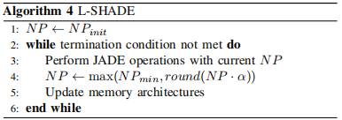
Frontier Exploration Period (2015-Present)
Representative Algorithm: L-SHADE
Key Technologies:
Linear Population Size Reduction
Success History-based Parameter Adaptation
Performance:
Outstanding performance in CEC competitions
Represents the state-of-the-art in DE performance

Slide 8
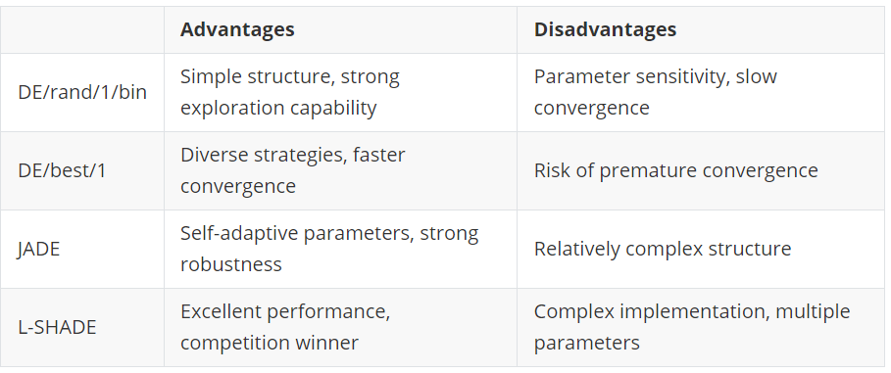
Discussion

Slide 9
Discussion
Evolution of Exploration-Exploitation Balance
- Progressed from strong exploration to intelligent balancing
- Adaptive mechanisms play a key role
Transition from "Artisanal" to "Intelligent" Algorithm
- Reduced need for manual intervention
- Enhanced self-learning capabilities
Continuous Expansion of Application Scope
- From numerical optimization to complex engineering problems
- Successful applications across multiple domains
Unity of Simplicity and Effectiveness

Slide 10
Conclusion & Future Work
Conclusion Summary
- Evolved from simple tool to intelligent framework
- Continuous performance improvements achieved
- Wide applications across various domains
- Remains highly influential in evolutionary computation
Future Research Focus
- Very large-scale and dynamic optimization
- Deeper theoretical analysis
- Integration with AI and machine learning

Slide 11
References
[1] Storn, R., & Price, K. (1997). Differential evolution – a simple and efficient heuristic for global optimization over continuous spaces. Journal of Global Optimization, 11(4), 341–359.
[2] Storn, R. (1996). Minimizing the real functions of the ICEC’96 contest by differential evolution. Technical Report, International Computer Science Institute.
[3] Zhang, J., & Sanderson, A. C. (2009). JADE: Adaptive differential evolution with optional external archive. IEEE Transactions on Evolutionary Computation, 13(5), 945–958.
[4] Tanabe, R., & Fukunaga, A. S. (2014). Improving the search performance of SHADE using linear population size reduction. In Proceedings of the 2014 IEEE Congress on Evolutionary Computation (CEC) (pp. 1658–1665).

Slide 12
Thank you!

