Slide 1
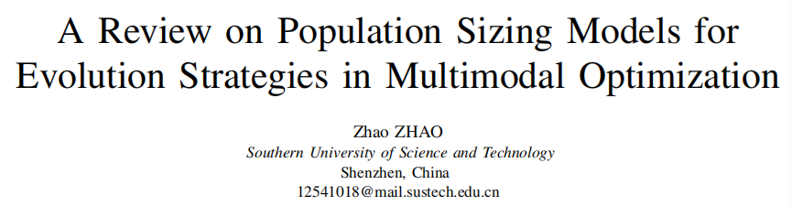
Date: 2025.12.19

Slide 2
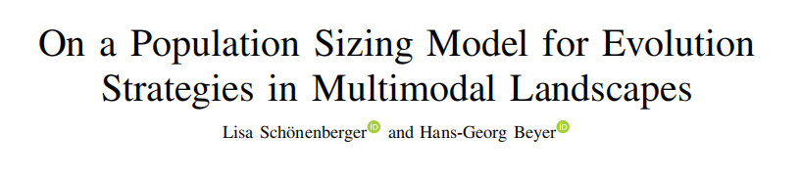
IEEE Evolutionary Computation 2025

Slide 3
Introduction
- Multi-modal optimization is a challenging problem where traditional methods often fail
- Evolution Strategies show strong potential for such problems, but their performance depends critically on population size selection
- This paper introduces a frozen noise model that provides a theoretical framework for determining optimal population sizes in multi-modal landscapes

Slide 4
Background
Multi-recombinant Evolution Strategies
including variants using σ self-adaptation (σSA) and cumulative step-size adaptation (CSA)
3 classic multimodal benchmark functions:
- Rastrigin: Exhibiting an exponential number of local optima
- Bohachevsky: Presenting a hyper ellipsoidal global structure
- Ackley: Infinitely many local optima and a nonlinear decaying global component.

Slide 5
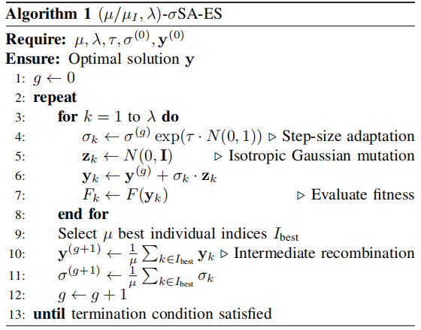
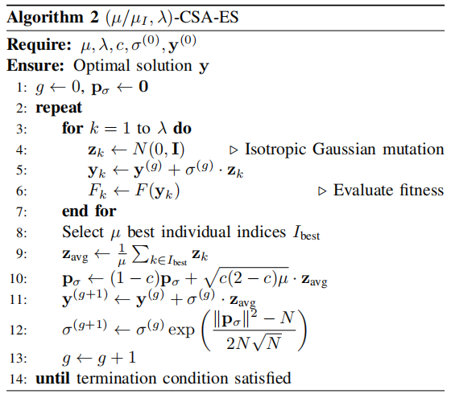
Proposed Algorithm:
Frozen Noise Model & Population Sizing Derivation

Slide 6


Frozen Noise Constuction
Decompose a complex multimodal function:
A globally smooth “skeleton” component, a series of local fluctuating “noise” components
A relatively simple sphere model optimization problem, with the sphere model superimposed
by distance-dependent noise

Slide 7

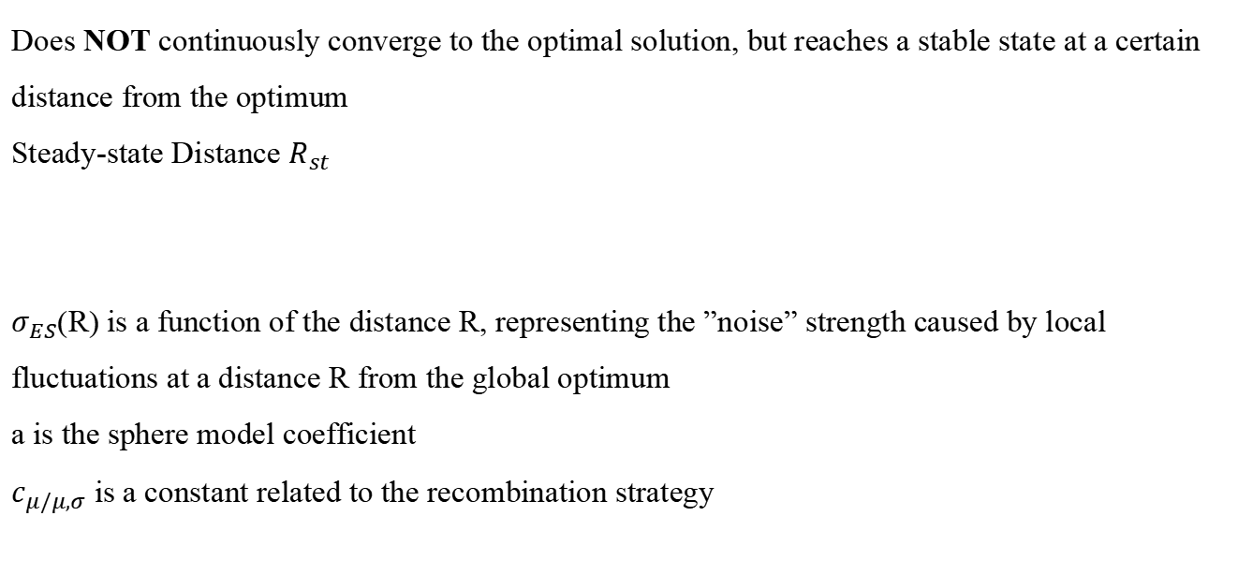
Steady-State Behavior Analysis
Does NOT continuously converge to the optimal solution, but reaches a stable state at a certain distance from the optimum
Steady-state Distance $R_{st}$
$σ_{ES}$(R) is a function of the distance R, representing the ”noise” strength caused by local fluctuations at a distance R from the global optimum
a is the sphere model coefficient
$c_{μ/μ,σ}$ is a constant related to the recombination strategy

Slide 8
Population Size Prediction Formulas
To achieve a specified success probability, there exists a specific relationship between the required ES population size and problem dimensionality
- For the Rastrigin and Bohachevsky functions, this relationship is sublinear.
- For the Ackley function, if the initial point is appropriately chosen, the required population size depends only weakly on dimensionality. If the initial point is too far from the global optimum, may even exhibit exponential difficulty growth.

Slide 9
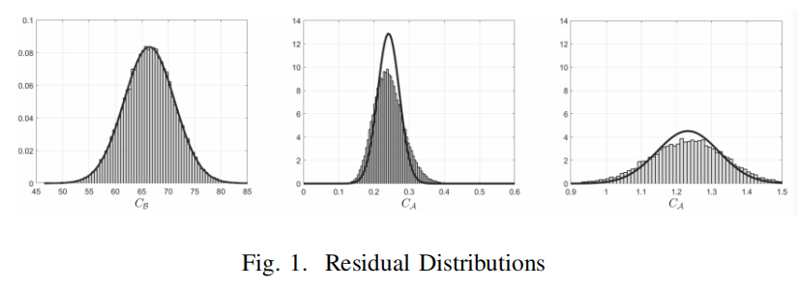
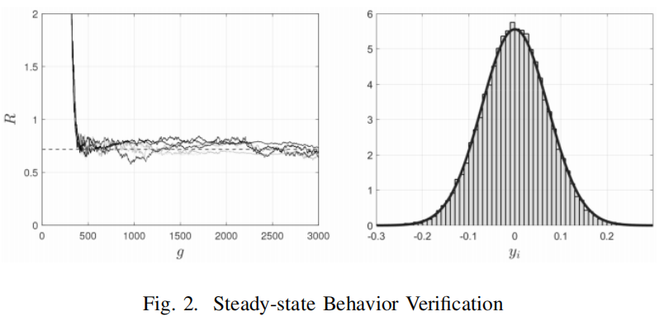
Experiment
Residual distributions approximate Gaussian, supporting model assumptions.
Parent component distributions match $N(0, R_{st}^{2}/N)$ predictions

Slide 10
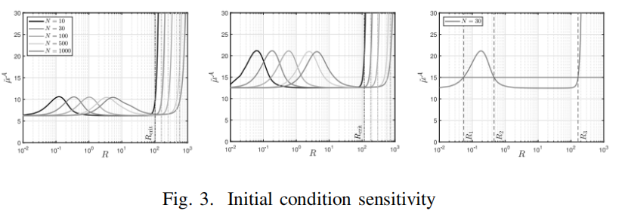
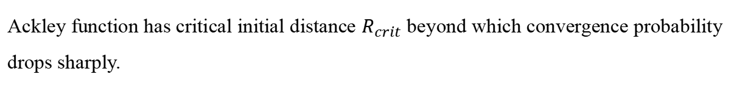
Experiment
Ackley function has critical initial distance $R_{crit}$ beyond which convergence probability drops sharply.

Slide 11
Discussion
Scaling Behavior Analysis
- Rastrigin and Bohachevsky: The population size grows sublinearly
- Ackley: Initial point is close to the global optimum, the population size depends only weakly on N, worst case may grows exponentially
Implications for Benchmark Design
- Rastrigin and Bohachevsky exhibit highly similar population size behavior
- The convergence of the Ackley function is highly sensitive to initial point selection

Slide 12
Discussion
Comparison with the Griewank Function
- Griewank function can also be decomposed into global and residual parts
- Its noise does not follow a Gaussian distribution
- The proposed model is not applicable to such functions

Slide 13
Conclusion
- Proposed the "frozen noise model," providing the first theoretical explanation for the sublinear population growth of ES in multimodal landscapes.
- Revealed that ES employs a "circling search" strategy, converging rapidly only after entering the global attractor region.
- The population sizing formulas offer a theoretical basis for parameter configuration and benchmark design.
- The model is applicable to spherical global structure functions and can be extended to non-spherical and dynamic scenarios in the future.

Slide 14
References
[1] L. Schonenberger and H.-G. Beyer, “On a population sizing model for evolution strategies in multimodal landscapes,” IEEE Transactions on Evolutionary Computation, vol. 29, no. 5, pp. 1807–1819, Oct. 2025.

Slide 15
Thank you!

