Slide 1
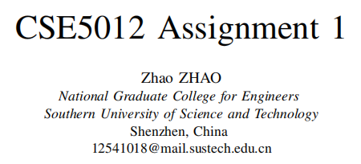
Date: 2025.10.17

Slide 2
Introduction
Evolutionary algorithms are population-based optimization techniques inspired by the process of natural selection.
Objective of this assignment: Design and implement an evolutionary algorithm framework for integer encoding
Contributions:
- Complete algorithm implementation
- Detailed pseudocode
- Multi-type test function verification

Slide 3
Background
Benchmark Functions:
Single-Peak Functions (f1-f7): Test convergence speed and local search capability
Multi-Peak Functions (f8-f15): Test global exploration and escape from local optima capability
More details of these functions will be shown in the experiment part

Slide 4
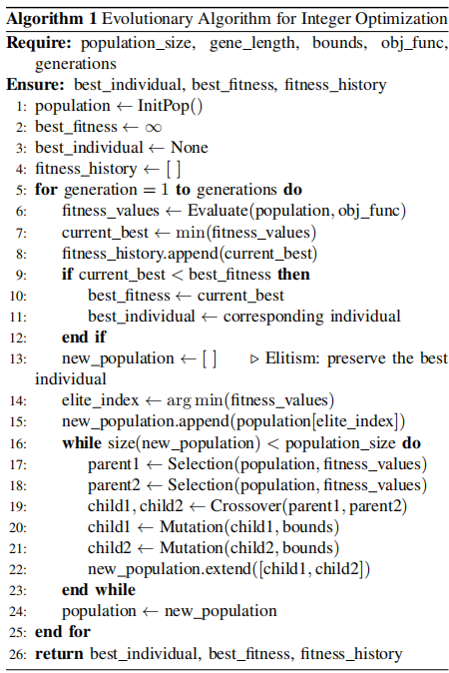
Algorithm Overview
Integer Encoding
Initialization → Evaluation → Selection → Crossover → Mutation → Elite Retention

Slide 5
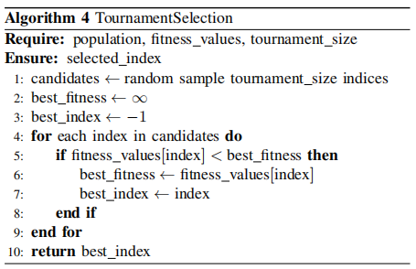
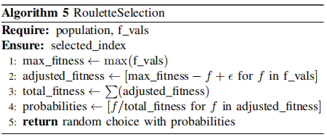
Operator Design: Selection
Tournament Selection:
Randomly select subsets, choose the optimal one
Control selection pressure
Roulette Selection:
Select based on fitness ratio
Maintain diversity

Slide 6
Operator Design: Crossover & Mutation
Single-point crossover:
Randomly select crossover points and exchange gene segments
Random reset mutation:
Replace genes with random values probabilistically to maintain population diversity

Slide 7
Experimental Setup
Parameter Settings:
Population Size: 200
Maximum Generations: 5000
Crossover Rate: 0.8
Mutation Rate: 0.1
Selection Strategy: Tournament
Experimental Environment:
Hardware: Intel Core i5-11300H CPU @ 3.10GHz, 16GB RAM
Programming Language: Python 3.10.14
Main Library: NumPy 2.2.6, Matplotlib 3.10.6

Slide 8
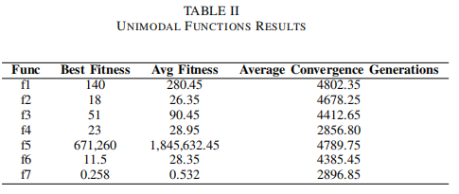
Unimodal Functions Performance
Observation:
f4 and f7 converge fast
f5 (Rosenbrock) remains challenging
f2: nonsmooth
f4: nondifferentiable
f5: “banana function” with narrow curved valleys, challenging for gradient-based algorithms
f6: flat regions
f7: random noise

Slide 9
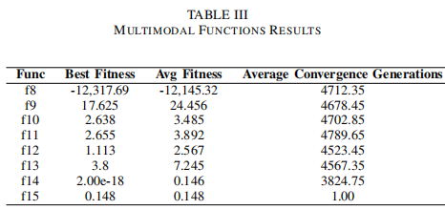
Multimodal Functions Performance
Observations:
Performs excellently on f8, f9, f10, f14
f15 performs badly
f8: numerous local minima, global optimum at the boundary
f9: classical multimodal test function
f10: almost flat outer regions and a narrow central hole, easy to causing early convergence
f11: numerous local minima
f12-f13: complex penalty
f14: Low-dimensional but features multiple sharp extreme points
f15: From real-world background significance

Slide 10
Statistical Significance Tests
Wilcoxon Test Results:
Convergence Accuracy: Significant difference between unimodal and multimodal (p=0.023)
Convergence Speed: No significant difference (p=0.156)
High-dimensional vs Low-dimensional: Significant difference in convergence accuracy (p=0.008)

Slide 11
Discussion
Advantages:
Performs well on most functions
Converges rapidly with strong global search capability
Limitations:
Still faces challenges with Rosenbrock and high-dimensional problems
Conclusion:
The algorithm demonstrates robustness and practicality.

Slide 12
Conclusion & Future Work
- Successfully implemented integer encoding evolutionary algorithm
- Validated effective performance across 15 benchmark functions
- Balances convergence speed with global exploration capability
Future:
- Adaptive parameter tuning
- Multi-population cooperative evolution
- Parallel computing

Slide 13
References
[1] Holland, J. H. (1975). Adaptation in natural and artificial systems. University of Michigan Press.
[2] Eiben, A. E., & Smith, J. E. (2015). Introduction to evolutionary computing. Springer.
[3] Potter, M. A., & De Jong, K. A. (1994). A cooperative coevolutionary approach to function optimization. In International Conference on Parallel Problem Solving from Nature.
[4] Talbi, E. G. (2009). Metaheuristics: from design to implementation. John Wiley & Sons.
[5] Coello, C. A. C. (2002). Theoretical and numerical constraint-handling techniques used with evolutionary algorithms: a survey of the state of the art. Computer Methods in Applied Mechanics and Engineering, 191(11-12), 1245-1287.

Slide 14
Thank you!

