Slide 1
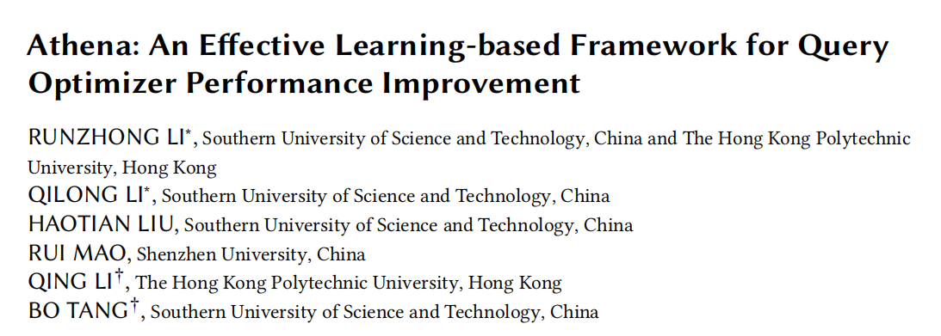
SIGMOD2025
12110120 赵钊
Date: 2025.5.12

Slide 2
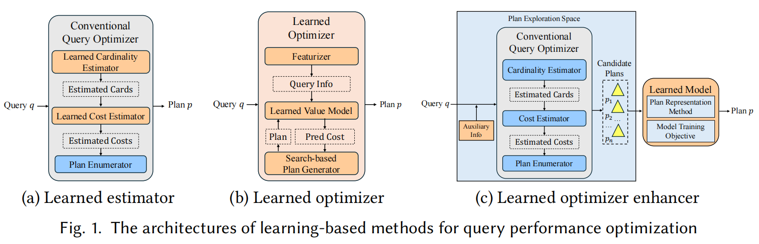
Introduction
Learning-based Query Optimizer
(I) Learned estimator: learning-based models --> more accurate estimates of intermediate cardinalities or plan costs
(II) Learned optimizer: end-to-end learned query optimizer, search-based plan generator and a learned value network
(III) Learned optimizer enhancer: generates multiple query plan candidates, selects the best one

Slide 3
Two representative learned optimizer enhancers
Bao: hints --> more plan candidates --> Tree-CNN choose the best
Lero: swinging the estimated cardinalities --> more plan candidates --> learning-to-rank model choose the best
Challenges:
(i) Plan Exploration Space: enumerate all of the plan candidates IMPOSSIBLE
(ii) Plan Representation Method: plan candidate --> a single vector
(iii) Model Training Objective: the loss function

Slide 4
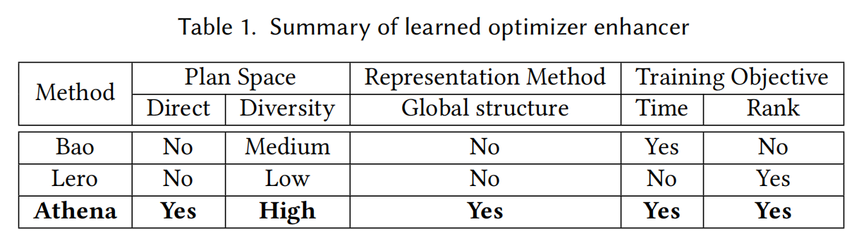
Plan Exploration Space:
Affecting the join orders indirectly --> Change the plan structure
Diversity of the generated plan candidates is limited
Plan Representation Method:
Bao & Lero --> Tree-CNN
Does NOT consider global structure
Model Training Objective (Loss Function):
Bao --> MSE of the execution time
Lero --> cross-entropy loss to learn the pair-wise rank
Do NOT consider the influence of different samples on the overall performance

Slide 5
Contribution:
Athena, an effective learning-based framework of query optimizer enhancer
- An order-centric plan explorer, which explicitly changes the root node of the join plan
- Tree-Mamba, a new tree structure representation method
- A time-weighted loss function, exact execution time + the learning-to-rank method
Integrate Athena int PostgreSQL

Slide 6
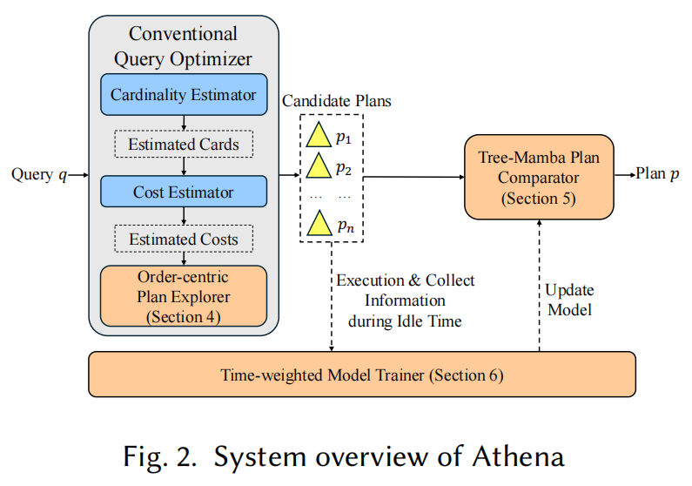
Overview of Athena
(i) Order-centric plan explorer
(ii) Tree-Mamba plan comparator
(iii) Time-weighted model trainer

Slide 7
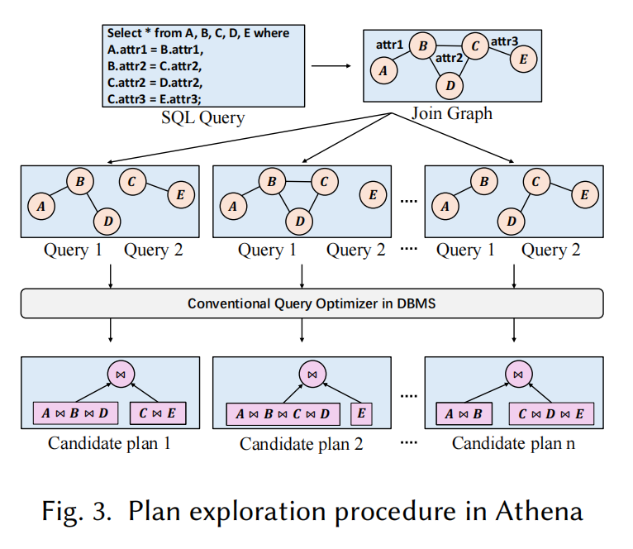
Order-centric Plan Explorer
Directly change the structures of the candidate plans
can be seamlessly
Only enumerates the top-level (root node)
Advantages:
- Integrated into the conventional query optimizer, without extra overhead
- The diversity of the generated candidate plans is better

Slide 8
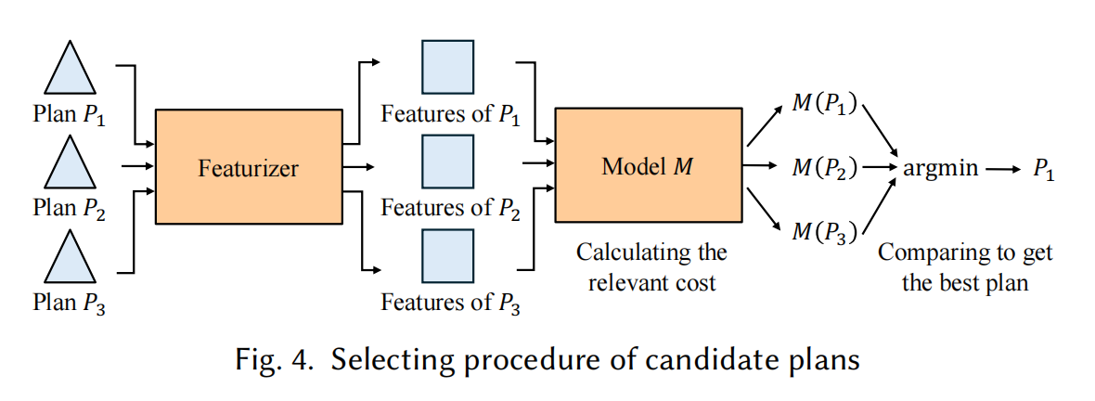
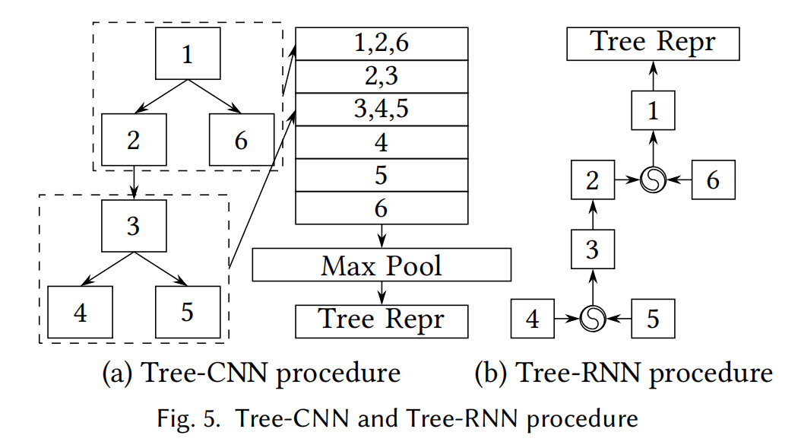
Tree-Mamba Plan Comparator
A query plan --> A tree of vectors
--MLP--> Predict their costs
Featurizer is IMPORTANT
such as Tree-CNN, Tree-LSTM
A query plan --> A tree of vectors
--MLP--> Predict their costs
Featurizer is IMPORTANT
such as Tree-CNN, Tree-LSTM
Tree-CNN
- parent node * children nodes
- max pool: capture the global info
Tree-RNN
- storing a hidden state representing the history at each step

Slide 9
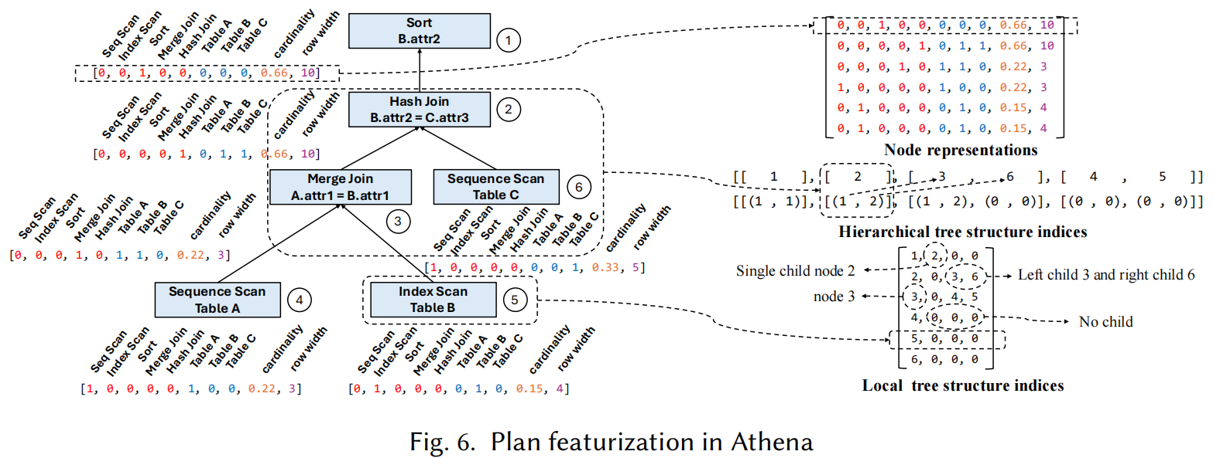
Mamba network: short causal CNN + linear RNN
(i) linear RNN --> global sequence information
(ii) causal CNN --> local sequence information
(iii) larger hidden state than traditional RNN

Slide 10
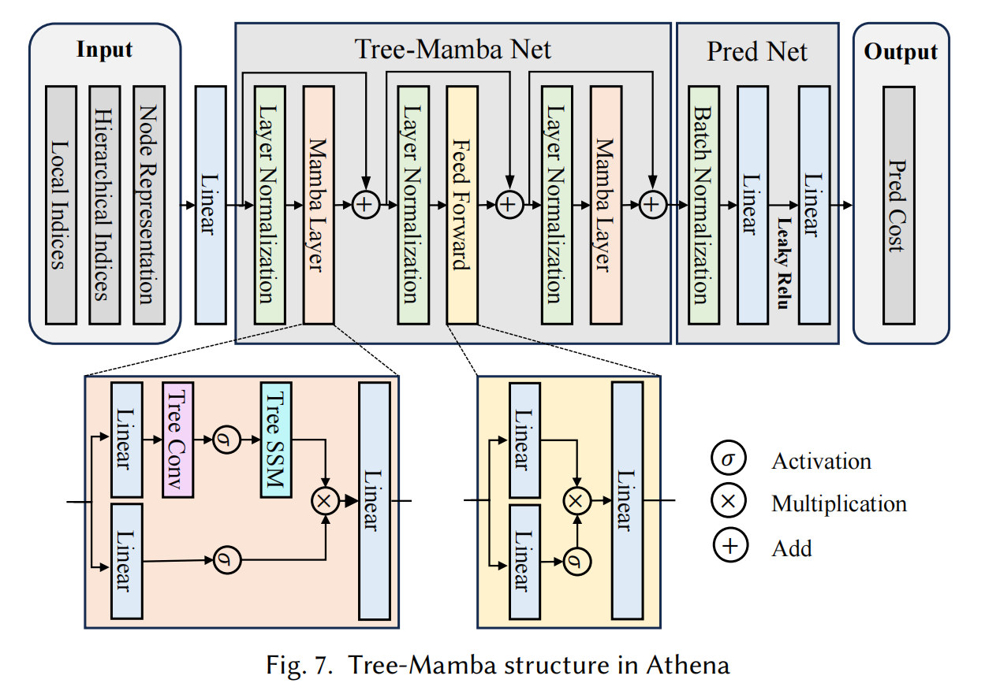



Tree-Mamba Architecture in Athena
Linear layer: converts representation --> hidden representation
Tree-Mamba Net: Mamba layer + Feed Forward layer + Mamba layer
skip connections & layer normalization
Feed Forward layer: Gated Linear Unit(GLU)
element-wise product
SiLU: Sigmoid Linear Unit activation function

Slide 11
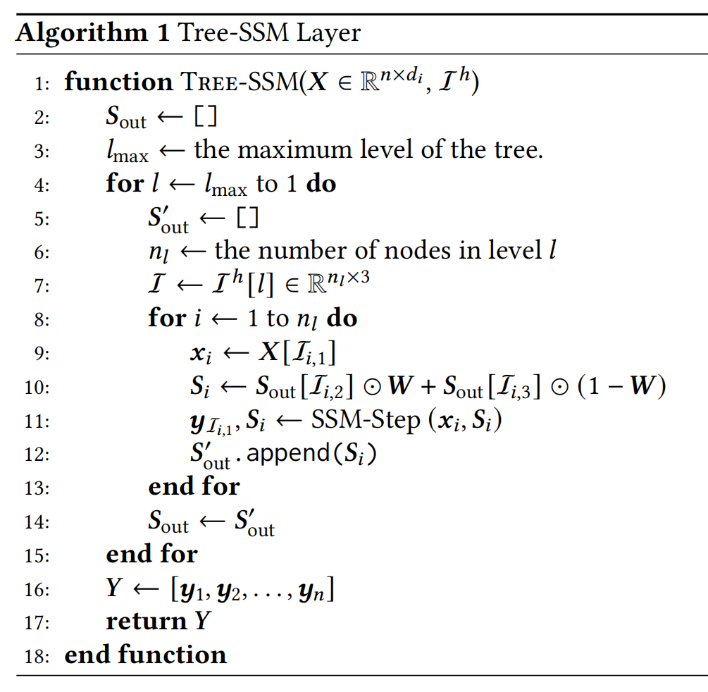
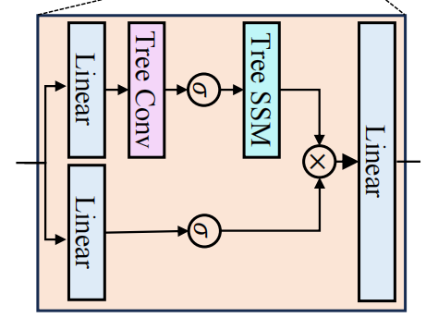
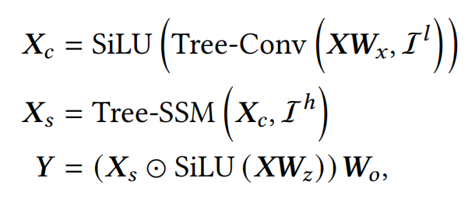


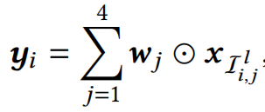
Mamba layer
Tree-Conv
Applies convolution to the hidden representations of nodes , guided by the local tree structure indices .
Tree-SSM
- Processes each level of the tree sequentially, bottom --upward--> root node.
- For each level
1. Retrieves and merges the hidden states from the children
2. Update the hidden states of the node
- Less matrix multiplication than traditional Tree-CNN
- Employs 4 kernels instead of the 3 kernels used in traditional Tree-CNN

Slide 12

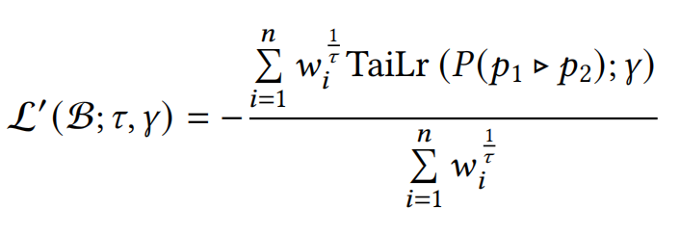
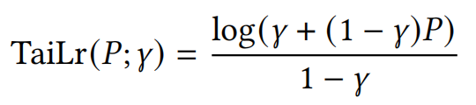
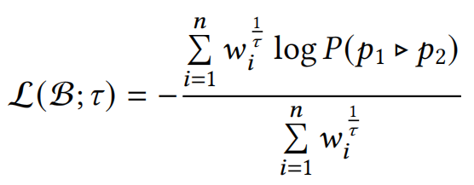






Time-weighted Model Trainer
Lero:
Ignore execution latency of a workload
Athena:
weight is defined as
is the temperature coefficient
𝜏= 1, mainly optimizes overall latency
𝜏= ∞, reduces to the standard cross-entropy loss
Replacing the log P with TaiLr(P)
balance between the fast convergence provided by log P and the alignment degree to L′(B) provided by P

Slide 13
Evaluation
Experimental Configuration:
Intel(R) Xeon(R) Gold 5122 CPU (3.6 GHz, 16 cores), 480 GB of DDR4 RAM, two NVIDIA TITAN Xp GPUs, Ubuntu Linux 20.04 LTS.
Compared Competitors:
Bao, Lero, LOGER(representative learned optimizer), the conventional query optimizer in PostgreSQL
Tested Benchmarks:
JOB, STATS, TPC-DS and DSB

Slide 14
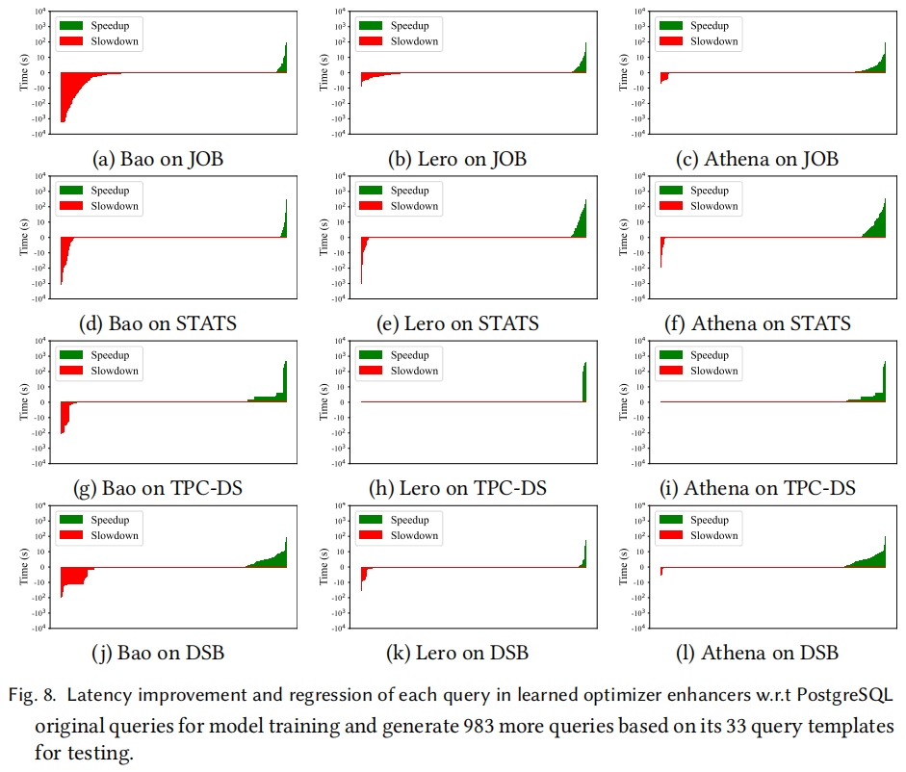
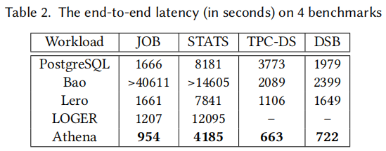
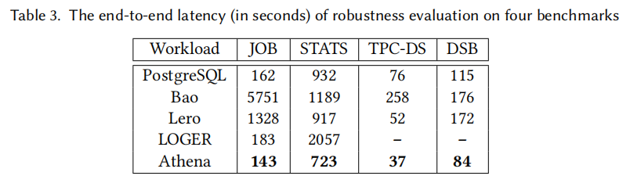
Overall Performance

Slide 15
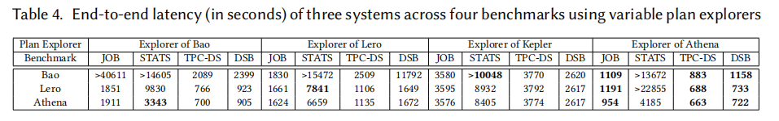
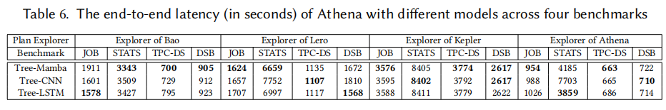
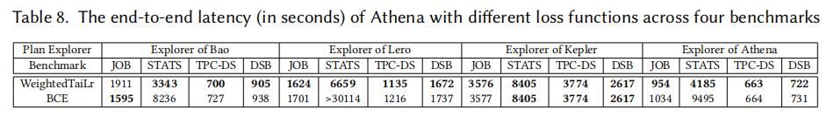
Effectiveness
Effect of Order-centric Explorer
Effect of Tree-Mamba Plan Comparator
Effect of Time-weighted Model Trainer

Slide 16
Conclusion
Athena, a learned optimizer enhancer
- Order-centric plan explorer
- Tree-Mamba plan comparator
- Time-weighted model trainer
Experiments. Athena better than the existing learned optimizer enhancers.
Future plan. Utilize Athena to improve the query processing performance of other DBMSs.

Slide 17
Thanks for Listening! Q & A

