Slide 1

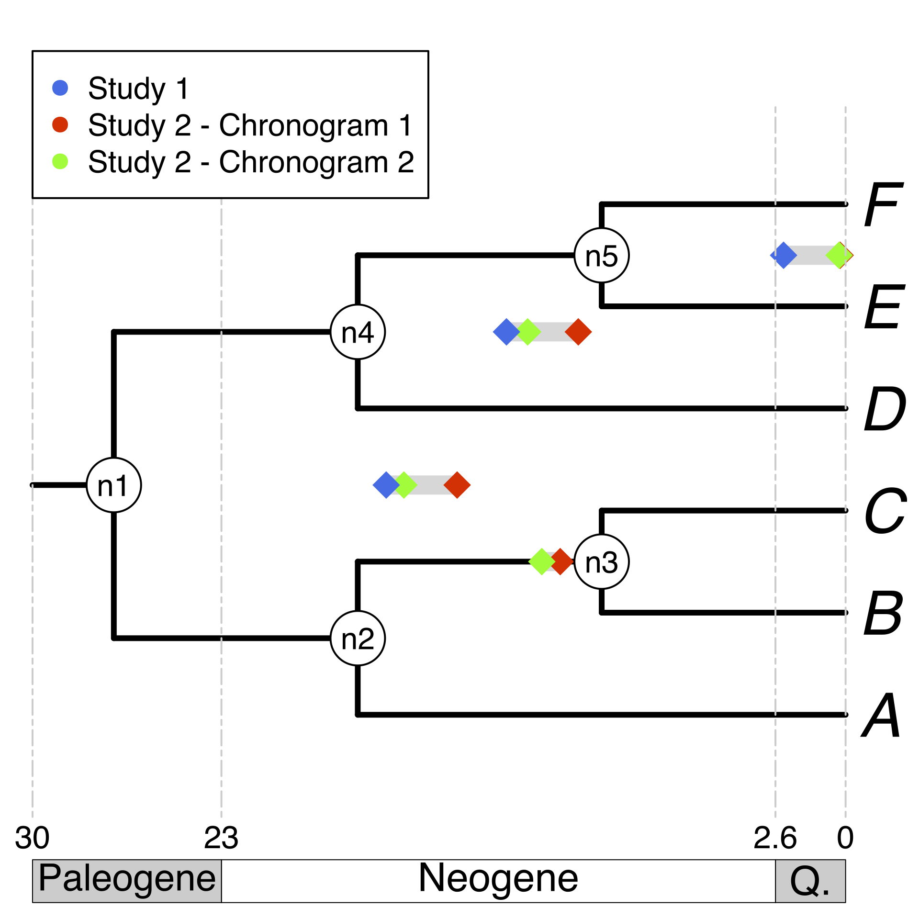
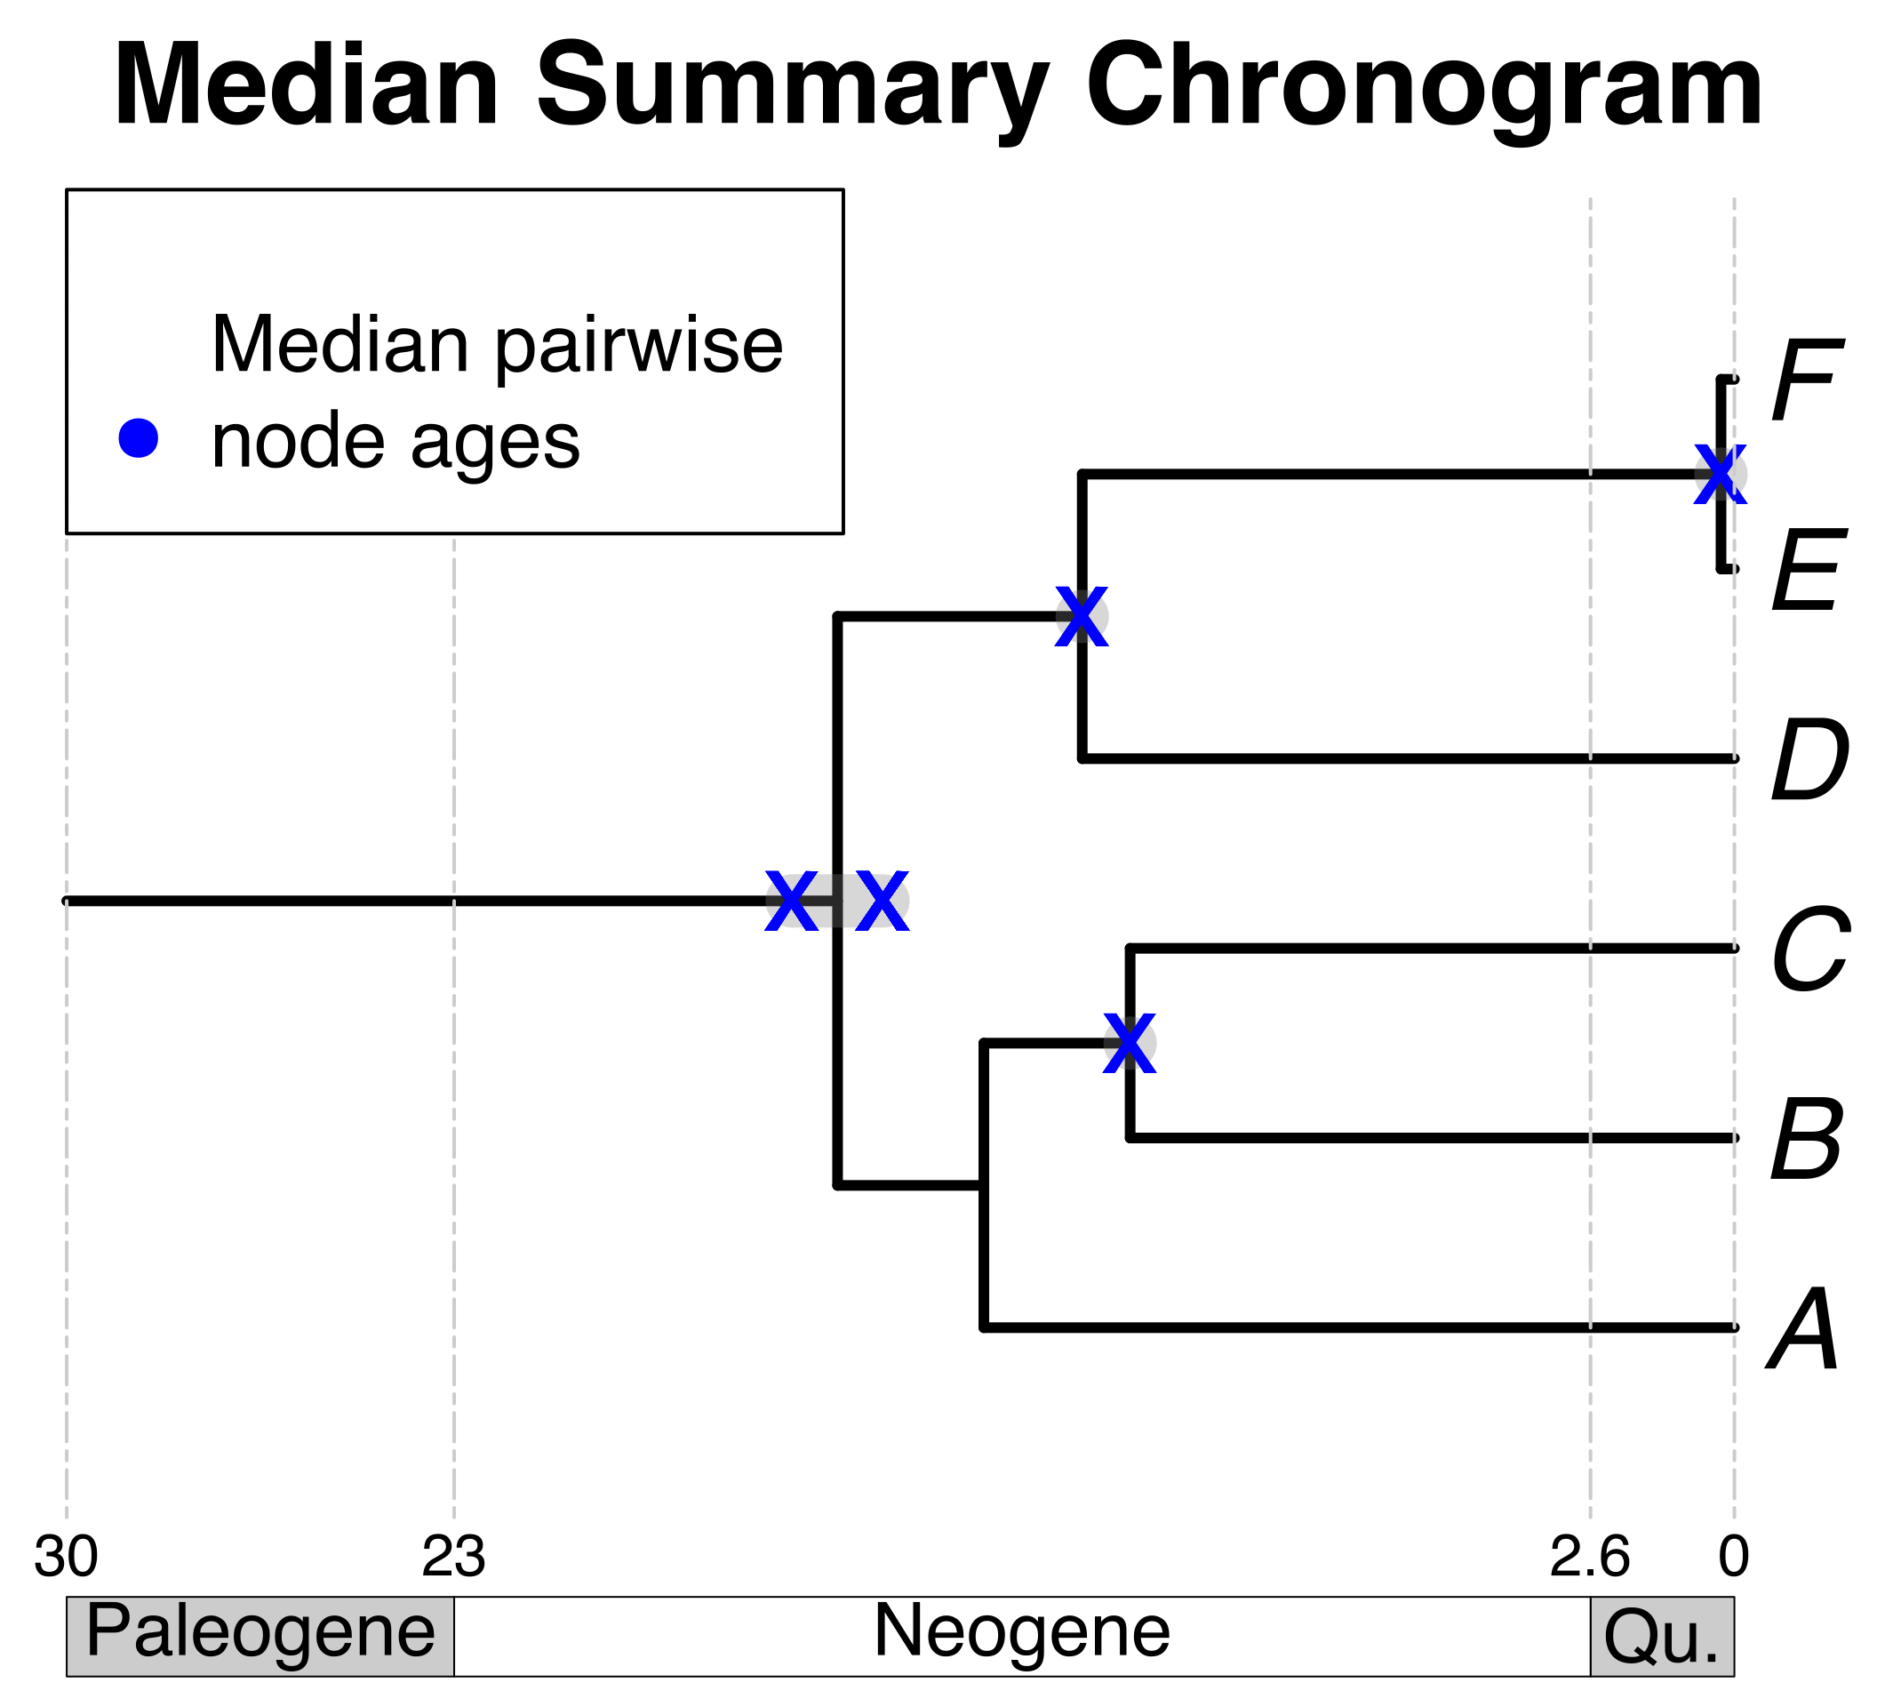

Calculate median pairwise ages per node
A tree topology for your taxa of interest
+
Your own tree
Bar Code of Life Data System tree
Map pruned source chronogram ages unto nodes on a tree topology
A tree from the
literature
Use median pairwise ages to date the tree topology
Pruned source
chronograms
B
E
Some taxa
of interest
C
F
A
D
Search and prune chronograms in a database

