Slide 1

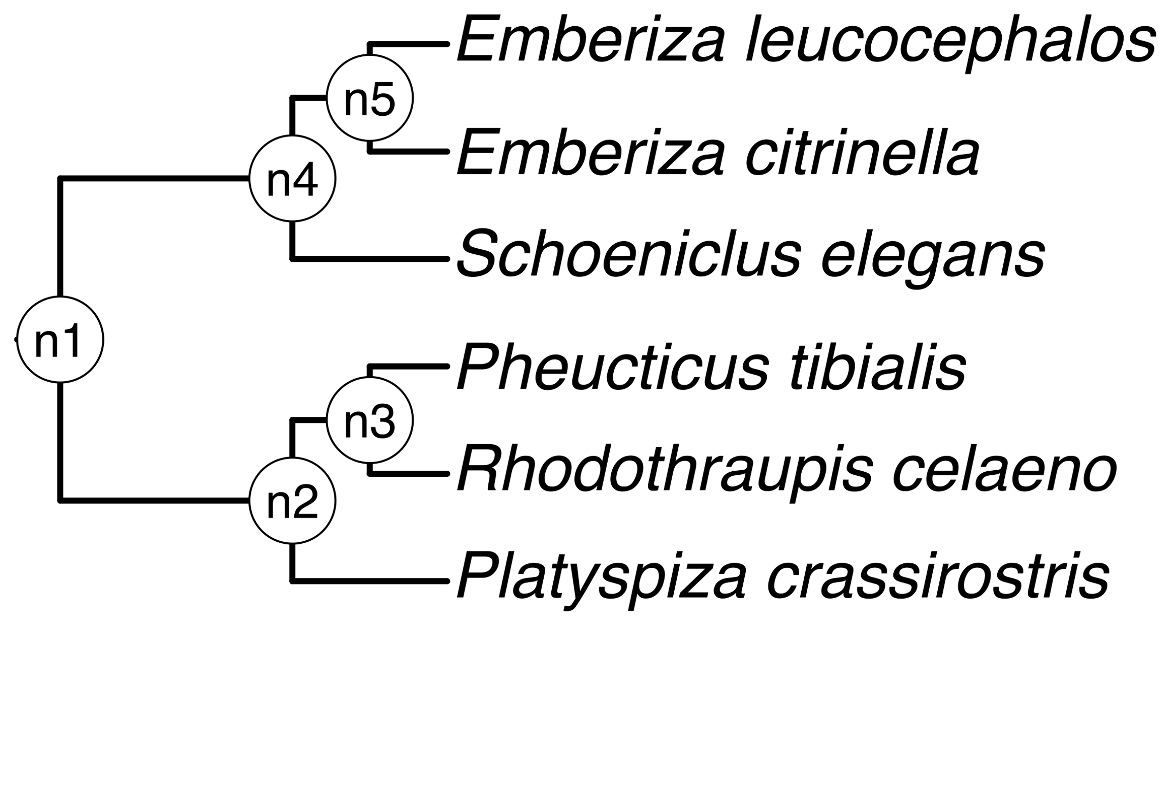
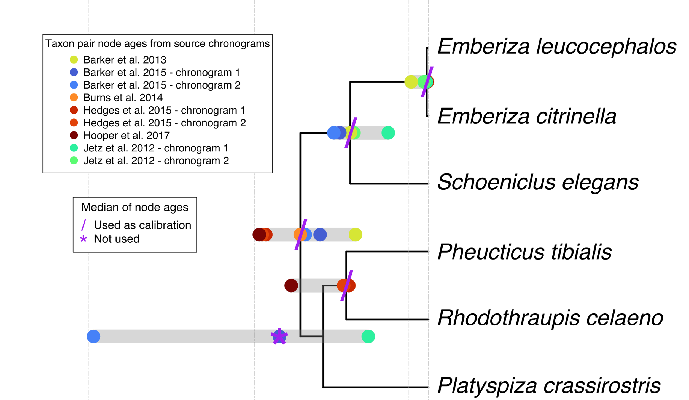

a) Create a DateLife search query
b) Search DateLife’s chronogram database
c) Summarize DateLife’s search results
a1) Assembled a list of species names. This is the list of 6 bird species:
b1) Searched processed taxon names across 253
chronograms in DateLife’s database v0.6.2
c1) Chose a tree topology from OpenTree’s synthetic phylogeny v13.4.
OpenTree topology
b2) Search resulted in 9 source chronograms from 6
independent, published studies:
c2) Congruified source
chronogram nodes to nodes
of the OpenTree topology.
See Table 1.
Pheucticus tibialis
Rhodothraupis celaeno
Emberiza citrinella
Emberiza leucocephalos
Emberiza elegans
Platyspiza crassirostris
chronogram 1
c3) Get summarized
congruified ages per
node. See Table 2.
chronogram 2
c4) Used summarized ages of
congruent nodes to date the
chosen tree topology with BLADJ.
Median summary chronogram
a2) Processed species names with TNRS and standardized to the OpenTree Taxonomy v3.3draft1.
One species name (shown in bold) is a synonym in the standardized taxonomy.
chronogram 1
chronogram 2
Pheucticus tibialis
Rhodothraupis celaeno
Emberiza citrinella
Emberiza leucocephalos
Schoeniclus elegans
Platyspiza crassirostris
chronogram 1
chronogram 2

