Slide 1

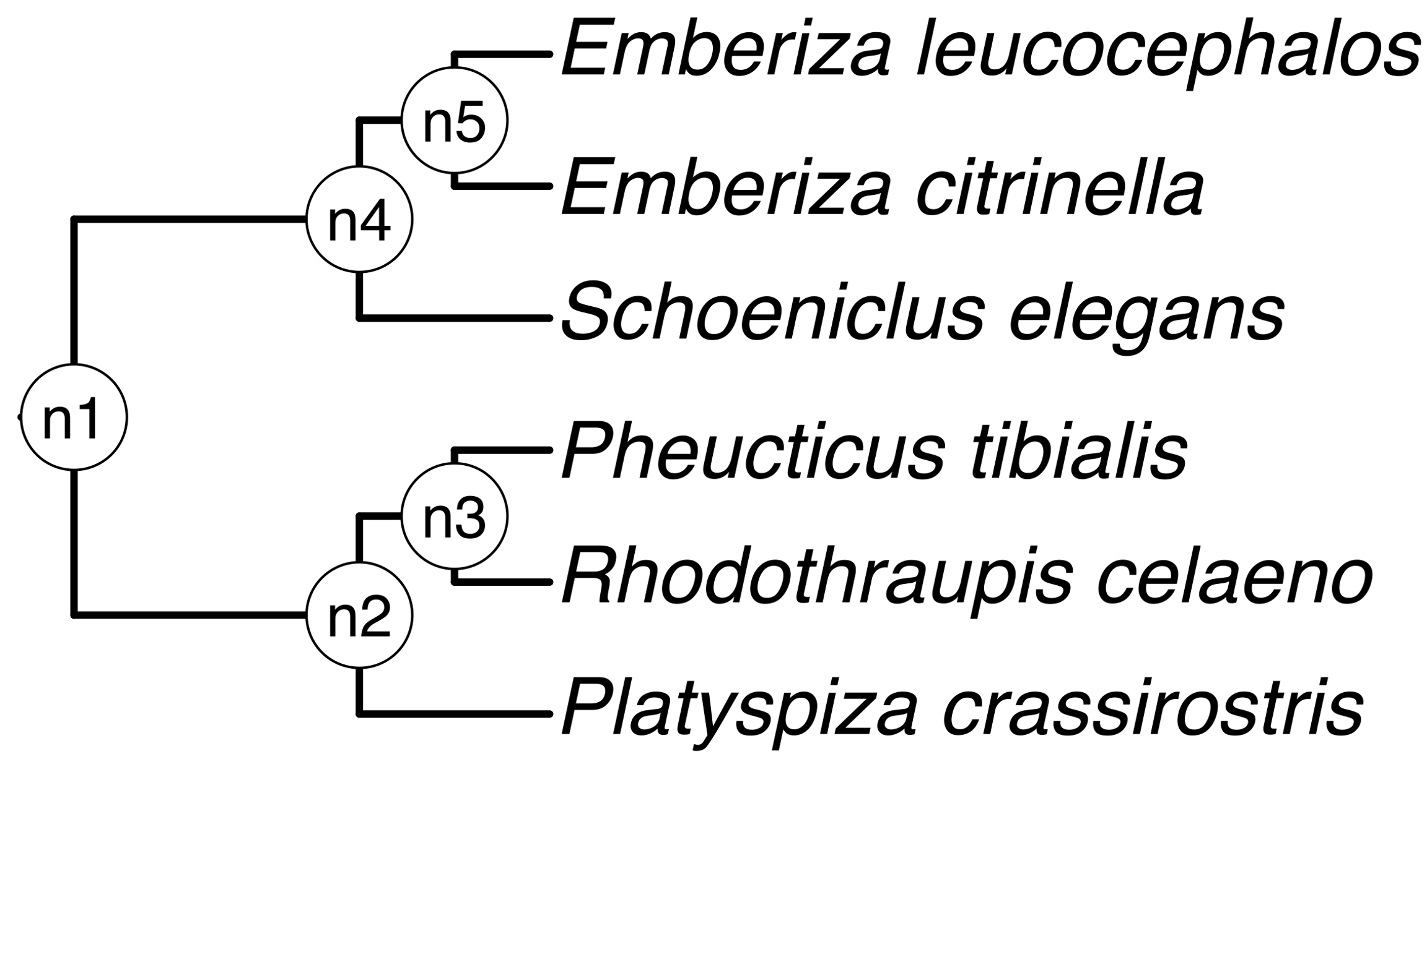
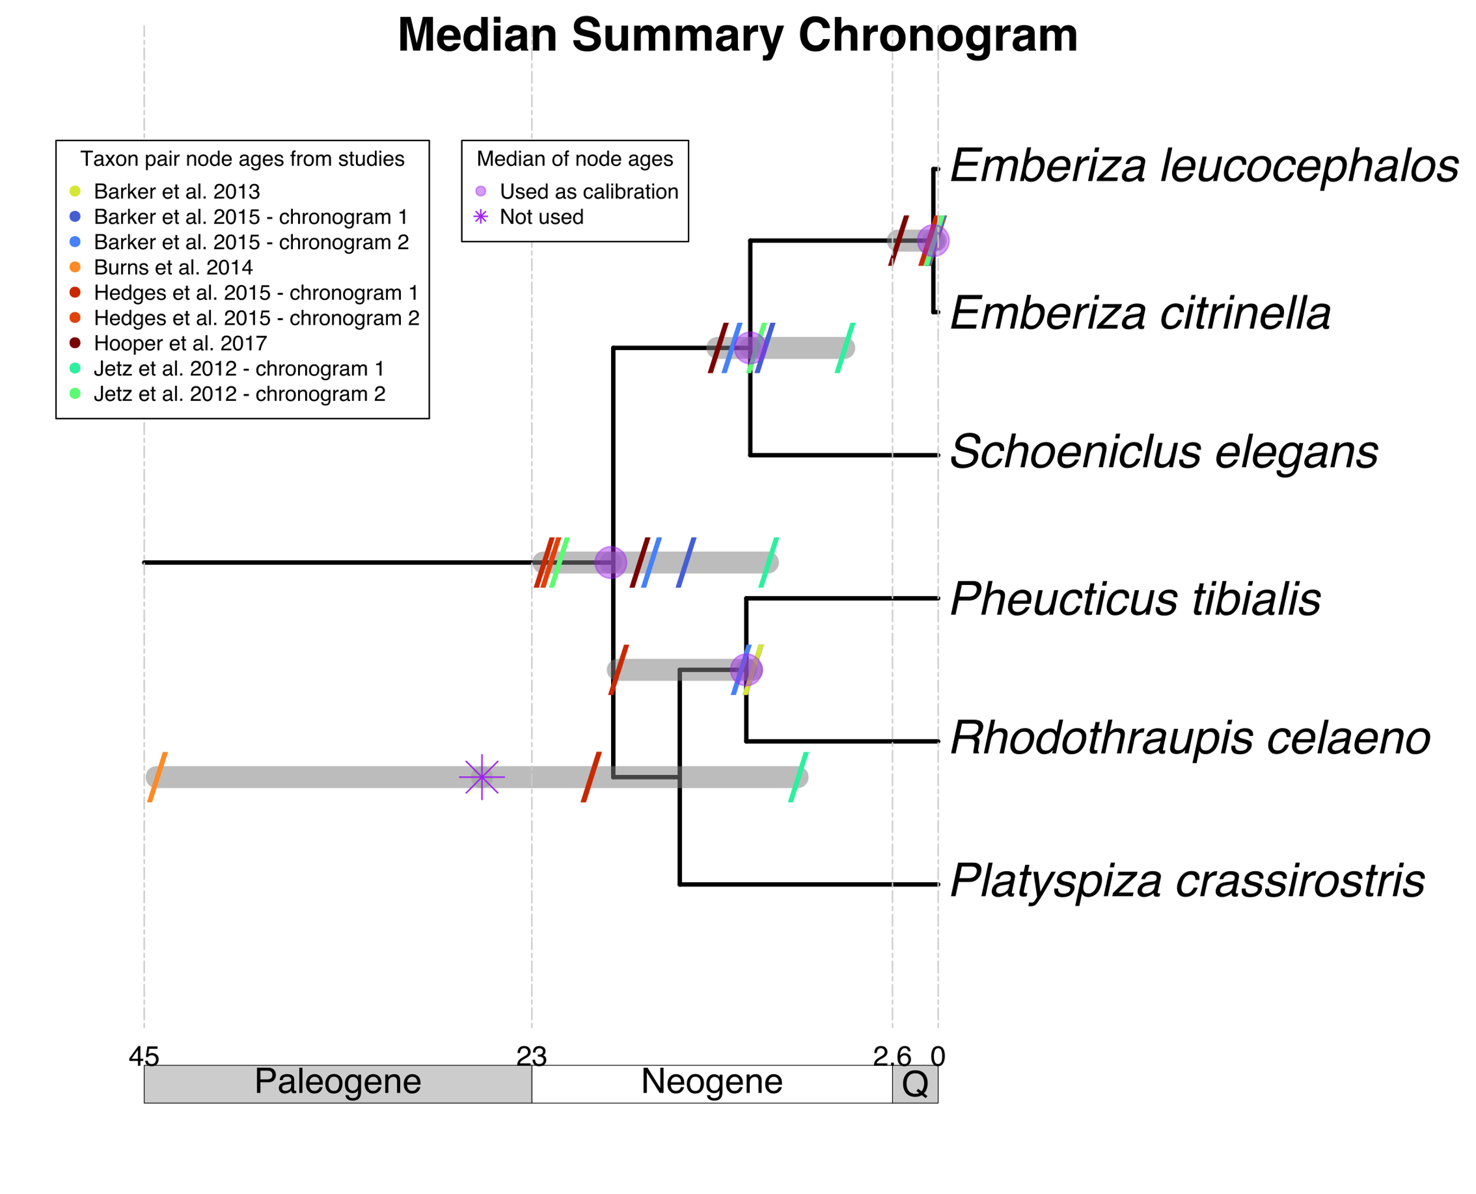
a) Create a DateLife search query
b) Search DateLife’s chronogram database
c) Summarize DateLife’s search results
a1) Assembled a list of species names. This is the list of 6 bird species:
b1) Searched processed taxon names across 253 chronograms in DateLife’s database v0.6.2
b2) Search resulted in 9 source chronograms from 6 independent, published studies:
c1) Chose a tree topology from OpenTree’s synthetic phylogeny v13.4.
c2) Congruified source chronogram nodes to nodes of tree topology.
See Table 1.
OpenTree topology
Pheucticus tibialis
Rhodothraupis celaeno
Emberiza citrinella
Emberiza leucocephalos
Emberiza elegans
Platyspiza crassirostris
chronogram 1
c3) Get summarized congruified ages per node. See Table 2.
chronogram 1
chronogram 2
c4) Used summarized ages of congruent nodes to date the chosen tree topology with BLADJ.
a2) Processed species names with TNRS and standardized to the OpenTree taxonomy v3.3draft1. One species name (bold) is a synonym in the standardized taxonomy.
chronogram 2
Median summary chronogram
chronogram 1
Pheucticus tibialis
Rhodothraupis celaeno
Emberiza citrinella
Emberiza leucocephalos
Schoeniclus elegans
Platyspiza crassirostris
chronogram 2

