Slide 1
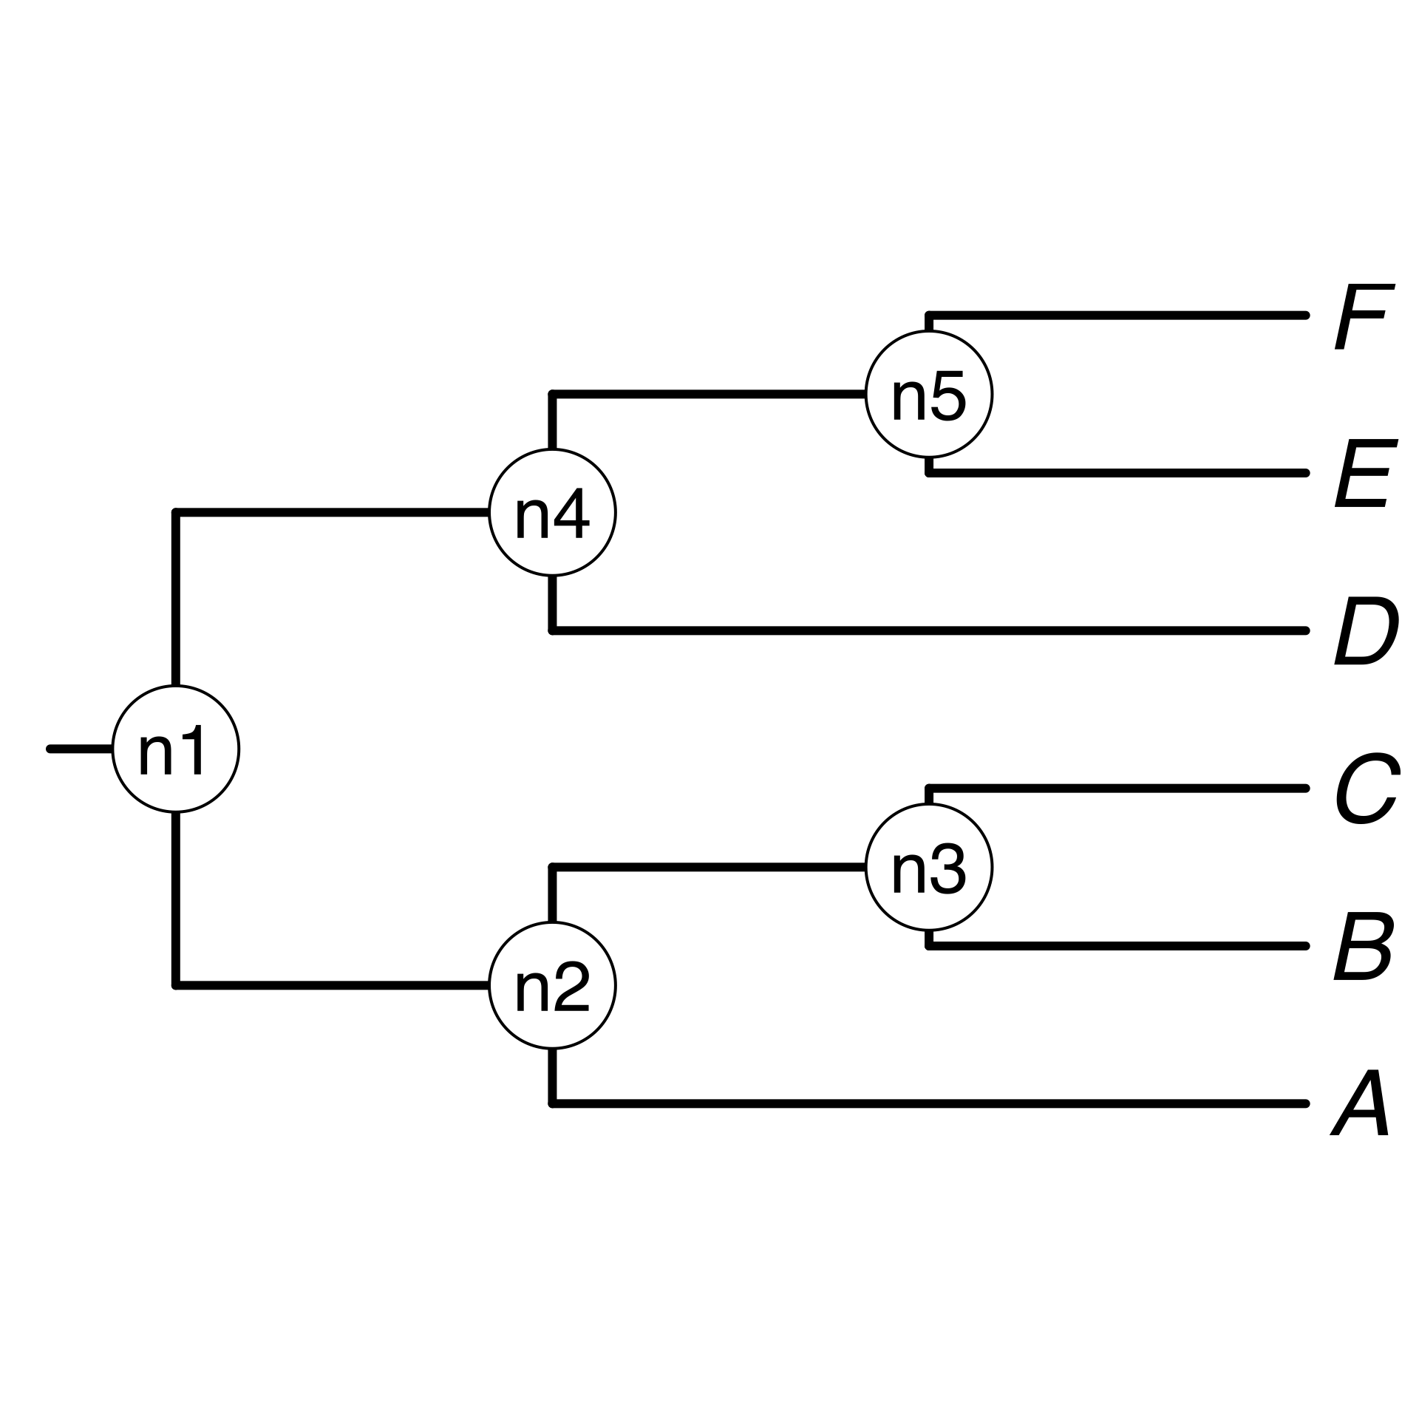


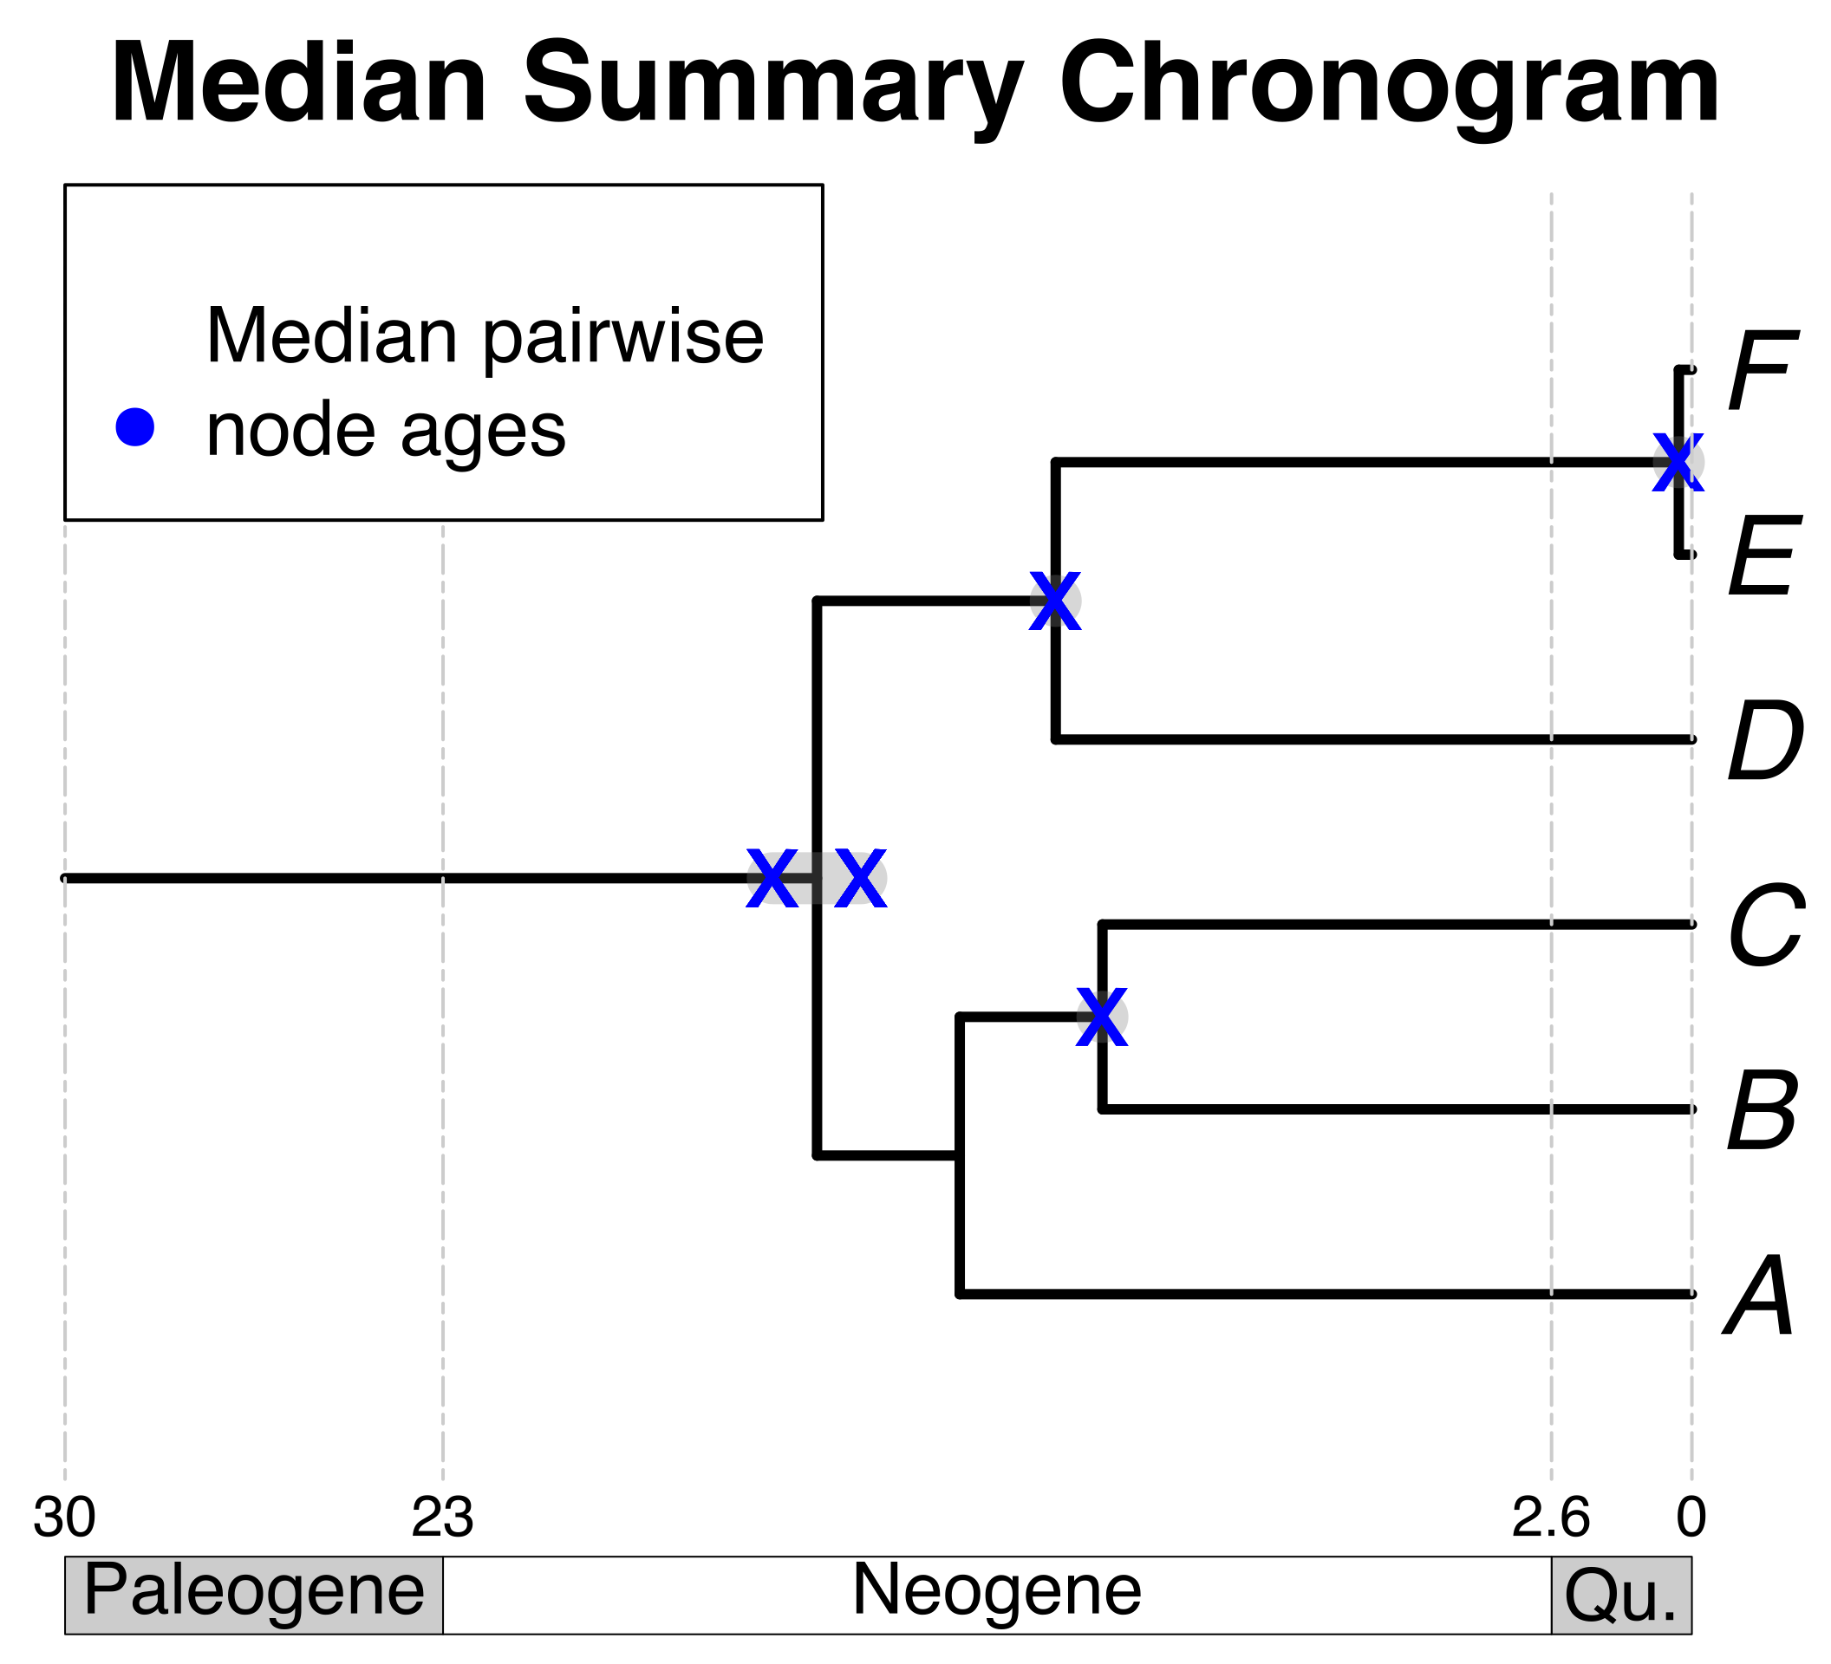
a) Creating a DateLife search query
b) Searching DateLife’s chronogram database
c) Summarizing DateLife’s search results
a1) User provides a list of taxon names, as a character string or as a tree:
b1) Search processed taxon names in chronogram database and identify (*).
b2) Prune matching chronograms and save as source chronograms.
c1) Choose a tree topology.
A tree from the
literature
a
B₁
C
D
Ee
F_{x}
Your own
tree
The largest source chronogram
*
c2) Congruify source chronogram nodes to nodes of tree topology.
c3) Summarize congruified node ages.
a2) Process taxon names with TNRS and standardize to a taxonomy. In this example, 4 names are synonyms in the standardized taxonomy (bold):
*
c4) Use summary ages of congruent nodes to date a tree topology.
A
B
C
D
E
F
Median summary chronogram
X Median pairwise
node ages
*

