Slide 1
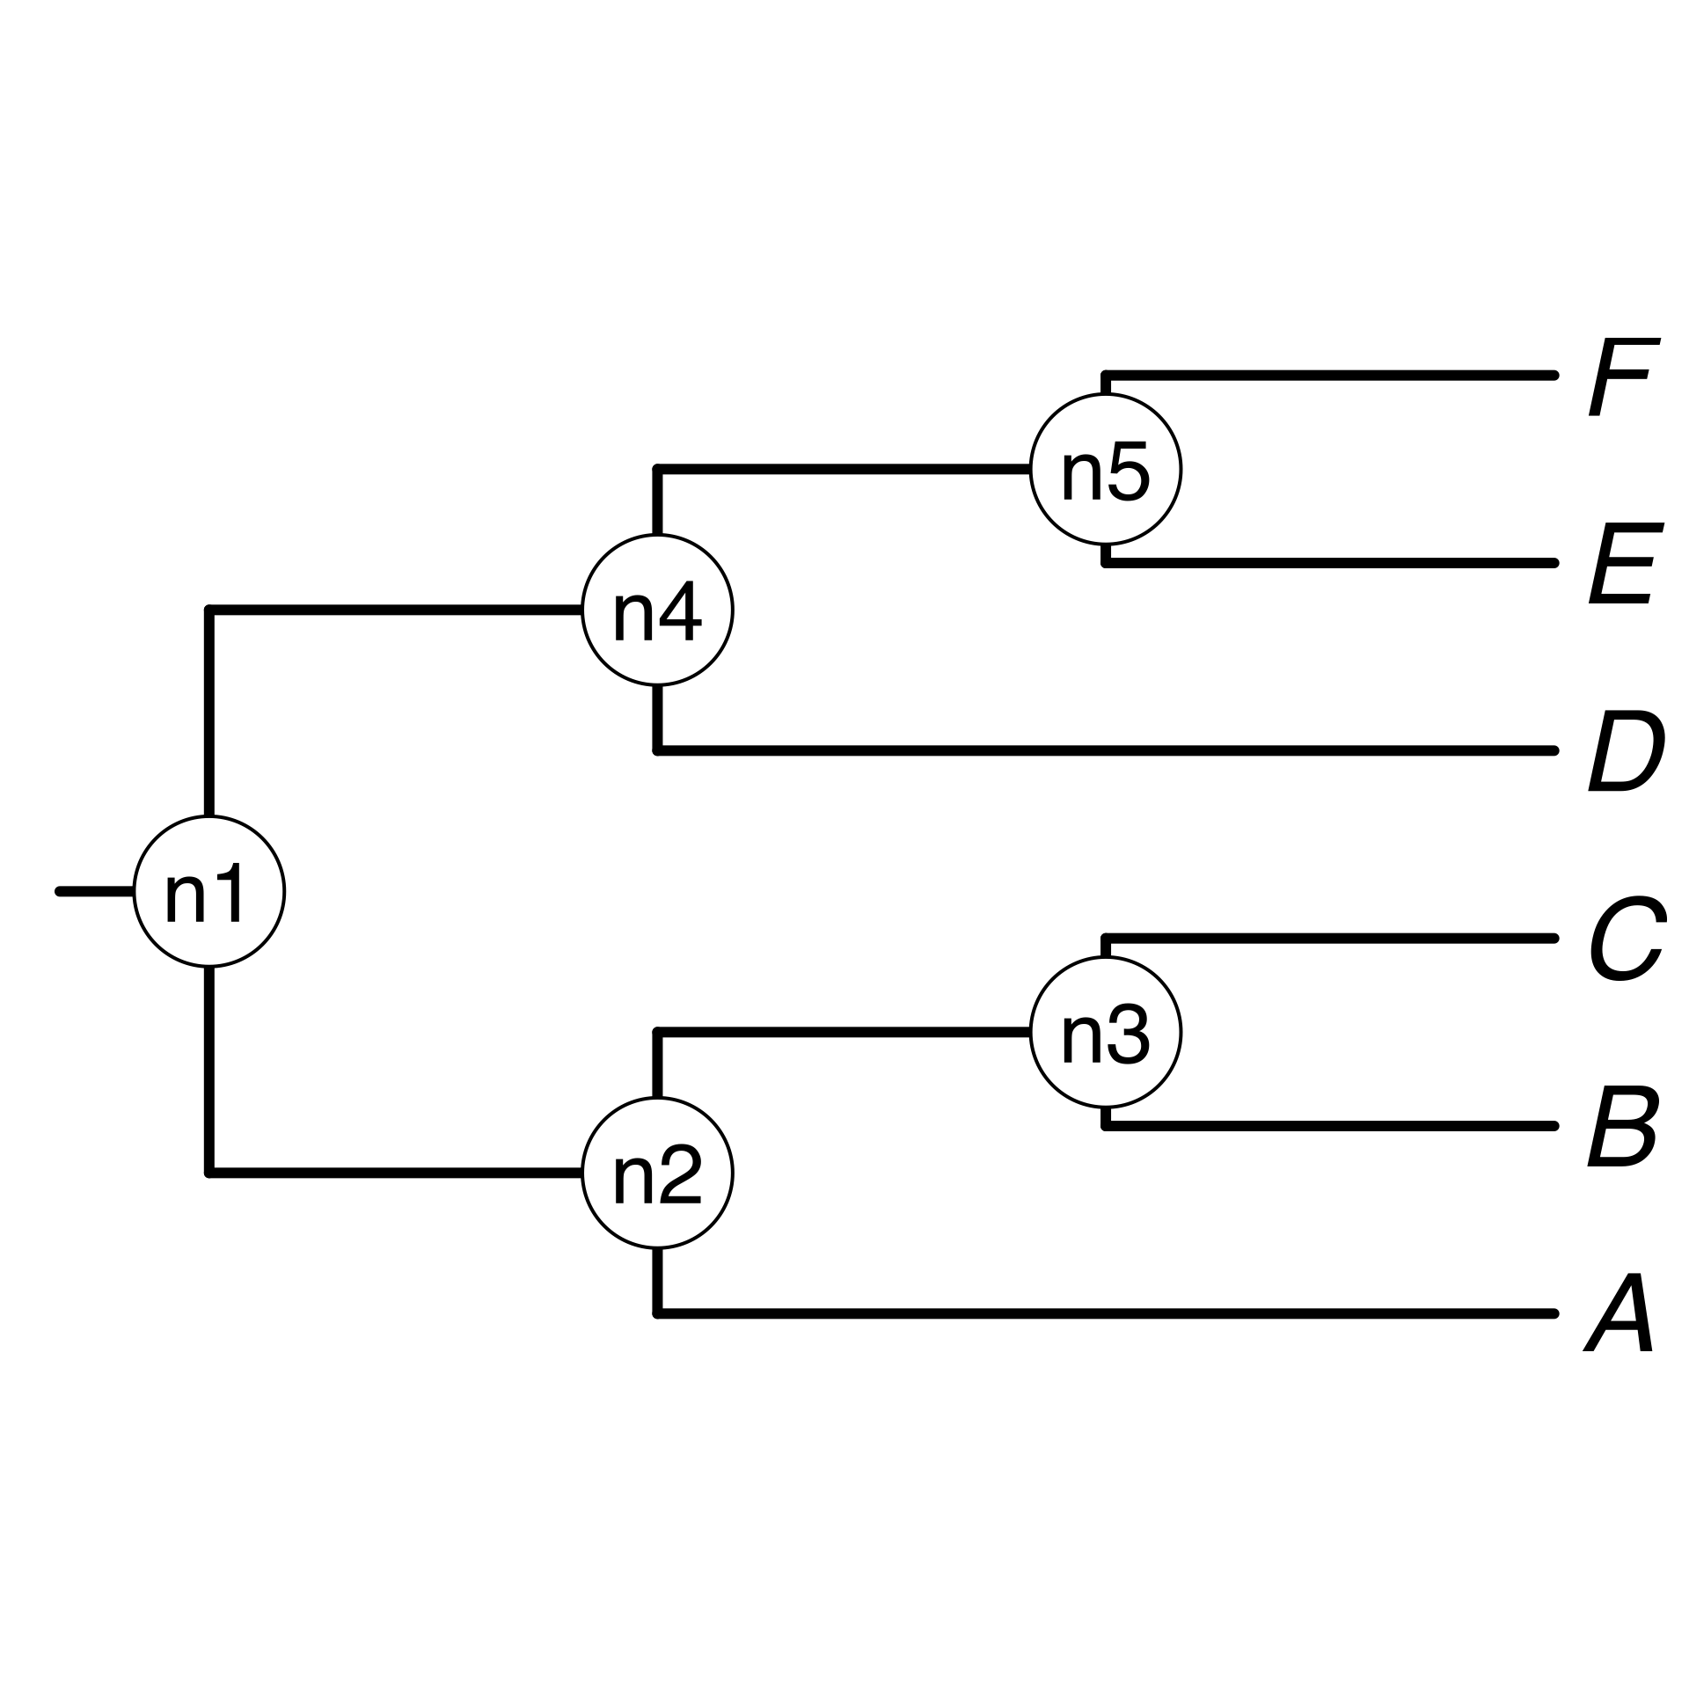


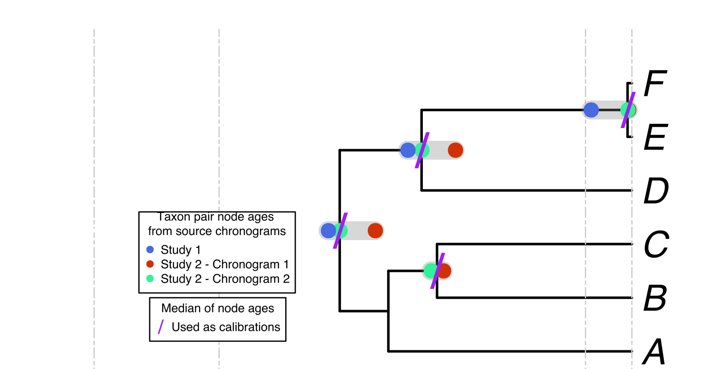
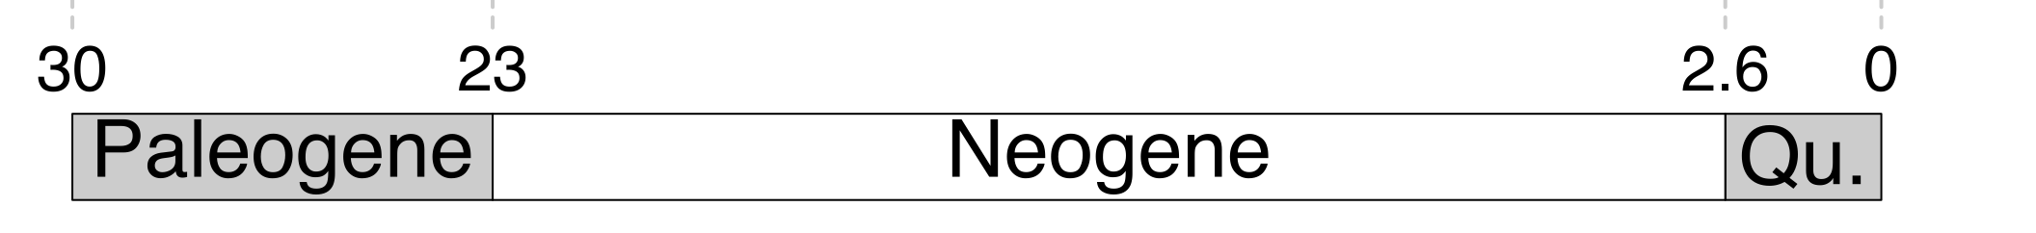
a, B₁ , C, D, Ee, F_{x}
Your own
tree
A, B, C, D, E, F
The largest
source
chronogram
A tree from
the literature
See Supplementary Tables S1 and S2

