Slide 1


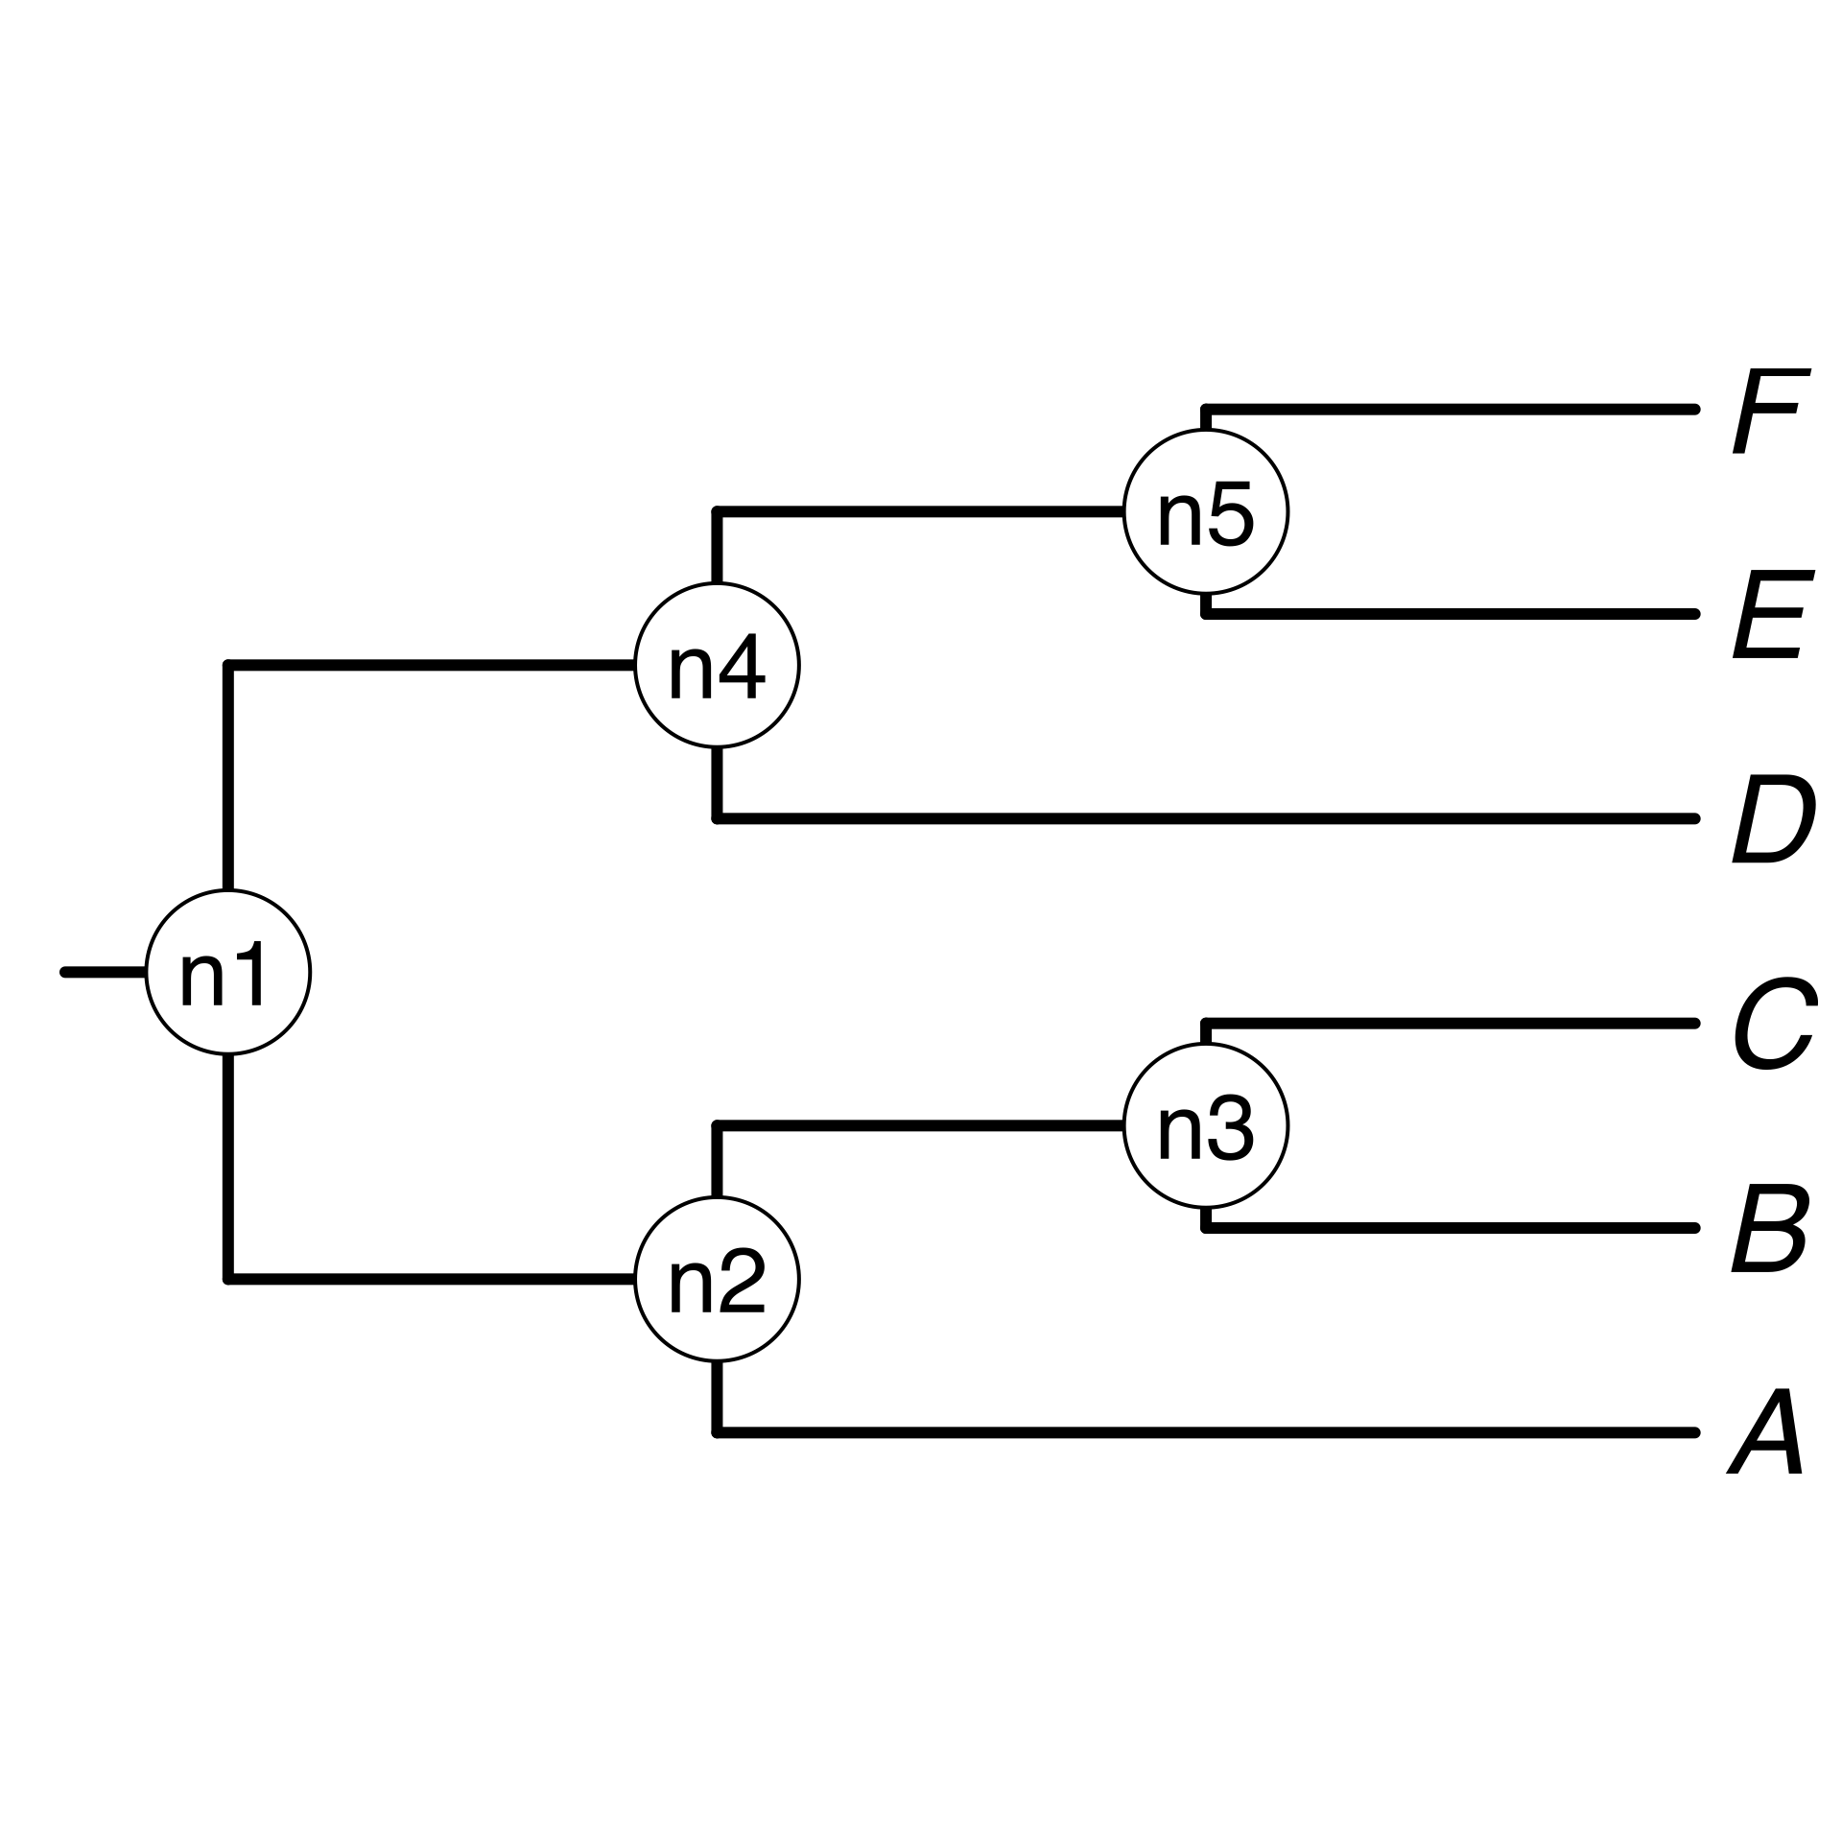
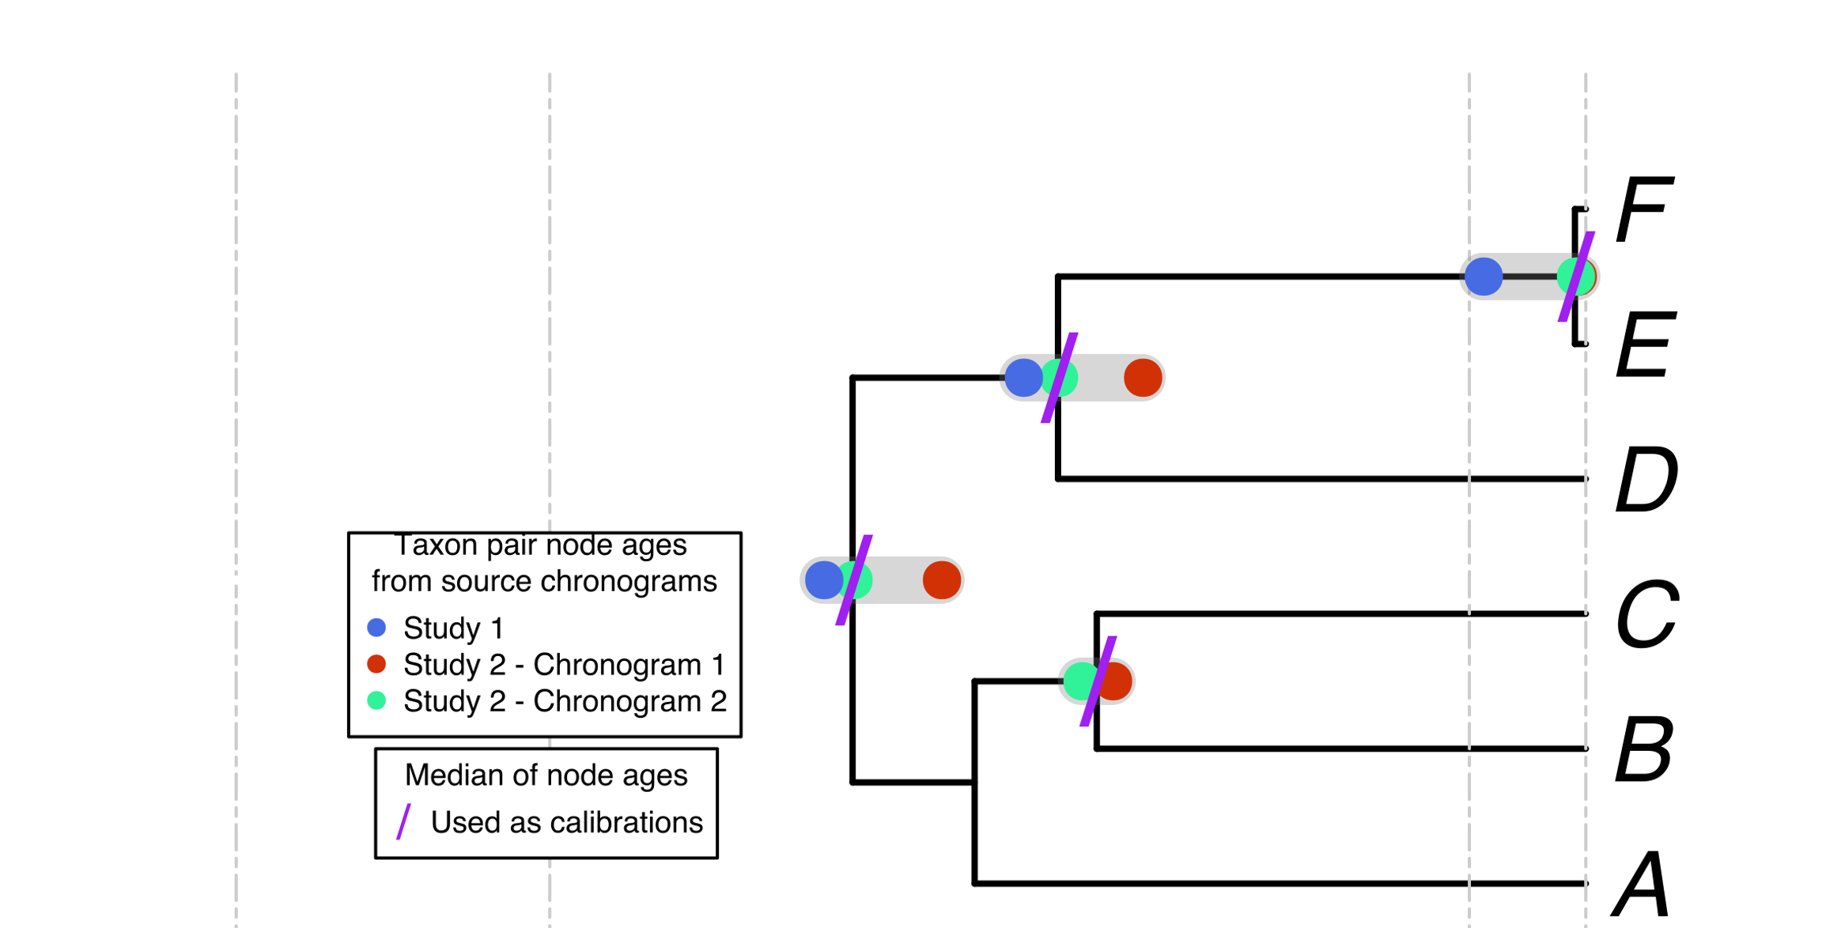
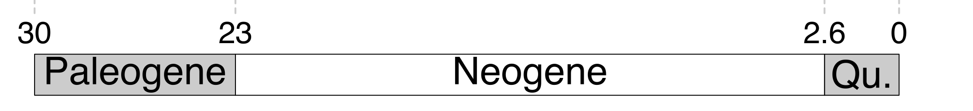
a) Creating a DateLife search query
a1) A list of taxon names provided by the user. It can contain synonyms and misspellings.
a, B₁ , C, D, Ee, F_{x}
The largest
source
chronogram
A tree from
the literature
a2) Taxon names are processed using the Taxonomic Name Resolution Service (TNRS) and are standardized to a taxonomy:
Your own
tree
A, B, C, D, E, F
b) Searching DateLife’s chronogram database
In this mock example, 4 names (in bold) are synonyms in the standardized taxonomy.
c) Summarizing DateLife’s search results
c2) Nodes from source chronogram are congruified to nodes in the tree topology:

