Slide 1
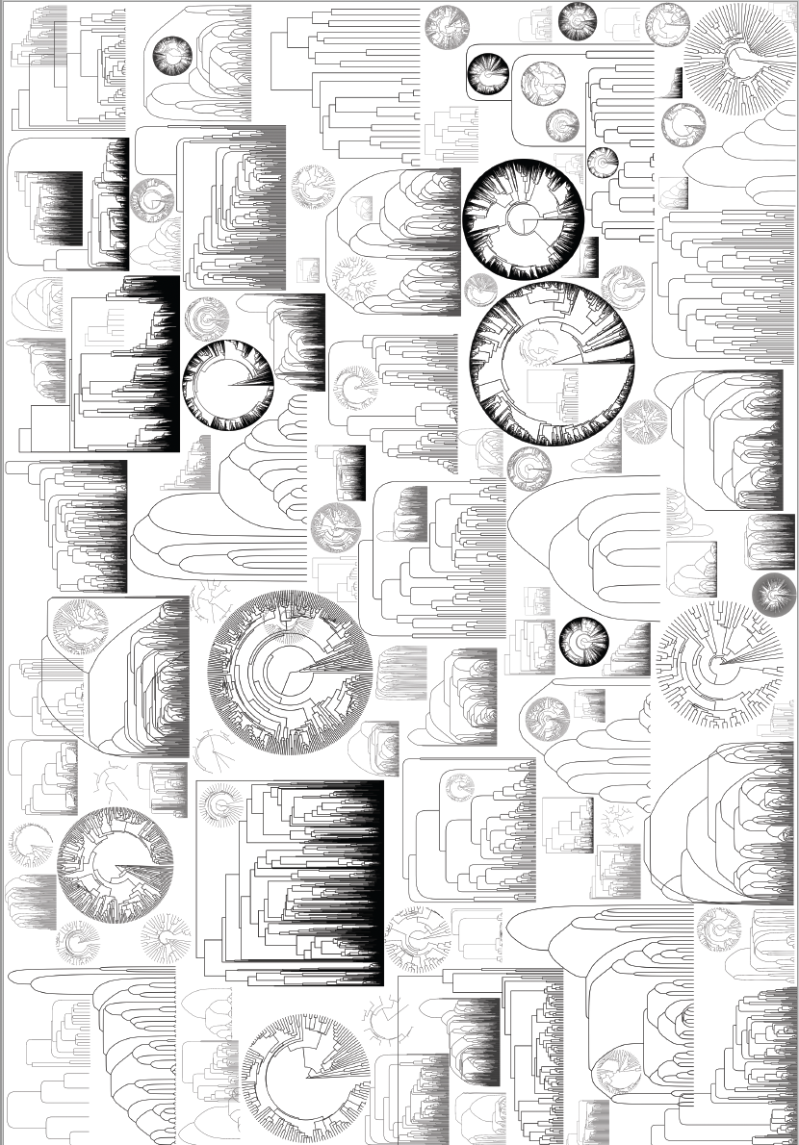
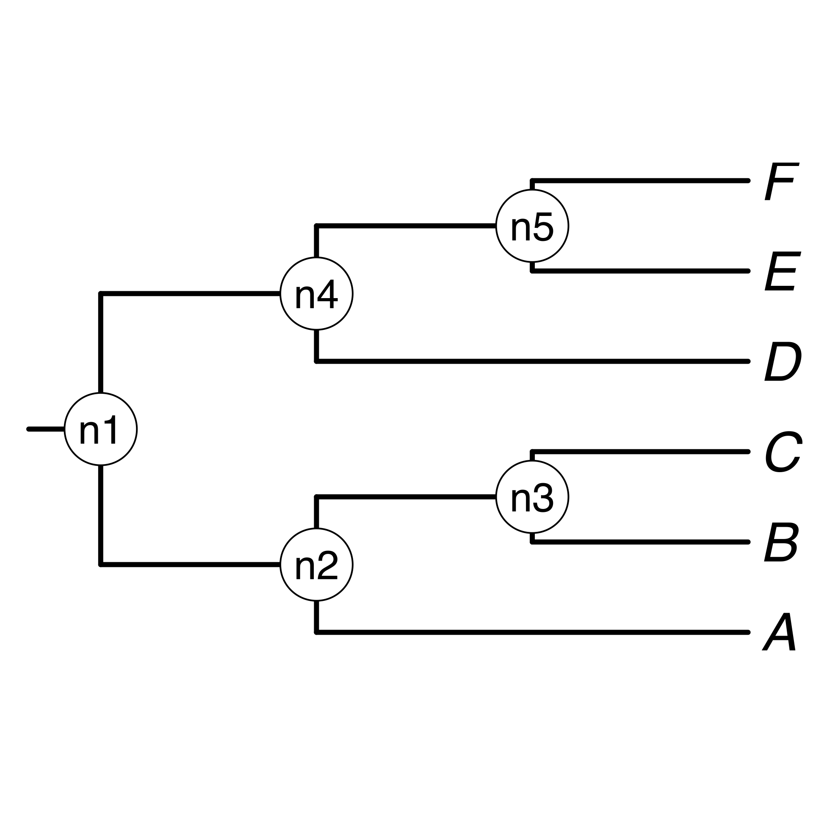


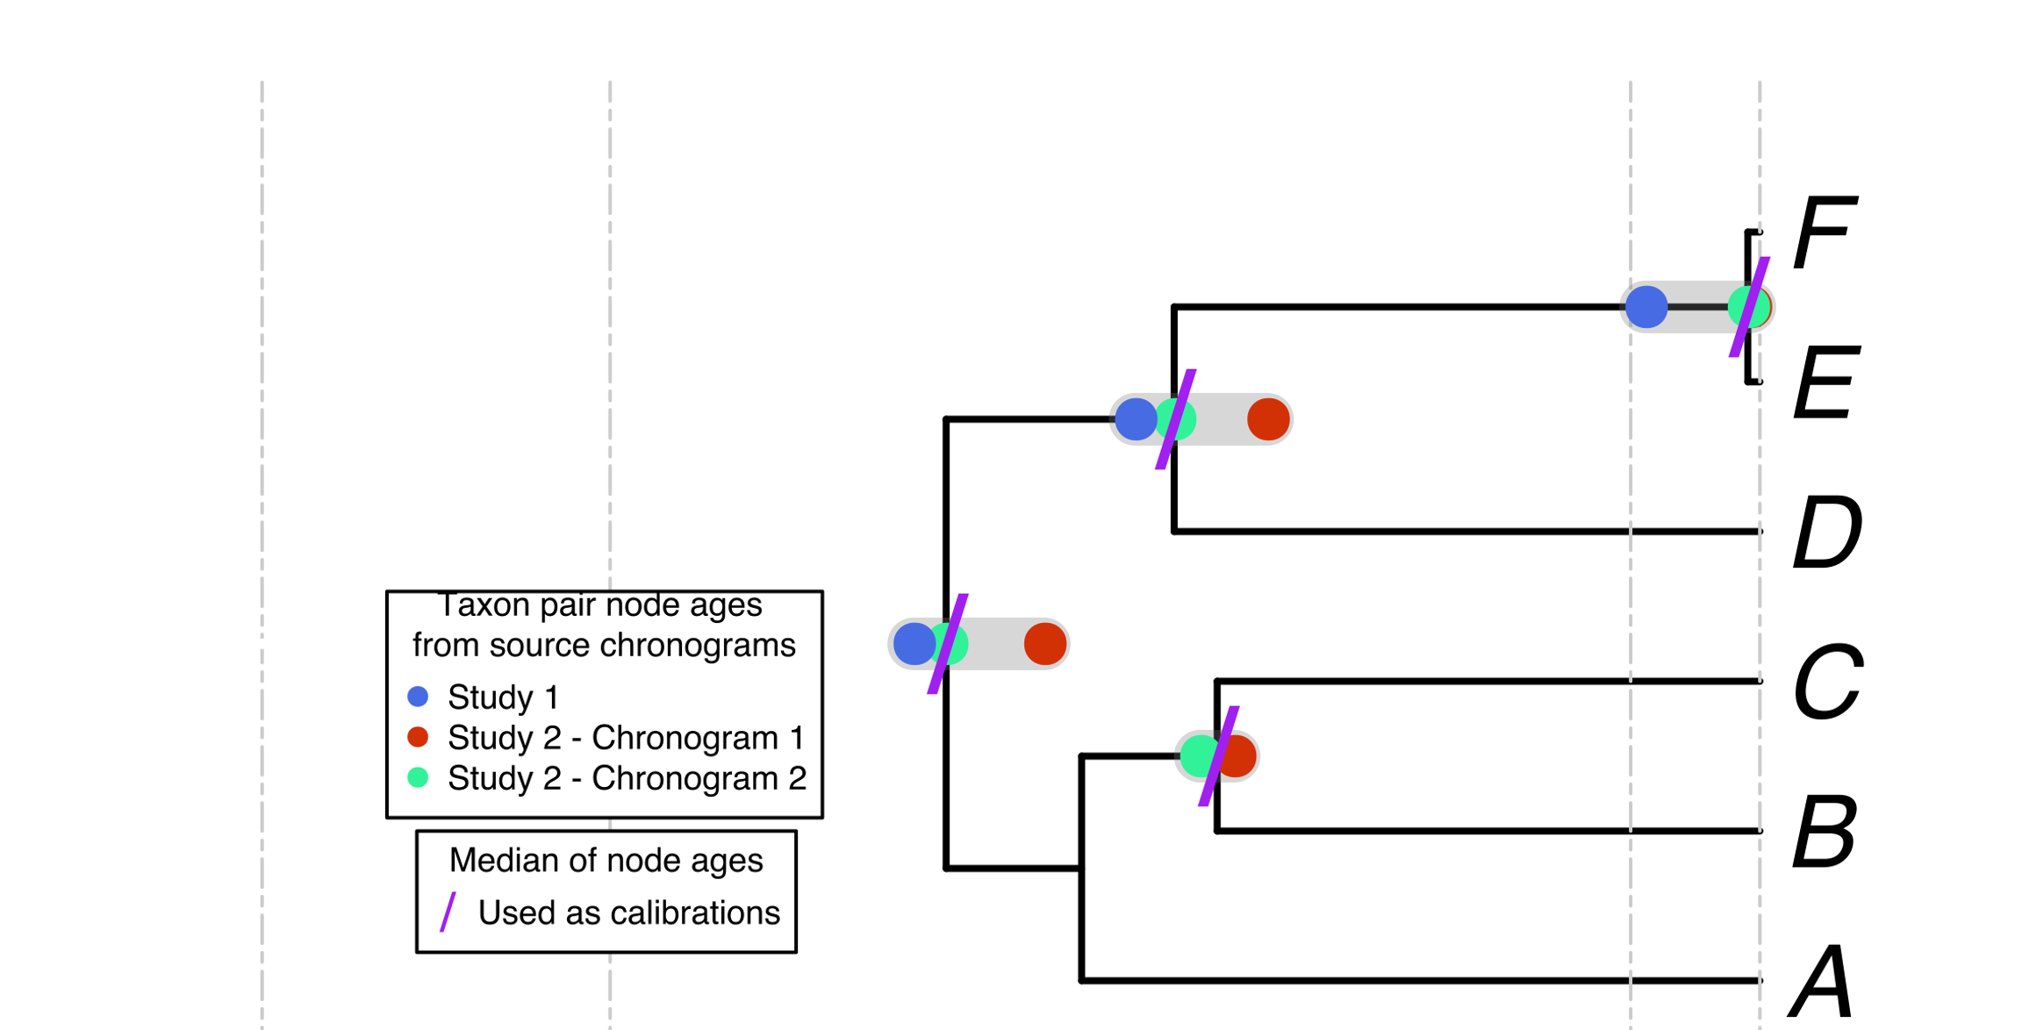
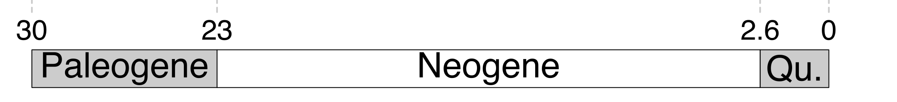
a) Creating a DateLife search query
Taxonomic
Name
Resolution
Service
a, B₁ , C, D, Ee, F_{x}
A, B, C, D, E, F
a2) Taxon names are processed using the Taxonomic Name Resolution Service (TNRS) and are standardized to a taxonomy:
a1) A list of taxon names provided by the user. It can contain synonyms and misspellings.
In this mock example, 4 names (in bold) are synonyms in the standardized taxonomy.
b) Searching DateLife’s chronogram database
c) Summarizing DateLife’s search results
c1) A tree topology of the taxa of interest is chosen:
Your own
tree
The largest
source
chronogram
A tree from
the literature
c2) Nodes from source chronogram are congruified to nodes in the tree topology:

