Slide 1
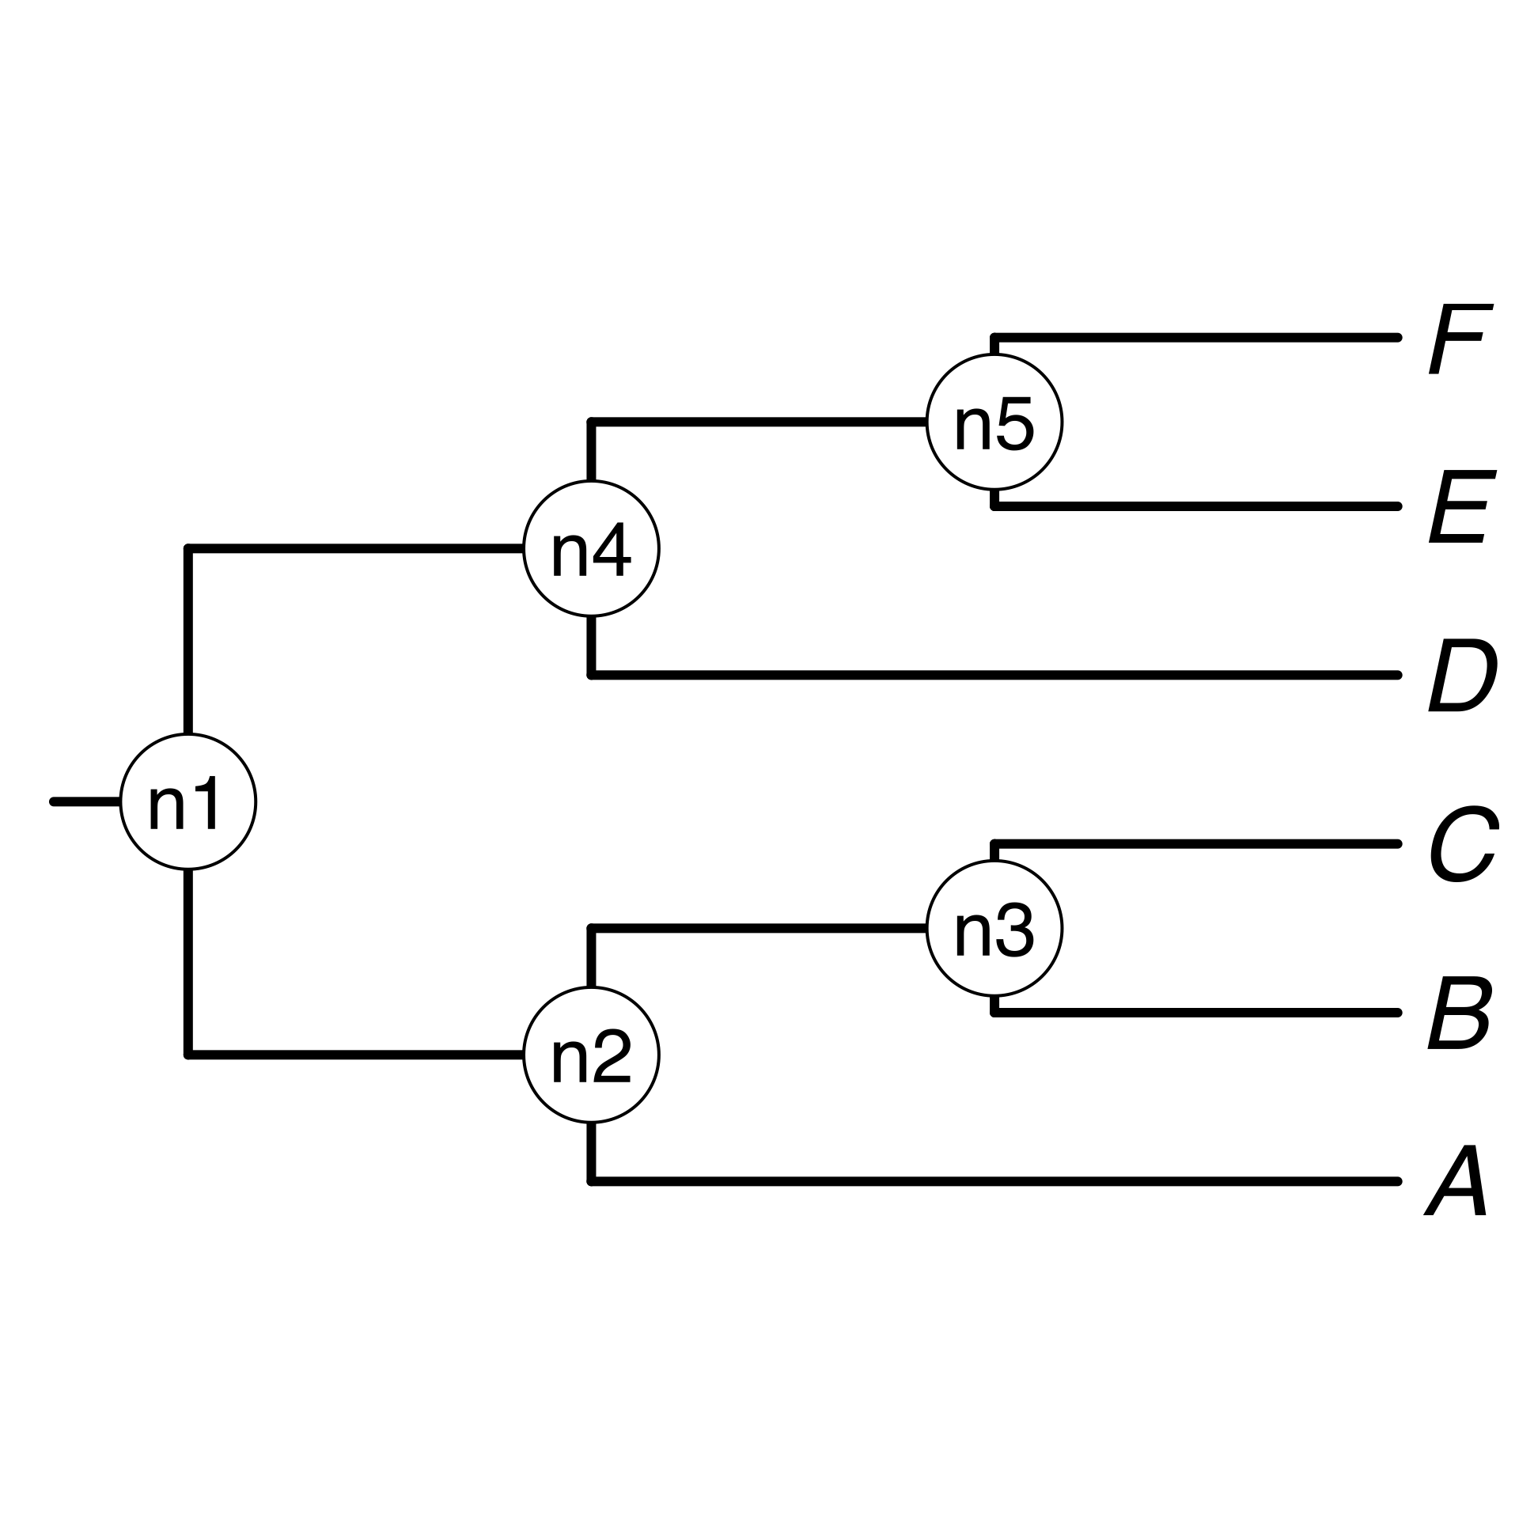


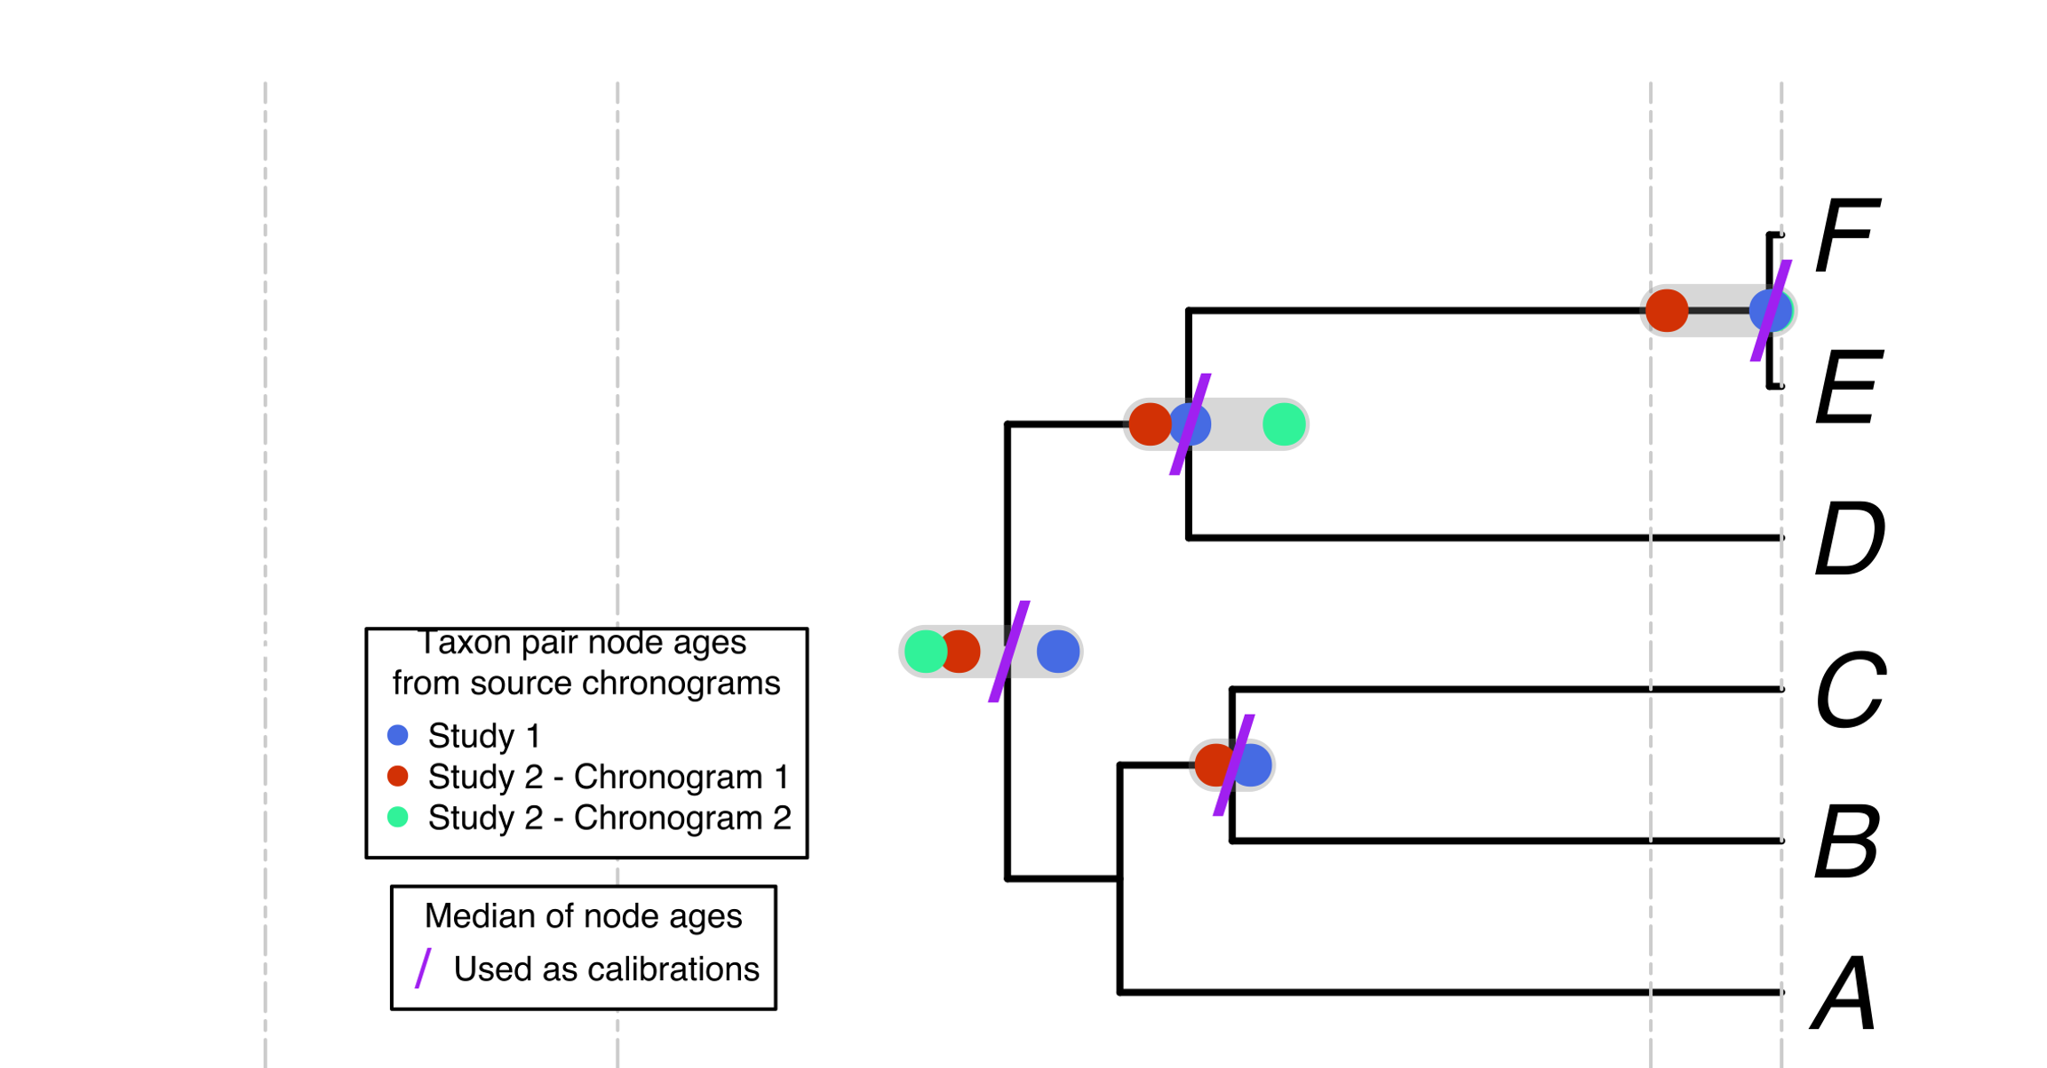
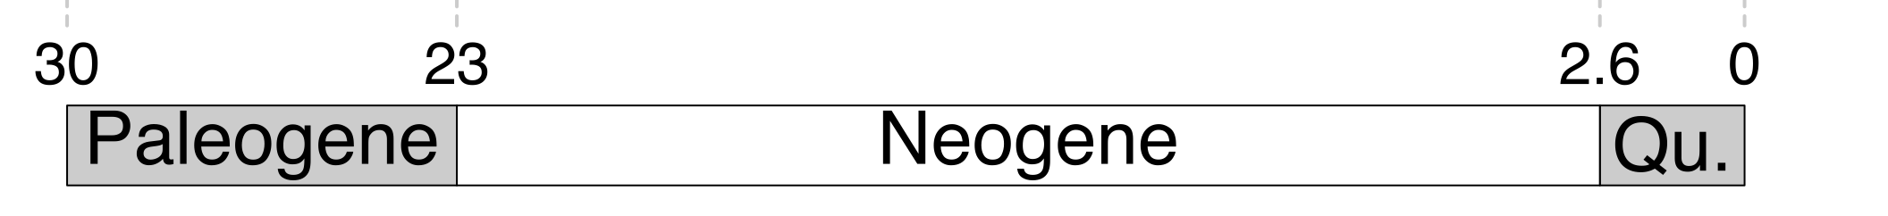
a) Creating a DateLife search query
b) Searching DateLife’s chronogram database
c) Summarizing DateLife’s search results
a1) A list of taxon names is
provided by the user. It can
contain synonyms and
misspellings:
b1) Processed taxon names are searched in
DateLife’s chronogram database and identified (*):
c1) A tree topology of the taxa of interest is chosen:
A tree from the
literature
a
B₁
C
D
Ee
F_{x}
Your own
tree
The largest source chronogram
*
c2) Nodes from source chronogram
are congruified to nodes in the
tree topology:
*
c3) Congruified node ages are summarized
by node:
a2) Taxon names are processed
using the Taxonomic Name
Resolution Service (TNRS)
and are standardized to a
taxonomy:
*
c4) Summary ages of congruent nodes are used as secondary calibrations to date a tree topology:
b2) Matching chronograms are pruned and saved as source chronograms:
A
B
C
D
E
F
Median summary chronogram
In this example, 4 names are synonyms in the standardized taxonomy, shown in bold.

