Slide 1
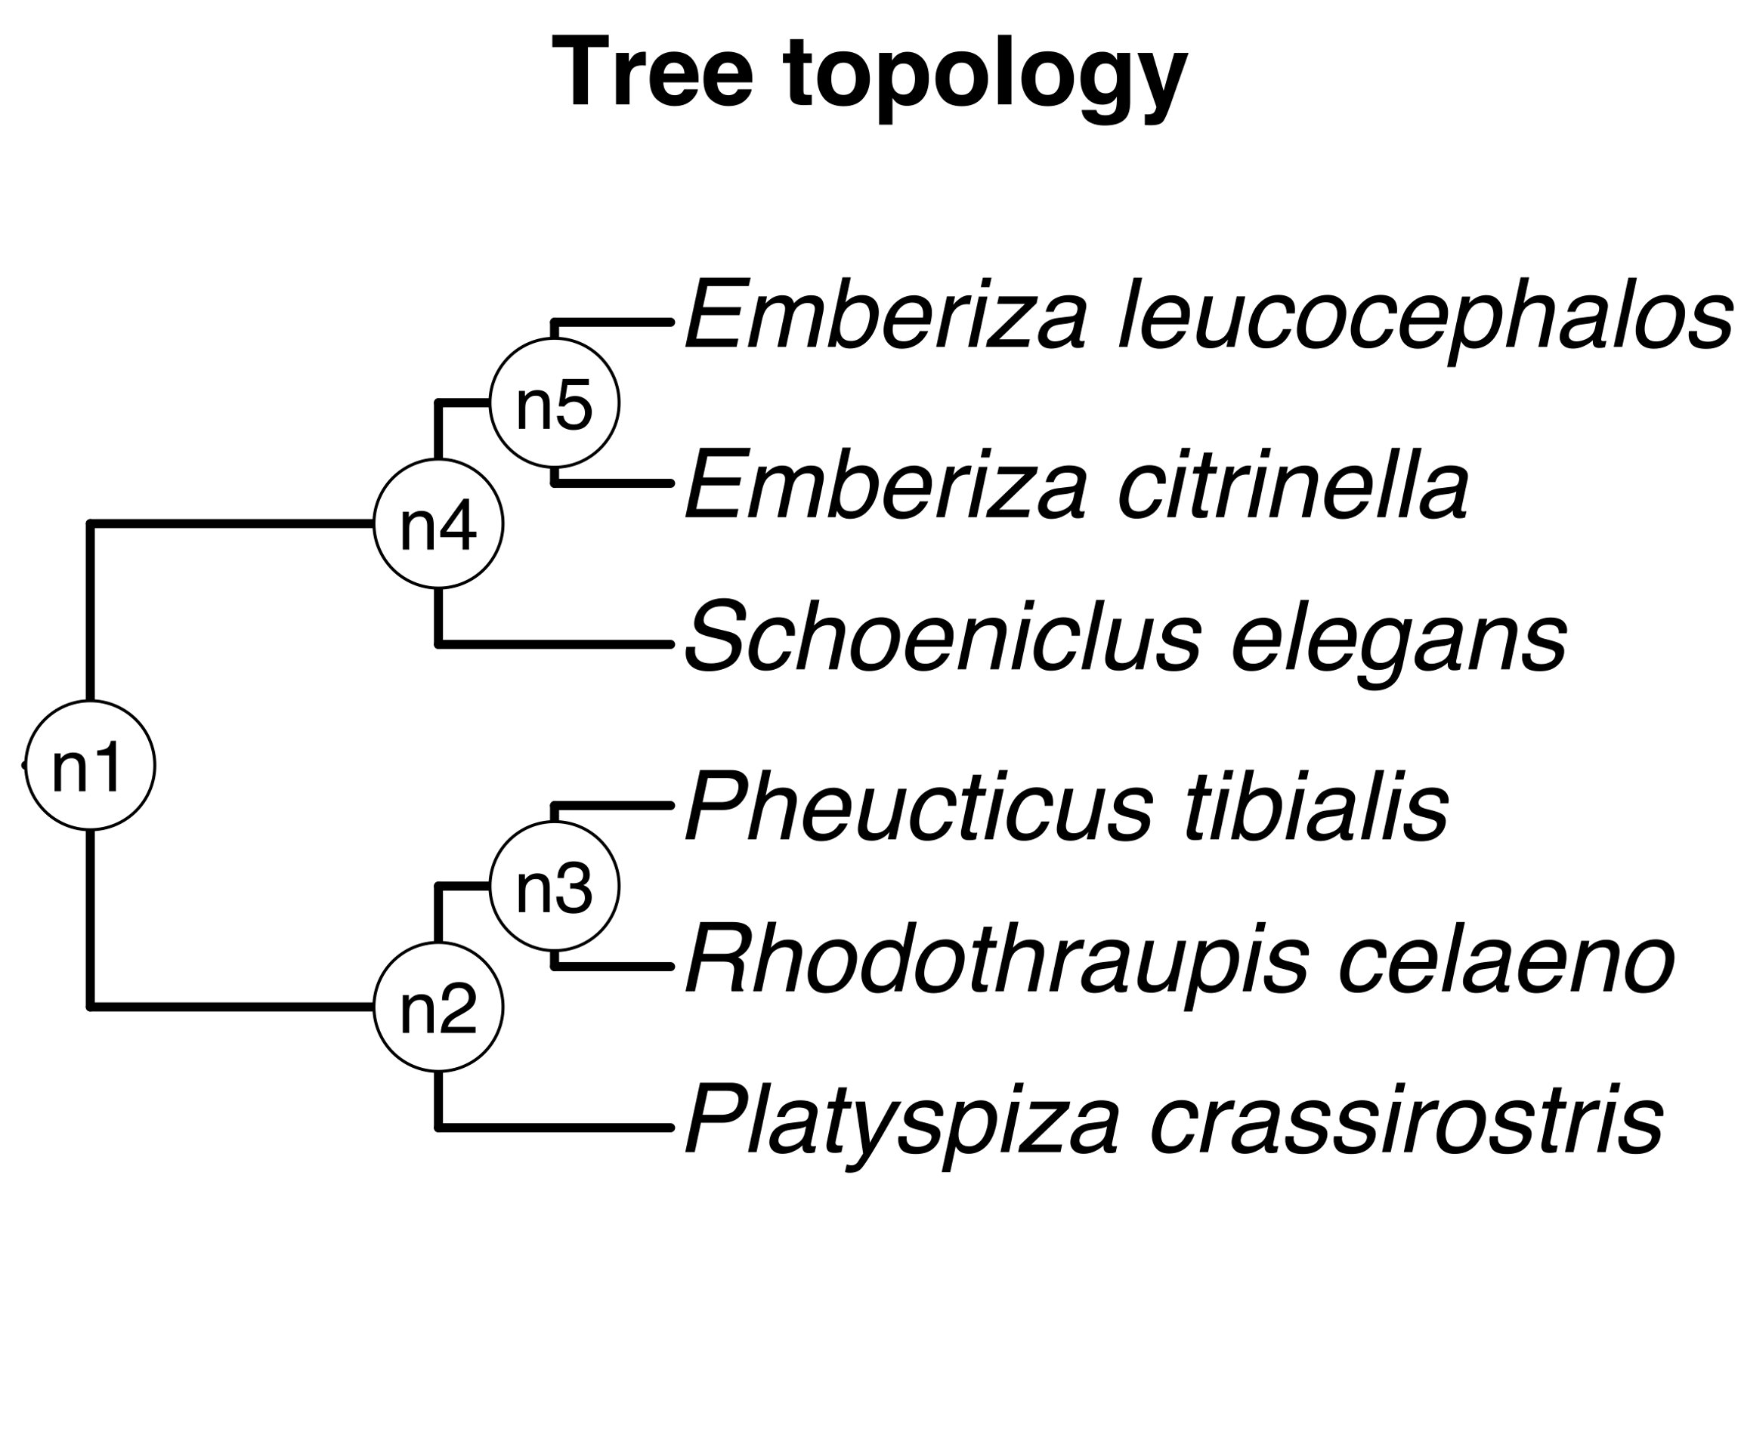
Taxon pair ages mapped to nodes of tree topology
Source
chronograms
Map
+
Summarize

