Slide 1
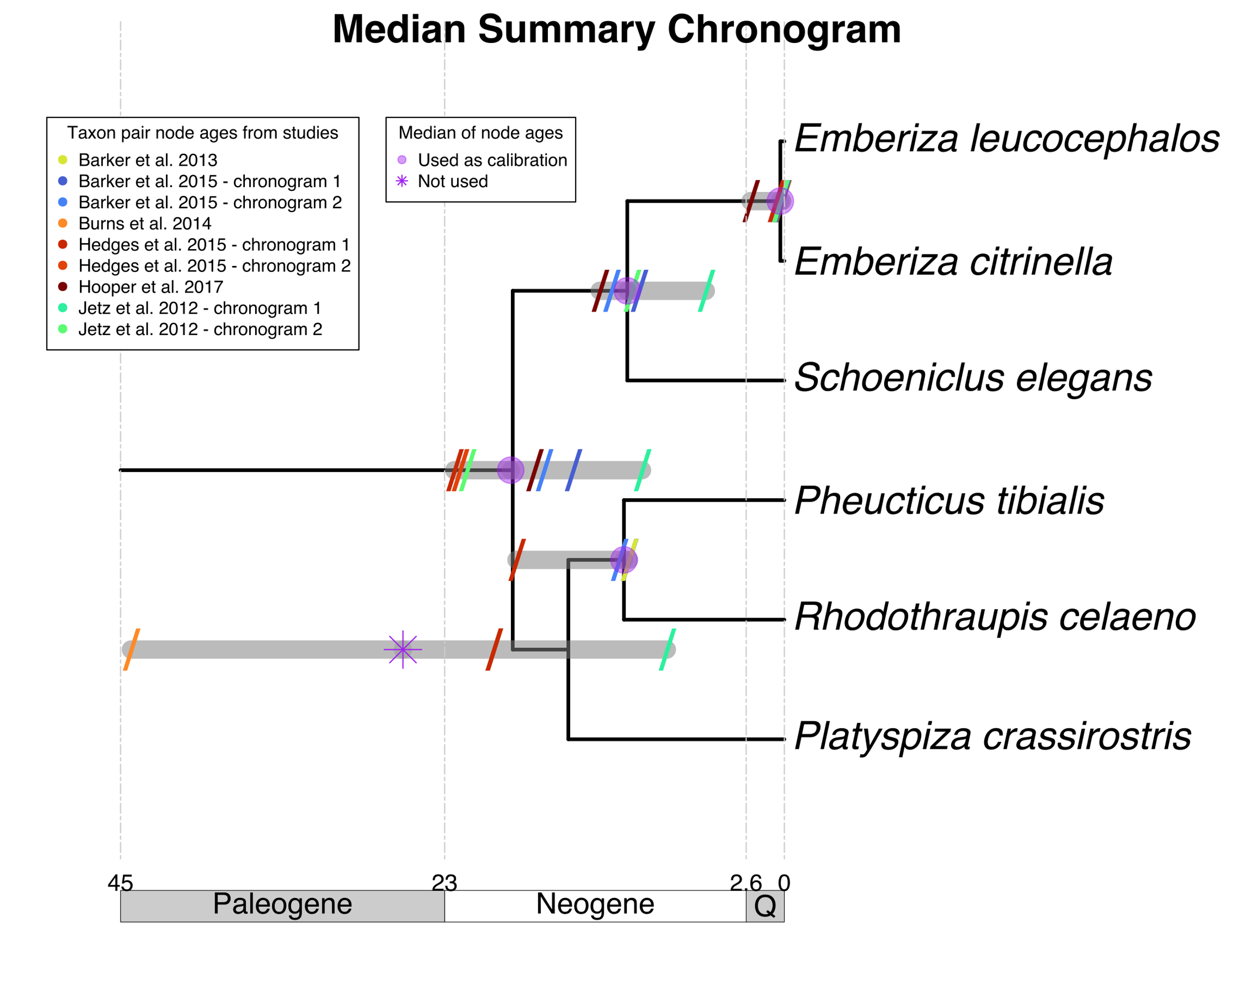
Summary of mapped taxon pair ages
Calibrate

