Slide 1
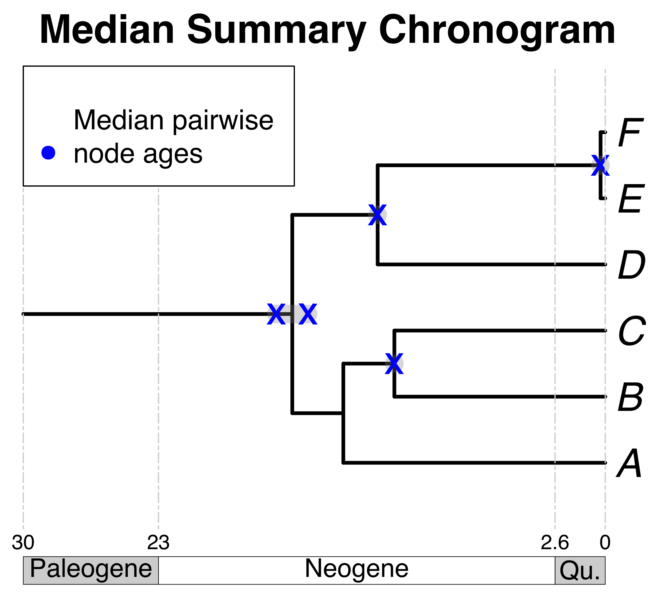


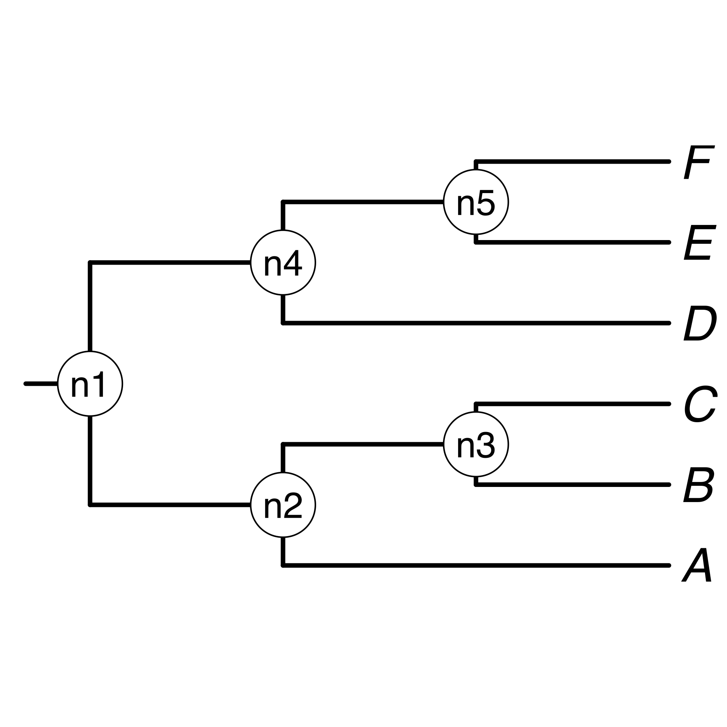
A) Creating a DateLife search query
B) Searching DateLife’s chronogram database
B2) Prune matching chronograms and save as source chronograms.
A1) User provides a list of taxon names, as a character string or as a tree.
B1) Match processed taxon names to chronogram database and identify (*).
a, B₁ , C, D, Ee, F_{x}
*
*
A B C D E F
A2) Process taxon names with TNRS and standardize to a taxonomy.
*
C3) Use ages of congruent nodes to date a tree topology.
C2) Congruify source chronogram nodes to nodes of tree topology.
C) Summarizing DateLife’s search results
C1) Choose a tree topology.
The largest source chronogram
A tree from the
literature
Your own
tree

