Slide 1
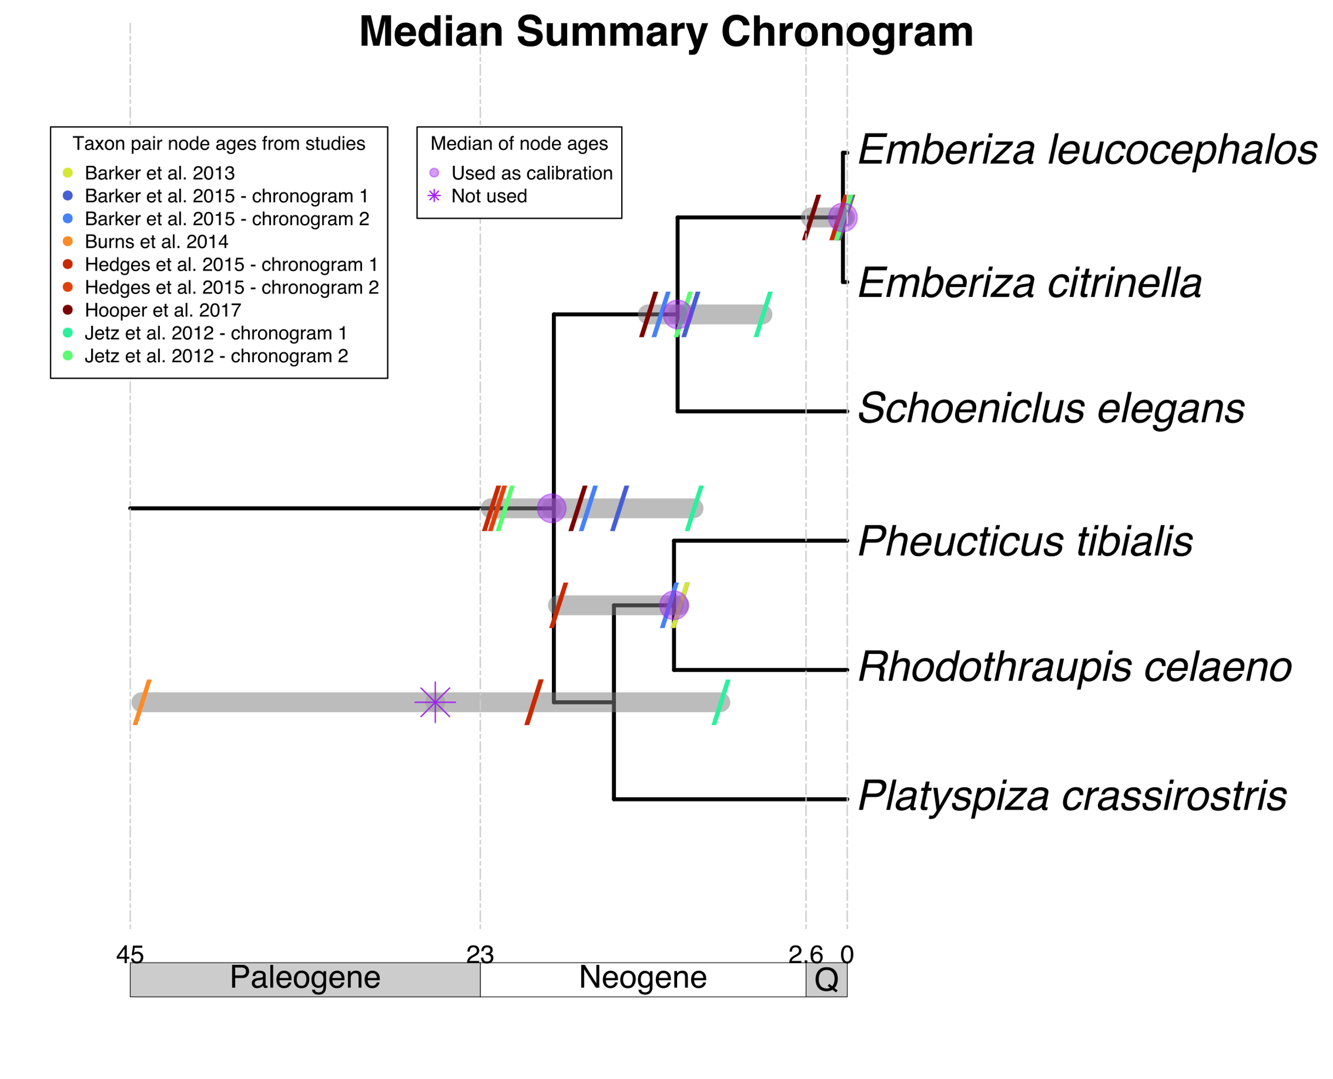

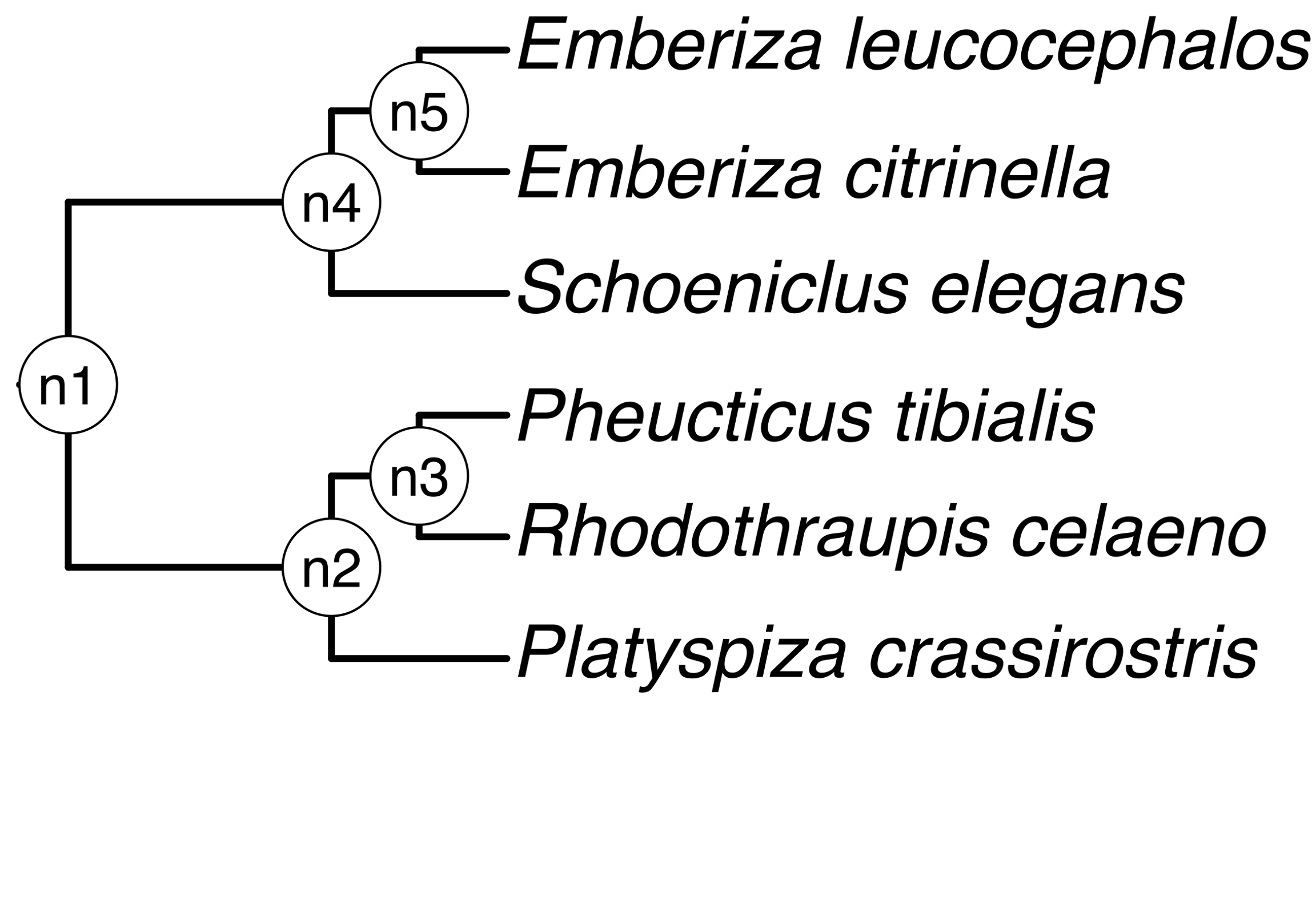
a) Creating a DateLife search query
b) Searching DateLife’s chronogram database
a1) Chose a list of bird
species names.
Pheucticus tibialis
Rhodothraupis celaeno
Emberiza citrinella
Emberiza leucocephalos
Emberiza elegans
Platyspiza crassirostris
a2) Processed species names with TNRS and standardized to the OpenTree taxonomy.
Pheucticus tibialis
Rhodothraupis celaeno
Emberiza citrinella
Emberiza leucocephalos
Schoeniclus elegans
Platyspiza crassirostris
b1) Searched processed names across 253 chronogram in
DateLife’s database v0.6.2
b2) Search resulted in 9 source chronograms from 6 independent, published studies.
chronogram 1
chronogram 2
chronogram 1
Median summary chronogram
chronogram 1
chronogram 2
chronogram 2
c) Summarizing DateLife’s search results
c1) Chose a tree topology from OpenTree’s synthetic phylogeny.
OpenTree topology
c2) Congruify source chronogram nodes to nodes of tree topology.
See Table 1.
c4) Use summarized ages of congruent nodes to date the chosen tree topology.
c3) Summarize ages. See Table 2.

