Slide 1

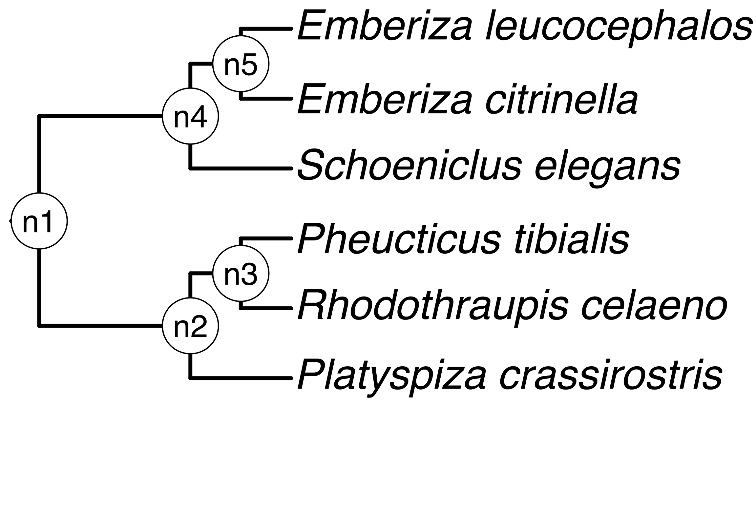
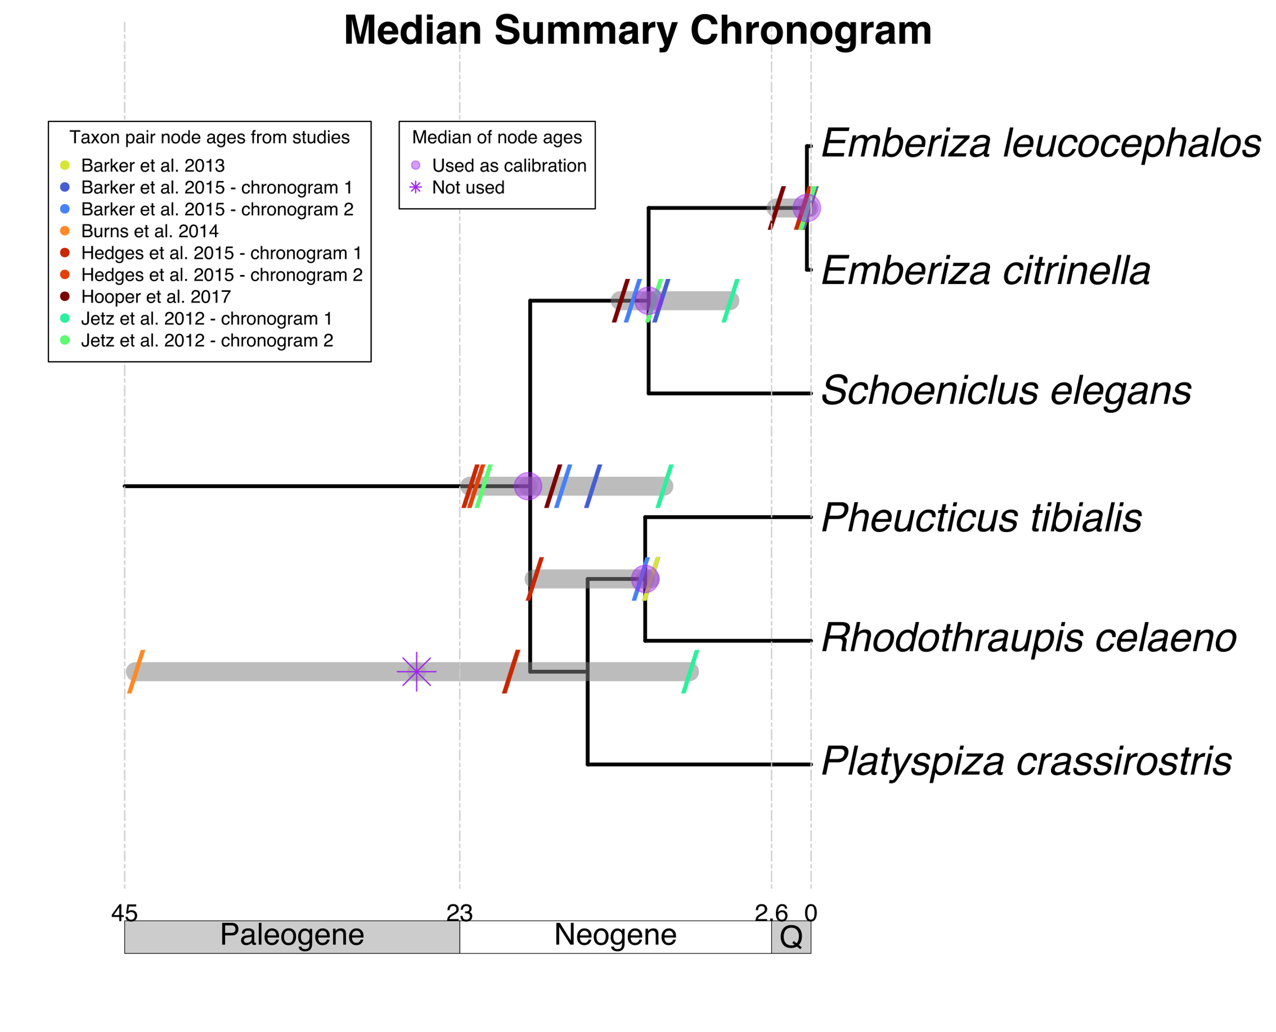
a) Create a DateLife search query
b) Search DateLife’s chronogram database
c) Summarize DateLife’s search results
a1) Assemble a list of species names. This is a list of 6 bird species:
b1) Searched processed taxon names across 253 chronogram in DateLife’s database v0.6.2
b2) Search resulted in 9 source chronograms from 6 independent, published studies.
c1) Chose a tree topology. We extracted one from OpenTree’s synthetic phylogeny.
c2) Congruify source chronogram nodes to nodes of tree topology. See Table 1.
OpenTree topology
Pheucticus tibialis
Rhodothraupis celaeno
Emberiza citrinella
Emberiza leucocephalos
Emberiza elegans
Platyspiza crassirostris
chronogram 1
c3) Summarize ages per node. See Table 2.
chronogram 1
chronogram 2
c4) Use summarized ages of congruent nodes to date the chosen tree topology with BLADJ.
a2) Process species names with TNRS and standardize to the OpenTree taxonomy. One species name (bold) is a synonym in the standardized taxonomy.
chronogram 2
chronogram 1
Median summary chronogram
Pheucticus tibialis
Rhodothraupis celaeno
Emberiza citrinella
Emberiza leucocephalos
Schoeniclus elegans
Platyspiza crassirostris
chronogram 2

