Slide 1
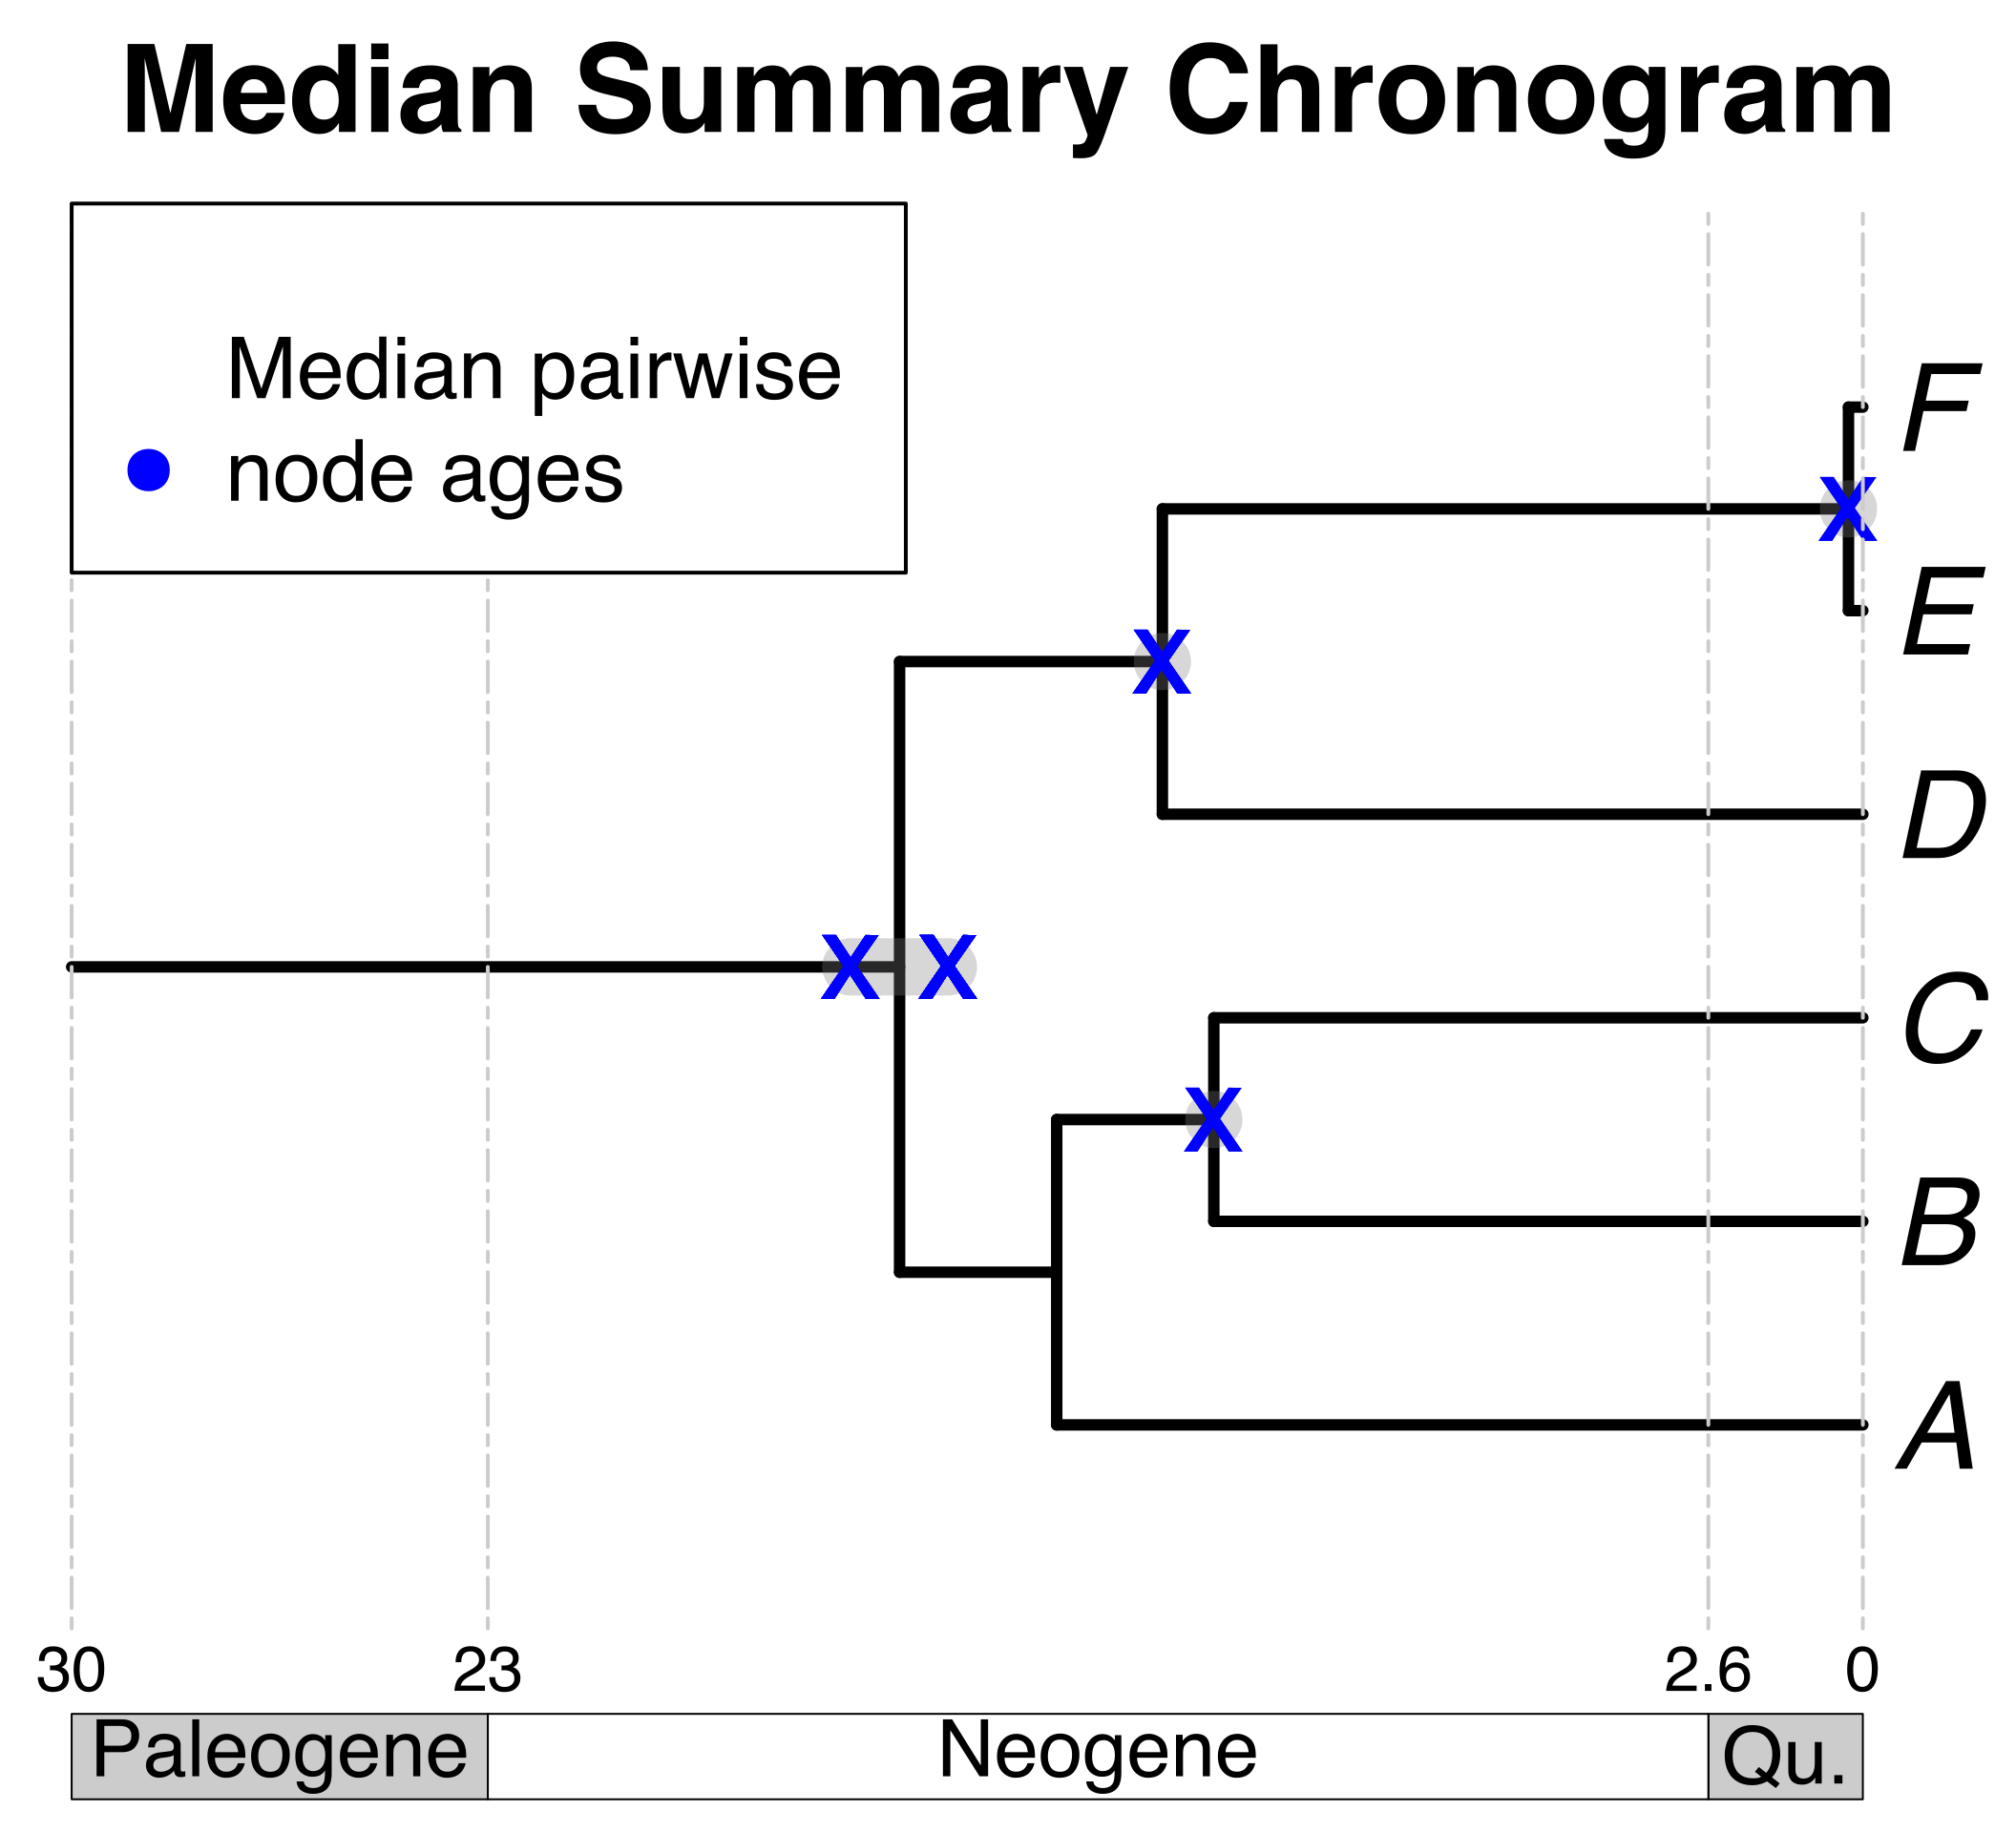


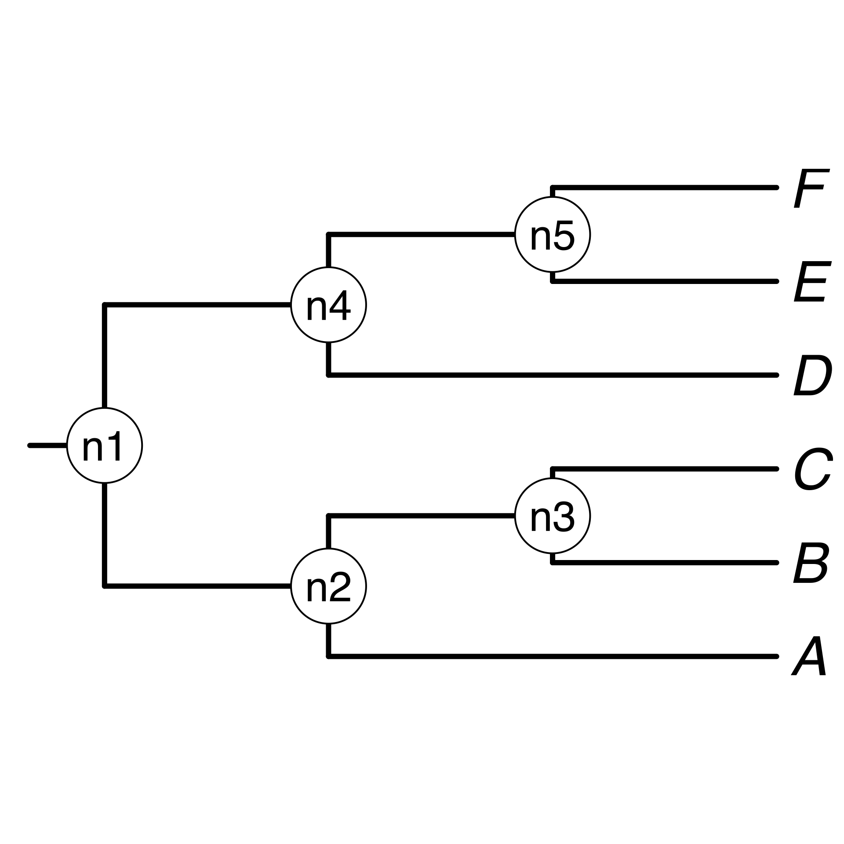
1. Creating a DateLife search query
2. Searching DateLife’s chronogram database
2b) Prune matching chronograms and save as source chronograms.
1a) User provides a list of taxon names, as a character string or as a tree.
2a) Match processed taxon names to chronogram database and identify (*).
a, B₁ , C, D, Ee, F_{x}
*
*
A B C D E F
1b) Process taxon names with TNRS and standardizE to a taxonomy.
*
3c) Use ages of congruent nodes to date a tree topology.
3b) Congruify source chronogram nodes to nodes of tree topology.
3. Summarizing DateLife’s search results
3a) Choose a tree topology.
The largest source chronogram
A tree from the
literature
Your own
tree

