Slide 1
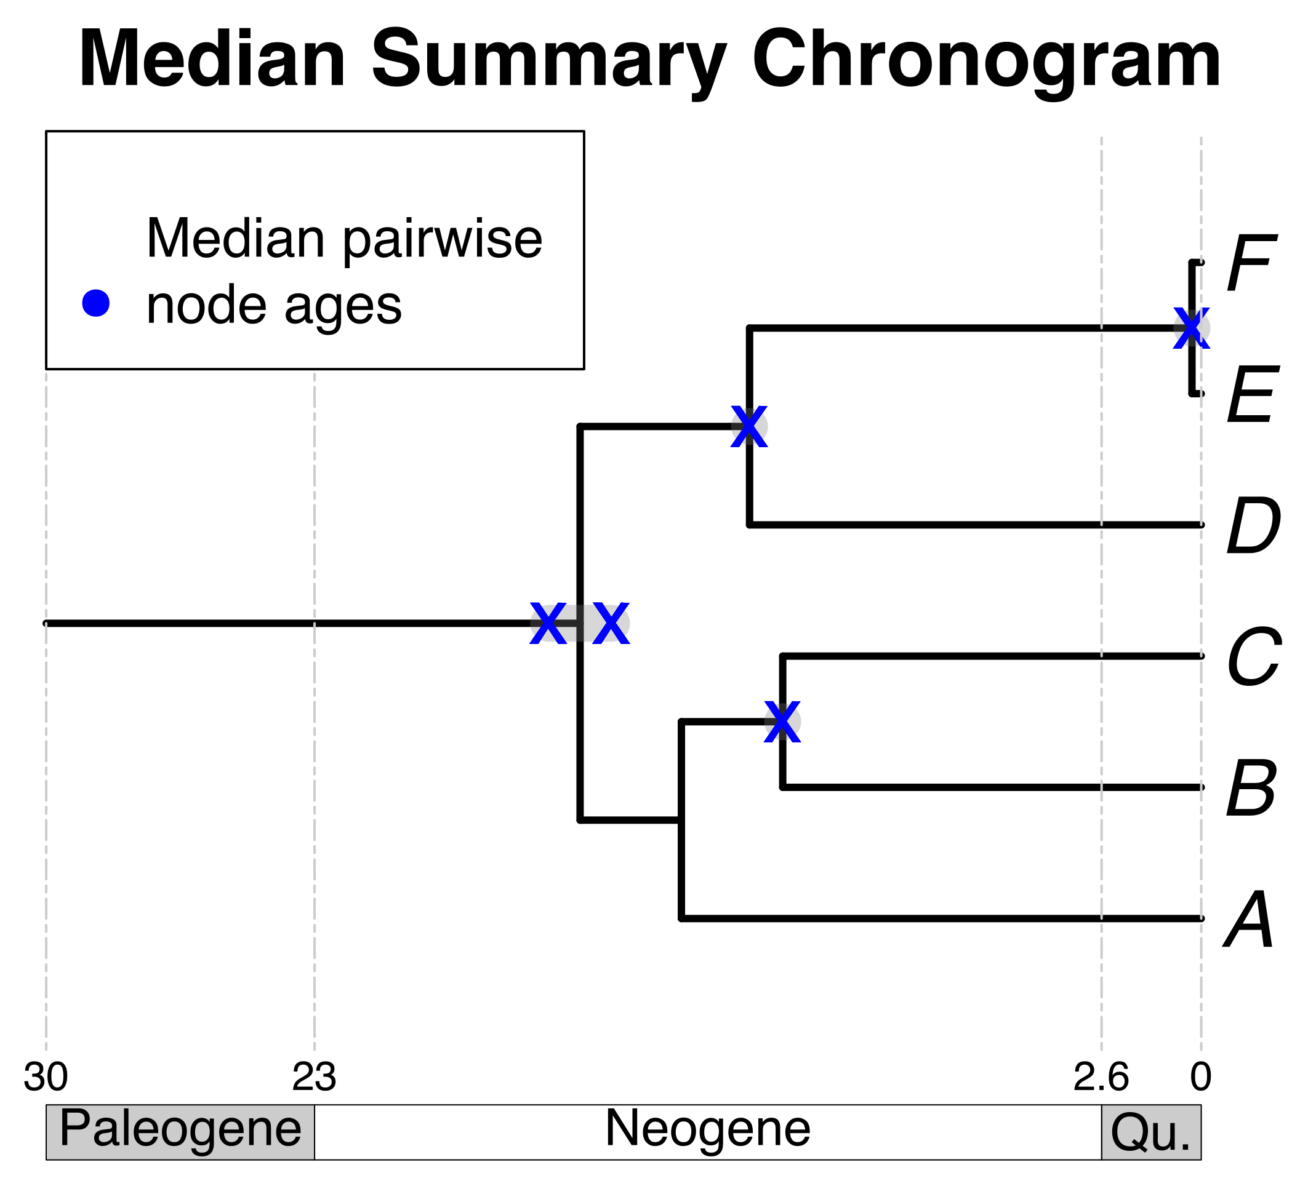

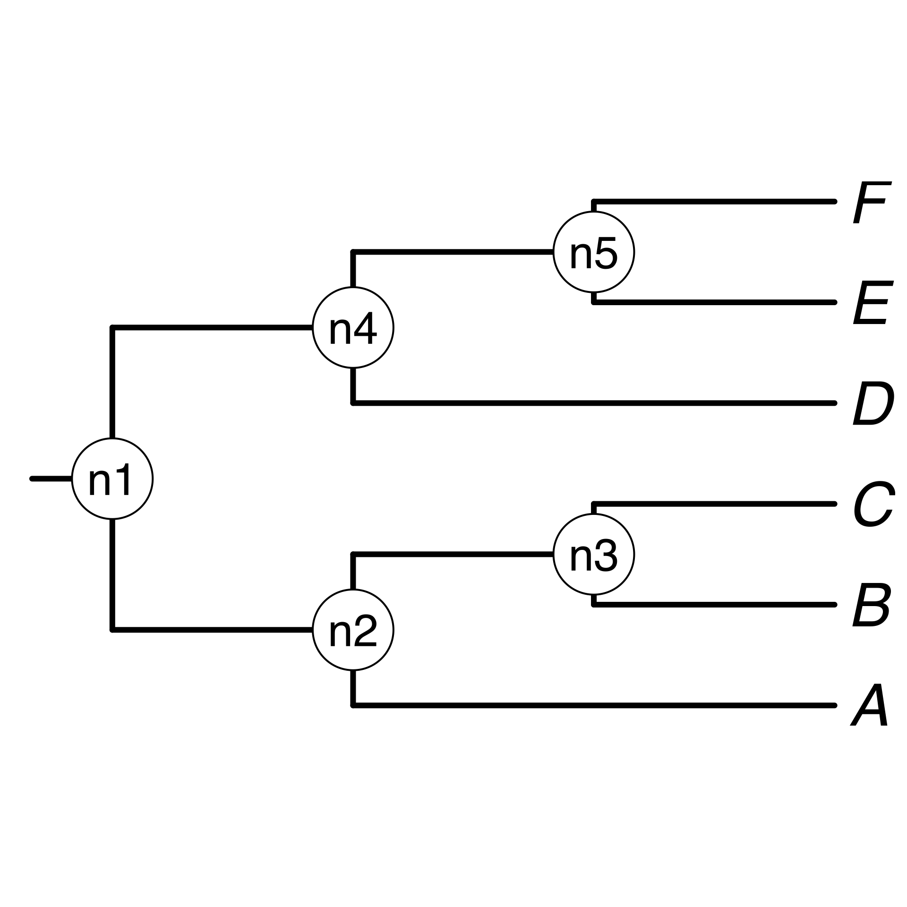

1a) A list of taxon names provided by the user.
*
*
A, B₁ , C, D, E, F_{x}
*
1b) Processing taxon names with TNRS and standardizing them to a taxonomy.
2b) Prune matching chronograms (source chronograms).
A B C D E F
2a) Match processed taxon names to chronogram database and identify (*).
3) Choose tree topology
The largest source chronogram
A tree from the
literature
Your own
tree
5) Use ages of congruent nodes to date a tree topology
4) Congruify source chronogram nodes to nodes of tree topology

