Slide 1


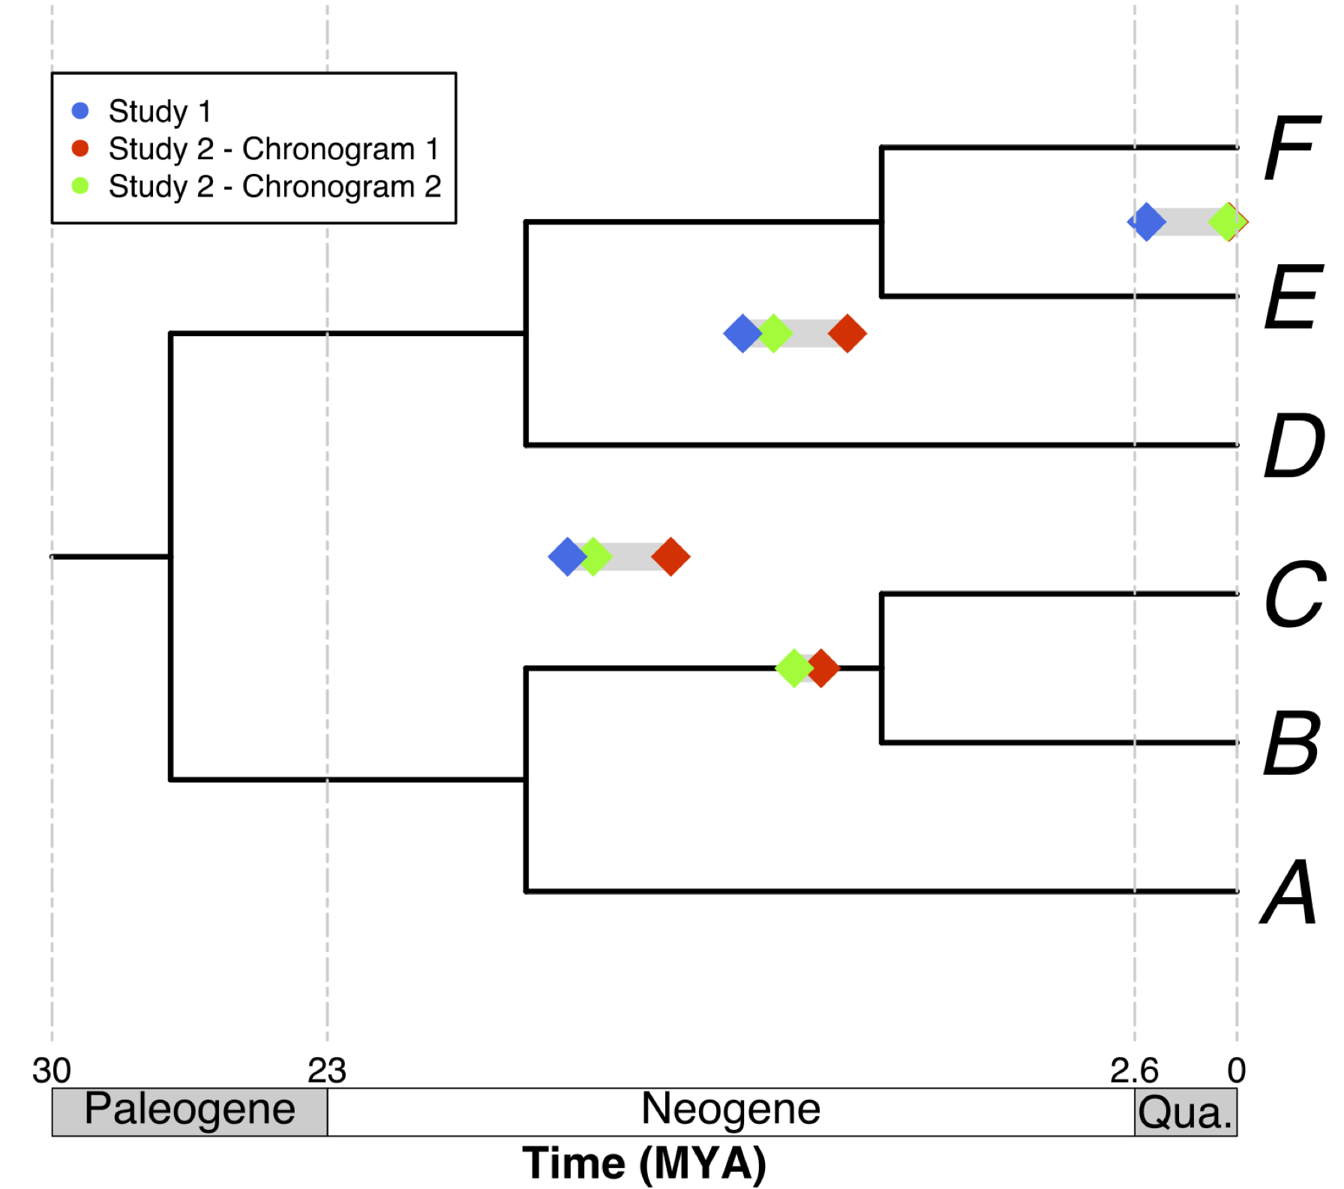
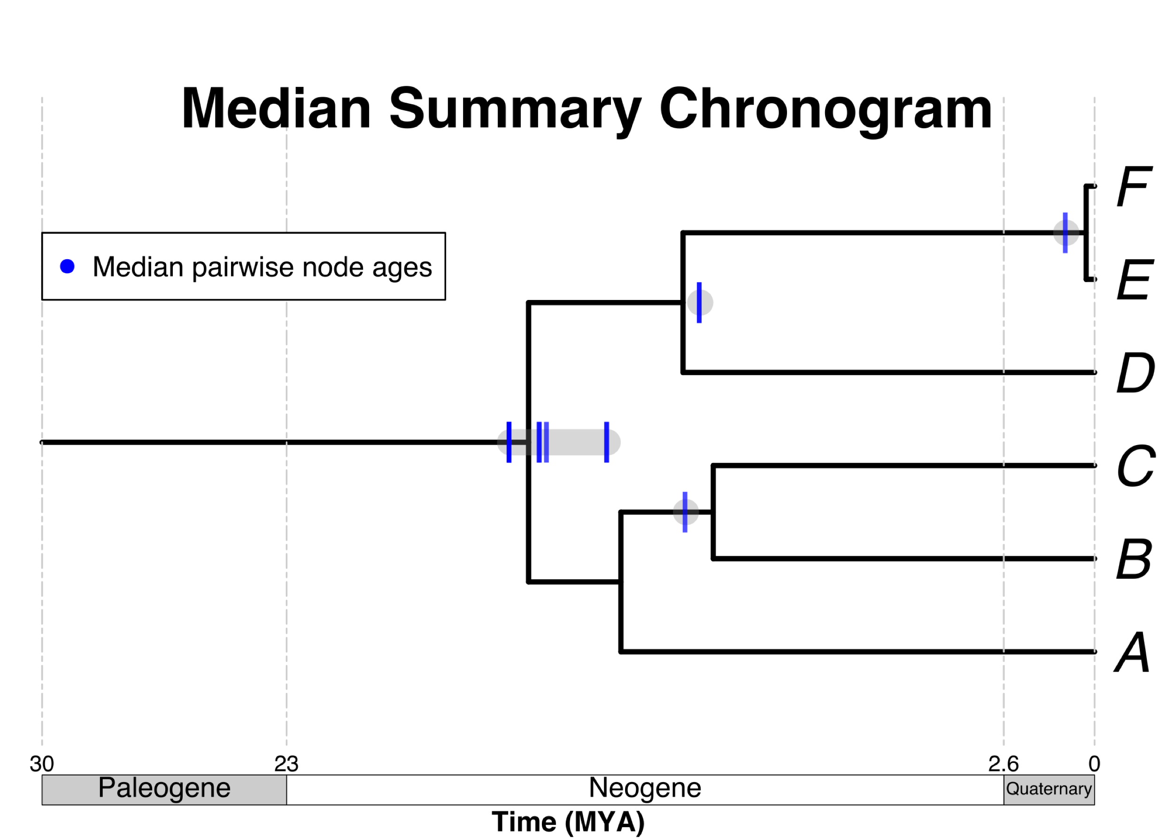
Some taxa
of interest
A tree
topology
B
C
E
F
A
D
Calculate median pairwise ages per node:
Use median pairwise ages to date the tree topology
Source
chronograms
Map ages unto nodes on a tree topology

