Slide 1

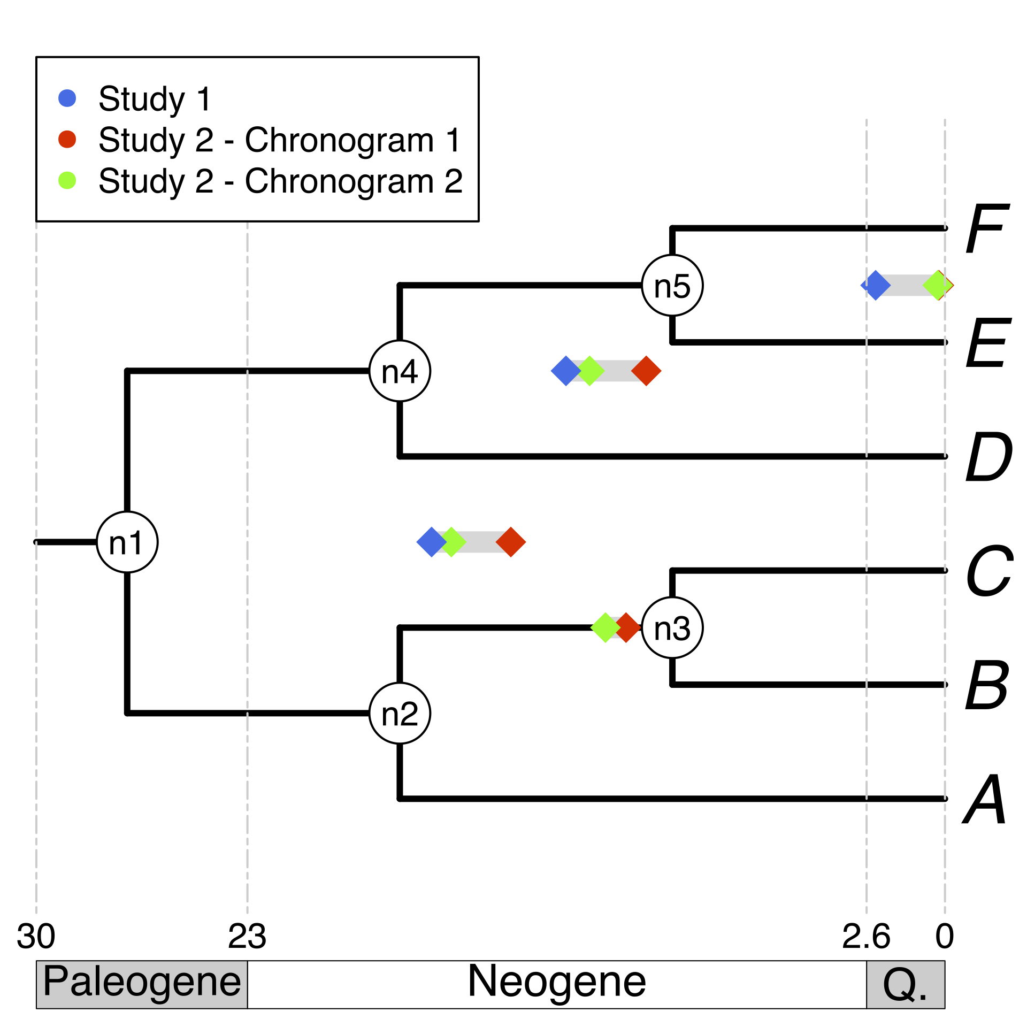
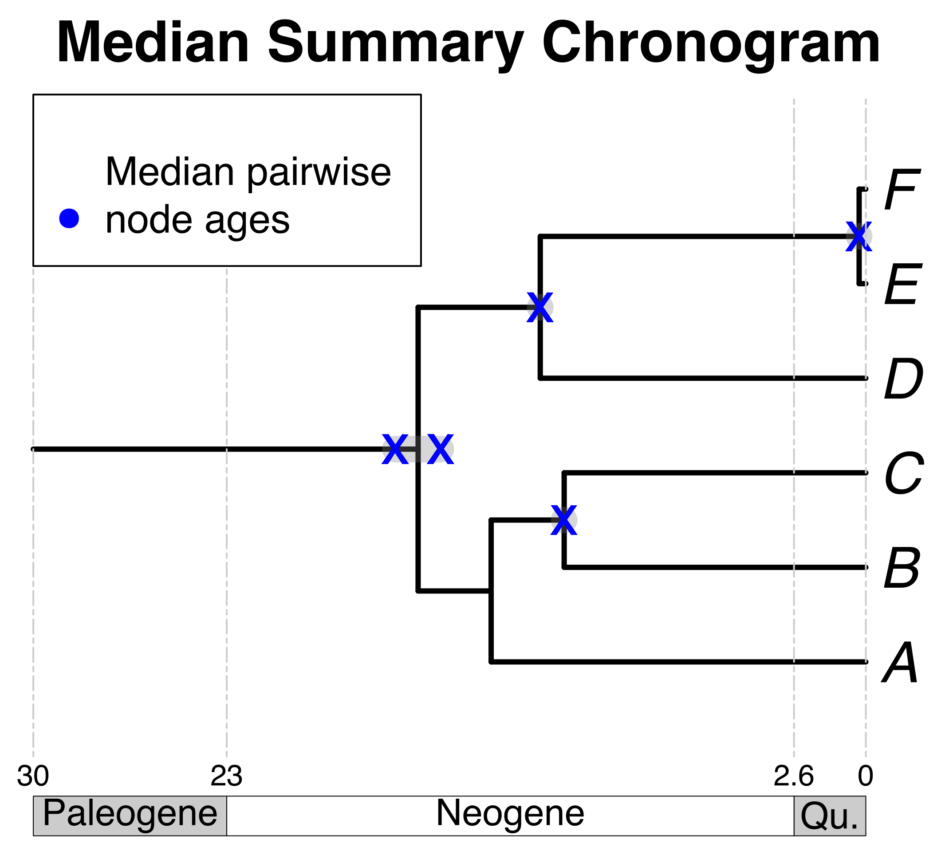

Some taxa
of interest
Search on a chronogram database
Map pruned source chronogram ages unto nodes on a tree topology
Calculate median pairwise ages per node
Use median pairwise ages to date the tree topology
E
B
F
Pruned source
chronograms
C
A
D
Your own tree
+
From the
literature
A tree topology

