Slide 1
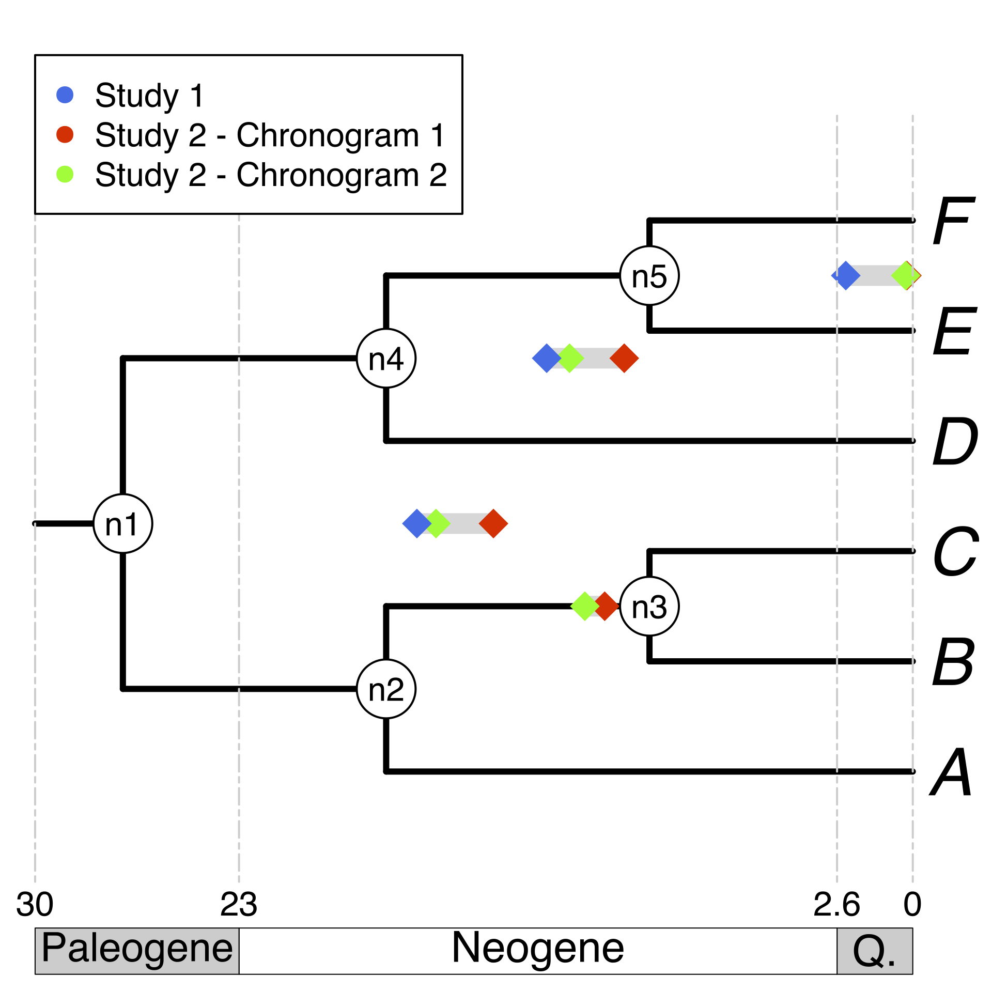
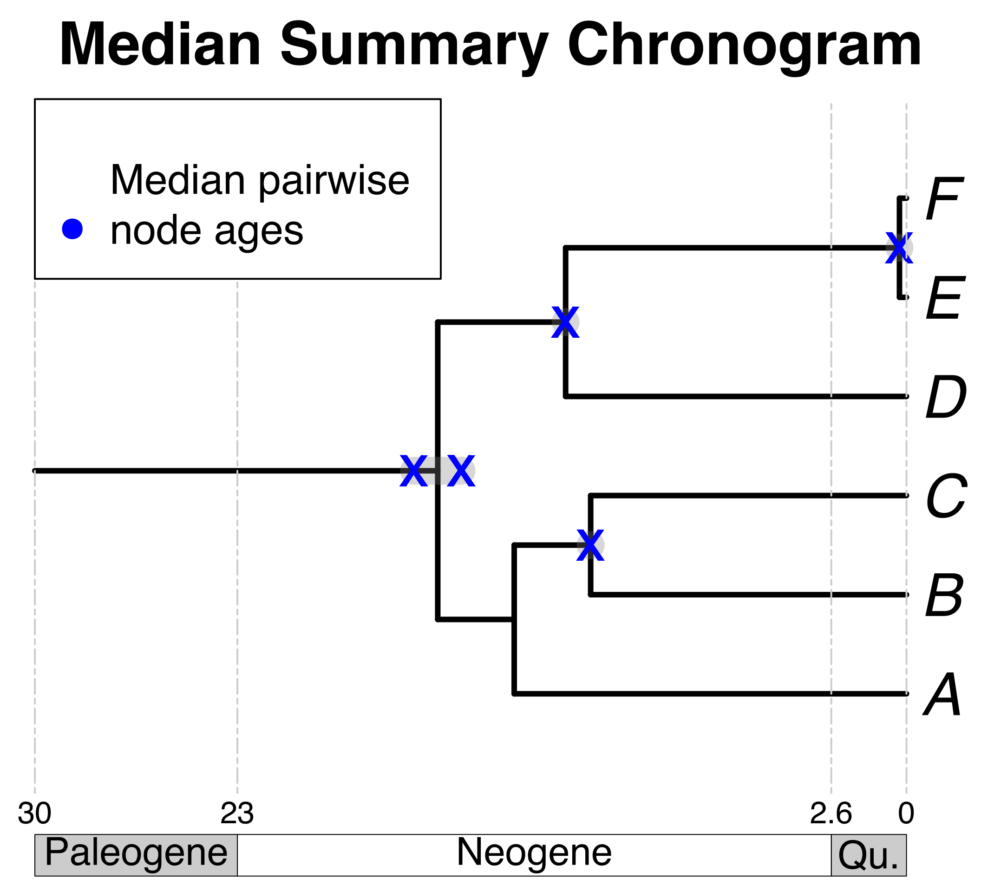


Literature
search
A tree topology
+
Your own tree
E
B
F
C
Source
chronograms
A
D
Some taxa
of interest
Search on a chronogram database
Map source chronogram ages unto nodes
on a tree topology
Calculate median pairwise ages per node
Use median pairwise ages to date the tree topology

