Slide 1
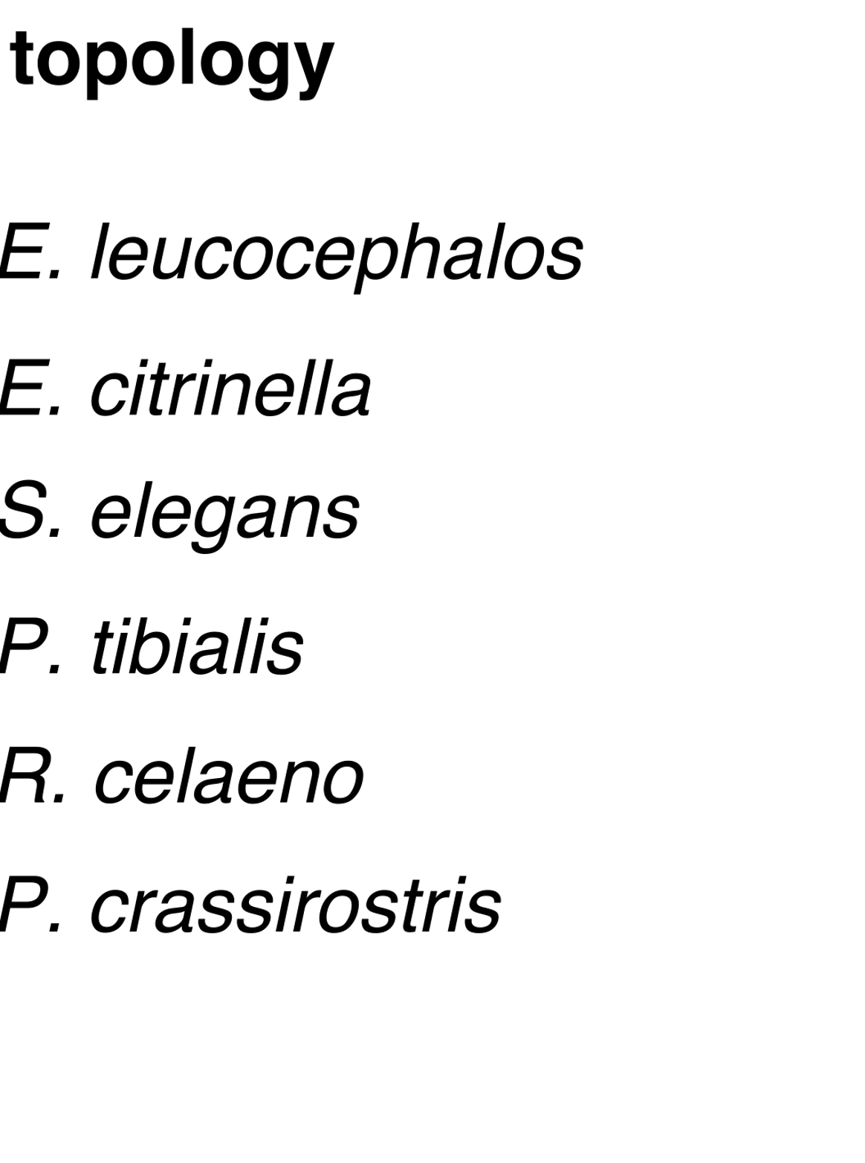
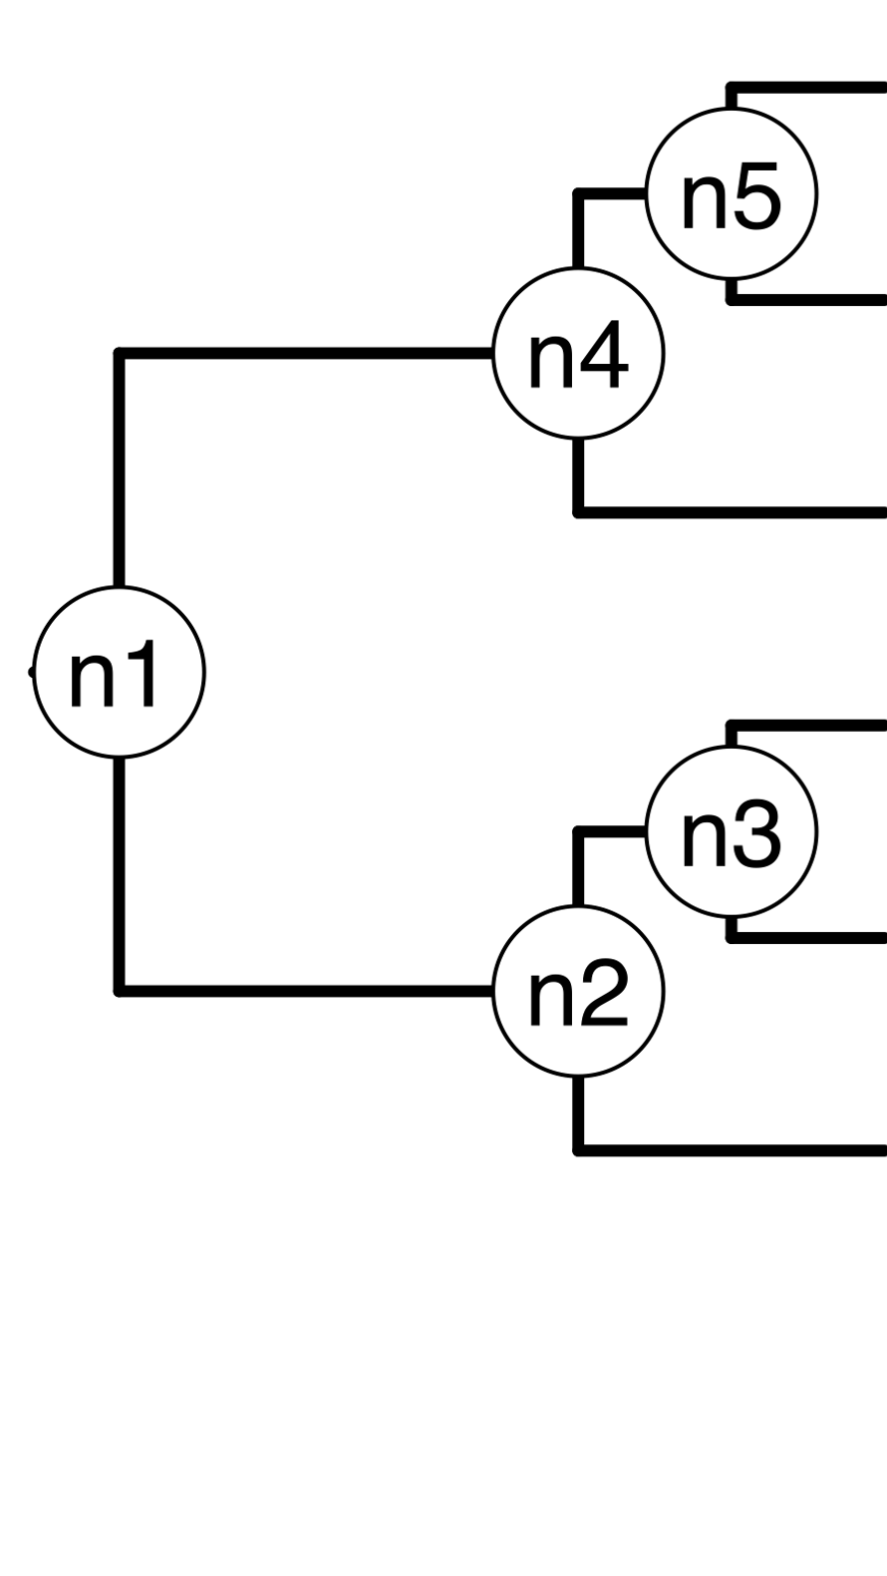





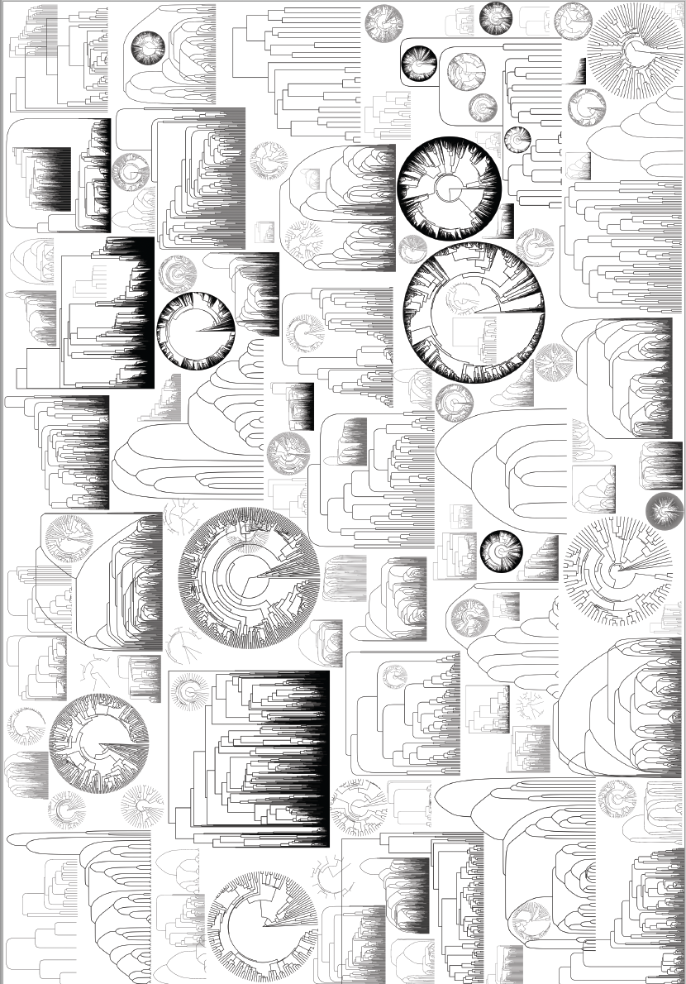
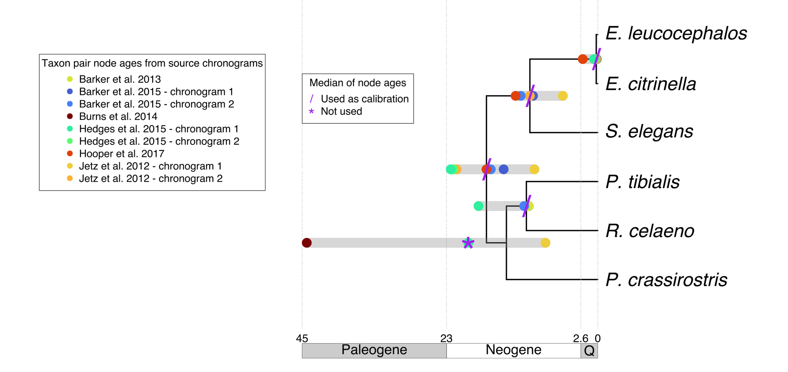
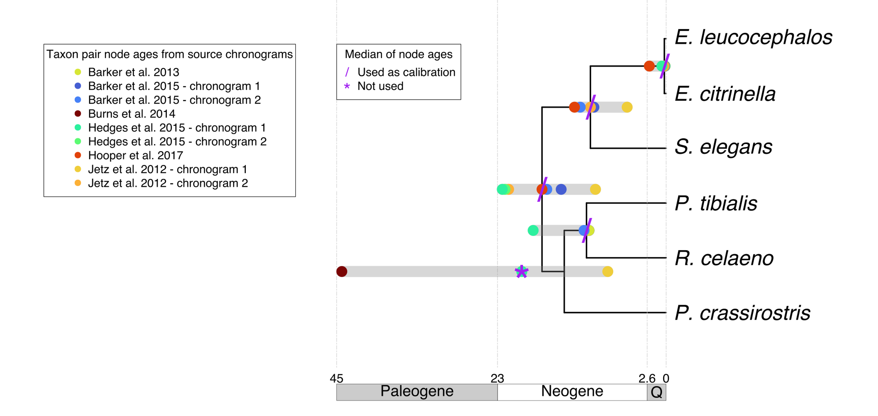
a)
Pheucticus tibialis
Rhodothraupis celaeno
Emberiza citrinella
Emberiza leucocephalos
Emberiza elegans
Platyspiza crassirostris
b)
P. tibialis
R. celaeno
E. citrinella
E. leucocephalos
Schoeniclus elegans
P. crassirostris
d)
Your own
tree
A tree from
the literature
c)
Barker et al. 2013
Hooper et al. 2017
Burns et al. 2014
*
Ma
Ma
Ma
*
*
Barker et al. 2015
Hedges et al. 2015
Jetz et al. 2012
chronogram 1
chronogram 1
chronogram 1
Ma
Ma
Ma
chronogram 2
chronogram 2
chronogram 2
Ma
Ma
Ma
*
*
*
g)
e) Table 1
f) Table 2
Ma

